Slide 1

Chapter 8
Address Resolution
Protocol (ARP)
TCP/IP Protocol Suite
‹#›
Copyright © The McGraw-Hill Companies, Inc. Permission required for reproduction or display.
Notes:
‹#›

Slide 2
OBJECTIVES:
To make a distinction between logical address (IP address) and physical address (MAC address).
To describe how the mapping of a logical address to a physical address can be static or dynamic.
To show how the address resolution protocol (ARP) is used to dynamically map a logical address to a physical address.
To show that the proxy ARP can be used to create a subnetting effect.
To discuss ATMARP, which maps the IP addresses when the underlying network is an ATM WAN.
To show that an ARP software package can be made of five components.
To show the pseudocode for each module used in the ARP software package.
TCP/IP Protocol Suite
‹#›
Notes:
‹#›

Slide 3
Chapter Outline
8.1 Address Mapping
8.2 The ARP Protocol
8.3 ATM ARP
8.4 ARP Package
TCP/IP Protocol Suite
‹#›
Notes:
‹#›

Slide 4
8-1 ADDRESS MAPPING
The delivery of a packet to a host or a router requires two levels of addressing: logical and physical. We need to be able to map a logical address to its corresponding physical address and vice versa. These can be done using either static or dynamic mapping.
TCP/IP Protocol Suite
‹#›
Notes:
‹#›

Slide 5
Topics Discussed in the Section
Static Mapping
Dynamic Mapping
TCP/IP Protocol Suite
‹#›
Notes:
‹#›

Slide 6
8-2 ADDRESS MAPPING
Anytime a host or a router has an IP datagram to send to another host or router, it has the logical (IP) address of the receiver. But the IP datagram must be encapsulated in a frame to be able to pass through the physical network. This means that the sender needs the physical address of the receiver. A mapping corresponds a logical address to a physical address. ARP accepts a logical address from the IP protocol, maps the address to the corresponding physical address and pass it to the data link layer.
TCP/IP Protocol Suite
‹#›
Notes:
‹#›

Slide 7
Topics Discussed in the Section
Packet Format
Encapsulation
Operation
Proxy ARP
TCP/IP Protocol Suite
‹#›
Notes:
‹#›

Slide 8
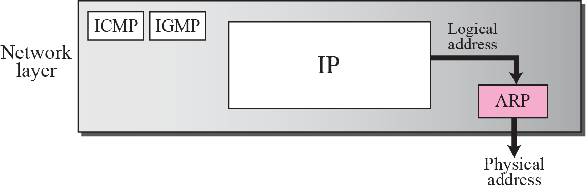
Figure 8.1 Position of ARP in TCP/IP protocol suite
TCP/IP Protocol Suite
‹#›
Notes:
‹#›

Slide 9
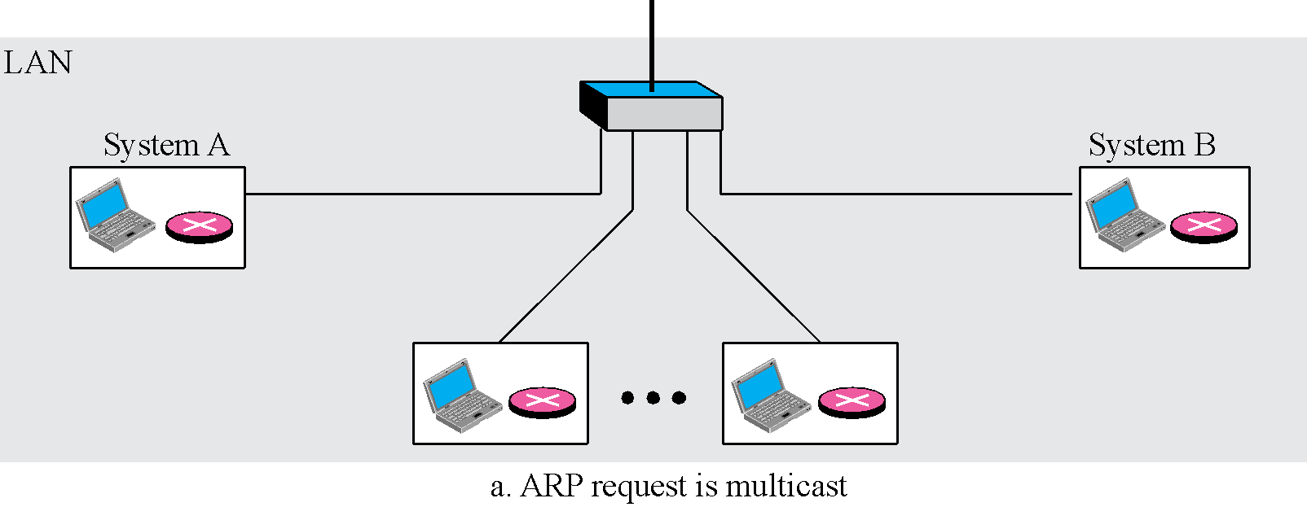
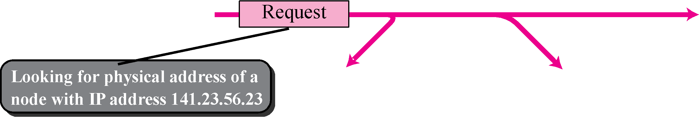
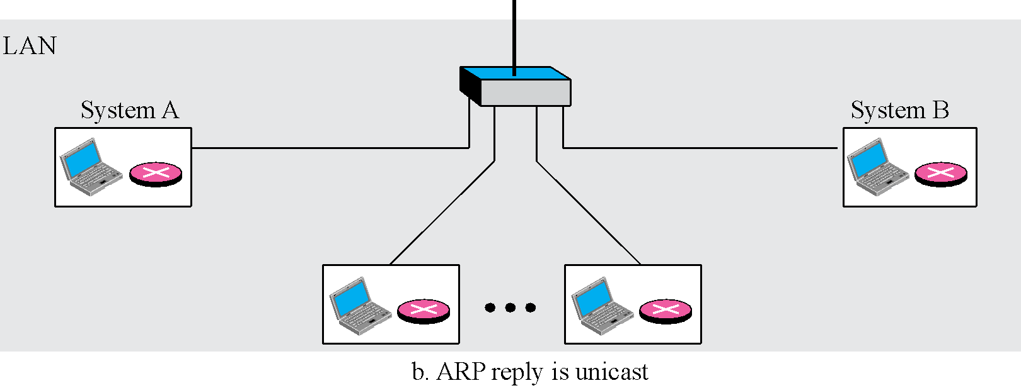
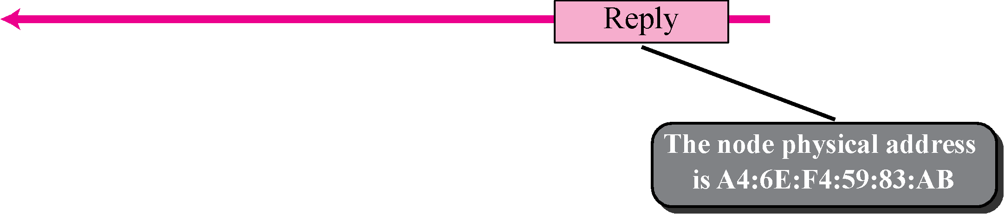
Figure 8.2 ARP operation
broadcast
TCP/IP Protocol Suite
‹#›
Notes:
‹#›

Slide 10
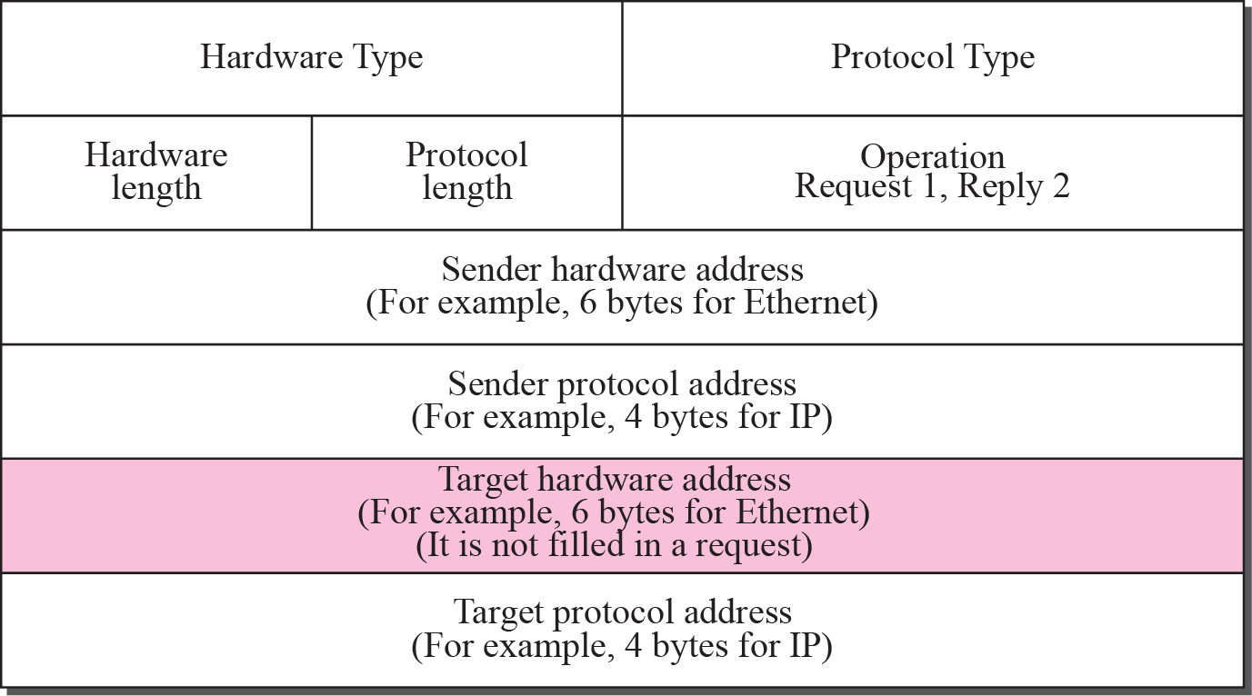
Figure 8.3 ARP packet
TCP/IP Protocol Suite
‹#›
Notes:
‹#›

Slide 11
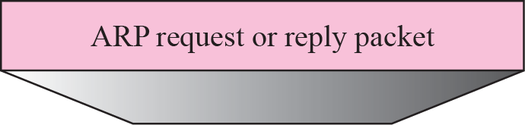
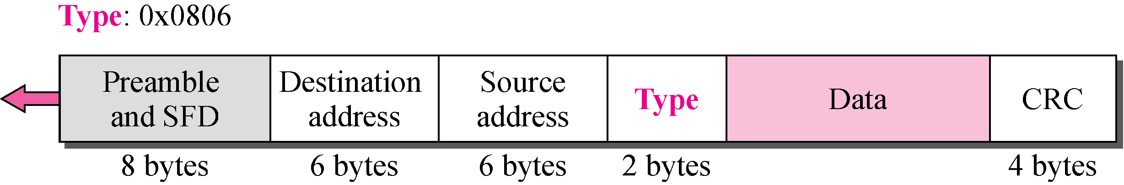
Figure 8.4 Encapsulation of ARP packet
TCP/IP Protocol Suite
‹#›
Notes:
‹#›

Slide 12

Note
An ARP request is broadcast; an ARP reply is unicast.
TCP/IP Protocol Suite
‹#›
Notes:
‹#›

Slide 13
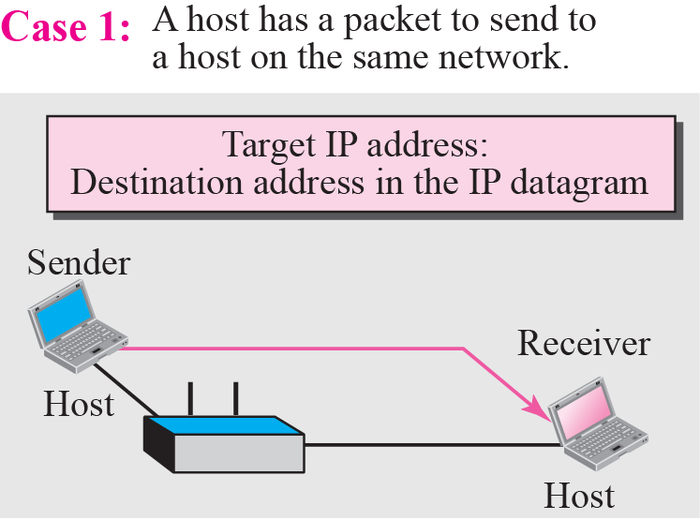
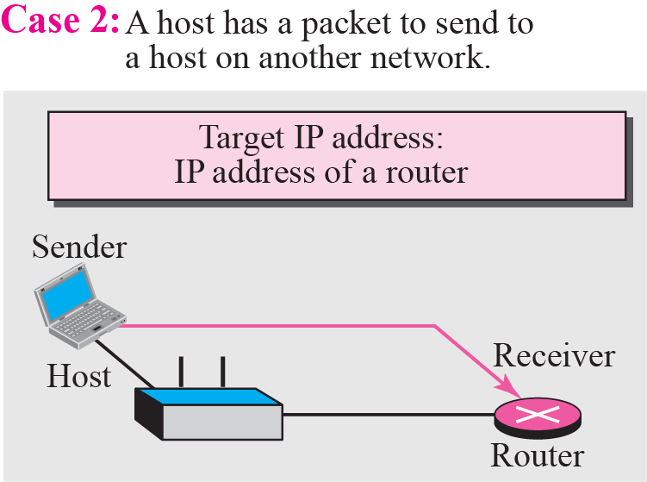
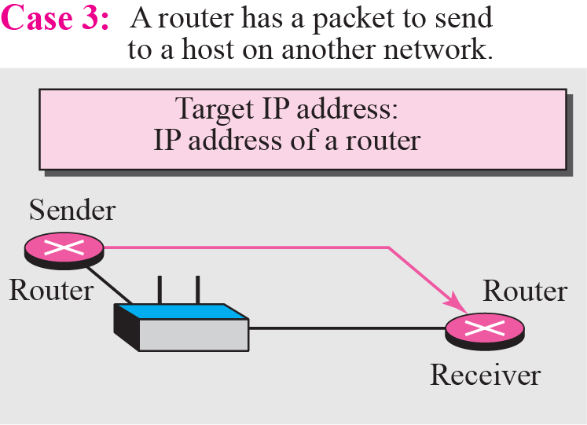
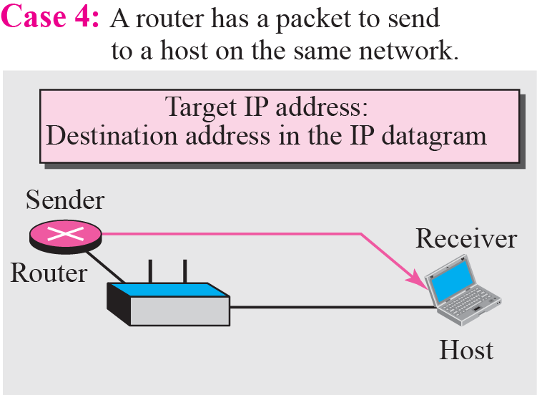
Figure 8.5 Four cases using ARP
TCP/IP Protocol Suite
‹#›
Notes:
‹#›

Slide 14
Example 8.1
A host with IP address 130.23.43.20 and physical address B2:34:55:10:22:10 has a packet to send to another host with IP address 130.23.43.25 and physical address A4:6E:F4:59:83:AB. The two hosts are on the same Ethernet network. Show the ARP request and reply packets encapsulated in Ethernet frames.
Solution
Figure 8.6 shows the ARP request and reply packets. Note that the ARP data field in this case is 28 bytes, and that the individual addresses do not fit in the 4-byte boundary. That is why we do not show the regular 4-byte boundaries for these addresses. Also note that the IP addresses are shown in hexadecimal.
TCP/IP Protocol Suite
‹#›
Notes:
‹#›

Slide 15
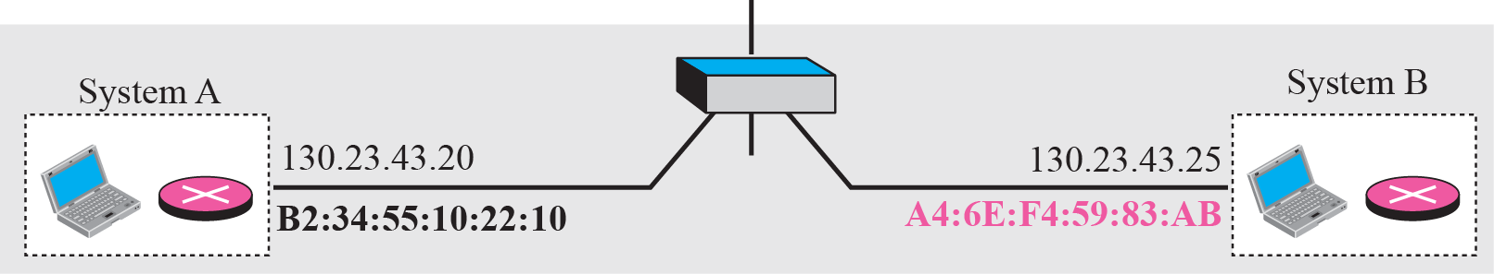
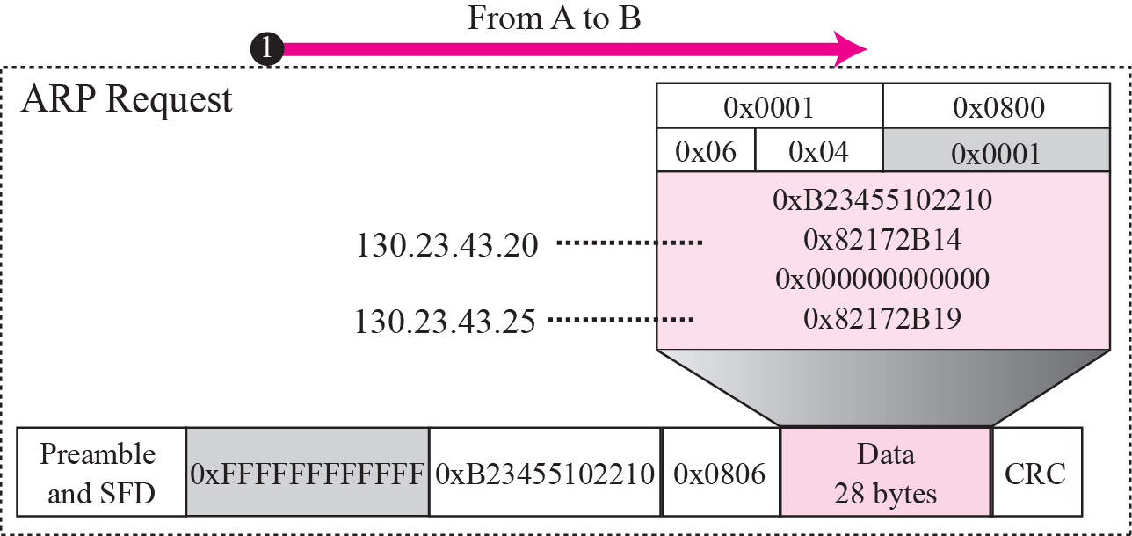
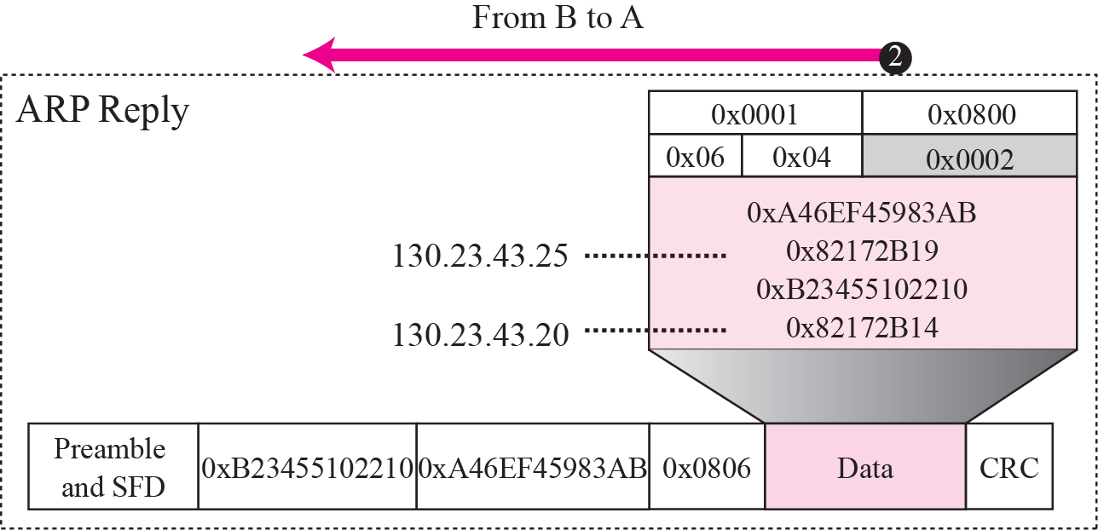
Figure 8.6 Example 8.1
TCP/IP Protocol Suite
‹#›
Notes:
‹#›

Slide 16
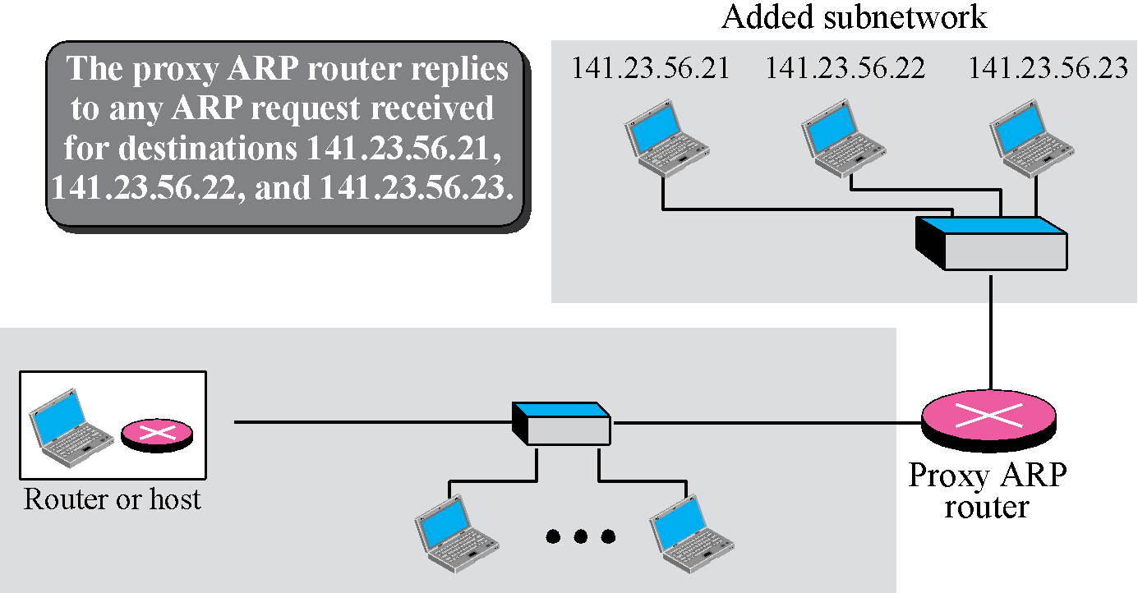
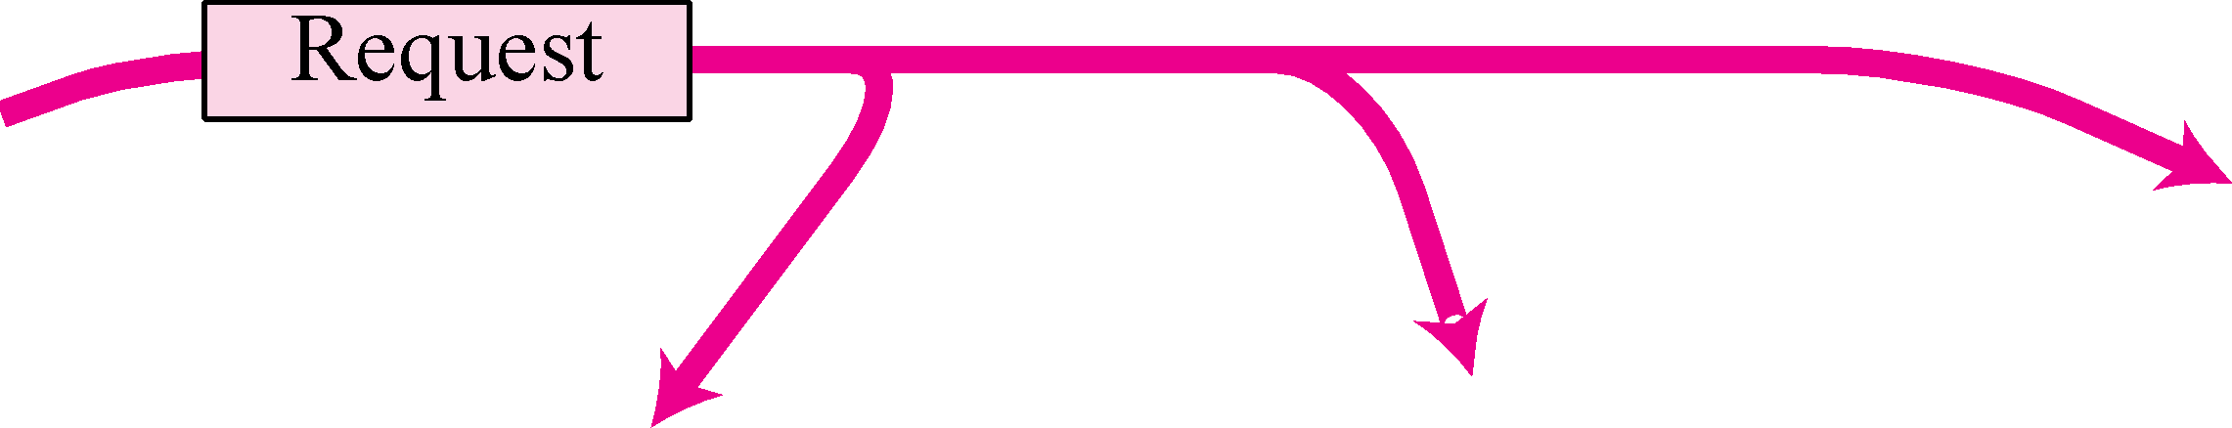
Figure 8.7 Proxy ARP
TCP/IP Protocol Suite
‹#›
Notes:
‹#›

Slide 17
8-3 ATM ARP
We discussed IP over ATM in Chapter 7. When IP packet are moving through an ATMWAN, a mechanism protocol is needed to find (map) the physical address of the exiting-point router in the ATM WAN given the IP address of the router. This is the same task performed by ARP on a LAN. However, there is a difference between a LAN and an ATM network. A LAN is a broadcast network (at the data link layer); ARP uses the broadcasting capability of a LAN to send (broadcast) an ARP request.
TCP/IP Protocol Suite
‹#›
Notes:
‹#›

Slide 18
Topics Discussed in the Section
Packet Format
ATMARP Operation
Logical IP Subnet (LIS)
TCP/IP Protocol Suite
‹#›
Notes:
‹#›

Slide 19
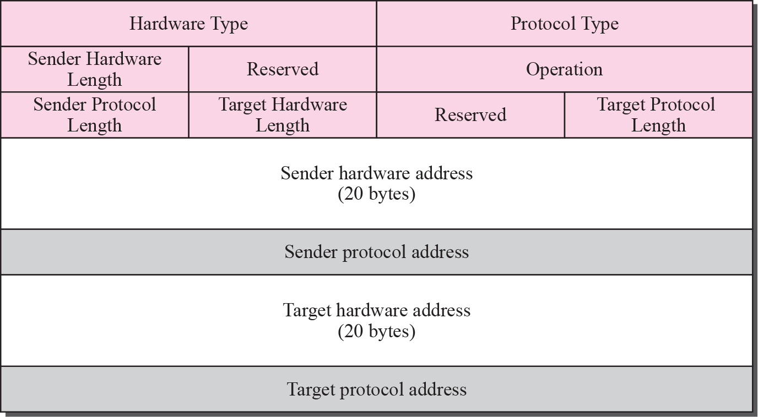
Figure 8.8 ATMARP packet
TCP/IP Protocol Suite
‹#›
Notes:
‹#›

Slide 20
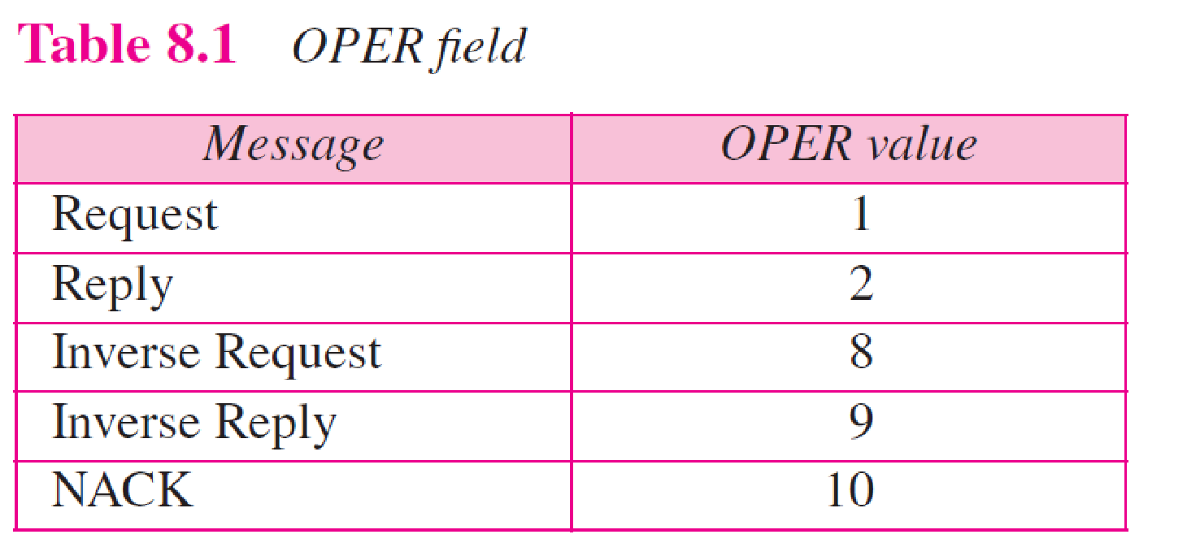
TCP/IP Protocol Suite
‹#›
Notes:
‹#›

Slide 21
Note
The inverse request and inverse reply messages can bind the physical address to an IP address in a PVC situation.
TCP/IP Protocol Suite
‹#›
Notes:
‹#›

Slide 22
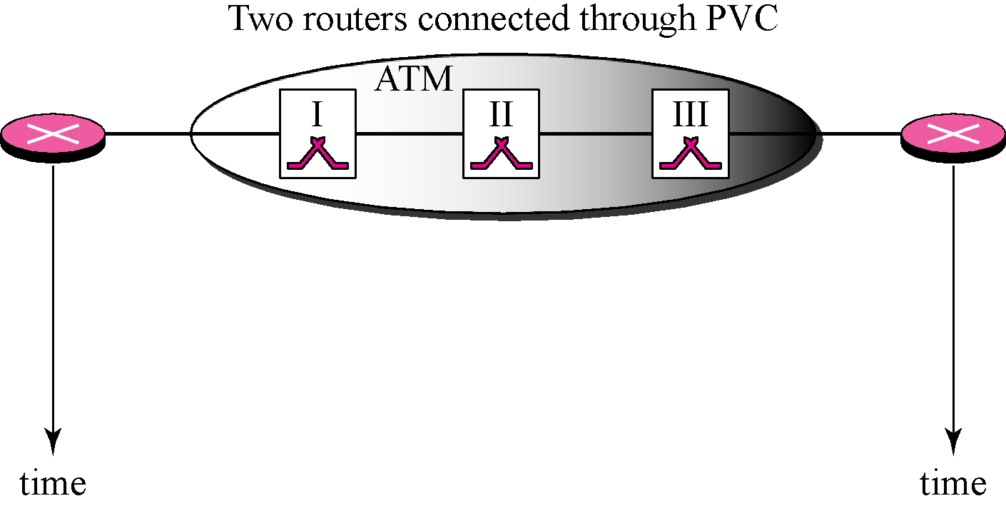
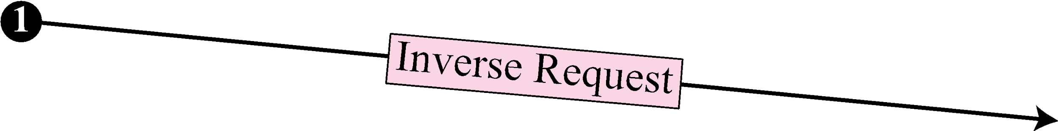
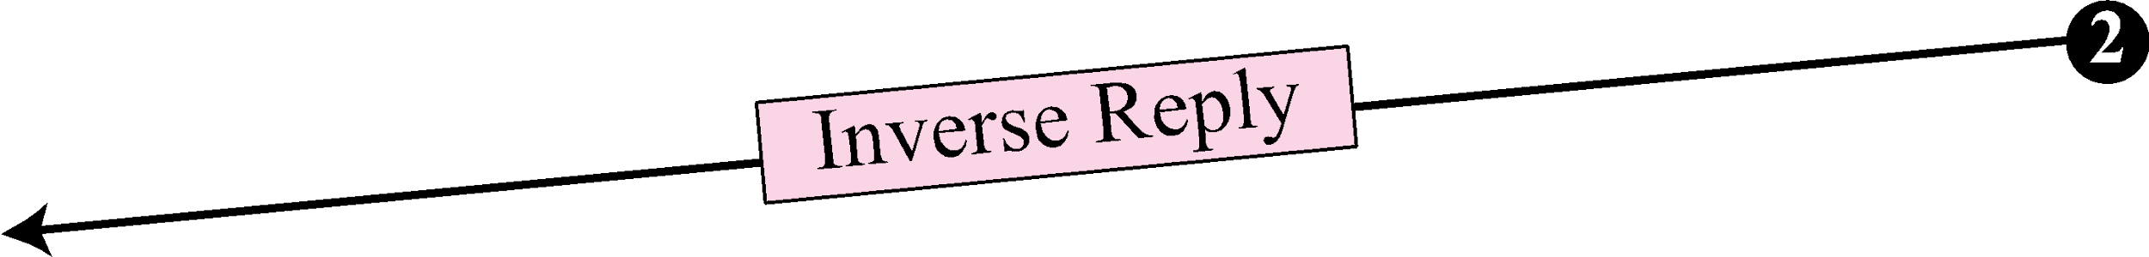
Figure 8.9 Binding with PVC
TCP/IP Protocol Suite
‹#›
Notes:
‹#›

Slide 23
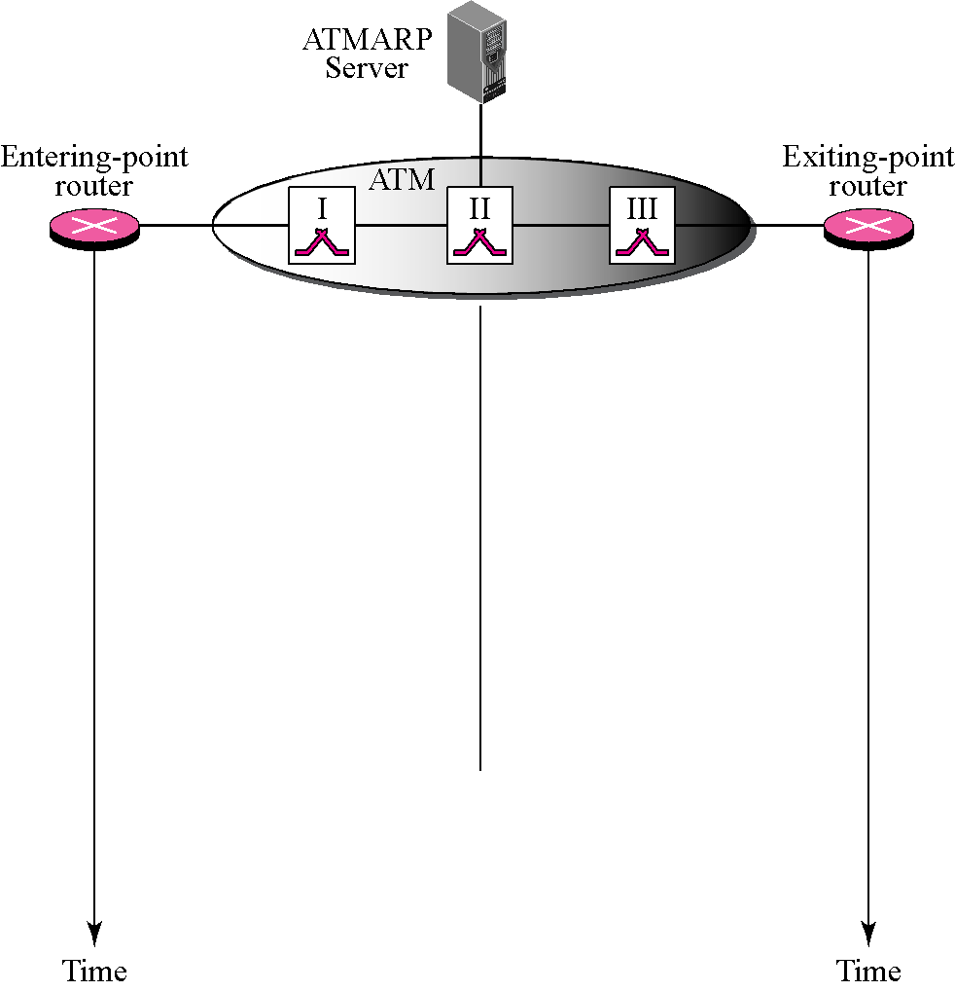

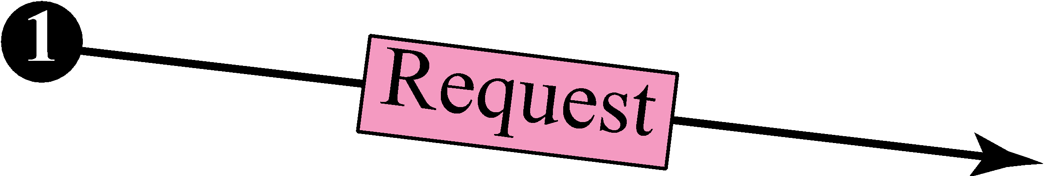
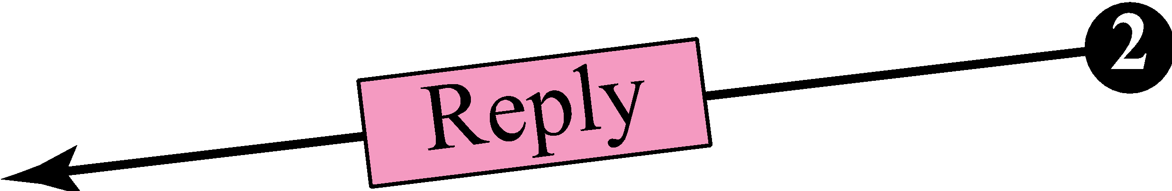
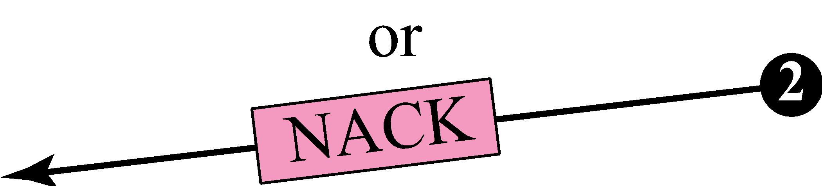

Figure 8.10 Binding with ATMARP
Finding physical
address
TCP/IP Protocol Suite
‹#›
Notes:
‹#›

Slide 24
Note
The request and reply message can be used to bind a physical address to an
IP address in an SVC situation.
TCP/IP Protocol Suite
‹#›
Notes:
‹#›

Slide 25
Note
The inverse request and inverse reply can also be used to build the server’s mapping table.
TCP/IP Protocol Suite
‹#›
Notes:
‹#›

Slide 26
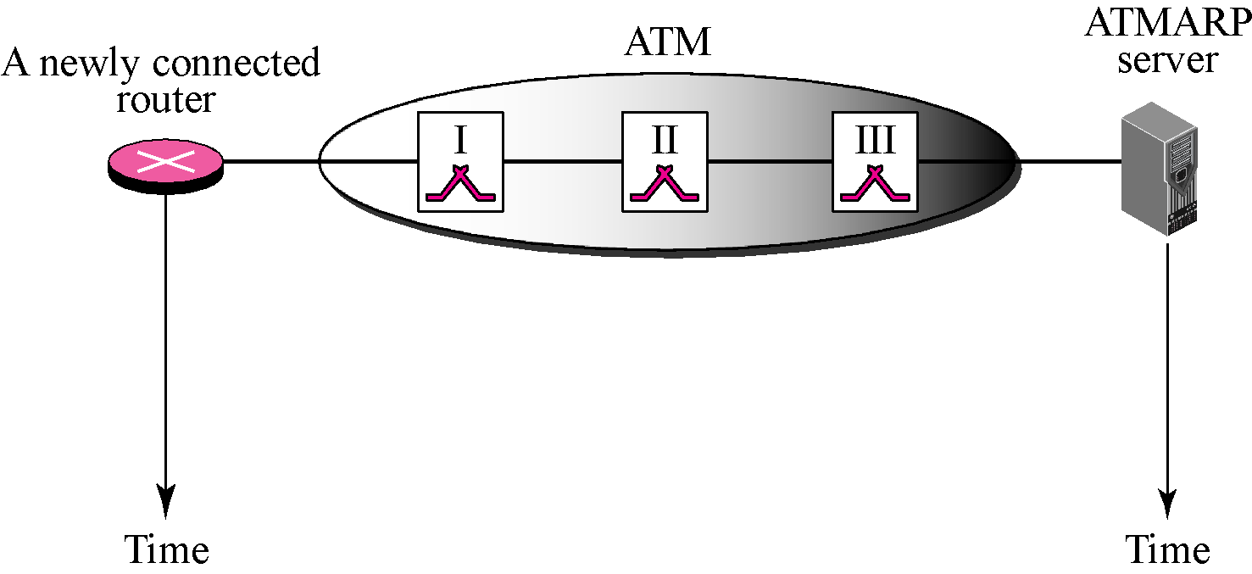
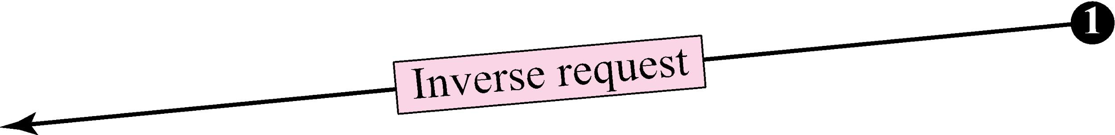
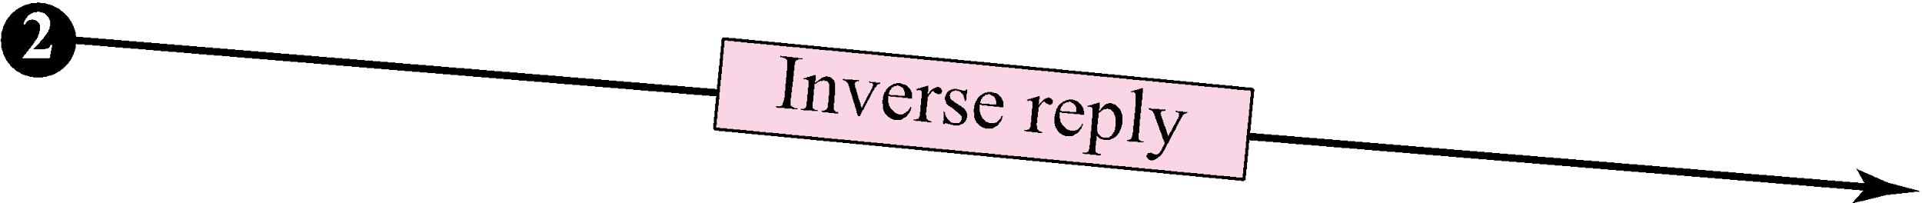
Figure 8.11 Building a table
TCP/IP Protocol Suite
‹#›
Notes:
‹#›

Slide 27
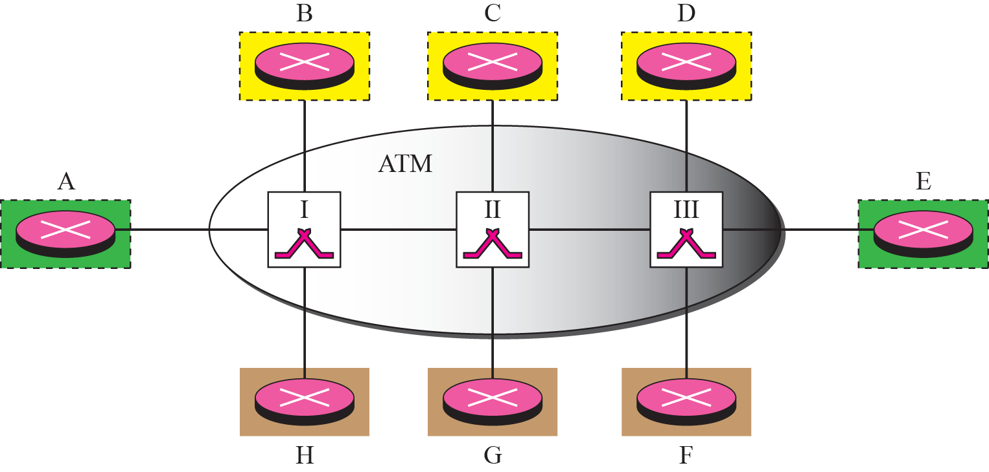
Figure 8.12 LIS
TCP/IP Protocol Suite
‹#›
Notes:
‹#›

Slide 28
Note
LIS allows an ATM network to be divided into several logical subnets.
To use ATMARP, we need a separate server for each subnet.
TCP/IP Protocol Suite
‹#›
Notes:
‹#›

Slide 29
8-4 ARP PACKAGE
In this section, we give an example of a simplified ARP software package. The purpose is to show the components of a hypothetical ARP package and the relationships between the components. Figure 8.13 shows these components and their interactions. We can say that this ARP package involves five components: a cache table, queues, an output module, an input module, and a cache-control module.
TCP/IP Protocol Suite
‹#›
Notes:
‹#›

Slide 30
Topics Discussed in the Section
Cache Table
Queues
Output Module
Input Module
Cache-Control Module
TCP/IP Protocol Suite
‹#›
Notes:
‹#›

Slide 31
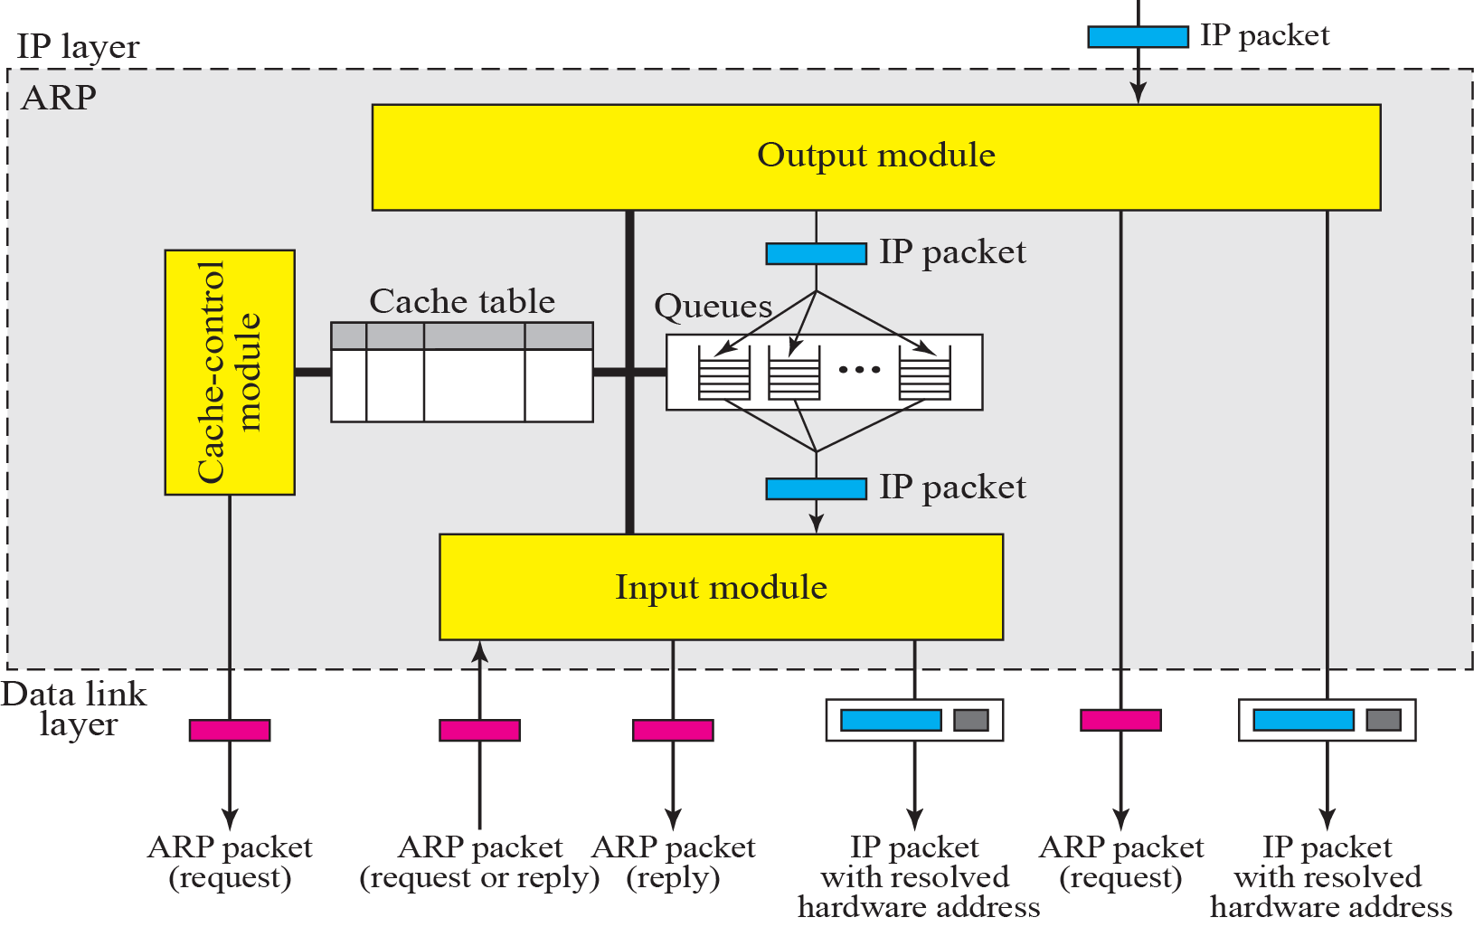
Figure 8.13 ARP components
TCP/IP Protocol Suite
‹#›
Notes:
‹#›

Slide 32
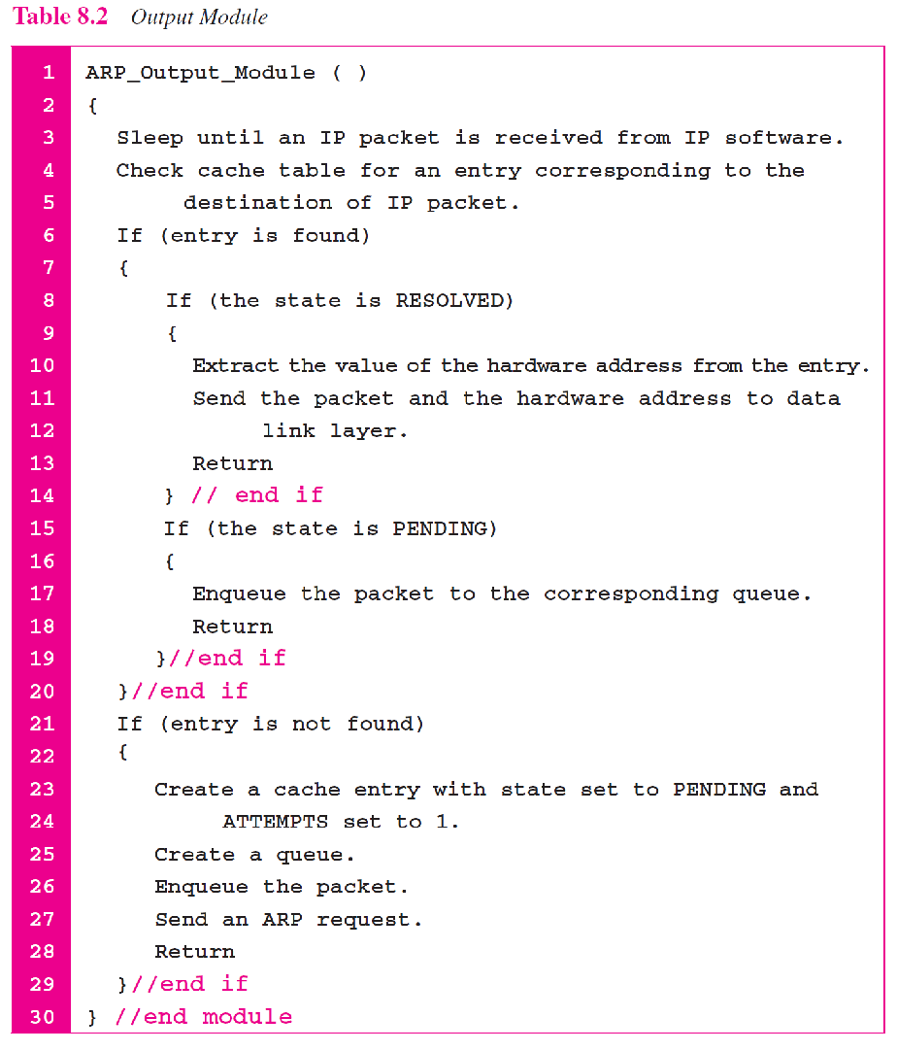
TCP/IP Protocol Suite
‹#›
Notes:
‹#›

Slide 33
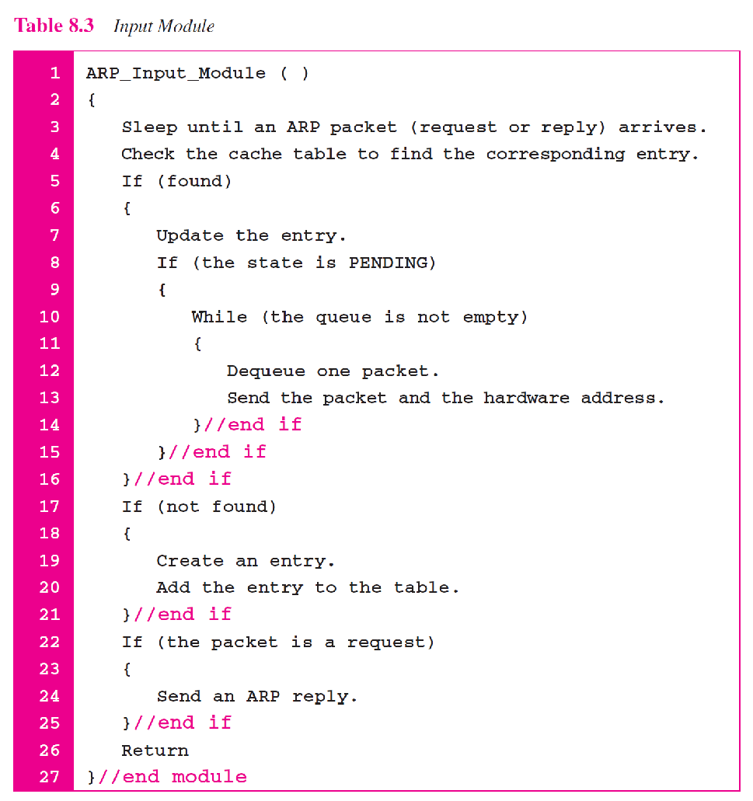
TCP/IP Protocol Suite
‹#›
Notes:
‹#›

Slide 34
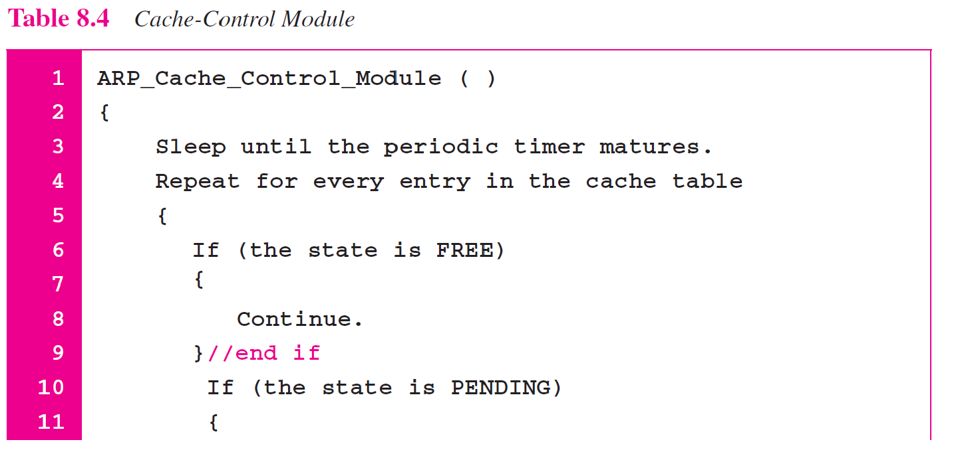
TCP/IP Protocol Suite
‹#›
Notes:
‹#›

Slide 35
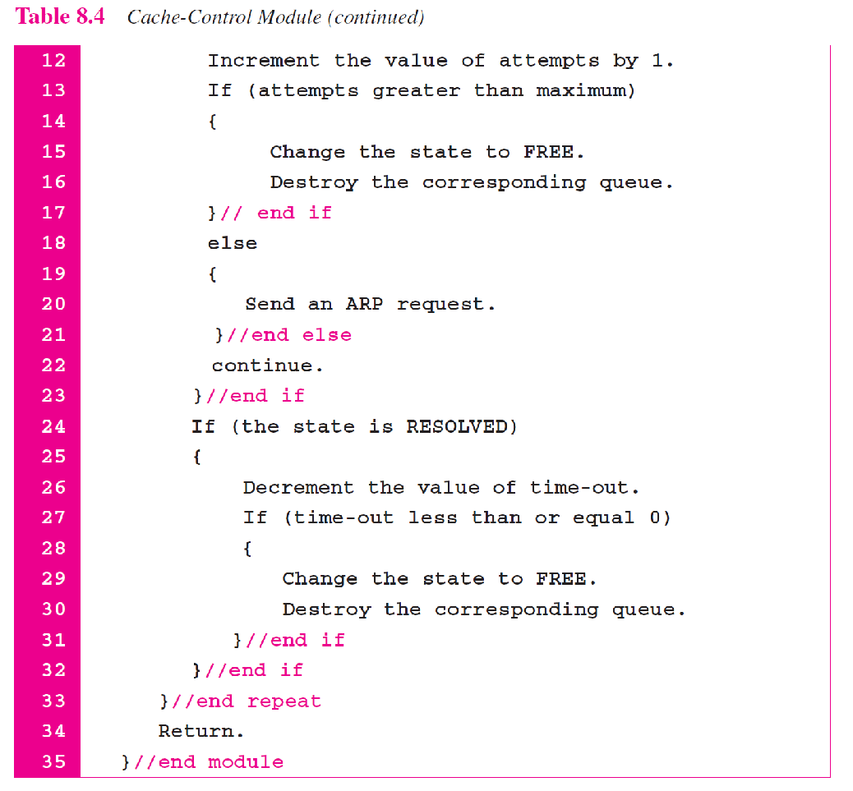
TCP/IP Protocol Suite
‹#›
Notes:
‹#›

Slide 36
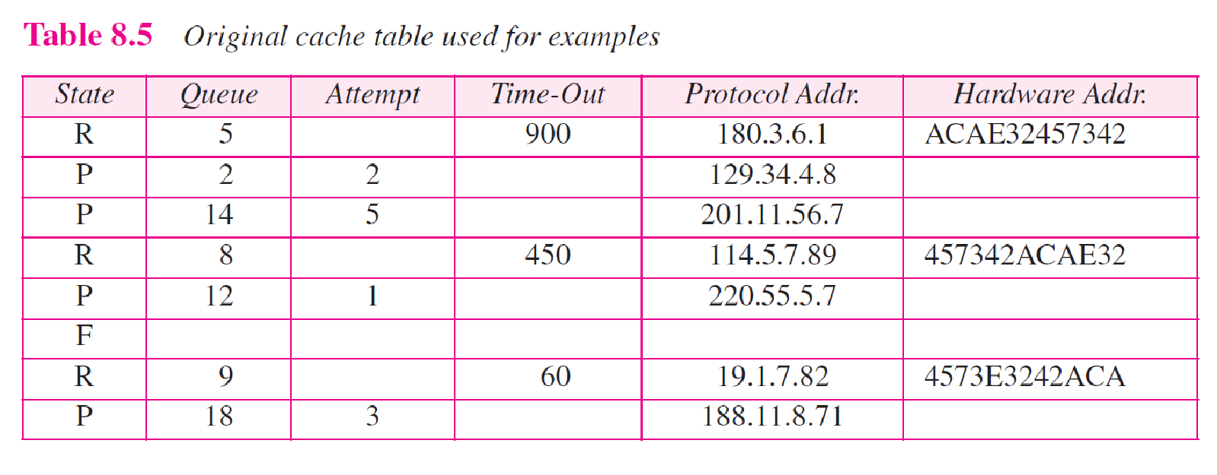
TCP/IP Protocol Suite
‹#›
Notes:
‹#›

Slide 37
Example 8.2
The ARP output module receives an IP datagram (from the IP layer) with the destination address 114.5.7.89. It checks the cache table and finds that an entry exists for this destination with the RESOLVED state (R in the table). It extracts the hardware address, which is 457342ACAE32, and sends the packet and the address to the data link layer for transmission. The cache table remains the same.
TCP/IP Protocol Suite
‹#›
Notes:
‹#›

Slide 38
Example 8.3
Twenty seconds later, the ARP output module receives an IP datagram (from the IP layer) with the destination address 116.1.7.22. It checks the cache table and does not find this destination in the table. The module adds an entry to the table with the state PENDING and the Attempt value 1. It creates a new queue for this destination and enqueues the packet. It then sends an ARP request to the data link layer for this destination. The new cache table is shown in Table 8.6.
TCP/IP Protocol Suite
‹#›
Notes:
‹#›

Slide 39
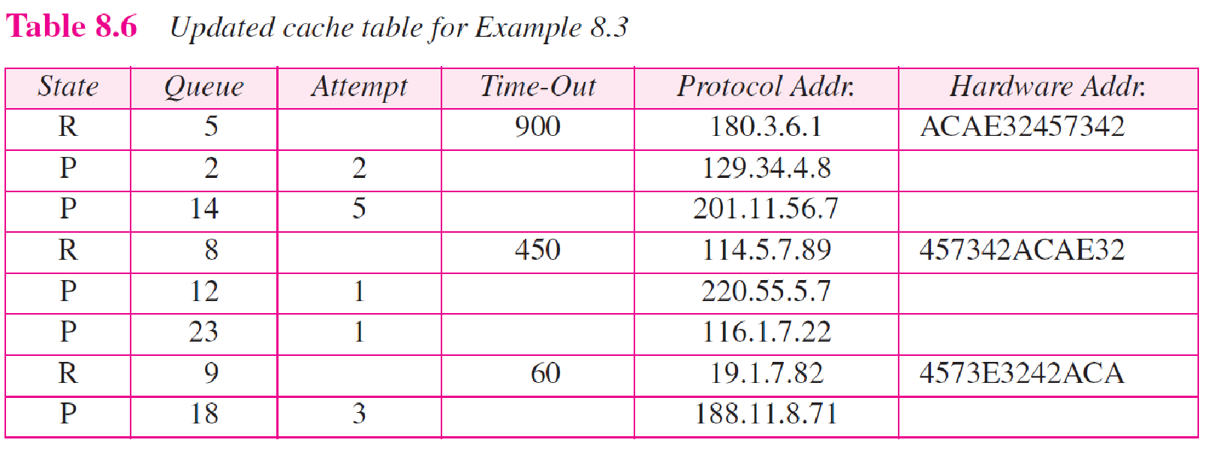
TCP/IP Protocol Suite
‹#›
Notes:
‹#›

Slide 40
Example 8.4
Fifteen seconds later, the ARP input module receives an ARP packet with target protocol (IP) address 188.11.8.71. The module checks the table and finds this address. It changes the state of the entry to RESOLVED and sets the time-out value to 900. The module then adds the target hardware address (E34573242ACA) to the entry. Now it accesses queue 18 and sends all the packets in this queue, one by one, to the data link layer. The new cache table is shown in Table 8.7.
TCP/IP Protocol Suite
‹#›
Notes:
‹#›

Slide 41
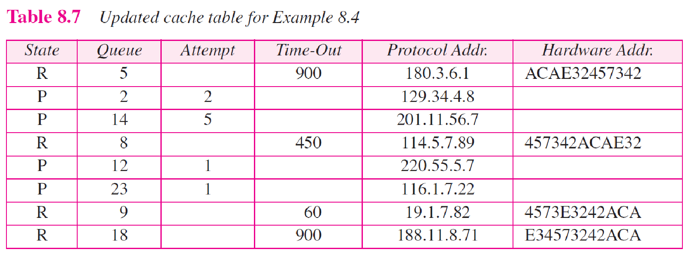
TCP/IP Protocol Suite
‹#›
Notes:
‹#›

Slide 42
Example 8.5
Twenty-five seconds later, the cache-control module updates every entry. The time-out values for the first three resolved entries are decremented by 60. The time-out value for the last resolved entry is decremented by 25. The state of the next-to-the last entry is changed to FREE because the time-out is zero. For each of the three pending entries, the value of the attempts
field is incremented by one. After incrementing, the attempts value for one entry (the one with IP address 201.11.56.7) is more than the maximum; the state is changed to FREE, the queue is deleted, and an ICMP message is sent to the original destination (see Chapter 9). See Table 8.8.
TCP/IP Protocol Suite
‹#›
Notes:
‹#›

Slide 43
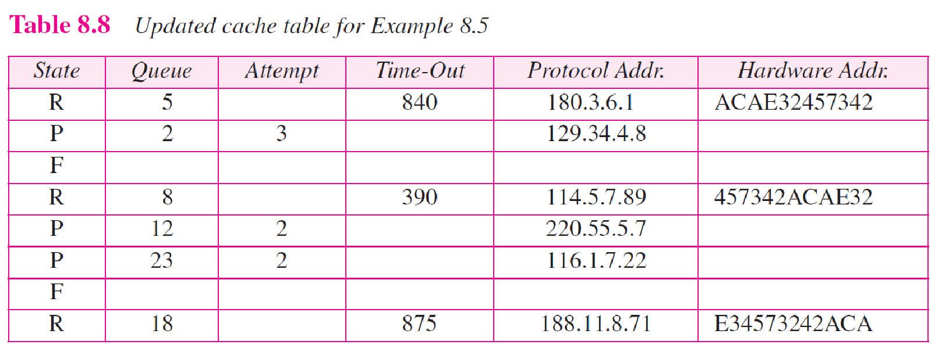
TCP/IP Protocol Suite
‹#›
Notes:
‹#›

