Slide 1
I/O Management

Slide 2
I/O Management
I/O management is a major component of operating system design and operation
Important aspect of computer operation
I/O devices vary greatly
Various methods to control them
Performance management
New types of devices

Slide 3
I/O Management
Ports, buses, device controllers connect to various devices
Device drivers encapsulate device details
Present uniform device-access interface to I/O subsystem

Slide 4
I/O Hardware
Incredible variety of I/O devices
Storage/Machine readable
Suitable for communicating with electronic equipment
Disks,
Tapes
Sensors
Controllers
USB Keys

Slide 5
I/O Hardware
Incredible variety of I/O devices
Transmission devices/Communication
Suitable for communicating with remote devices
network cards
modems
Human-interface/Human Readable
Suitable for communicating with the user
Terminals i.e. Screen, video display
Keyboard,
Mouse,
Printers

Slide 6
I/O Hardware
Incredible variety of I/O devices
More specialized devices –
Eg- Those involved in the steering of a military fighter jet or a space shuttle.
In these aircraft,
a human gives input to the flight computer via a joystick and foot pedals, and
the computer sends output commands that cause motors to move rudders, flaps, and thrusters.

Slide 7
I/O Hardware
Unit of transfer:
Data may be transferred as a stream of bytes or characters (e.g., terminal I/O) or in larger blocks (e.g., disk I/O).
Data representation:
Different data encoding schemes are used by different devices, including differences in character code and parity conventions.
Error conditions:
The nature of errors, the way in which they are reported, their consequences, and the available range of responses differ widely from one device to another.

Slide 8
I/O Hardware
Types of I/O devices-
Block oriented
Stream oriented

Slide 9
I/O Hardware
Block-oriented device
stores information in blocks that are usually of fixed size, and transfers are made one block at a time.
Generally, it is possible to reference data by its block number.
Disks and USB keys devices.

Slide 10
I/O Hardware
Stream-oriented device
transfers data in and out as a stream of bytes, with no block structure.
Terminals, printers, communications ports, mouse and other pointing devices, and most other devices that are not secondary storage

Slide 11
11.2 ORGANIZATION OF THE I/O FUNCTION
Three techniques for performing I/O:
Programmed I/O
Interrupt-driven I/O
Direct memory access (DMA)

Slide 12
11.2 ORGANIZATION OF THE I/O FUNCTION
Programmed I/O:
The processor issues an I/O command, on behalf of a process, to an I/O module;
that process then busy waits for the operation to be completed before proceeding.

Slide 13
11.2 ORGANIZATION OF THE I/O FUNCTION
Interrupt-driven I/O:
The processor issues an I/O command on behalf of a process.
There are then two possibilities.
If the I/O instruction from the process is non blocking,
the processor continues to execute instructions from the process that issued the I/O command.
If the I/O instruction is blocking,
then the next instruction that the processor executes is from the OS,
which will put the current process in a blocked state Interrupt the current process and schedule another process.

Slide 14
11.2 ORGANIZATION OF THE I/O FUNCTION
Direct memory access (DMA):
The processor sends a request for the transfer of a block of data to the DMA module and is interrupted only after the entire block has been transferred.
A DMA module controls the exchange of data between main memory and an I/O module.
DMA is the dominant form of transfer that must be supported by the operating system.

Slide 15
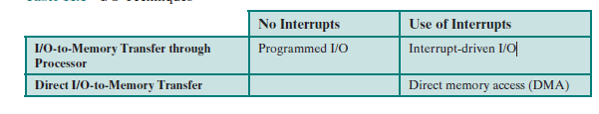
11.2 ORGANIZATION OF THE I/O FUNCTION

Slide 16
11.2 ORGANIZATION OF THE I/O FUNCTION
Direct memory access (DMA):
The DMA unit is capable of mimicking the processor
Taking control of the system bus just like a processor
It needs to do this to transfer data to and from memory over the system bus.

Slide 17
11.2 ORGANIZATION OF THE I/O FUNCTION
Direct memory access (DMA):
The DMA technique works as follows.
When the processor wishes to read or write a block of data, it issues a command to the DMA module by sending to the DMA module some information:

Slide 18
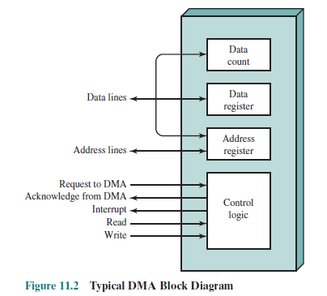
11.2 ORGANIZATION OF THE I/O FUNCTION
Direct memory access (DMA):
The information is:
Whether a read or write is requested,
Using the read or write control line between the processor and the DMA module
The address of the I/O device involved, communicated on the data lines

Slide 19
11.2 ORGANIZATION OF THE I/O FUNCTION
Direct memory access (DMA):
• The starting location in memory to read from or write to, communicated on the data lines and stored by the DMA module in its address register
• The number of words to be read or written, again communicated via the data lines and stored in the data count register

Slide 20
11.2 ORGANIZATION OF THE I/O FUNCTION
Direct memory access (DMA):
The processor then continues with other work.
It has delegated this I/O operation to the DMA module

Slide 21
11.2 ORGANIZATION OF THE I/O FUNCTION
Direct memory access (DMA):
The DMA module transfers the entire block of data,
one word at a time,
directly to or from memory,
without going through the processor

Slide 22
11.2 ORGANIZATION OF THE I/O FUNCTION
Direct memory access (DMA):
When the transfer is complete,
the DMA module sends an interrupt signal to the processor.
The processor is involved only at the beginning and end of the transfer

Slide 23
Direct Memory Access (DMA)
DMA Controller is a hardware device that allows I/O devices to directly access memory with less participation of the processor.
For The data transfer between a storage media such as magnetic disk and memory unit. The peripherals can directly communicate with each other using the memory buses, removing the intervention of the CPU. This type of data transfer technique is known as DMA or direct memory access.

Slide 24
Direct Memory Access (DMA)
During DMA, the CPU is idle and it has no control over the memory buses. The DMA controller takes over the buses to manage the transfer directly between the I/O devices and the memory unit.

Slide 25
Direct Memory Access (DMA)
GATE | GATE-CS-2016 (Set 1) | Question 41
The size of the data count register of a DMA controller is 16 bits. The processor needs to transfer a file of 29,154 kilobytes from disk to main memory. The memory is byte addressable. The minimum number of times the DMA controller needs to get the control of the system bus from the processor to transfer the file from the disk to main memory is _________
(A) 3644 (B) 3645 (C) 456 (D) 1823

Slide 26
Direct Memory Access (DMA)
GATE | GATE-CS-2016 (Set 1) | Question 41
The size of the data count register of a DMA controller is 16 bits. The processor needs to transfer a file of 29,154 kilobytes from disk to main memory. The memory is byte addressable. The minimum number of times the DMA controller needs to get the control of the system bus from the processor to transfer the file from the disk to main memory is _________
(A) 3644 (B) 3645 (C) 456 (D) 1823 Answer: (C) Explanation: Size of data count register of the DMA controller = 16 bits Data that can be transferred in one go = 2¹⁶ bytes = 64 kilobytes File size to be transferred = 29154 kilobytes So, number of times the DMA controller needs to get the control of the system bus from the processor to transfer the file from the disk to main memory = ceil(29154/64) = 456

Slide 27
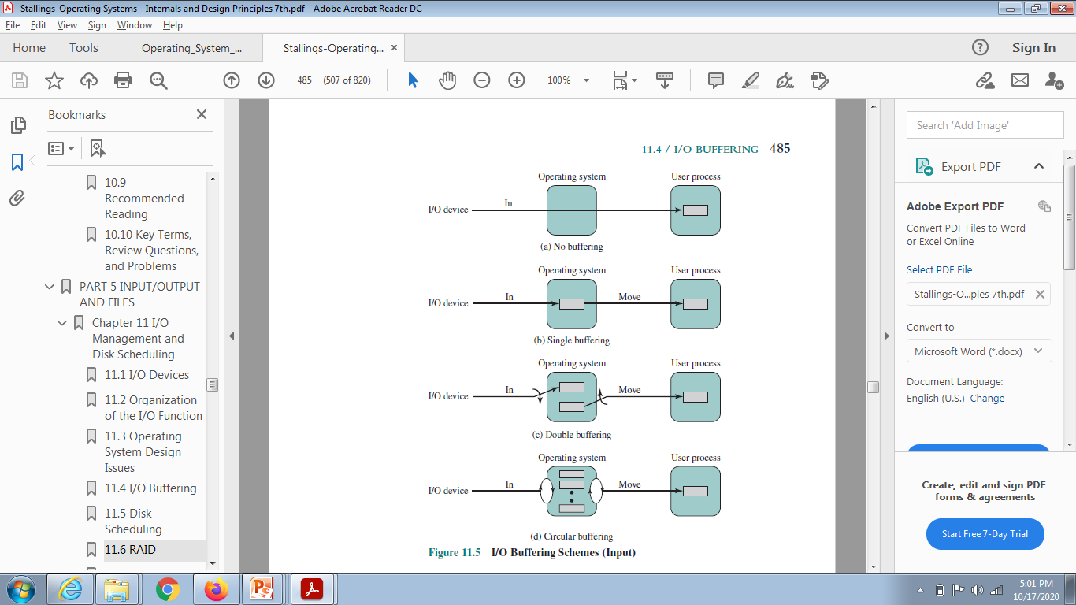
I/O BUFFERING

Slide 28
I/O BUFFERING
Single Buffer
The simplest type of support that the OS can provide
When a user process issues an I/O request,
the OS assigns a buffer in the system portion of main memory to the operation.

Slide 29
I/O BUFFERING
Single Buffer
Input transfers are made to the system buffer.
When the transfer is complete, the process moves the block into user space and immediately requests another block.
It is called reading ahead, or anticipated input;

Slide 30
I/O BUFFERING
Single Buffer
Done in the expectation that the block will eventually be needed.
This approach provides a speedup compared to no buffering.

Slide 31
I/O BUFFERING
Double Buffer
Assigning two system buffers to the operation
A process now transfers data to (or from) one buffer
while the operating system empties (or fills) the other.
Known as buffer swapping .

Slide 32
I/O BUFFERING
Circular Buffer
Double buffering may be inadequate if the process performs rapid bursts of I/O
In this case, the problem can often be alleviated by using more than two buffers.

Slide 33
I/O BUFFERING
Circular Buffer
When more than two buffers are used,
the collection of buffers is referred to as circular buffer,
with each individual buffer being one unit in the circular buffer.
This is simply the bounded-buffer producer/consumer model

Slide 34
I/O BUFFERING
The Utility of Buffering
Buffering is a technique that smoothes out peaks in I/O demand.
No amount of buffering will allow an I/O device to keep pace with a process indefinitely
when the average demand of the process is greater than the I/O device can service
Why??

Slide 35
I/O BUFFERING
Even with multiple buffers,
all of the buffers will eventually fill up
the process will have to wait after processing each chunk of data.
In a multiprogramming environment,
Variety of I/O activity
Variety of process activity to service,
buffering can increase the efficiency of the OS and the performance of individual processes.

