Slide 1
1.3 Software Planning & Estimation
Module 1

Slide 2
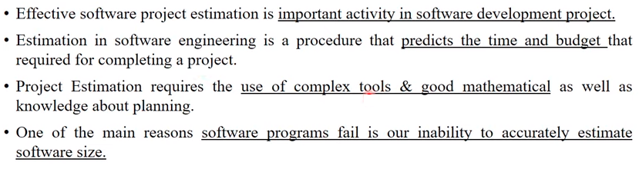
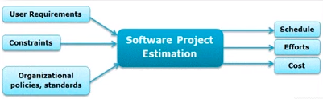

Slide 3
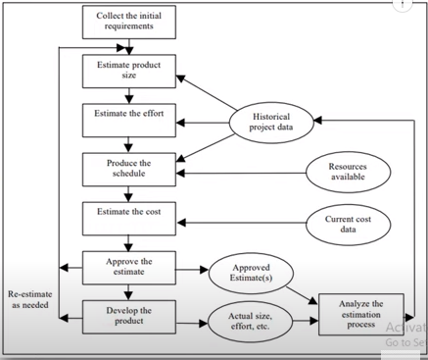
Steps for software product estimation

Slide 4
Software Measurement
Direct measures of the software engineering process include cost and effort applied.
Direct measures of the product include lines of code (LOC) produced, execution speed, memory size, and defects reported over some set period of time.
Indirect measures of the product include functionality, quality, complexity, efficiency, reliability, maintainability

Slide 5
Software Planning & Estimation
Accurate estimation of project size is central to satisfactory estimation of all other project parameters such as effort, completion time, and total project cost.
Product Metrics estimations : LOC, FP, COCOMO .
LOC : This metric measures the size of a project by counting the number of source instructions in the developed program.
FP(Function point metric): FP has several advantages over LOC.
FP can be easily computed from the problem specification itself.
Using LOC, size can be accurately determined only after code can be fully written.

Slide 6
Software Product metrics
Software project measures are tactical; project metrics and the indicators derived from them are used by a project manager and a software team to adapt project workflow and technical activities.
The first application of project metrics on most software projects occurs during estimation.
Metrics collected from past projects are used as a basis from which effort and time estimates are made for current software work.

Slide 7
As a project proceeds, measures of effort and calendar time expended are compared to original estimates (and the project schedule).
The project manager uses these data to monitor and control progress.
Used to :
minimize the development schedule by making the adjustments necessary to avoid delays and mitigate potential problems and risks.
assess product quality on an ongoing basis and, when necessary, modify the technical approach to improve quality.

Slide 8
Types of Software product Metrics
1. Size-Oriented Metrics
metrics derived by normalizing quality and/or productivity measures by considering the size of the software that has been produced.
a set of simple size-oriented metrics can be developed for each project:
Errors per KLOC (thousand lines of code).
Defects per KLOC.
$ per LOC.
Page of documentation per KLOC.
In addition, other interesting metrics can be computed:
Errors per person-month.
LOC per person-month.
$ per page of documentation.

Slide 9
LOC
A line of code (LOC) is any line of text in a code that is not a comment or blank line.
Size Estimation
Depends on programming language.
Example:
Void main() {
//print 1 to 10 no.s
int I;
for (i = 1; i <= 10; i++)
{
printf(i); //print value of i
}
}

Slide 10
Product Metrics
Function-oriented Metrics
software metrics use a measure of the functionality delivered by the application
Function points derived from direct measures of the information domain.
Number of user inputs. Each user input that provides distinct application oriented data to the software
Number of user outputs. Each user output that provides application oriented information to the user is counted. In this context output refers to reports, screens, error messages, etc.
Number of user inquiries. An inquiry is defined as an on-line input that results in the generation of some immediate software response in the form of an on-line output.
Number of files. Each logical master file (i.e., a logical grouping of data that may be one part of a large database or a separate file) is counted.
Number of external interfaces. All machine readable interfaces (e.g., data files on storage media) that are used to transmit information to another system are counted.

Slide 11
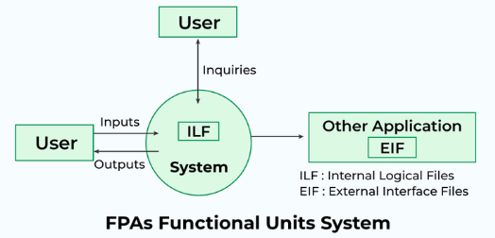
FP (Function Point)
Functional Point Analysis (FPA):
It is a software measurement technique used to assess the size and complexity of a software system based on its functionality.
It involves categorizing the functions of the software, such as input screens, output reports, inquiries, files, and interfaces, and assigning weights to each based on their complexity.
By quantifying these functions and their associated weights, FPA provides an objective measure of the software’s size and complexity.

Slide 12
EI: These are user inputs that update internal logical files.
Example: A form on a website where users enter their contact details (name, email, phone number) to sign up for a newsletter.
EO:These are user outputs that provide data derived from internal logical files or from external interface files.
Example: A report generated by a software system that displays sales statistics for a given period.
EQ: These involve inputs that result in the generation of immediate output.
Example: A search functionality on a website where users can look up products by entering keywords and immediately seeing the search results.
ILF: These are user identifiable groups of logically related data or control information maintained within the system.
Example: A database table that stores user information such as user IDs, names, and passwords.
EIF: These are user identifiable groups of logically related data or control information that are used by the system but maintained within another system.
Example: A table in a remote database accessed by the software system to get product pricing information.

Slide 13
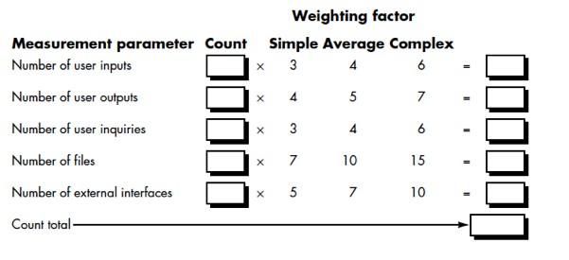
Product Metrics
FP calculation
FP = Count total * ( 0.65 + 0.01 * ∑ Fi)

Slide 14
The Fi (i = 1 to 14) are "complexity adjustment values" based on responses to the following questions
Does the system require reliable backup and recovery?
Are data communications required?
Are there distributed processing functions?
Is performance critical?
Will the system run in an existing, heavily utilized operational environment?
Does the system require on-line data entry?
Does the on-line data entry require the input transaction to be built over multiple screens or operations?
Are the master files updated on-line?
Are the inputs, outputs, files, or inquiries complex?
Is the internal processing complex?
Is the code designed to be reusable?
Are conversion and installation included in the design?
Is the system designed for multiple installations in different organizations?
Is the application designed to facilitate change and ease of use by the user?
Each of these questions is answered using a scale that ranges from 0 (not important or applicable) to 5
(absolutely essential)

Slide 15
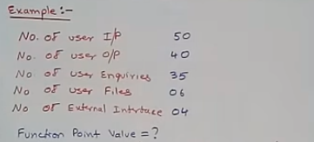
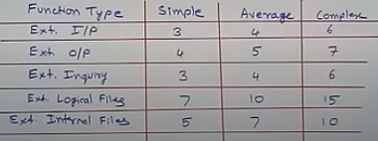
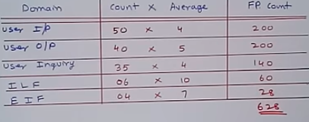
Example 1:
Unadjusted function point: (count-total)
Complexity adjustment factor: here, we assume: 3
14 questions are used for FPA,
∑(fi)= 42

Slide 16
FP = Count total * ( 0.65 + 0.01 * ∑ Fi)
Function point value
= count-total * [0.65+0.01* ∑(fi)]
= 628 * [0.65+0.01* 42]
=671.96

Slide 17
Example 2
Given the following values, compute function point when all complexity adjustment factor (CAF) are average and weighting factors are
User Input = 40 Simple
User Output = 35 Complex
User Inquiries = 30 Simple
User Files = 8 Average
External Interface = 6 Average
Count Total = 40* 3 + 35 * 7 + 30 * 3 + 8 *10 +6 *7=577
Σ(Fi) = 14* 3 = 42 (total 14 Fi Each is average on scale of 1-5 hence 3)
FP = count total [0.65 + 0.01 Σ(Fi)]
FP = 577 * (0.65+ 0.42)
= 617.39

Slide 18
Assignment:
Consider a software project with the following information domain characteristic for the calculation of function point metric.
Number of external inputs (I) = 30
Number of external output (O) = 60
Number of external inquiries (E) = 23
Number of files (F) = 08
Number of external interfaces (N) = 02
It is given that the complexity weighting factors for I, O, E, F, and N are 4, 5, 4, 10, and 7, respectively. It is also given that, out of fourteen value adjustment factors that influence the development effort, four factors are not applicable, each of the other four factors has value 3, and each of the remaining factors has value 4. The computed value of the function point metric is ?

Slide 19
Once function points have been calculated, they are used in a manner analogous to LOC as a way to normalize measures for software productivity, quality, and other attributes:
Errors per FP.
Defects per FP.
$ per FP.
Pages of documentation per FP.
FP per person-month.
Reference:
Rajesh Narang, Software Engineering Principles & Practices, McGraw Hill, (318-329)
Roger S. Pressman Software Engineering Practitioner’s Approach, McGraw Hill, 5th edition (89-91)

Slide 20
Software Product Estimation COCOMO model (Constructive Cost Estimation Model)
Basic Effort Estimation Model uses size of Code to estimate man month effort and project duration in month.
Effort: Amount of labour that will be required to complete a task. It is measured in person-months units.
Schedule: Simply means the amount of time required for the completion of the job, which is, of course, proportional to the effort put. It is measured in the units of time such as weeks, months.

Slide 21
Software are categorized into :
Organic:
If the team size required is adequately small, the problem is well understood and has been solved in the past and also the team members have a nominal experience regarding the problem.
2. Semi-detached projects:
If the vital characteristics such as team-size, experience, knowledge of the various programming environment lie in between that of organic and Embedded.
The projects classified as Semi-Detached are comparatively less familiar and difficult to develop compared to the organic ones and require more experience and better guidance and creativity.
Eg: Compilers or different Embedded Systems can be considered of Semi-Detached type

Slide 22
3. Embedded Projects:
A software project with requiring the highest level of complexity, creativity, and experience requirement fall under this category.
Such software requires a larger team size than the other two models and also the developers need to be sufficiently experienced and creative to develop such complex models.

Slide 23
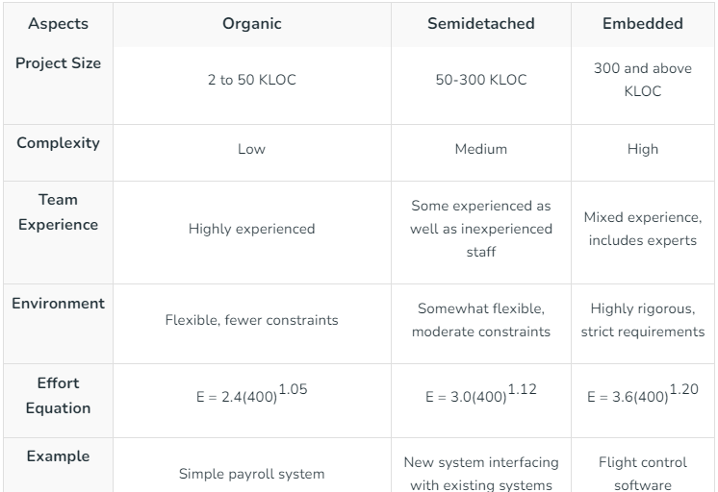
Comparison

Slide 24
Stages of COCOMO
Basic
Computes the basic estimation of project
Intermediate
It is the extension of basic model
It refines the estimate obtained by basic model
Detailed

Slide 25
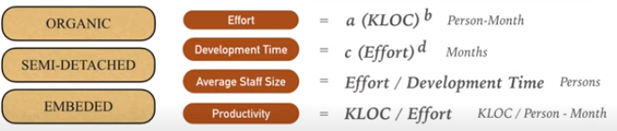
Basic COCOMO

Slide 26
COCOMO
Coefficients Related to Basic Model
Estimation at the early design stage where ONLY User Requirements are defined
Effort (E)= a* (KLOC)^b
Project Duration (Development time)
(D) = c* (Effort)^d (represented in Months)
Person Required = Effort /Project Duration
Development Model | a | b | c | d
Organic | 2.4 | 1.05 | 2.5 | 0.38
Embedded | 3.6 | 1.20 | 2.5 | 0.32
Semi detached | 3.0 | 1.12 | 2.5 | 0.35

Slide 27
Example
Suppose a project manager has used FP analysis to estimate lines of source code required to develop a project and finds that the code size is 10,000.
Estimate duration of the project and number of persons required.
Assume the project is classified as Embedded Project.
Assume the project is classified as Organic Project.

Slide 28
Software Measurement
For Embedded:
Effort = 57.06 , Project duration = 9.12 months and person =6.26 i.e. 6
For organic:
Effort = 26.92 , Project duration = 8.72 moths and person =3.08 i.e. 3
Development Model | a | b | c | d
Organic | 2.4 | 1.05 | 2.5 | 0.38
Embedded | 3.6 | 1.20 | 2.5 | 0.32
Semi detached | 3.0 | 1.12 | 2.5 | 0.35

Slide 29
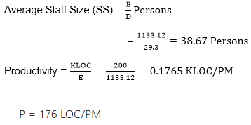
Example
A project size of 200 KLOC is to be developed. Software development team has average experience on similar type of projects. The project schedule is not very tight. Calculate the Effort, development time, average staff size, and productivity of the project.
Sol:
The semidetached mode is the most appropriate mode, keeping in view the size, schedule and experience of development time.
Hence
E=3.0(200)^1.12=1133.12PM D=2.5(1133.12)^0.35=29.3PM

Slide 30
Assignment
Suppose that a Basic project was estimated to be 400 KLOC (kilo lines of code). Calculate effort and time for each of the three modes of development.

Slide 31

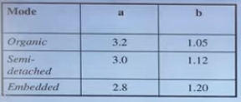

Intermediate COCOMO I
The basic COCOMO model considers that the effort is only a function of the number of lines of code and some constants calculated according to the various software systems.
The intermediate COCOMO model recognizes these facts and refines the initial estimates obtained through the basic COCOMO model by using a set of 15 cost drivers based on various attributes of software engineering.
EAF (Error Adjustment Factor)

Slide 32
The product of all effort multipliers results in an effort adjustment factor (EAF).
Typical values for EAF range from 0.9 to 1.4.

Slide 33
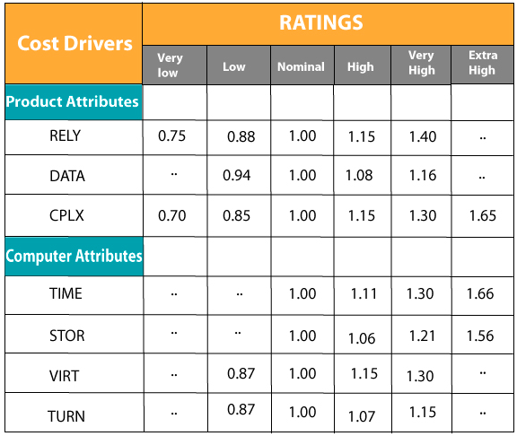
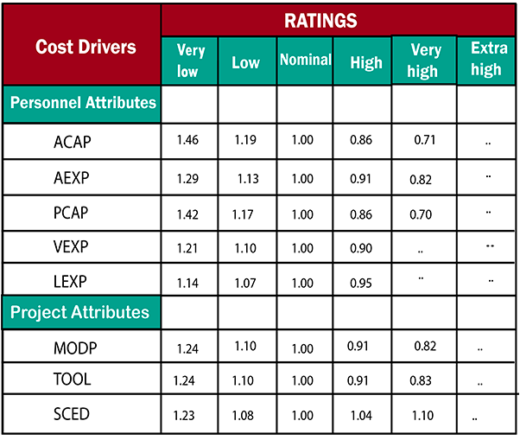

Slide 34
Product attributes:
Required software reliability extent
Size of the application database
The complexity of the product
Hardware attributes
Run-time performance constraints
Memory constraints
The volatility of the virtual machine environment
Required turnabout time
Personal attributes
Analyst capability
Software engineering capability
Application experience
Virtual machine experience
Programming language experience
Project attributes
Use of software tools
Application of software engineering methods
Required development schedule

Slide 35
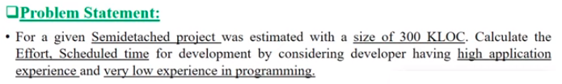
Example

Slide 36
detailed cocomo
In detailed cocomo, the whole software is differentiated into multiple modules, and then we apply COCOMO in various modules to estimate effort and then sum the effort.
The Six phases of detailed COCOMO are:
Planning and requirements
System structure
Complete structure
Module code and test
Integration and test
Cost Constructive model

Slide 37


COCOMO II
Effort Estimation: The primary formula used in Intermediate COCOMO II is:
A:Constant scale factor (typically 2.94 for the Intermediate COCOMO II model)
Size: Estimated size of the project in KLOC (thousands of lines of code)
B: Exponent derived from five scale factors
EAF: Effort Adjustment Factor, a product of the 17 cost drivers
The formula for calculating BBB is:

Slide 38
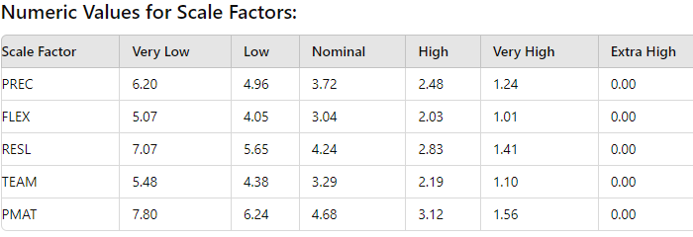

Slide 39
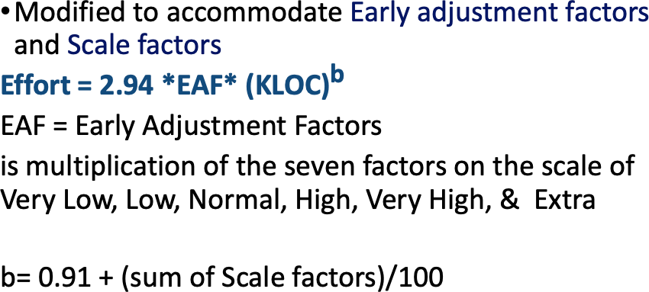
COCOMO II

Slide 40
COCOMO II model
Scale factors (5 factors):
Precedentness or Previous Experience: Higher experience lesser time
Development Flexibility: More freedom to choose convenient development process less time
Risk Resolution: Lesser analysis done more time
Team Cohesion: more seamless interaction less time
Process Maturity: More matured process less time

Slide 41
COCOMO II
EAF = Early Adjustment Cost Factors (7 major):
Product Attributes
S/w Reliability req. more reliable more time
Size of application data : more data size more time
Complexity of product : complex will require more time
2.Platform (H/W Attributes):
4. Execution time constraint: higher constraint more time
5. Main storage constraint : higher constraint more time
6. Platform volatility (OS/RDBMS/Browser change): More flexibility more time
7. Required turnabout time

Slide 42
COCOMO II
EAF = Early Adjustment Cost Factors (7 major):
3. Personnel Attribute:
8. Analyst Capability: More ability less time
9. Programmer Capability: More ability less time
10.Personnel Continuity : More ability less time
11. Application Experience : More experience less time
12. Virtual Machine Experience : More experience less time
13. Language & Tool Experience : More experience less time
4. Project Attributes:
13. Use of Software tools More tools less time
14. (Application of SE methods )Multisite: More places more time
15. (Required development schedule) Normal or compressed

