Slide 1
1.4 Project Management Activities: Planning , Scheduling & Tracking
Module 1

Slide 2
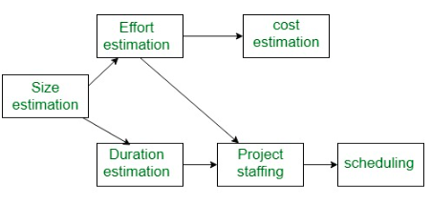
Project Management Activities
No one plans to fail, but fails to plan
Planning is the next important stage in project development

Slide 3
Estimation
Importance of estimation in Planning
involves estimation an attempt to determine how much money, how much effort, how many resources, and how much time it will take to build a specific software- based system or product
Performed by Software managers—using information solicited from customers and software engineers and software metrics data collected from past projects
Projects being costly it is reasonable to develop an estimate before you start creating the software.

Slide 4
Project Planning
The objective of software project planning is to provide a framework that enables the manager to make reasonable estimates of resources, cost, and schedule.
These estimates are made within a limited time frame at the beginning of a software project and should be updated regularly as the project progresses.

Slide 5
Planning
What will be the inputs for planning ? Steps in planning
Scope (What to develop)
Estimation (Time and hence cost)
Risks associated
Human Resources available (role, number, when will be available etc.)

Slide 6
Planning
prepare a task table mentioning the task name, task id, duration, resource name
Create a network of these tasks that will enable to get the job done on time
Some observations:
In a complex system many tasks may occur in parallel
Result of work performed during one task may have a profound effect on work to be conducted in another task
Interdependencies are very difficult to understand without a schedule
Virtually impossible to assess progress on a moderate or large software project without a detailed schedule.

Slide 7
Reasons for late delivery of products
An unrealistic deadline established by someone outside the software development group and forced on managers and practitioners within the group.
Changing customer requirements that are not reflected in schedule changes.
An honest underestimate of the amount of effort and/or the number of resources that will be required to do the job.
Predictable and/or unpredictable risks that were not considered when the project commenced.
Technical difficulties that could not have been foreseen in advance.
Human difficulties that could not have been foreseen in advance.
Miscommunication among project staff that results in delays.
A failure by project management to recognize that the project is falling behind schedule and a lack of action to correct the problem.

Slide 8
Late delivery Remedies:
Perform a detailed estimate using historical data from past projects. Determine the estimated effort and duration for the project.
Using an incremental process model, develop a strategy that will deliver critical functionality by the imposed deadline, but delay other functionality until later.
Document the plan.
Avoid to impose unrealistic deadline

Slide 9
Project Scheduling
An activity that distributes estimated effort across the planned project duration by allocating the effort to specific tasks
specific software tasks are identified and scheduled
the schedule evolves over time
During early stages of project planning, a macroscopic schedule is developed identifying all major activities and the product functions to which they are applied.
As the project gets under way, refine into a detailed schedule.
Two approaches:
Based on the end-date for release distribute effort within the prescribed time frame
Based on the time required for each activity, decide the end date

Slide 10
Basic principle guides of Scheduling
Compartmentalization:
Break into a number of manageable activities and tasks by decomposing both the product and the process.
Interdependency:
The interdependency of each compartmentalized activity or task must be determined.
Some tasks must occur in sequence while others can occur in parallel.
Some activities cannot commence until the work product produced by another is available. Other activities can occur independently.
Time allocation
Each task to be scheduled must be allocated some number of work units (e.g., person- days of effort). In addition, each task must be assigned a start date and a completion date that are a function of the interdependencies and whether work will be conducted on a full-time or part-time basis.

Slide 11
Effort validation.
Every project has a defined number of staff members.
As time allocation occurs, the project manager must ensure that no more than the allocated number of people have been scheduled at any given time.
For example, consider a project that has three assigned staff members (e.g., 3 person-days are available per day of assigned efforts).
On a given day, seven concurrent tasks must be accomplished. Each task requires 0.50 person days of effort. More effort has been allocated than there

Slide 12
Define responsibilities Every task that is scheduled should be assigned to a specific team member.
Define outcomes Every task that is scheduled should have a defined outcome. For software projects, the outcome is normally a work product (e.g., the design of a module) or a part of a work product. Work products are often combined in deliverables.
Define milestones Every task or group of tasks should be associated with a project milestone. A milestone is accomplished when one or more work products has been reviewed for quality and has been approved.

Slide 13
Some facts about Scheduling
Experienced resources would need less time for development
Familiar tools & defined process will reduce the development efforts
Adding more programmers/ developers will NOT ALWAYS reduce the project duration
A recommended distribution (not rules) of effort across the definition and development phases is often referred to as the 40–20–40 rule
40% of effort is allocated to front-end analysis and design
20% for coding
40%Forty percent applied to back-end testing

Slide 14
Defining Task set
Irrespective of the process model used for development, task set that enable a software team to define, develop, and ultimately support computer software.
A task set is a collection of software engineering work tasks, milestones, and deliverables that must be accomplished to complete a particular project.
The task set to be chosen must provide enough discipline to achieve high software quality.
It must NOT burden the project team with unnecessary work.
In order to develop a project schedule, a task set must be distributed on the project timeline.

Slide 15
Defining Task set
Based on phase of the project identify the various major tasks: Concept , Analysis , Design, Coding, Maintenance
Concept scoping determines the overall scope of the project.
Preliminary concept planning establishes the organization’s ability to undertake the work implied by the project scope.
Technology risk assessment evaluates the risk associated with the technology to be implemented as part of project scope.
Proof of concept demonstrates the feasibility of a new technology in the software context.
Concept implementation implements the concept representation in a manner that can be reviewed by a customer and is used for “marketing” purposes when a concept must be sold to other customers or management.
Customer reaction to the concept solicits feedback on a new technology concept and targets specific customer applications.

Slide 16
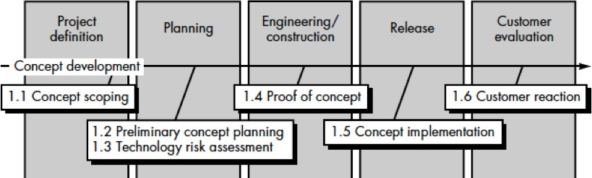
Sample Linear Development Approach Tasks

Slide 17
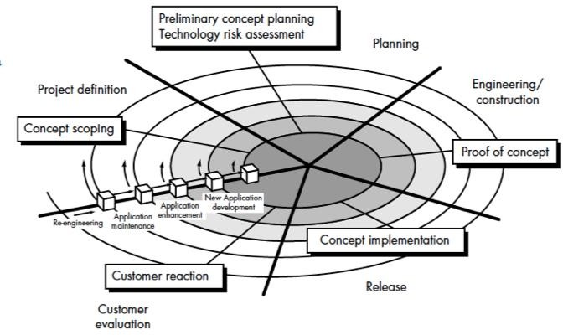
Sample Spiral Development Approach Tasks

Slide 18
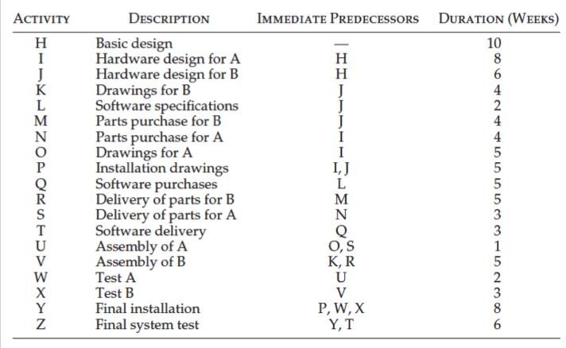
Sample Task Table

Slide 19
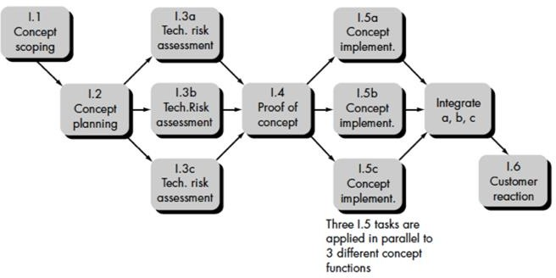
Sample Task Network Diagram

Slide 20
Scheduling Methods and tools
Project Scheduling methods:
Critical Path Method (CPM)
Program Evaluation & Review Technique (PERT)
Gantt chart
Project Scheduling Tools
Microsoft Project
Monday.com
ProjectManager.com
SmartTask
ProofHub
GanttPRO
Zoho Projects

Slide 21
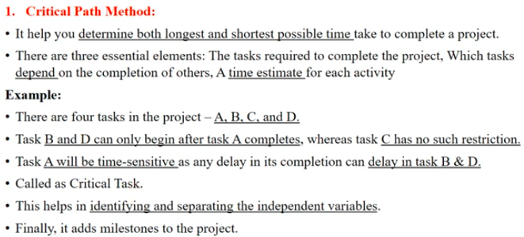

Slide 22
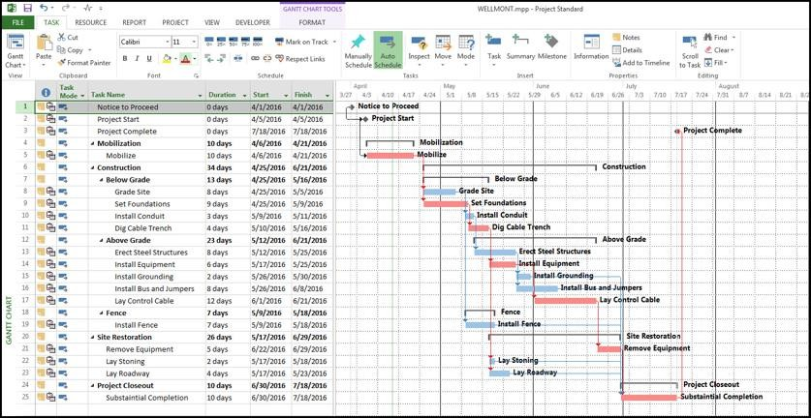
Gantt Chart

Slide 23
Tracking the Schedule
The project schedule provides a road map
Properly developed project schedule defines the tasks and milestones that must be tracked and controlled as the project proceeds
Tracking can be accomplished by:
Conducting periodic project status meetings in which each team member reports progress and problems.
Evaluating the results of all reviews conducted throughout the software engineering process.
Determining whether formal project milestones (the diamonds shown in Figure) have been accomplished by the scheduled date
Comparing actual start-date to planned start-date for each project task listed in the resource table
Meeting informally with practitioners to obtain their subjective assessment of progress to date and problems on the horizon.
Using earned value analysis to assess progress quantitatively.

