Slide 1
WELCOME

Slide 2


GOVERNMENT RESIDENTIAL WOMENS’ POLYTECHNIC LATUR
PRESENTATION
ON
Stick for blind people
GUIDE NAME : Mr.P.P.Chilme
Name of Student Roll No.
1.Rajmane Sakshi Dattatray 48
2. Rathod Sujata Anand 50
3.Mane Sayali Tatyarao 40
4.Boyane Shivanjali Sanjay 77
5.Shaikh Fija Pashumiya 75

Slide 3
CONTENT
Introduction Of Project
Problem Statement
Objectives
Planning Of Project
Circuit diagram
Components used In project
Application
Future Scope
Conclusion

Slide 4
INTRODUCTION
The Smart Stick for Blind People is designed to help visually impaired individuals move around more safely and independently. Traditional walking sticks (or white canes) can only detect obstacles when they physically touch something, which means the user might not know about objects that are further away or higher up , like branches or signs. This can make moving around in new places difficult and sometimes dangerous.
This smart stick improves upon the traditional cane by using an Proximity sensor to detect obstacles from a distance. The sensor can see objects ahead and give the user a warning through vibrations or sounds before they get too close. This way, the user can avoid tripping over or bumping into things that they might not be able to feel with a regular cane.

Slide 5
PROBLEM STATEMENT
Blind individuals face challenges moving safely with regular sticks, as they cannot detect obstacles ahead. A smart stick using an proximity sensor and buzzer can help by detecting nearby obstacles and alerting the user with sound, enhancing their safety and independence while navigating different environments.

Slide 6
PROJECT OBJECTIVES
To design and develop Smart Stick For Blind People
To Use Sensors to detect obstacles and warn the user.
To Make the Stick easy to use and affordable for everyone.

Slide 7
Planning of project
1) Problem understanding:
Study and understand the daily challenges faced by visually impaired individuals, focusing on the limitations of traditional walking sticks.
2) Requirement Gathering :
Define the hardware and software components required, such as Proximity sensor, microcontroller (e.g., Arduino uno board) buzzer, and IOT modules.
3) Hardware Design:
Design the smart stick by integrating an Proximity sensor to detect obstacles, a microcontroller to process the sensor data, and an alert system (buzzer/vibration) to notify the user.
4) Testing :
Test the stick in different environments (indoors and outdoors) to ensure that it detects obstacles accurately and produce sound to the user.
5) User Testing:
Gather feedback from visually impaired individuals to validate the effectiveness and usability of the smart stick.
6) Documentation :
Creating the Report of project.

Slide 8

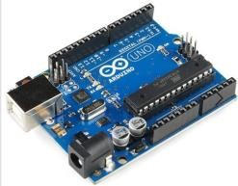
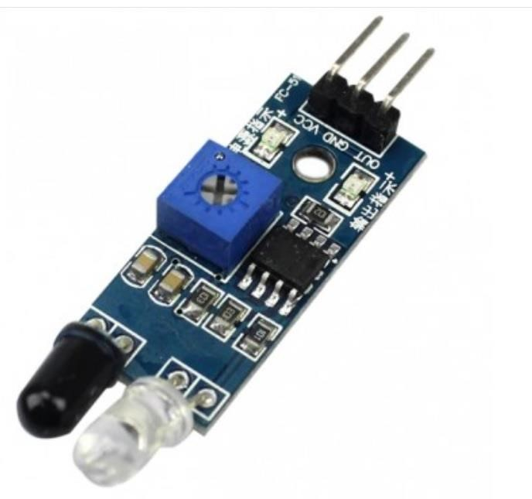
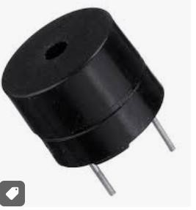
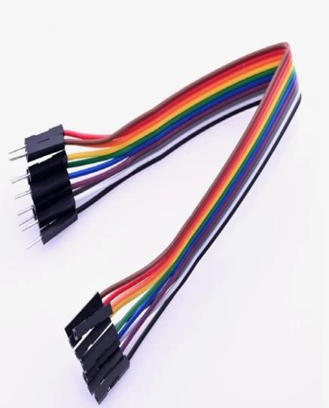
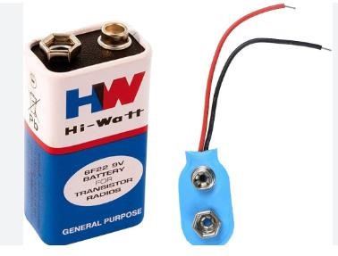
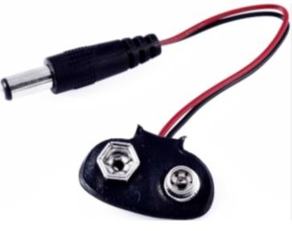
Components used

Slide 9
information about Components
Arduino Uno board : Arduino Uno board is used for programming and all other components are integrated with arduino.
Buzzer : Buzzer is used for producing sound or beep after detecting the Obstacle or object.
Ultrasonic Sensor : The ultrasonic sensor is a key component used to detect obstacles by emitting ultrasonic sound waves and measuring the time it takes for the sound to bounce back after hitting an object
Battery : 9V Battery is used for Power Connection .
Battery connector : Battery Connector is used for connecting Battery to the Arduino Uno Board.
Jumper wires: It quickly connect components to the PINs of your microcontroller(Arduino Uno Board) to form circuits of project.

Slide 10
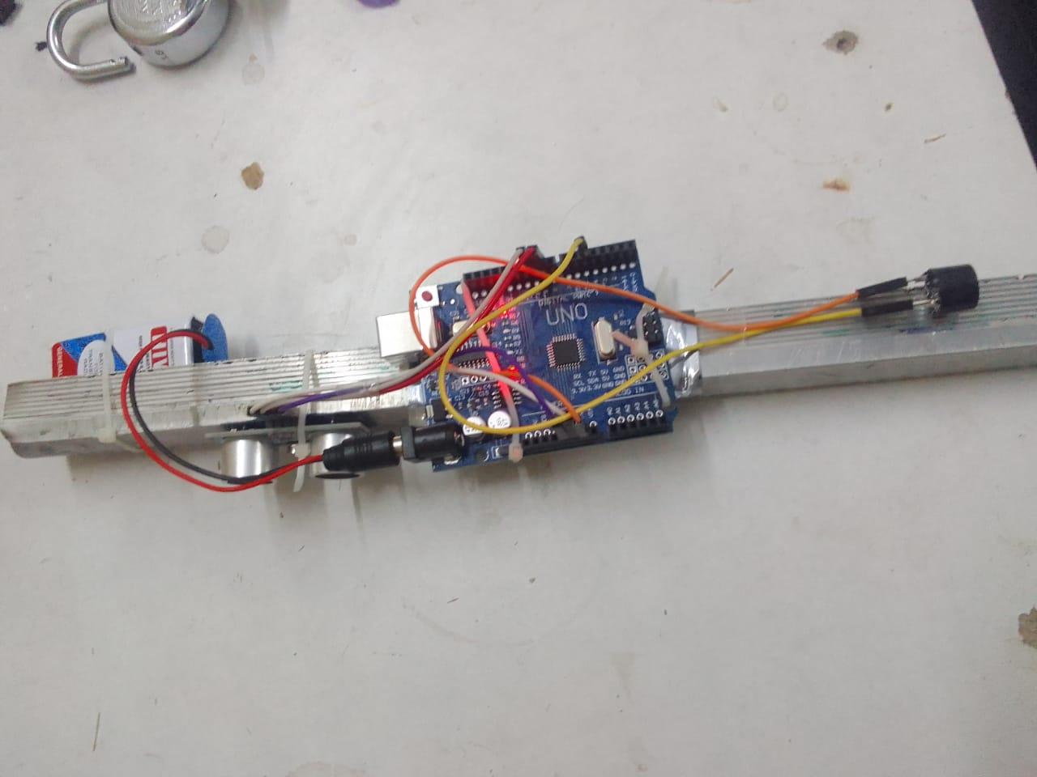
Stick after developent

Slide 11
FUTURE SCOPE
Integration with other technologies: Future versions of the smart stick could be integrated with GPS or navigation apps to help users find specific locations or follow predefined routes. For example, it could guide users to bus stops, shops, or even their homes.
Advanced obstacle detection: the stick could incorporate more advanced sensors, such as ultrasonic or infrared, to detect a wider range of obstacles, including moving objects, and provide more detailed feedback (e.g., Vibration or voice alerts).
Smart features: The addition of voice commands, Bluetooth connectivity, or smartphone integration could allow the user to customize alerts, track routes, or even send emergency notifications to caregivers or family members in case of accidents.
Affordable mass production: As technology advances, the cost of making the smart stick could decrease, allowing it to be produced in large quantities and made available to more people, especially in low-income or developing areas.

Slide 12
Conclusion
The Smart Stick for Blind People is an effective and innovative solution that helps blind individuals move around more safely and independently. By detecting obstacles in real-time and providing immediate audio alerts, it gives users the confidence to navigate different environments. As technology progresses, the stick could be enhanced with additional features like GPS, voice commands, and more accurate sensors, making it even more useful. Overall, this project holds great potential to improve the quality of life for blind individuals and make the world a more accessible place for them.

Slide 13
Thank you

