Slide 1
Amazon Fine Food Reviews
BUAN 6346.501 - BIG DATA PROJECT

Slide 2
Introduction
We are classifying every amazon fine food review in this dataset as either good or bad by performing Sentiment Analysis on the data.
Business Objectives
Generating insights for businesses based on customer feedback
Enable customers to make informed decisions

Slide 3
About Data
Data source - Kaggle
Reviews of fine foods and other products from Amazon
Data span - more than 10 years ( Volume ) - from Oct 1999 - Oct 2012
Includes product and user information, ratings and plain text review

Slide 4
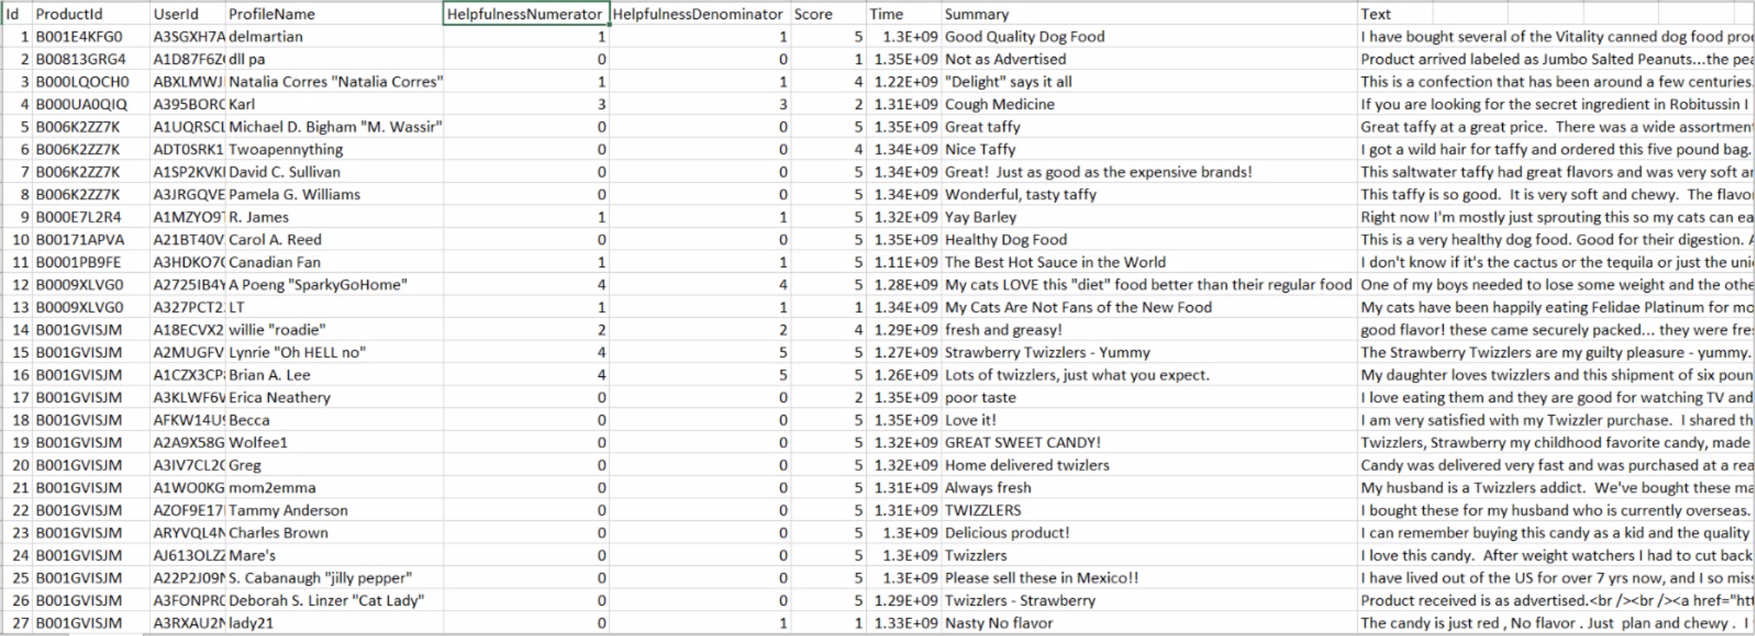
Data Statistics
568,454 - Reviews
256,059 - Users
74,258 - Products
260 users with > 50 reviews
10 Columns

Slide 5
Platform Used - Databricks
Platform in Azure for running Apache Spark
Distributed, general-purpose, cluster-computing framework
Provides in memory data processing capabilities
Used to develop API’s
Allow data workers to execute streaming, Machine Learning, SQL workloads

Slide 6
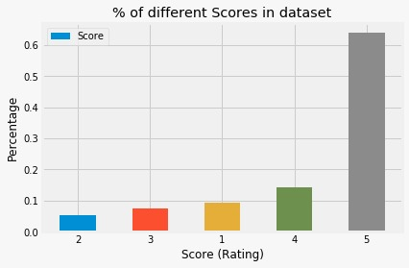
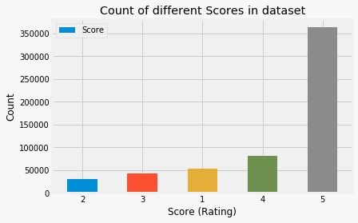
Exploratory Data Analysis (EDA)

Slide 7
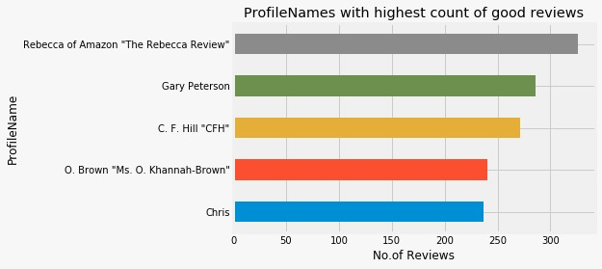
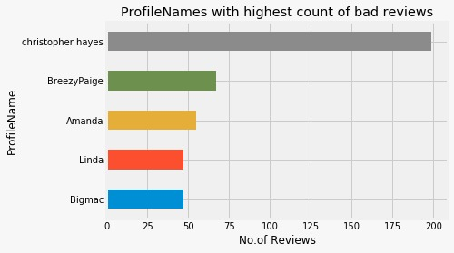
Profiles with highest no.of good or bad reviews

Slide 8
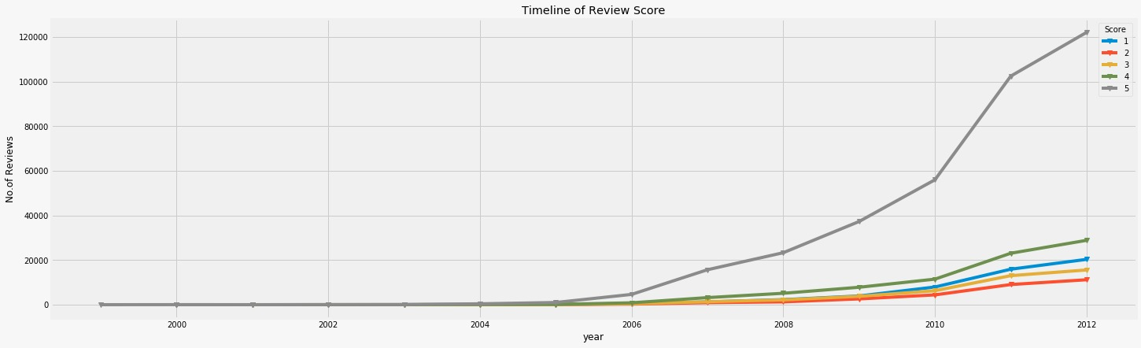
Reviews in each year

Slide 9
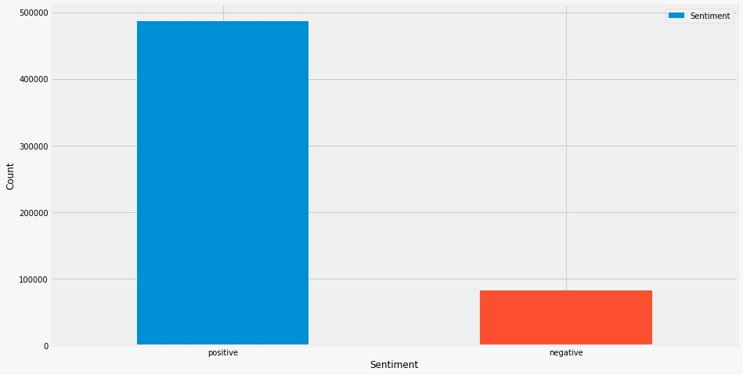
Count of positive & negative reviews
Ratings 3,4,5 are considered as positive and 1,2 as negative

Slide 10
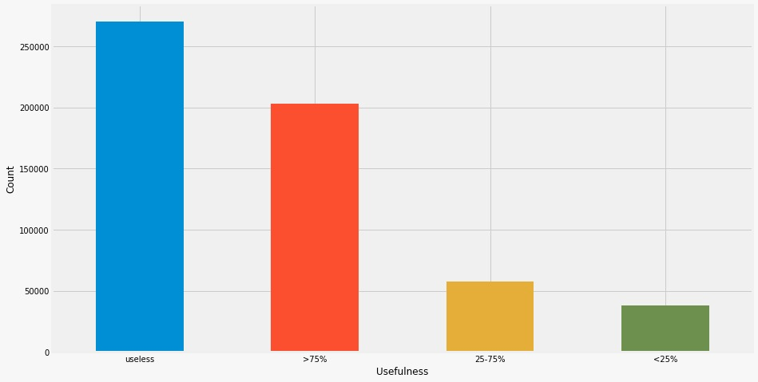
Usefulness of reviews
Categorization based on helpfulness

Slide 11
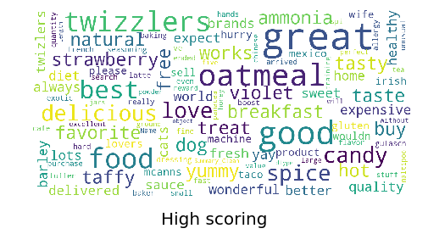
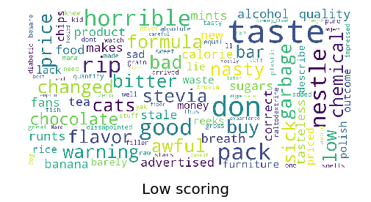
Word Clouds of Positive and Negative reviews after summary cleaning
The Larger the text size, the higher its importance and occurrence
Distinguish between high and low scoring words reviews

Slide 12
Data Cleaning & Text Preprocessing
Discard empty rows and columns
Ordinal to categorical
Stemming
Performed lemmatization
Removing hashes or special characters, Punctuations & Html tags
Removing stop words

Slide 13
Word Counts with CountVectorizer
The CountVectorizer provides a simple way to both tokenize a collection of text documents and build a vocabulary of known words, but also to encode new documents using that vocabulary
The reviews are converted to numpy array containing binary digits
Performed to convert the summary column into numeric vector form

Slide 14
TF - IDF
It’s a way to score importance of words in a document based on frequency of words.
Most common words like “the”, “and”... are scaled down.
Term Frequency is number of times a particular word(W) occurs in a review divided by total number of words (Wr) in review. The term frequency value ranges from 0 to 1.
Inverse Document Frequency is calculated as log(Total Number of Docs(N) / Number of Docs which contains particular word(n)).

Slide 15
Model to predict sentiments
Our project aim is to predict good or bad reviews.
Performed text classification algorithms:
Naive Bayes
Logistic Regression
Support Vector Machine (SVM)

Slide 16
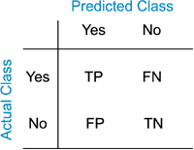
Confusion Matrix
Technique for summarizing the performance of a classification algorithm.
Gives a better idea of what your classification model is getting right and what types of errors it is making.

Slide 17
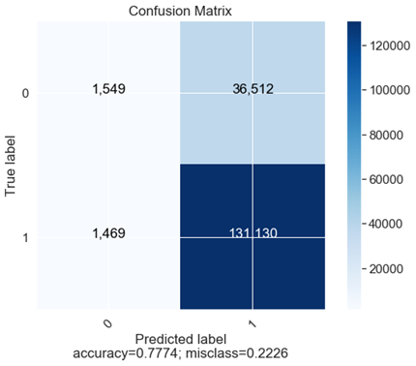
Logistic Regression
Falls under the category of supervised learning
Measures the relationship between the categorical dependent variable and one or more independent variables
Estimates probabilities using a logistic/sigmoid function.
Output is a classification problem which is used to predict a binary outcome (1/0, -1/1, True/False) given a set of independent variables.

Slide 18
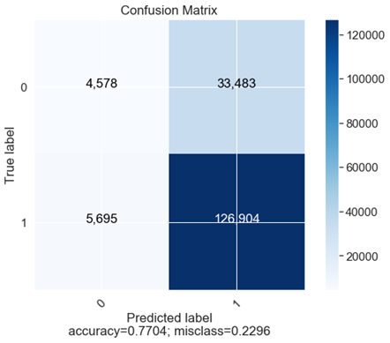
Multinomial Naïve Bayes
Specialized version of Naive Bayes that is designed more for text documents.
Estimates the conditional probability of a particular word given a class as the relative frequency of term t in documents belonging to class(c).
Variation takes into account the number of occurrences of term t in training documents from class (c), including multiple occurrences

Slide 19
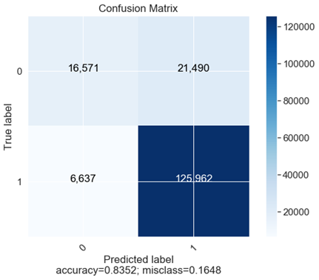
Support Vector Machines
Used for both classification and regression challenges.
In this algorithm, we plot each data item as a point in n-dimensional space with the value of each feature being the value of a particular coordinate.
Then, we perform classification by finding the hyperplane that differentiate the two classes very well.

Slide 20
Models & Accuracy
Conclusion
Support Vector Machine (SVM) | 83.51%
Naive Bayes | 77.04%
Logistic Regression | 77.74%
SVM classifier has highest accuracy with better prediction of an unknown review

