Slide 1
A DELIVERY DATASET WITH NO DELIVERY SIGNAL
20,475 orders across 25 cities · 1 Jan 2023 to 31 Dec 2024
ZOMATO BI · OPERATIONS READOUT
The file records outcomes, not the levers needed for staffing or win-back decisions.
Notes:
This readout reviews 20,475 orders over a two-year window across 25 cities. The central finding is definitive: while outcomes like late delivery and churn are tracked, the dataset lacks the operational levers required to drive staffing or retention decisions.

Slide 2
ORDER TIMING & DISPOSITION
LATE DELIVERY IS COMMON, BUT THE DATA CANNOT SAY WHY
CANCELLED ORDERS
LATE DELIVERIES (>45M)
AVERAGE DURATION
90TH PERCENTILE
22.3%
40.1M
61.0M
24.9%
NO REASON LOGGED
MEAN DURATION
TAIL DURATION
Unrecorded root cause
1 IN 4 COMPLETED
Completed orders
Long-tail delay
Crosses threshold
One in four completed orders is late. City, rain, traffic, and hour do not separate late orders in a way that supports staffing.
02
Notes:
One in four completed orders is late. The file records that it happened. It does not record the lever that would change it.

Slide 3
ARCHITECTURE & GOVERNANCE
ONE PIPELINE KEEPS THREE PLACES ALIGNED
01
02
03
INGESTION & SCORING
TRANSFORMATION & ML
REPORTING & BI
PostgreSQL
Python
Power BI
Receives raw orders directly from operational databases and owns the single restaurant score logic.
Performs cleaning, feature engineering, and both models once, then exports static standardized results.
Reads six pages from Python exports; strictly aggregates without inventing secondary business rules.
Order city strictly means restaurant city. DAX only sums, averages, and calculates rates so dashboards and SQL never drift.
03
Notes:
If Power BI redefined late delivery, the dashboard and SQL would drift apart. This project removes that inconsistency.

Slide 4
RECONCILIATION & AUDIT
EVERY LOGGED QUALITY ISSUE WAS FIXED BEFORE ANALYSIS
AUDIT ITEM | SQL WAREHOUSE | PYTHON PIPELINE | STATUS
Logged quality issues | 100% resolved | 100% resolved | ✓ RESOLVED BEFORE MODELING
Total dataset orders | 20,475 rows | 20,475 rows | ✓ EXACT MATCH
Delivered revenue | ₹52.36 lakh | ₹52.36 lakh | ✓ MATCHES TO THE PAISA
Ambiguous slash dates | 3,222 flagged | Parsed MM/DD | ● DOCUMENTED LIMITATION
Broken distance feature | Unusable | Excluded | ▼ EXCLUDED FROM ALL RUNS
3,222 slash dates were read as month/day. That can nudge one day across a month boundary; it does not create the flat trend.
04
Notes:
3,222 slash dates were read as month/day. That can nudge one day across a month boundary. It does not create the flat trend.

Slide 5
COMMERCIAL PERFORMANCE
REVENUE IS FLAT; KOLKATA LEADS A WIDE FIELD
COMPLETED REVENUE
AOV (ON-TIME VS LATE)
2024 VS 2023 GROWTH
TOP CITY & CUISINE
₹52.36L
₹392
+0.4%
₹2.02L
TOTAL REALIZED
EQUAL ORDER VALUE
FLAT TRAJECTORY
KOLKATA LEADS
Full 2-year period
No price penalty
₹1.60L – ₹2.06L / mo
South Indian ₹3.07L
MONTHLY RANGE & STABILITY
CUISINE CONCENTRATION
Monthly completed revenue stays tightly bounded between ₹1.60 lakh and ₹2.06 lakh across all 24 months, confirming structural stagnation across cohorts.
South Indian cuisine generates ₹3.07 lakh, standing 34% above the tenth-ranked cuisine in a fragmented demand environment across all 25 cities.
There is no growth story and no collapse. Do not reallocate budget toward a fastest-growing city. The series does not support one.
05
Notes:
There is no growth story and no collapse. Do not reallocate budget toward a fastest-growing city. The series does not support one.

Slide 6
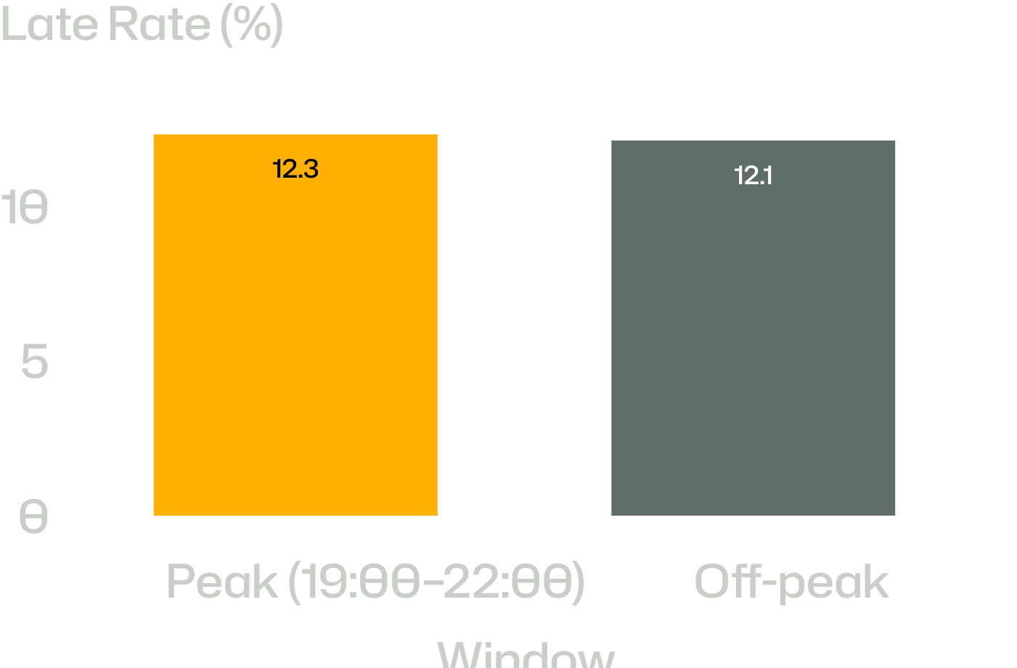
DIURNAL & WEATHER COVARIATES
HOUR 19 IS BUSY, BUT IT IS NOT SLOWER
PEAK ORDER VOLUME SHARE
22.2%
Peak volume accounts for 22.2% of daily orders, yet delivery failure rates remain virtually identical.
Orders between 19:00 and 22:00
TRAFFIC MATCH COVERAGE
5.1%
UNUSABLE FIELD
Matches only 5.1% of valid orders
Busy is not the same as late. City, rain, and traffic tests are not statistically significant. Do not add riders for rain or 7 pm on this evidence.
LATE DELIVERY RATE BY TIME OF DAY (12.3% VS 12.1%)
06
Notes:
Busy is not the same as late. Do not add riders for rain or for 7 pm on this evidence.

Slide 7
REGRESSION BENCHMARKING
THE DELIVERY MODEL IS THE LEAST WEAK, NOT A STAFFING TOOL
EXPLAINED VARIANCE (R²)
ROOT MEAN SQUARED ERROR (RMSE)
−0.0022
9.8 MIN
TARGET: ≥ 0.75 · COMPLETE MISS
TARGET: ≤ 6.0 MIN · MISS
Worse than predicting sample mean duration
Unacceptable error margin for dispatch
FAIR ALGORITHM TOURNAMENT
DATA LEAKAGE PREVENTION
Random Forest outperformed Linear Regression, Decision Tree, and Gradient Boosting under cross-validation, yet still failed production thresholds.
Customer feedback ratings and the uncalibrated distance column were strictly excluded from training to avoid post-hoc bias.
Winning only means it was the least weak of four models. It cannot guide fleet allocation or dispatch.
07
Notes:
Winning only means it was the least weak of four models.

Slide 8
FEATURE IMPORTANCE & SENSITIVITY
NO TESTED FEATURE MOVES DELIVERY TIME
PERMUTATION DELTA
KITCHEN PREP TIME
RAIN EFFECT ON TAIL
0.00X
r ≈ 0.00
EQUAL
MINUTES SHIFT
ZERO CORRELATION
IDENTICAL DURATION
Shuffling features leaves RMSE flat
Prep and transit move independently
Clear and wet delivery bars align
SHUFFLE SENSITIVITY TEST
OPERATIONAL COUPLING
Permuting any single feature in the feature matrix shifts test RMSE by only a few thousandths of a minute, indicating zero actionable predictive signal.
Preparation time and delivery time move together by approximately zero. Delay originates in untracked friction: kitchen handoff, dispatch wait, or local routing.
This is association, and the association was tested and not found. A rain chart with equal bars is not a roster; do not staff rain from this chart.
08
Notes:
This is association, and the association was tested and not found. Do not staff rain from this chart.

Slide 9
CHURN CLASSIFICATION EVALUATION
THE CHURN F1 IS THE BASE RATE, NOT A TARGETING MODEL
OBSERVED BASE RATE
TEST F1 SCORE
DISCRIMINATION (ROC-AUC)
87.4%
0.933
0.514
NATURAL CHURN
BASE RATE ARTIFACT
COIN FLIP = 0.500
No order in 60d post-Nov 1
Identical to majority-class guessing
Near-zero ranking discrimination
TEMPORAL SPLIT DESIGN
THE NAIVE CLASSIFIER TRAP
Features were frozen strictly at 1 November 2024; the target label measures activity across the subsequent 60-day window, preventing future leakage.
A trivial model predicting that 100% of customers churn achieves an F1 of 0.933. The algorithm learned no behavioral drivers beyond prevalence.
The cutoff prevents leakage. A high F1 here is the base rate, not a targeting model.
09
Notes:
The cutoff prevents leakage. A high F1 here is the base rate, not a targeting model.

Slide 10
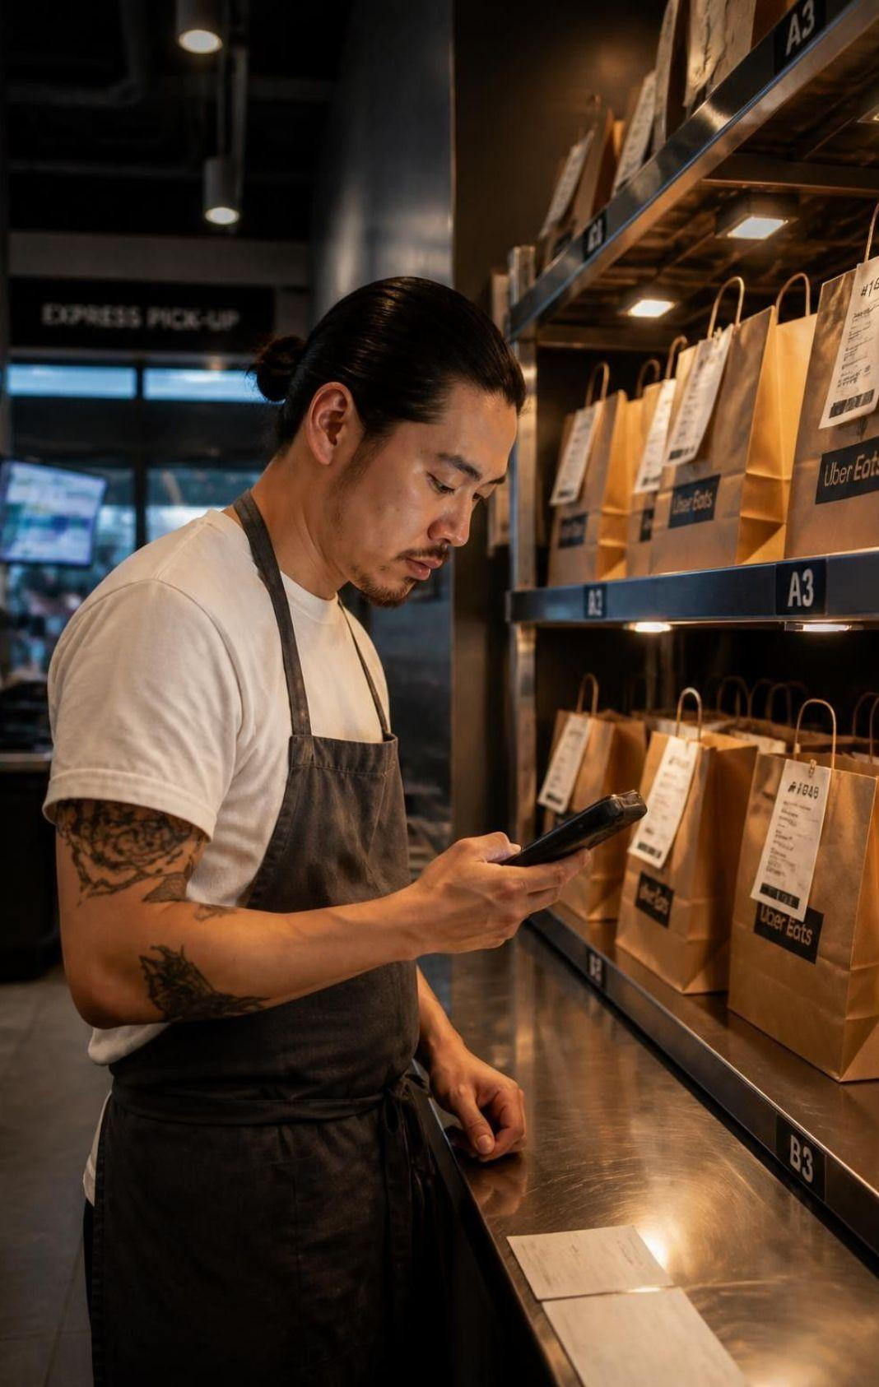
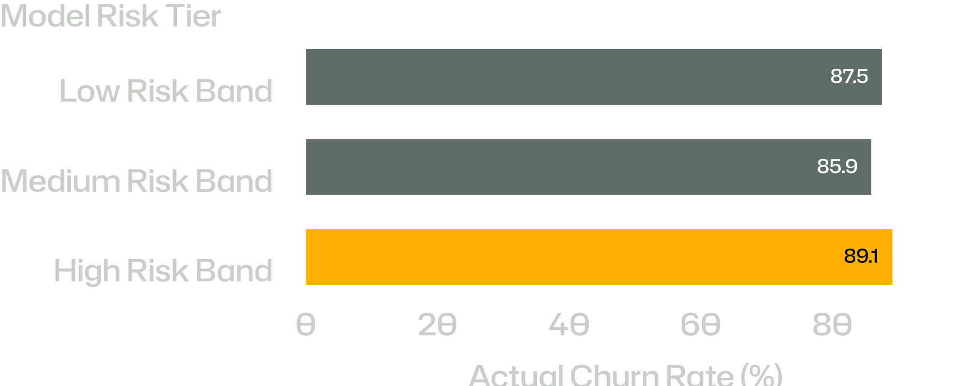
RISK STRATIFICATION AUDIT
RISK BANDS DO NOT SEPARATE CUSTOMERS
ACTUAL ATTRITION BY PREDICTED TIER: 87.5% · 85.9% · 89.1%
FIG 1 · HUB DISPATCH LOG · NOV 2024
The bars are the finding. Do not mail the High band.
Notes:
Low: 87.5% actually churned. Medium: 85.9% actually churned. High: 89.1% actually churned. The bars are the finding. Do not mail the High band.

