Slide 1
EduBridge : Connecting Rural Learners to the future
CSE7101- Capstone Project
Review-1
Batch Number: CSE 241
Under the Supervision of,
Mr. Md Zia Ur Rahman
Assistant Professor
School of Computer Science and Engineering
Presidency University
Roll Number | Student Name
20221CSE0388 | Sakshi Kumari
20221CSE0068 | Bhrigu Gupta
20221CSE0066 | Shreyas S
Name of the Program: Computer Science And Engineering
Name of the HoD: Dr. Asif Mohammed
Name of the Program Project Coordinator: Dr. Jayavadivel Ravi
Name of the School Project Coordinators: Dr. Sampath A K , Dr. Geetha A

Slide 2
Content
Problem Statement
Objectives
Background and Related work for title Selection
Analysis of Problem Statement
Innovation or Novel Contributions
Tech Stack and Methodology
Git-hub Link
Timeline of the Project
References

Slide 3
Problem Statement Number: PSCS_32
Organization: Government of Kerala
Category (Hardware / Software / Both) : Software
Problem Description:
Ideate and implement a system to enhance the quality of education in rural
areas. The aim of the system should not only focus on increasing the literacy
rate but also should assist to elevate the communication skills and knowledge
of the targeted society.

Slide 4
Problem Statement Number: PSCS_32
The System Should Offer / Key Features :
Study materials and mentor access.
Monitoring skill progress
Bridge the digital divide
Provide information about grants, loans and incentives.
Offer connectivity to financially disadvantage patrons.
Help individuals with employment opportunities.
Research and development
Access to material resources

Slide 5
Objectives
Why are we building it?
Improve Quality of Education : Provide accessible , high-quality study materials tailored to the needs of rural learners.
Enhance Communication Skills : Include interactive modules , language training , and mentor-led sessions to boost speaking and presentation skills.
Personalized Skill Monitoring – Track each learner’s progress through analytics and provide targeted improvement plans.
Bridge the Digital Divide – Offer offline access, low-data usage features, and user-friendly interfaces for first-time technology users.
Information Access for Opportunities – Share details about available grants, loans, scholarships, and government incentives.

Slide 6
Objectives
Connect the Financially Disadvantaged – Facilitate internet and device access through CSR partnerships and NGO tie-ups.
Employment and Career Support – Provide job listings, vocational training, and career counseling relevant to rural areas.
Encourage Research & Development – Promote innovation through local problem-solving projects and community-driven initiatives.
Material Resource Sharing – Enable a resource exchange system for books, tools, and educational materials within the community

Slide 7
Background and Related work for Title selection
Why did we choose this Title?
We chose this title because it encapsulates the project’s core vision — to transform rural education by combining academic resources, skill development, and access to opportunities in a single platform. Unlike generic
e-learning tools, this system bridges the digital divide by offering:
Localized, accessible study materials tailored to rural needs.
Mentor access for guidance and doubt-solving.
Skill progress tracking to ensure measurable growth.
Information on grants, loans, and incentives to empower financially disadvantaged learners.
Employment links to connect skilled individuals with job opportunities.
The title is precise, impactful, and solution-oriented, immediately communicating the problem we address and the holistic approach we take making it attractive for educators, policymakers, and CSR sponsors.

Slide 8
Analysis of Problem Statement
Core Problem Identified : Rural areas suffer from low quality of education, despite growing internet penetration. Issues include lack of trained mentors, limited resources, poor communication skills, and lack of awareness about opportunities.
Scope of the Problem : Literacy rate improvement is only one part; the real challenge is employability and communication skills. The target group is students, unemployed youth, and financially disadvantaged individuals. The impact is both social (knowledge growth) and economic (better employment prospects).
Root Causes : Poor access to quality study materials in local languages. Limited mentor guidance to explain concepts beyond textbooks. Lack of tracking systems for skill progress. Digital divide — low awareness of online resources, weak infrastructure, and affordability issues. No structured career and financial support system for rural learners.

Slide 9
Analysis of Problem Statement
Why Existing Solutions Fall Short : Google/YouTube: Unstructured content, no mentor support, and no local customization. Government portals: Often underutilized due to lack of awareness and complexity. EdTech apps: Mostly designed for urban audiences, costly, and require high-speed internet.
Need for a New Approach : An integrated platform that combines study materials, skill tracking, career opportunities, and financial resources. Accessible both online and offline, with mentor-assisted learning.Can be supported by CSR initiatives for funding and sustainability.

Slide 10
Data and Facts supporting the Initiative
Rural Literacy Rate: 73.5% (Latest Census) - lower than 87.7% in urban areas.
Digital Literacy: Only ~35% rural households have internet access (NSO 2020).
School Infrastructure: 56% of govt. schools lack functional computers (UDISE+ 2021).
English Proficiency: Very low in rural students, limiting global communication and job opportunities.
Awareness Gap: Limited knowledge of grants, loans, and skill development programs.
Employment Opportunities: Rural youth face higher unemployment due to skill and connectivity gaps.
Need for Intervention: A platform can bridge education, communication, and employment access.

Slide 11
Research about Similar Initiatives
What are others doing?
Platform | Reach / Stats | Limitations
DIKSHA | Over 524 crore learning sessions, 6,125 crore learning minutes, and 2.9 lakh+ content pieces; serves all 36 states & UTs indiancentury.inWikipedia | Primarily for school curriculum; limited offline mentorship and no career/skill pathway integration.
SWAYAM | ~1.2 crore registrations and 4 crore enrollments across 11,700 courses indiancentury.inWikipedia | Focused on higher education; lacks real-time mentor support and is internet-dependent.
eVidyaloka | Over 1,100 active volunteer teachers delivering virtual lessons in regional languages Wikipedia | Dependent on video conferencing; limited offline access and absence of employment scheme info.

Slide 12
Innovation or Novel Contributions
What are we doing different?
Feature | Existing Platforms | Your Platform
Offline Accessibility | Limited or standalone | Seamless offline + online hybrid support
Mentor Interaction | Rare or virtual only | Personalized mentor chat and guidance
Skill Progress Analytics | Minimal | Robust tracking with action plans
Localized Support & Language | Often monolingual or broad | Multi-regional language support and content
Opportunity Integration | Not included | Fully integrated jobs, schemes, and resource hub
Community & Resource Sharing | Rare | Built-in workflows for mobile libraries & kiosks

Slide 13
Tech Stack and Methodology
Layer | Technology | Reason for Choice
Frontend (Web) | React.js | Fast, responsive UI; can be turned into a PWA for offline use.
Backend | Java (Spring Boot) | Robust, scalable, enterprise-grade backend; great for APIs & microservices.
Database | PostgreSQL / MySQL | Reliable, relational DB for structured education data.
File Storage | AWS S3 / Firebase Storage | Stores PDFs, videos, and offline resources.
AI/ML | TensorFlow Lite (on-device) / OpenAI API | Personalized learning paths & translation in local languages.
Deployment | Vercel (frontend) + AWS EC2 / Render (backend) | Reliable hosting for Java Spring Boot apps.

Slide 14
Github Link
Github Link (Public Access)

Slide 15
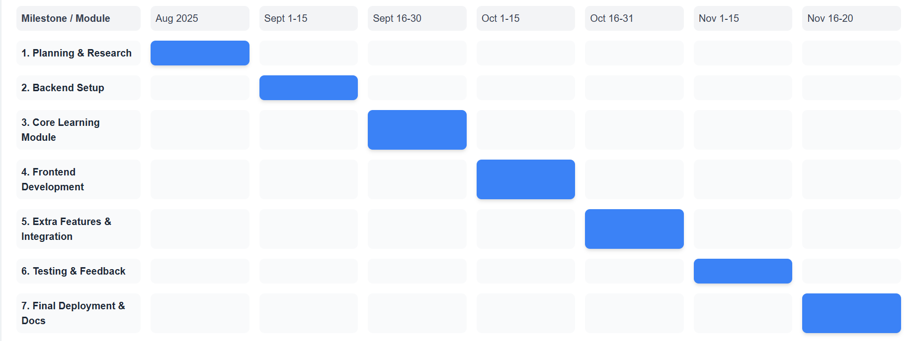
Timeline of the Project (Gantt Chart)

Slide 16
References (IEEE Paper format)
[1]. A. Kumar, B. R. Patel, and C. Zhang, “Plant disease identification using convolutional neural networks,” IEEE Access, vol. 9, pp. 34567–34578, Mar. 2021.
[2]. J. Smith, “Deep learning in agricultural systems,” IEEE Transactions on Neural Networks and Learning Systems, vol. 32, no. 7, pp. 1234–1245, Jul. 2021.

Slide 17


