Slide 1

Student-Record-System
A Comprehensive Web-Based Dashboard for Academic Management
Built with MERN Stack (MongoDB, Express.js, React, Node.js)
| Date: May 07, 2025
by Udit Maltare

Slide 2
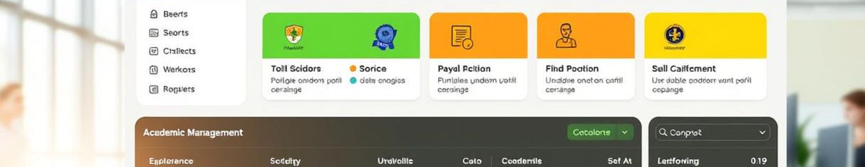
What is the Student Record System?
Web-Based Application
Admin Approval Flow
Built with MERN
A centralized online platform where students can manage and view their academic records anytime, anywhere.
Students must register through the portal, after which their account is subject to admin approval. Once approved, they are notified via email and granted access.
Important updates such as registration approval or changes in academic data are sent via email to keep students informed.

Slide 3
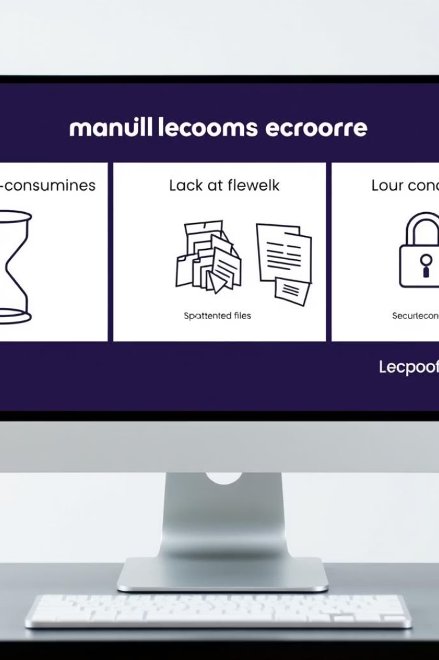
Why Student Record System?
Challenges of Manual Processes
Lack of Centralization
Time-consuming and prone to errors
Difficulty accessing academic details.
Security Needs
Role-based access and administrative oversight required

Slide 4
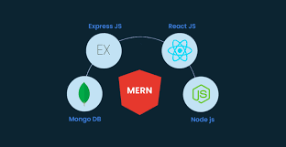
Technology Stack
Frontend
React with Redux for dynamic UI and state control
Backend
Node.js and Express.js powering APIs and logic
Database
MongoDB for flexible, scalable data storage

Slide 5
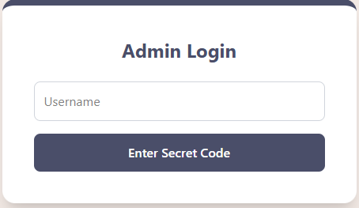
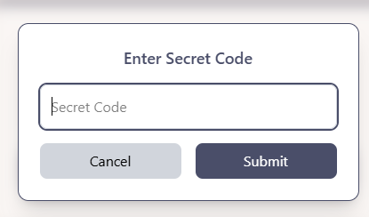
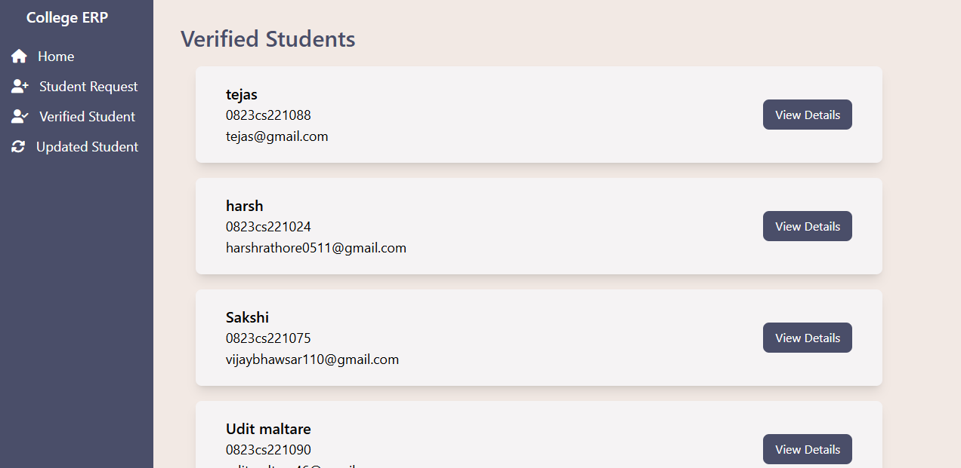
Admin Board

Slide 6
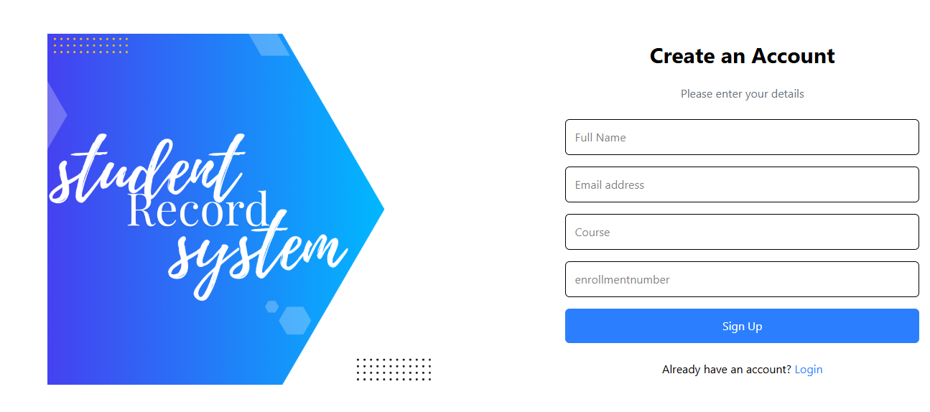
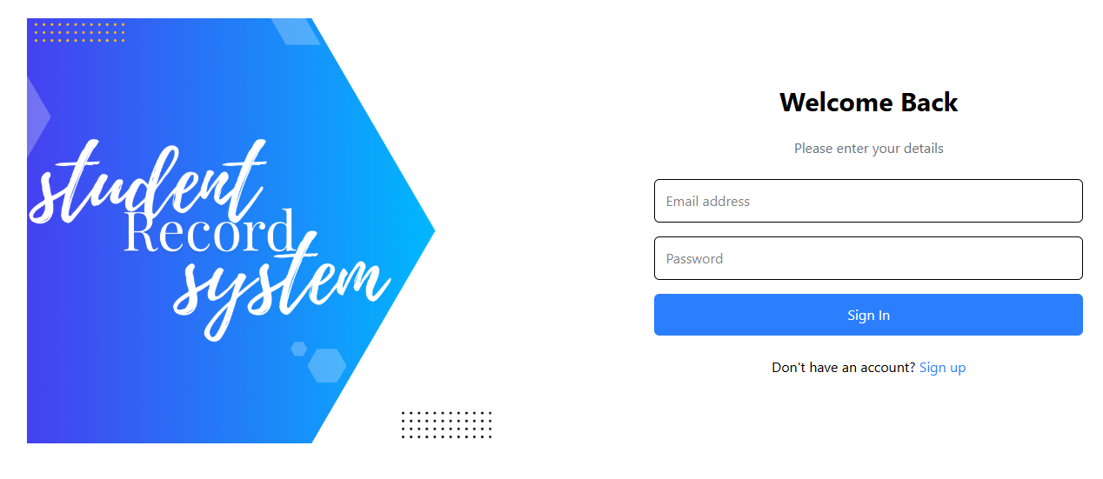
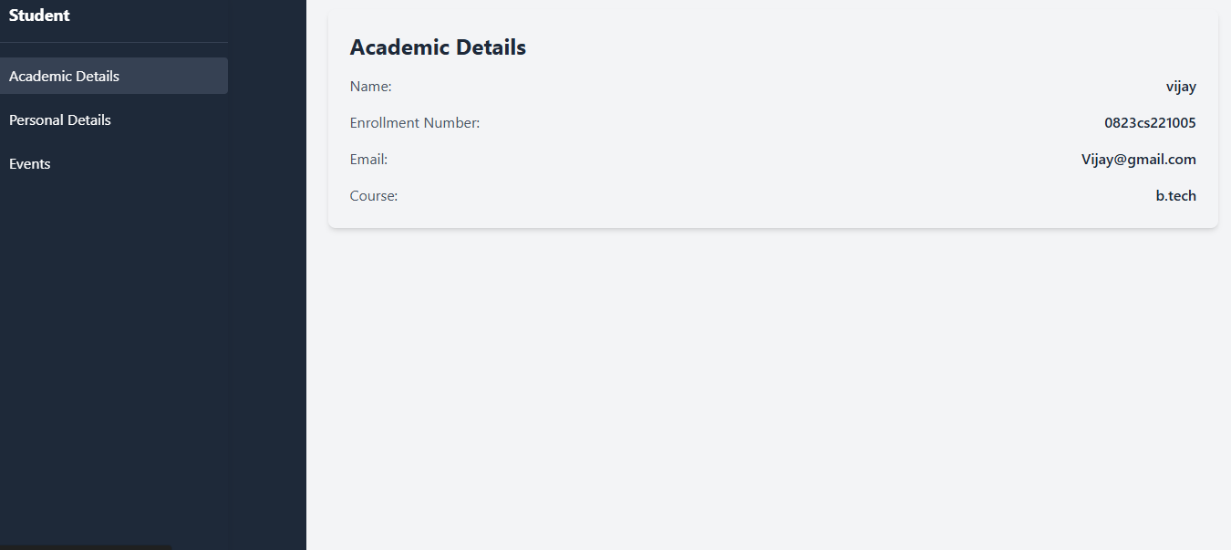
Student Board
Live demo

