Slide 1
ADIDAS US SALES
PERFORMANCE ANALYSIS
Professional Data Analytics & Business Intelligence Presentation
EDA • Excel • Power BI • Tableau

Slide 2
Presentation Overview
• Business objective & analytical approach
• Dataset structure and data-quality assessment
• Key performance indicators
• EDA: trends, retailers, products, regions, cities & sales methods
• Dashboard implementation: Excel, Power BI & Tableau
• Business insights and recommendations
2

Slide 3
Dataset Overview
Records
9,637
Columns
13
Cities
52
Retailers
6
Products
6
Sales Methods
3
CORE FIELDS
• Retailer & retailer ID
• Invoice date
• Region / state / city
• Product
• Price per unit
• Units sold
• Total sales
• Operating profit
• Sales method
3

Slide 4
Data Quality & Preparation
Missing values
0 across 13 columns
Clean
Duplicate rows
0
Clean
Data types
6 numeric + 7 object fields
Consistent
Date preparation
invoice_date converted to datetime
Ready for time analysis
Geographic coverage
52 unique cities
Broad coverage
4

Slide 5
Executive KPI Snapshot
Total Orders
9,637
Total Units
2,475,611
Total Sales
119,996,275
Operating Profit
33,158,084
Profit Margin
27.63%
WHAT THE KPIS TELL US
• Sales scale is approximately 120M across the analyzed transactions.
• Operating profit is approximately 33.2M, with a reported dashboard margin of 27.63%.
• The dataset records more than 2.47M units sold and 9.6K orders.
• The KPI layer provides the executive starting point for deeper segment analysis.
5

Slide 6
Monthly Sales Trend
TREND INTERPRETATION
• Sales fluctuate meaningfully across the year.
• July is the strongest displayed month at roughly 12.28M.
• September–October show a noticeable slowdown.
• Sales recover toward December, ending near 11.39M.
6

Slide 7
Retailer Performance
BUSINESS READING
• Foot Locker has the largest record count (2,630).
• West Gear has 2,372 records and is the strongest sales contributor in the dashboard view.
• Sports Direct follows with 2,030 records.
• Record count and sales value are different measures and should be interpreted separately.
7

Slide 8
Product Performance
KEY FINDING
• All six product categories have very similar record volumes.
• The dashboard shows Men's Street Footwear as the leading category by sales value.
• This indicates that sales differences are not simply caused by one category having far more transactions.
• Product decisions should consider both sales and operating profit.
8

Slide 9
Regional & City Performance
TOP-CITY VIEW
• New York — leading displayed city at ~5.76M sales
• Charleston — among the next strongest cities
• San Francisco — strong contributor
• Portland — strong contributor
• Orlando — strong contributor
REGIONAL TAKEAWAY
• West contributes the largest displayed share at 30.29%.
• The Northeast is the second-largest region at 20.90%.
9

Slide 10
Sales Method Mix
CHANNEL INSIGHT
• In-store is the largest sales method at 37.47%.
• Outlet contributes 32.81%.
• Online contributes 29.72%.
• The mix is relatively balanced, so an omnichannel strategy remains important.
10

Slide 11
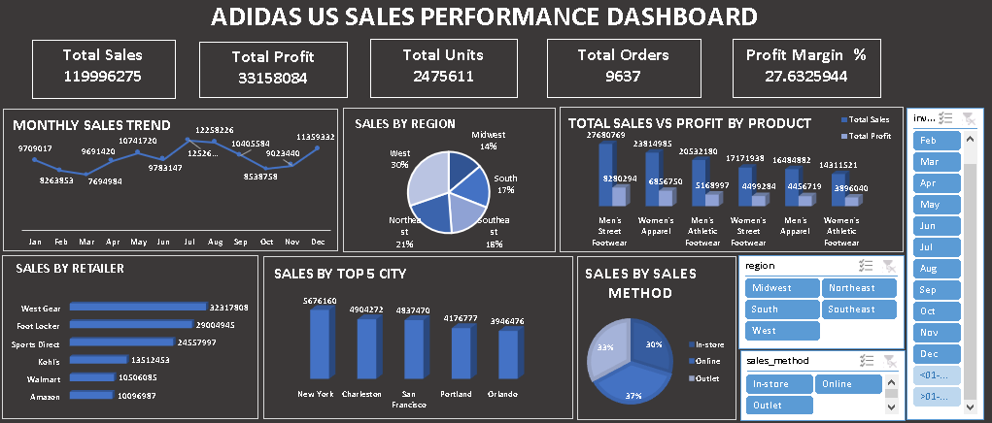
Excel Dashboard
11

Slide 12
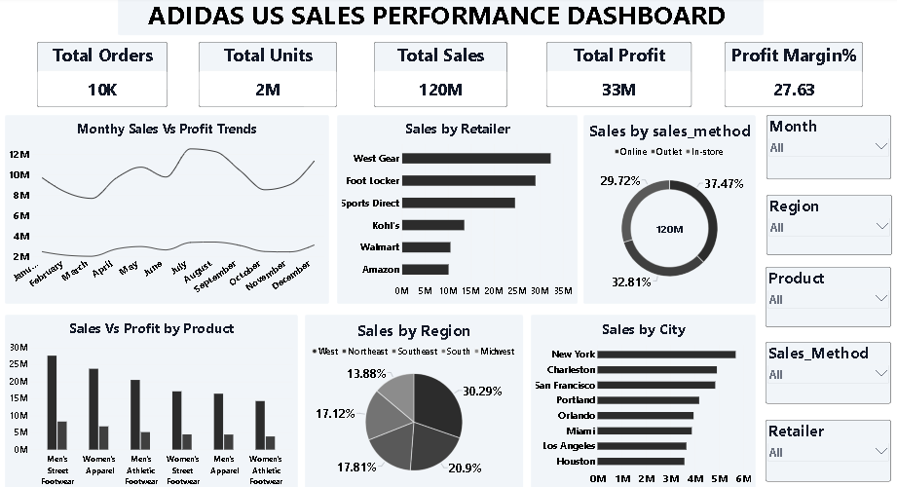
Power BI Dashboard
12

Slide 13
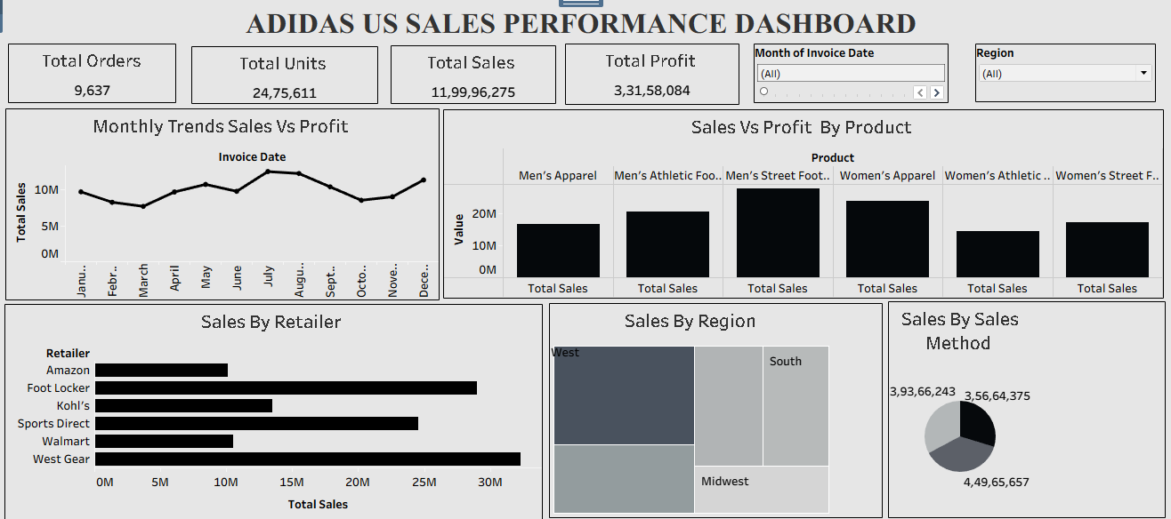
Tableau Dashboard
13

Slide 14
Key Business Insights
West-led performance
West is the largest regional contributor in the Tableau view (30.29%).
Retailer concentration
West Gear and Foot Locker occupy the strongest sales positions in the dashboard story.
Product opportunity
Men's Street Footwear is the leading displayed product category by sales.
Balanced channels
In-store leads, but Outlet and Online remain substantial contributors.
City concentration
New York is the leading displayed city, with several other major cities contributing strongly.
Profit alongside sales
Product-level sales vs operating-profit views support more balanced decisions than sales-only ranking.
14

Slide 15
Recommendations
• Prioritize inventory and promotional planning for high-sales product categories, especially Men's Street Footwear.
• Develop retailer-specific strategies for West Gear and Foot Locker.
• Protect the West region's performance while investigating the drivers behind its stronger contribution.
• Maintain a balanced omnichannel strategy across In-store, Outlet and Online.
• Use city-level performance to localize inventory and marketing decisions.
• Track operating profit and margin alongside sales for every major segment.
• Extend the dashboard with YoY growth, average order value, segment-level margin and channel profitability where supported by the source data.
15

Slide 16
CONCLUSION
The Adidas US sales analysis provides a clear, multi-dimensional view of performance across time, products, retailers, geography and sales methods. The source EDA reports a clean dataset with no missing values or duplicate rows, while the BI dashboards translate the analysis into decision-ready visuals.
The combined view highlights strong performance in the West, important contributions from leading retailers, Men's Street Footwear as a key product, and a relatively balanced sales-method mix.
DATA → INSIGHT → ACTION
16

