Slide 1
PIZZA SALES
DATA ANALYTICS PROJECT
EDA • Excel • Power BI • Tableau
RECORDS
48,620
REVENUE
817.86K
ORDERS
21,350
PIZZA NAMES
32

Slide 2
Presentation Overview
• Project background and objectives
• Dataset structure and data quality
• Exploratory Data Analysis (EDA)
• Excel dashboard and findings
• Power BI dashboard and findings
• Tableau dashboard and findings
• Cross-platform comparison
• Key insights, recommendations and conclusion

Slide 3
1. Dataset Overview
ROWS
48,620
COLUMNS
13
PIZZA NAMES
32
DUPLICATES
0
Important fields
Data quality
• order_id — order-level analysis
• quantity — pizzas sold
• order_date / order_time — time analysis
• unit_price / total_price — revenue analysis
• pizza_size / pizza_category — segmentation
• pizza_name — product performance
• No missing values reported in the EDA notebook
• No duplicate rows reported
• order_date converted to datetime
• Hour extracted from order_time for hourly analysis

Slide 4
2. Exploratory Data Analysis (EDA)
EDA workflow
Core EDA visuals
• Monthly Sales Trend — line chart
• Orders by Day — bar chart
• Orders by Hour — line chart
• Revenue by Category — pie chart
• Revenue by Pizza Size — bar chart
• Top Pizza Products — ranking chart
• Correlation Heatmap — numeric relationships
• Load and inspect the dataset
• Check shape, data types and descriptive statistics
• Validate missing values and duplicates
• Create grouped summaries
• Analyze category, size, time and product performance
• Build visualizations for business interpretation

Slide 5
3. EDA Findings
Orders by day
Descriptive statistics
• Friday: 8,106 sales-line records
• Saturday: 7,355
• Thursday: 7,323
• Sunday: 5,917 — lowest among the seven days
• Average quantity: 1.02
• Average unit price: 16.49
• Average line revenue: 16.82
• Quantity ranges from 1 to 4
• Unit price ranges from 9.75 to 35.95
Category distribution
• Classic: 14,579
• Supreme: 11,777
• Veggie: 11,449
• Chicken: 10,815
EDA establishes a clean, analysis-ready dataset.

Slide 6
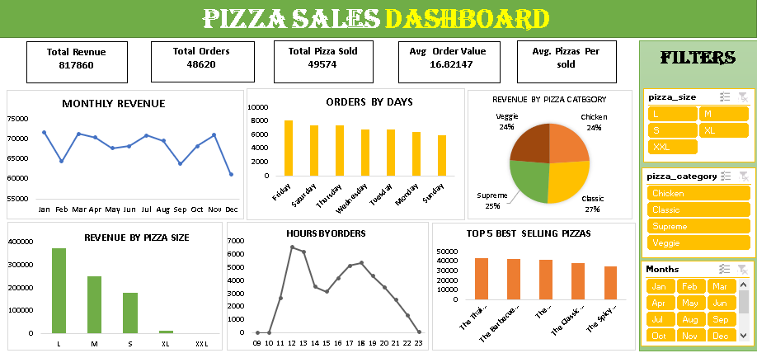
4. Excel Dashboard
Spreadsheet-based dashboard with slicers and KPI cards
Dashboard features
• Total Revenue, Total Orders and Total Pizza Sold KPIs
• Monthly Revenue trend
• Orders by Days
• Revenue by Pizza Category
• Revenue by Pizza Size
• Hours by Orders
• Top 5 Best Selling Pizzas
• Filters for size, category and months

Slide 7
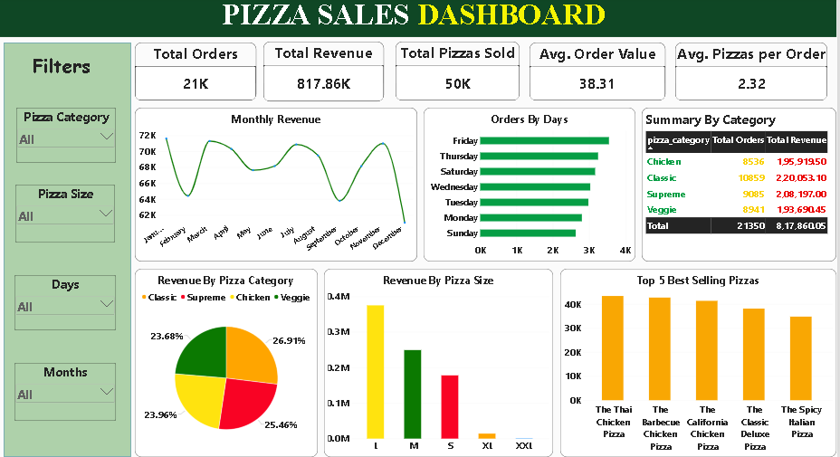
5. Power BI Dashboard
Interactive business intelligence view
Key KPI cards
ORDERS
21K
REVENUE
817.86K
PIZZAS
50K
AOV
38.31

Slide 8
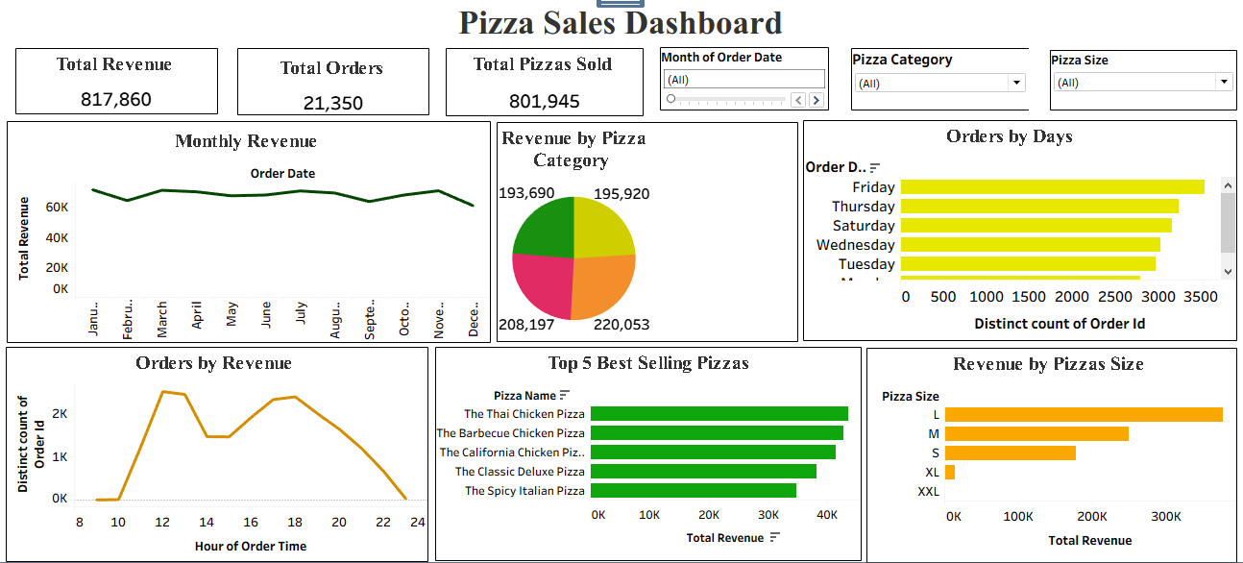
6. Tableau Dashboard
Visual analytics and comparative storytelling
Key views
• Monthly Revenue
• Orders by Days
• Revenue by Pizza Category
• Orders by Revenue / hourly pattern
• Top 5 Best Selling Pizzas
• Revenue by Pizza Size
Presentation value
• Clean visual storytelling
• Strong comparative views
• Suitable for analytical presentations

Slide 9
7. Excel vs Power BI vs Tableau
Area
Excel
Power BI
Tableau
Ease for beginners
Excellent
High
Moderate–High
Interactive filters
Strong
Strong
Good
KPI presentation
Clear
Excellent
Clear
Business reporting
Good
Excellent
Excellent
Visual storytelling
Good
Very Good
Excellent
Best role in project
Spreadsheet dashboard
Primary BI dashboard
Visual analytics
Recommended: present Power BI as the primary business dashboard, supported by EDA, Excel and Tableau.

Slide 10
8. Key Business Insights
• Total revenue is approximately 817.86K across the project dashboards.
• 21,350 distinct orders are reported in the Power BI and Tableau dashboards.
• Friday is the strongest ordering day; Sunday is the weakest.
• Classic is the largest category by sales-line count in the EDA output.
• Large (L) pizzas are the dominant revenue-producing size in the supplied dashboard views.
• Top product views repeatedly feature Thai Chicken, Barbecue Chicken, California Chicken, Classic Deluxe and Spicy Italian pizzas.
• Monthly and hourly views show variation in demand, supporting time-based staffing and promotion decisions.

Slide 11
9. Recommendations
Business recommendations
Project-quality recommendations
• Plan staffing and preparation around high-demand periods.
• Use targeted promotions to improve weaker days such as Sunday.
• Feature high-performing pizzas in combos and promotional placements.
• Use size-level revenue for inventory and ingredient planning.
• Review category and product trends monthly.
• Standardize KPI formulas across all tools.
• Document whether 'orders' means rows or DISTINCTCOUNT(order_id).
• Use SUM(quantity) for Total Pizzas Sold.
• Reconcile dashboard values before final presentation.
• Keep a consistent visual theme across platforms.

Slide 12
10. KPI Standardization
Recommended definitions
Why this matters
• Total Revenue = SUM(total_price)
• Total Orders = DISTINCTCOUNT(order_id)
• Total Pizzas Sold = SUM(quantity)
• Average Order Value = Total Revenue / Total Orders
• Average Pizzas per Order = Total Pizzas Sold / Total Orders
• The supplied screenshots show some different KPI values/labels.
• A single dataset should produce consistent metrics when the definitions are the same.
• The Tableau screenshot shows a Total Pizzas Sold value that should be validated against the EDA/Excel/Power BI measure.
• State the exact formula under each KPI in the final project.

Slide 13
11. Conclusion
EDA
Data understanding
EXCEL
Spreadsheet BI
POWER BI
Business dashboard
TABLEAU
Visual analytics
The project demonstrates an end-to-end analytics workflow:
Raw sales data → EDA → KPI development → Dashboarding → Business insights
Together, the four components demonstrate technical analysis, visualization and business intelligence skills.
THANK YOU

