Slide 1
The Learning Revolution:
How Our Data-Driven Approach is Reshaping Education 🚀

Slide 2
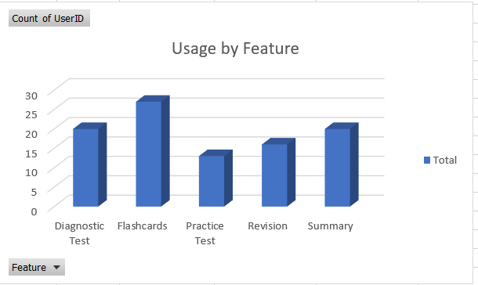
Flashcards are our most used feature, indicating that students prefer quick, accessible tools for review and retention.

Slide 3
Coaching Class Benefits
Targeted Learning: By helping students pinpoint their areas of weakness, our diagnostic tests enable them to concentrate their study time on the most important topics.
Effective Retention: Flashcards and other features encourage regular, active recall, which has been shown to enhance long-term memory and test scores.
Structured Success: Our classes help students feel less stressed and more confident by providing a clear learning path and essential features that make difficult subjects easier to understand.

