Slide 1

OLA Data Analyst Project
Power BI Dashboard | SQL Analysis | Python Data Import
Sakshi Chavan
June 2025

Slide 2
Project Overview
Goal: Analyze 1,00,000+ OLA ride bookings for Bengaluru.
Tools Used:
• SQL (MySQL Workbench)
• Power BI (DAX, Power Query)
• Python (Data Import)
• Excel/CSV (Mock Data)

Slide 3
Step-by-Step Process
1. Imported data into MySQL using Python
2. Explored data using 20 SQL queries
3. Loaded dataset into Power BI
4. Cleaned data using Power Query
5. Built DAX measures for KPIs
6. Created visual dashboards
7. Published project on GitHub

Slide 4
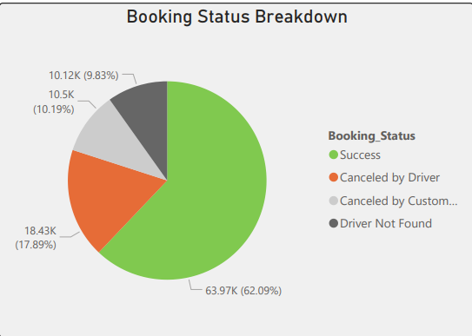
Data Summary
• Total Bookings: 1,03,024
• Success Rate: 62.09%
• Cancelled by Drivers: 17.89%
• Cancelled by Customers: 9.83%
• Driver Not Found: 10.19%
• Total Booking Value: ₹35.08 Million

Slide 5
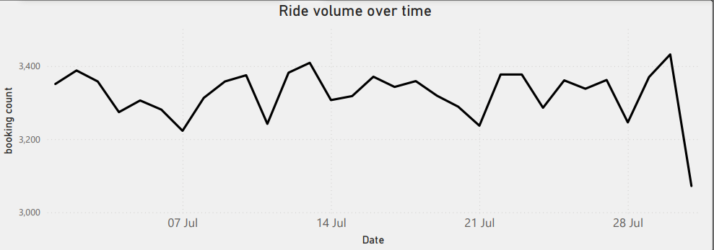
Booking Trends & Volume
• Booking Volume Over Time (by Date)
• Peak bookings on weekends and match days
• Stable volume across month with notable spikes

Slide 6
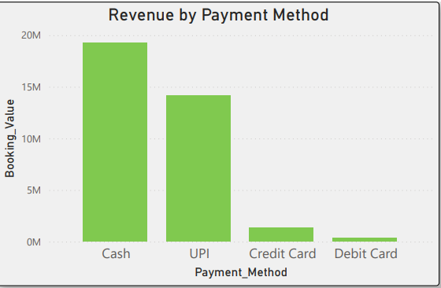
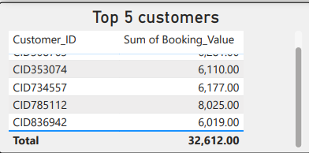
Revenue Insights
• Revenue by Payment Method:
- Highest: UPI & Cash
- Lowest: Debit Card
• Top 5 Customers by Booking Value:
- CID785112 – ₹8,025
- CID308763 – ₹6,281

Slide 7
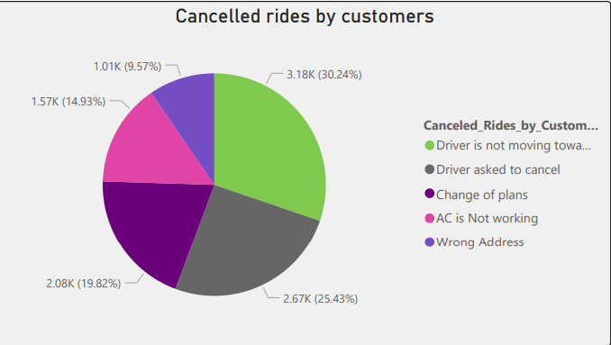
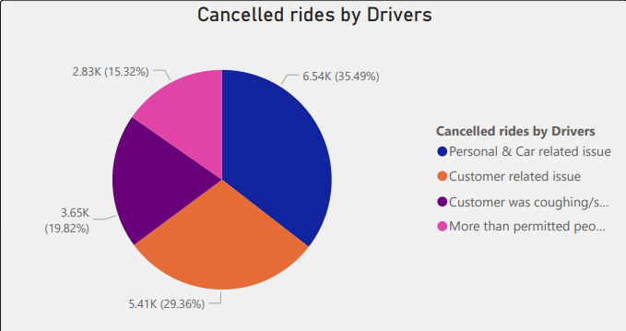
Cancellation Analysis
• Customer Cancellation Reasons:
1. Driver not moving – 30.24%
2. Driver asked to cancel – 25.43%
3. Change of plans – 19.82%
• Driver Cancellation Reasons:
1. Personal/Car Issues – 35.49%
2. Customer Issues – 29.36%

Slide 8
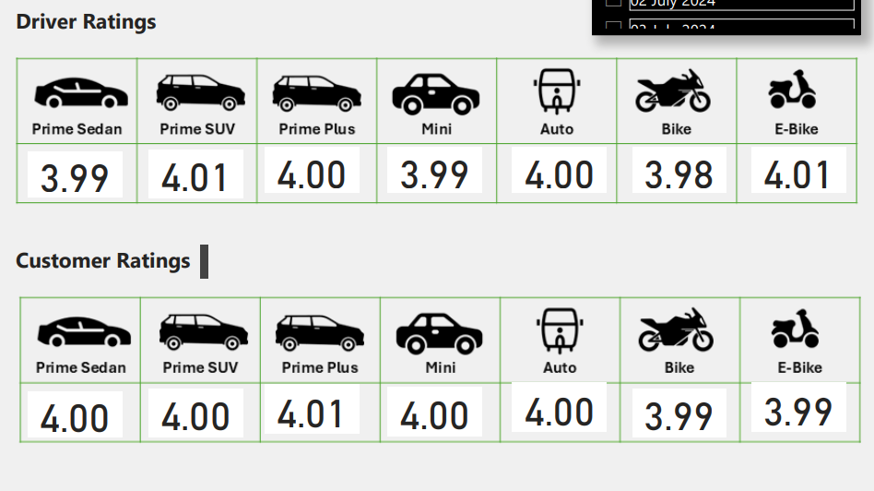
Ratings & Feedback
• Average Driver Rating: ~4.00
• Average Customer Rating: ~3.99
• Ratings remained consistent throughout the month
• Indicates stable service quality

Slide 9
Key Insights
• 62% of bookings succeeded
• ~28% were cancelled (driver or customer)
• Highest revenue from UPI and Cash
• Cancellations mainly due to personal/car issues
• Ratings remained around 4.0 for both parties

Slide 10
Project Links & Contact
📂 GitHub Repository:
https://github.com/sakshichavan290/Ola_data_analyst_project
📩 sakshichavan290@gmail.com
🌐 linkedin.com/in/[your-profile]
Thank you!

