Slide 1
GENERATIVE AI
Title
Generation of Audio and detailed Summery Report of Forecasted Load
Mentor:- Prof. Rakhee Kallimani
NAME | USN
Ashmith Shet | 02FE21BEE009
Ashwini H Byakod | 02FE22BEE004
Shreesakshi Gacchi | 02FE22BEE034
Vaishnavi Amasi | 02FE22BEE052

Slide 2
INTRODUCTION: In recent years, the growing integration of renewable energy sources like solar and wind into the power grid has introduced new challenges in balancing energy supply and demand. Accurate load forecasting has become essential for ensuring grid stability, reducing operational costs, and enhancing energy efficiency. Traditional forecasting methods often struggle to capture the nonlinear and dynamic patterns inherent in electrical load data. To address this, our project leverages Long Short-Term Memory (LSTM), a powerful deep learning model well-suited for time-series prediction. By utilizing historical data including voltage, current, solar power, wind power, temperature, and humidity, the LSTM model is trained to predict the energy load for the next 24 hours. This approach not only improves forecasting accuracy but also supports smarter decision-making in energy management systems.

Slide 3
PROBLEM STATEMENT:- Accurate short-term load forecasting is crucial for efficient power grid management, especially with the variability introduced by weather and renewable sources. However, traditional forecasts are often hard to interpret for non-technical users. This project develops a Generative AI-based 24-hour load forecasting system that uses LSTM models to predict future electrical loads based on real-time inputs like voltage, current, solar/wind power, temperature, and humidity. It uniquely presents the forecast through: 1. A voice-narrated video, 2.A story-style summary, 3. And a structured load table, making complex data more understandable and actionable for a broader audience.

Slide 4
LITERATURE SURVEY:-
LITERATURE SURVEY : 1
Title | Zero-shot Load Forecasting Using Large Language Models in Integrated Energy Systems
Objective | Enable accurate load forecasting without historical data (zero-shot). Use LLMs to improve prediction transferability across households. Bridge time series data and text via prompt generation. Validate on real-world solar household data.
Methodology | Preprocessing: Clean, interpolate, and normalize energy data. Prompt Generation: Convert time series into text using multi-task learning and similarity alignment. Forecasting: Use a pre-trained LLM (like GPT-2) to predict future load; reconstruct outputs back to time series.

Slide 5
LITERATURE SURVEY : 2
Title | Energy Forecasting with Language Models*
Objective | Use language models to predict energy load. - Improve accuracy and ease of use compared to traditional methods..
Methodology | Convert energy data into sentences. Fine-tune language models (e.g., BART, Pegasus). - Predict future load using autoregressive generation.

Slide 6
LITERATURE SURVEY : 3
Table | Synthetic Multi-Resolution Load Data Generation*
Objective | Generate realistic, synthetic time-series load data at various resolutions. -Address data scarcity for power system research.
Methodology | - Use GANs, cGANs, and PCA models trained on 70 TB of PMU data. - Create load profiles at multiple time-scales (seconds to years). - Combine and resample data via the LoadGAN open-source tool.

Slide 7
LITERATURE SURVEY : 4
Table | Probabilistic Net Load Forecasting for High-Penetration RES Grids Using ECDM*
Objective | Forecast day-ahead net load with uncertainty quantification. Improve accuracy and diversity using an enhanced diffusion model with cross-attention. - Extend forecasting to load, RES, and net load together.
Methodology | Train a conditional diffusion model with historical load, weather, and calendar data. Apply weekly data arrangement and adaptive KDE for scenario generation. - Validate on real-world datasets against leading models.

Slide 8
LITERATURE SURVEY : 5
Table | Generative Modeling and Data Augmentation for Power System Production Simulation*
Objective | Enhance load forecasting accuracy under small datasets using generative models. Apply data augmentation with *TS-Diffusion* and *TimeGAN*. - Improve power system simulation through better forecast inputs..
Methodology | - Augment a small real-world load dataset using TS-Diffusion and TimeGAN models. - Train machine learning regressors (ExtraTree, Random Forest, CatBoost, XGBoost) on augmented data. - Compare forecast performance with RMSE and MAE. - Use forecasts in a cost-optimization power system simulation combining grid and PV energy.

Slide 9
OBJECTIVES
Predict next 24-hour electrical load accurately.
Accept user input for energy & weather parameters.
Generate:
1. Load forecast video
2. Voice summary (MP3)
3. Story-style text summary
4. Tabular results
Make it interactive and user-friendly.

Slide 10
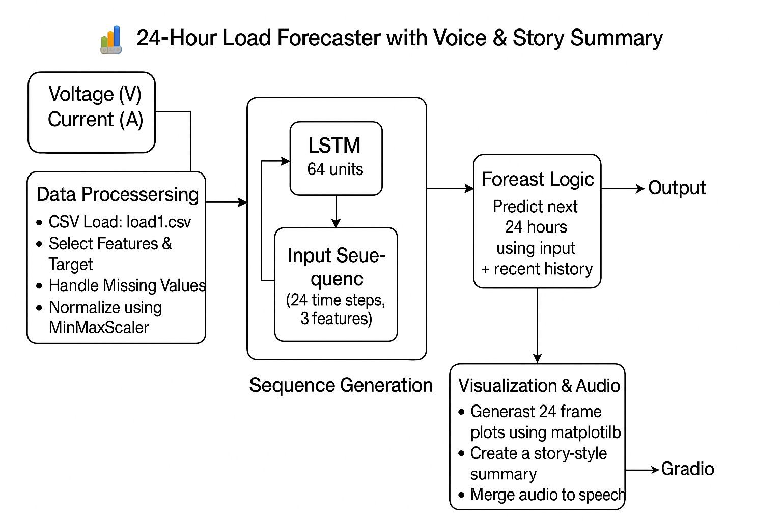
SYSTEM ARCHITECTURE

Slide 11
TOOLS &TECHNOLOGIES
Model: LSTM (TensorFlow + Keras)
Frontend: Gradio
Voice Gen: gTTS (Google Text-to-Speech)
Video Creation: MoviePy
Deployment: Hugging Face Spaces
Languages: Python, Markdown

Slide 12
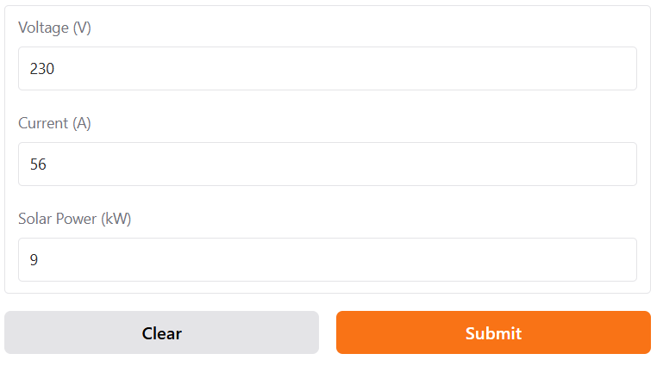
OUTCOME AND RESULTS

Slide 13
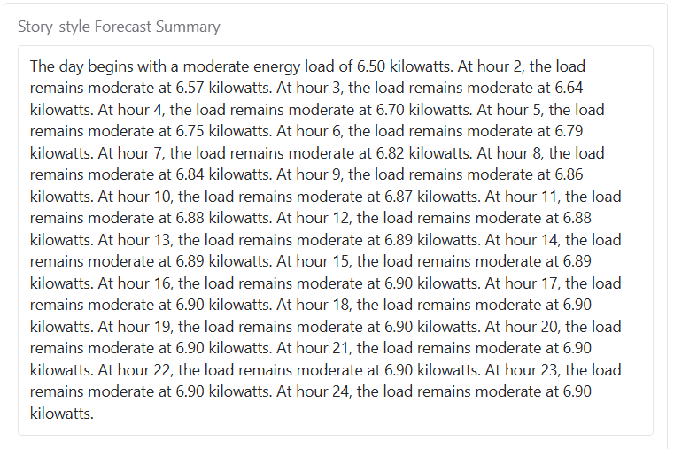
OUTCOME AND RESULTS

Slide 14
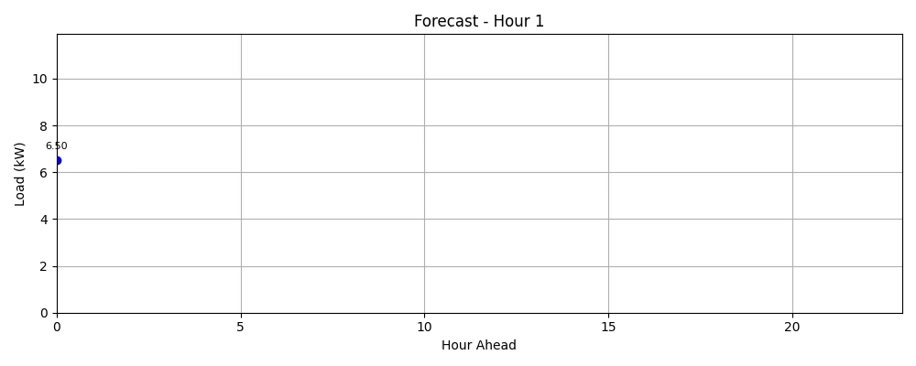
OUTCOME AND RESULTS

Slide 15
CONCLUSION
The 24-Hour Load Forecaster with Voice and Story Summary effectively bridges the gap between complex data analytics and user-friendly communication. By integrating LSTM-based forecasting with generative AI tools like gTTS and MoviePy, the system transforms raw input data into meaningful predictions accompanied by a human-like voice summary and a story-style explanation. This not only makes energy forecasting more accessible to non-technical users but also enhances understanding through audio-visual aids. The tool is especially valuable for smart grid planning, energy management, and educational purposes, and its scalable design allows for adaptation to other time-series applications beyond electrical load forecasting.

Slide 16
THANK YOU

