Slide 1
Topic: Generation of X.509 V3 Digital Certificates using RSA for email applications
INDUSTRIAL INTERNSHIP PRESENTATION
Sakshi Ganeriwal 12BCE1054

Slide 2
Internship Details
Internship in SETS (Society of Eletronic Transaction and Security), Taramani Chennai
Duration: 1st June 2014- 7th July 2014
Mentor: Mr. Kunal Abhishek, Senior Research Associate

Slide 3
What is this project about?
A security and authentication system for SETS – Society for Electronic Transactions and security using RSA algorithm.

Slide 4
What we did?
Study of RSA
Basic study of x.509 certificates
Study of basic OpenSSL
Implementation of RSA algorithm
Building the system using OpenSSL, PHP

Slide 5
Phases of our Project
first phase
We understood the basic theoretical concepts of cryptography.
We implemented, the RSA algorithm, an encryption algorithm used for generating digital certificates using C++ and JAVA.

Slide 6
second phase
we developed a digital certificate generation application with PHP and OpenSSL tools. The certificate authority manages the server and maintains a database of his/her clients who have applied for a digital certificate. Similarly, the clients have their own online secure portals through which they either generate their self-signed certificate or request for one from the certificate authority.
For a self-signed certificate, the user needs to download the executable batch file provided to him on his portal, which enables him to generate his own certificate.
For a CA-signed certificate, the client first downloads the executable batch file provided to him on his portal, which enables him to generate certificate signing request and sends it to the CA. The certificate authority sends the digital certificate to the client’s mail-box. The CA and the clients are connected through http server-client sessions.

Slide 7
Cryptography
Why do we need it?
Encryption System
Private Key Encryption System
Public Key Encryption System
Need for Digital Certificate.

Slide 8
Private-Key Cryptography
traditional private/secret/single key cryptography uses one key
Key is shared by both sender and receiver
if the key is disclosed communications are compromised
also known as symmetric, both parties are equal
hence does not protect sender from receiver forging a message & claiming is sent by sender

Slide 9
Public-Key Cryptography
uses two keys
– a public key
– a private key
asymmetric since parties are not equal
uses clever application of number theory concepts to function
complements rather than replaces private key cryptography

Slide 10
Public-Key Cryptography
public-key/two-key/asymmetric cryptography involves the use of two keys:
a public-key, which may be known by anybody, and can be used to encrypt messages, and verify signatures
a private-key, known only to the recipient, used to decrypt messages, and sign (create) signatures
is asymmetric because
those who encrypt messages or verify signatures cannot decrypt messages or create signatures

Slide 11
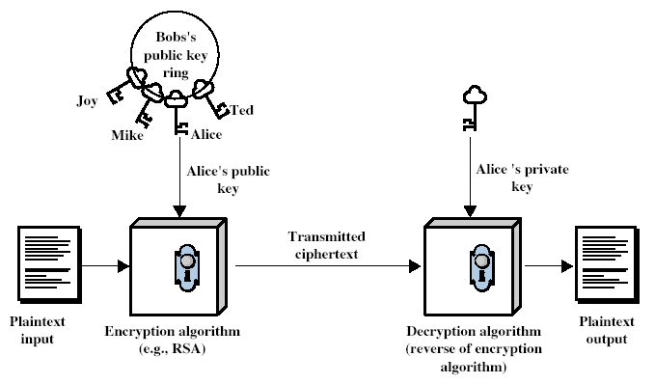
Public-Key Cryptography
Notes:
Stallings Fig 9-1.

Slide 12
What is RSA?
RSA is a public-key cryptosystem that is widely used for secure data transmission
In such a cryptosystem, the encryption key is public and differs from the decryption key which is kept secret. In RSA, this asymmetry is based on the practical difficulty of factoring the product of two large prime numbers, the factoring problem.
RSA stands for Ron Rivest, Adi Shamir and Leonard Adleman

Slide 13
How does RSA work?
Choose two distinct prime numbers p and q.
For security purposes, the integers p and q should be chosen at random, and should be of similar bit-length. Prime integers can be efficiently found using a primality test.
Compute n=pq.
n is used as the modulus for both the public and private keys. Its length, usually expressed in bits, is the key length.
Compute φ(n) = φ(p)φ(q) = (p − 1)(q − 1) = n - (p + q -1), where φ is Euler's totient function.
Choose an integer e such that 1 < e < φ(n) and gcd(e, φ(n)) = 1; i.e., e and φ(n) are coprime.
e is released as the public key exponent.

Slide 14
How does RSA work?
Determine d as d ≡ e^−1 (mod φ(n)); i.e., d is the multiplicative inverse of e (modulo φ(n)).
This is more clearly stated as: solve for d given d⋅e ≡ 1 (mod φ(n)).
This is often computed using the extended Euclidean algorithm. Using the pseudo code in the Modular integers section, inputs a and n correspond to e and φ (n), respectively.
d is kept as the private key exponent.
The public key consists of the modulus n and the public (or encryption) exponent e. The private key consists of the modulus n and the private (or decryption) exponent d, which must be kept secret. p, q, and φ(n) must also be kept secret because they can be used to calculate d.

Slide 15
Let’s Make a Key
Let’s use small prime numbers for the example:
p=2 q=5
n=pq=10
Compute the totient:
φ(n) = (p-1)(q-1) = 1*4 = 4
Observe that the number of integers less than n that are coprime to n is 4: (1, 3, 7, 9)
Choose an integer e s.t. 1 < e < φ(n), and e and φ(n) are coprime
e = 3 (e is used as the public key exponent)
Compute d s.t. de = 1 + kφ(n) for some integer k
d = 7 (d is used as the private key exponent)

Slide 16
Let’s Make a Key
So then, the public key will be:
c=m^{e} mod n
c=m³ mod 10
And the private key will be:
m=c^{d} mod n
m=c⁷ mod 10
We use the public key to encrypt and the private key to decrypt
If we want to encrypt m=8 we use
c=8³ mod 10 = 2
In order to decrypt c=2 we use
m=2⁷ mod 10 = 8

Slide 17
Does this seem easy to crack?
If n is 256 bits or shorter, you can crack the keys in a couple of hours on your own computer
Typical keys are 1024-2048 bits long
It is possible that 1024 bits keys will be breakable soon
The current recommendation is that keys be 2048 bits

Slide 18
Encryption
Alice transmits her public key (n, e) to Bob and keeps the private key d secret. Bob then wishes to send message M to Alice.
He first turns M into an integer m, such that 0 ≤ m < n by using an agreed-upon reversible protocol known as a padding scheme. He then computes the ciphertext c corresponding to
c =m^e mod(n)

Slide 19
Decryption
Alice can recover m from c by using her private key exponent d via computing
M=c^d(mod n)
Given m, she can recover the original message M by reversing the padding scheme.

Slide 20
What are certificates?
In cryptography, a public key certificate (also known as a digital certificate or identity certificate) is an electronic document used to prove ownership of a public key.
The certificate includes information about the key, information about its owner's identity, and the digital signature of an entity that has verified the certificate's contents are correct.
If the signature is valid, and the person examining the certificate trusts the signer, then they know they can use that key to communicate with its owner.

Slide 21
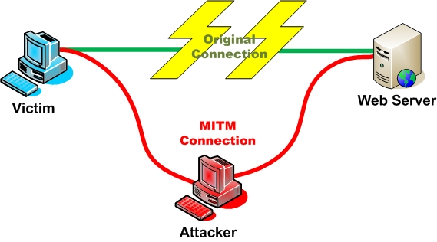
Why Certificates?
Authentication
To increase the difficulty of MITM attacks

Slide 22
Certificate Authority (CA)
In cryptography, a certificate authority or certification authority (CA) is an entity that issues digital certificates.
Issuer/Signer of the certificate
Binds public key w/ identity + attributes

Slide 23
Certification Authorities
Trusted organization that issues certificates and maintains status information about certificates.
Certification Practice Statement

Slide 24
How Digital Certificates work?
Generate Public and Private Keys.
Get Certificate from the CA
Sign the document/page using the private key.
Send signed document over open networks along with the CA’s certificate.
Recipient verifies using the signing CA’s public key
Trust Chain and Fingerprints
Notes:
http://wwwinfo.cern.ch/support/java/docs/javatutorial/security1.2/sigcert/
Digital Signatures
The basic idea in the use of digital signatures is the following:
1.You "sign" the document or code using one of your private keys
(which you can generate using keytool or security API methods).
That is, you generate a digital signature for the document or code,
using the jarsigner tool or API methods.
2.You send the other person (the "receiver") the document or code
and the signature.
3.You also supply the receiver the public key corresponding to the
private key used to generate the signature, if they don't already
have it.
4.Using the public key, the receiver can verify the authenticity of the
signature and the integrity of the document/code.
Actually, a receiver needs to ensure the public key itself is authentic
before they can reliably use it to check the signature's authenticity. It is
more typical to supply a certificate containing the public key rather than
just the public key itself, as discussed in the next section.
Certificates :
A certificate contains
a public key.
the "distinguished name" information of the entity (person,
company, etc.) whose certificate it is. This entity is referred to as
the certificate subject or owner. The distinguished name
information includes the following attributes (or a subset): the
entity's name, organizational unit, organization, city or locality, state
or province, and country code.
a digital signature. A certificate is signed by one entity (the issuer)
to vouch for the fact that the enclosed public key is the actual
public key of another entity (the owner).
the "distinguished name" information for the signer (issuer).
One way for a recipient to check whether a certificate is valid is by
verifying its digital signature using its issuer's (signer's) public key. That
key may itself be stored in another certificate whose signature can be
verified using the public key of that other certificate's issuer, and that key
may also be stored in yet another certificate, and so on; you can stop
checking when you reach a public key that you already trust and use it to
verify the signature on the corresponding certificate.
If the recipient cannot establish such a trust chain (for example, because
the required issuer certificates are not available), the certificate
fingerprint(s) can be calculated (for example, as may be done by the
keytool -import or -printcert command). Each fingerprint is a
relatively short number that uniquely and reliably identifies the certificate.
(Technically, it's a hash value of the certificate information, using a
message digest function.) The recipient can call up the certificate owner
and compare the fingerprints of the received certificate with those of the
certificate that was sent. If the fingerprints are the same, the certificates
are the same.
Thus, you can ensure that a certificate was not modified in transit. One
other potential uncertainty when working with certificates is the identity of the sender.
Sometimes a certificate is self-signed, that is, signed using the private key
corresponding to the public key in the certificate; the issuer is the same as the subject.
This is ok if the receiver already knows and trusts the sender.
Otherwise, the sender needs to obtain a certificate from a trusted third
party, referred to as a Certification Authority (CA). To do so, you send a
self-signed Certificate Signing Request (CSR) to the CA. The CA verifies
the signature on the CSR and your identity (for example, by checking
your driver's license or other information). The CA then vouches for you
being the owner of the public key by issuing a certificate and signing it
with its own (the CA's) private key. Anybody who trusts the issuing CA's
public key can now verify the signature on the certificate. In many cases,
the issuing CA itself may have a certificate from a CA higher up in the CA
hierarchy, leading to certificate chains.
Certificates of entities you trust are typically imported into your keystore
as "trusted certificates." The public key in each such certificate may
then be used to verify signatures generated using the corresponding
private key. Such verifications can be done by
the jarsigner tool (if the document/code and signature appear in
a JAR file),
API methods, or
the runtime system, when a resource access is attempted and a
policy file specifies that the resource access is allowed for the code
attempting the access if its signature is authentic. The code's class
file(s) and signature must be in a JAR file.
If you are sending signed code or documents to others, you need to
supply them the certificate containing the public key corresponding to the
private key used to sign the code/document. The keytool -export
command or API methods can export your certificate from your keystore
to a file, which can then be sent to anyone needing it. A person that
receives the certificate can import it into their keystore as a trusted
certificate, for example, using API methods or the keytool -import
command.
If you use the jarsigner tool to generate a signature for a JAR file, the
tool retrieves your certificate and its supporting certificate chain from your
keystore and stores them, along with the signature, in the JAR file.

Slide 25
Web Server Security
Server Authentication using SSL
Information to/from the correct Web Site
Information in encrypted form
Setting up SSL on a Web Site
Create a Server Certificate Request
Obtain the Server Certificate from a CA/locally
Install it on the Web Server
Establishing an SSL connection
Need root certificate of the issuing CA
Notes:
Authentication:
Server authentication means a web client need to be sure that it is communicating with a correct web site.Web Servers and Browsers provide this service by using the SSL protocol.
To use SSL we need to get a Server Certificate and install it on the Web Server.When communicating with a site using https:// we are using the SSL. The browser executes a server authentication protocol to make sure it is communicating with the correct site.
SSL establishes secure connections between two TCP protocols. (Accessing https urls causes SSL security to be invoked at both the client and the server end. SSL handshake is then performed to exchange cryptographically protected messages that establish security for the session.
Setting up SSL:
All the three steps are performed by the browsers using the tool such as Key Manager.
CertReq program can be used to generate a certificate locally. (If you are getting a free trial version of the server certificate you will also need to get the CA(signer’s) certificate. This is different from the global root certificate.
Installing a server certificate on a Web Site can again be done using tool provided by various vendors
Enabling SSL on a web site:
We need to specify the IP address of this web site and and also specify the SSL port number(default is 443).
We can also specify whether the whole site a directory or some file needs to use secure access.
Establishing an SSL connection:
To authenticate a web site my browser will need the issuing CA’s root certificate. Almost all of these certificates are built into the browsers.

Slide 26
What is x.509?
In cryptography, X.509 is an ITU-T standard for a public key infrastructure (PKI).

Slide 27
Structure of x.509 Certificates
Certificate
Version
Serial Number
Algorithm ID
Issuer
Validity
Not Before
Not After
Subject
Subject Public Key Info
Public Key Algorithm
Subject Public Key
Issuer Unique Identifier (optional)
Subject Unique Identifier (optional)
Extensions (optional)
...
Certificate Signature Algorithm
Certificate Signature

Slide 28
The system built
A local network based system was built that allowed users to login and generate their public key, private key, and certificates which would be authenticated by the SETS Certificate Authority.

Slide 29
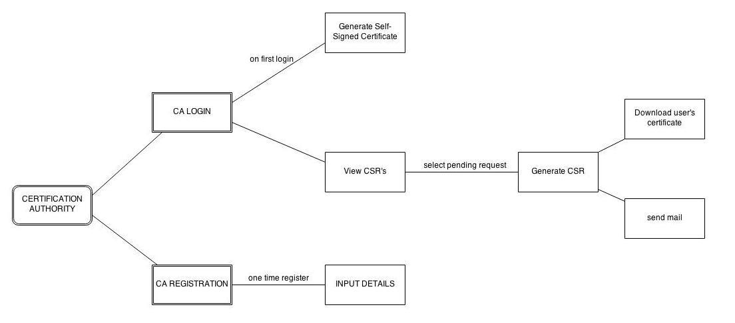
Design of the system
Certificate

Slide 30
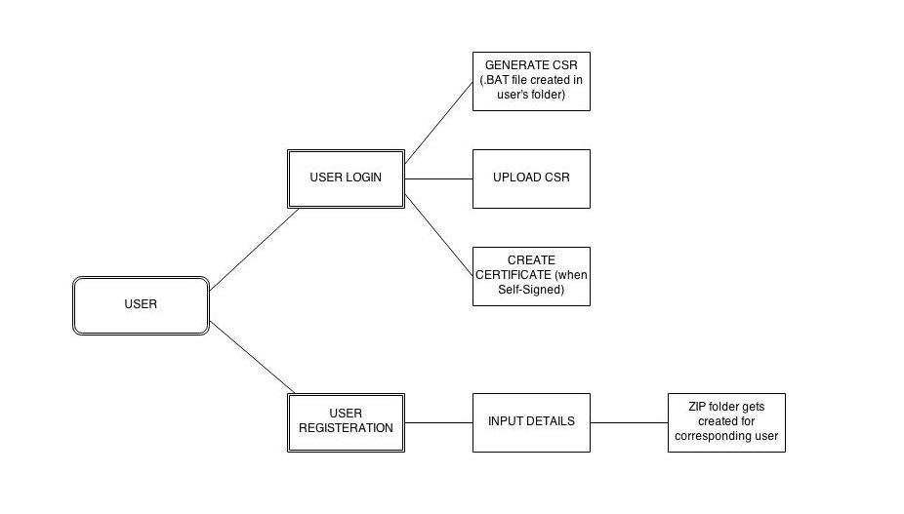
Design of the system

Slide 31
THANK-YOU!

