Slide 1
Scala – Day 4

Slide 2
Agenda
  Scala’s Hierarchy
  Traits
  Packages and Imports

Slide 3
Scala’s Hierarchy

Slide 4
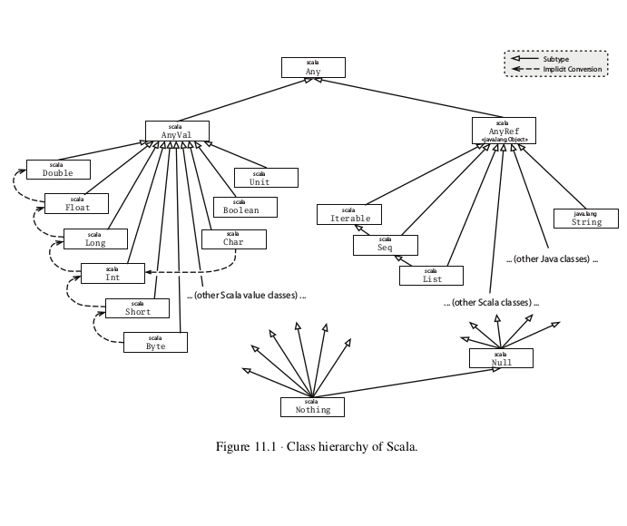
Notes:
P1. An advantage of this approach is that object creation can be centralized and the details of how objects are represented with classes can be hidden. This hiding will both make your library simpler for clients to understand.

Slide 5
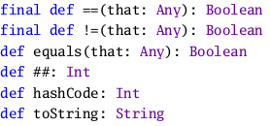
Scala’s class hierarchy
  At the top of the hierarchy is class Any.
  The equality and inequality methods, == and != , are declared final in class Any, so they cannot be overridden in subclasses.
Notes:
P1. An advantage of this approach is that object creation can be centralized and the details of how objects are represented with classes can be hidden. This hiding will both make your library simpler for clients to understand.

Slide 6

Bottom types
  Class Null is the type of the null reference; it is a subclass of every reference class (i.e., every class that itself inherits from AnyRef ). Null is not compatible with value types.
  Type Nothing is at the very bottom of Scala’s class hierarchy; it is a sub-type of every other type. However, there exist no values of this type whatsoever.
Defining your own value classes
  For a class to be a value class, it must have exactly one parameter and it must have nothing inside it except defs. Furthermore, no other class can extend a value class, and a value class cannot redefine equals or hashCode .
Notes:
P1. An advantage of this approach is that object creation can be centralized and the details of how objects are represented with classes can be hidden. This hiding will both make your library simpler for clients to understand.

Slide 7
Traits

Slide 8
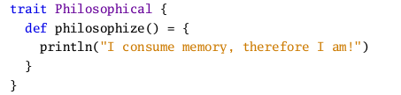

How traits work
  Traits are a fundamental unit of code reuse in Scala. A trait encapsulates method and field definitions, which can then be reused by mixing them into classes. Unlike class inheritance, in which each class must inherit from just one superclass, a class can mix in any number of traits.
  Once a trait is defined, it can be mixed in to a class using either the extends or with keywords.
Notes:
P1. An advantage of this approach is that object creation can be centralized and the details of how objects are represented with classes can be hidden. This hiding will both make your library simpler for clients to understand.

Slide 9

The Ordered trait
  To solve the problem of comparison between two objects of same class we use Ordered trait.
  Mix in the Ordered trait with the class with type parameter.
  Define a compare method for comparing two objects. This method should compare the receiver, this , with the object passed as an argument to the method. It should return an integer that is zero if the objects are the same, negative if receiver is less than the argument, and positive if the receiver is greater than the argument.
Notes:
P1. An advantage of this approach is that object creation can be centralized and the details of how objects are represented with classes can be hidden. This hiding will both make your library simpler for clients to understand.

Slide 10
Traits
Traits
Declare fields
Can have state
Define functionality
Anything that can be done in class definition can be done in trait definition as well
Cannot have class parameters
(which are passed to primary constructor of class)
Super calls are dynamically bound

Slide 11
Traits
To trait or not to trait?
If the behavior will not be reused, then make it a concrete class. It is not
reusable behavior after all.
If it might be reused in multiple, unrelated classes, make it a trait. Only
traits can be mixed into different parts of the class hierarchy.
If you want to inherit from it in Java code, use an abstract class

Slide 12
Packages and Imports

Slide 13


Putting code in packages
  You can place code into named packages in Scala in two ways.
  First, you can place the contents of an entire file into a package by putting a package clause at the top of the file
  The other way is to follow a package clause by a section of curly braces that contains the definitions that go into the package.
Notes:
P1. An advantage of this approach is that object creation can be centralized and the details of how objects are represented with classes can be hidden. This hiding will both make your library simpler for clients to understand.

Slide 14
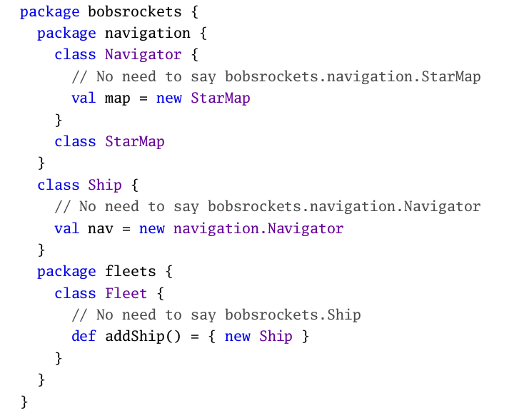
Concise access to related code

Slide 15
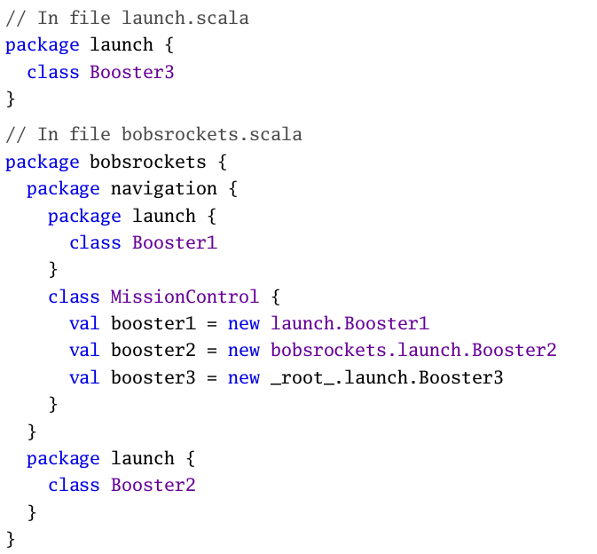

Slide 16
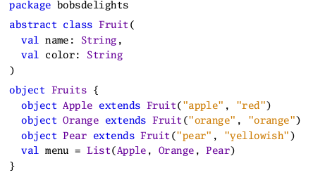
Imports
  In Scala, packages and their members can be imported using import clauses.
Notes:
P1. An advantage of this approach is that object creation can be centralized and the details of how objects are represented with classes can be hidden. This hiding will both make your library simpler for clients to understand.

Slide 17
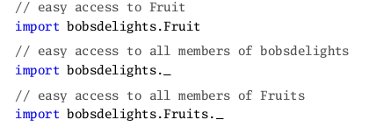
Imports
  In Scala, packages and their members can be imported using import clauses.
Notes:
P1. An advantage of this approach is that object creation can be centralized and the details of how objects are represented with classes can be hidden. This hiding will both make your library simpler for clients to understand.

Slide 18

Imports
  Imports in Scala can appear anywhere, not just at the beginning of a compilation unit. Also, they can refer to arbitrary values.
Notes:
P1. An advantage of this approach is that object creation can be centralized and the details of how objects are represented with classes can be hidden. This hiding will both make your library simpler for clients to understand.

Slide 19
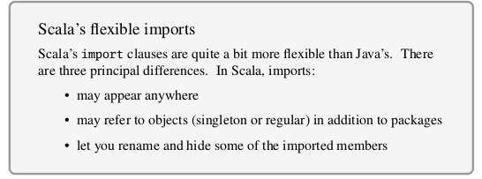
Imports
Notes:
P1. An advantage of this approach is that object creation can be centralized and the details of how objects are represented with classes can be hidden. This hiding will both make your library simpler for clients to understand.

Slide 20

Imports
An import selector can consist of the following:
• A simple name x . This includes x in the set of imported names.
• A renaming clause x => y . This makes the member named x visible under the name y .
• A hiding clause x => _ . This excludes x from the set of imported names.
• A catch-all ‘ _ ’. This imports all members except those members mentioned in a preceding clause. If a catch-all is given, it must come last in the list of import selectors.
Implicit Imports
Notes:
P1. An advantage of this approach is that object creation can be centralized and the details of how objects are represented with classes can be hidden. This hiding will both make your library simpler for clients to understand.

Slide 21
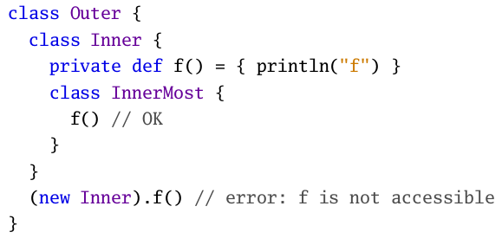
Access Modifiers
Members of packages, classes, or objects can be labeled with the access
modifiers private and protected. Scala’s treatment of access modifiers
roughly follows Java’s but there are some important differences.
Private members
A member labeled private is visible only inside the class or object that contains the member definition. In Scala, this rule applies also for inner classes.
Notes:
In Scala, the access (new Inner).f() is illegal because f is declared
private in Inner and the access is not from within class Inner . By con-
trast, the first access to f in class InnerMost is OK, because that access is contained in the body of class Inner . Java would permit both accesses
because it lets an outer class access private members of its inner classes.

Slide 22
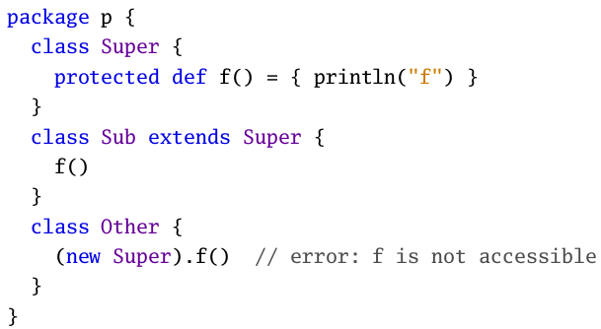
Access Modifiers (contd ...)
Protected members
Access to protected members in Scala is also a bit more restrictive than in Java. In Scala, a protected member is only accessible from subclasses of the class in which the member is defined.
Notes:
In Java such accesses are also
possible from other classes in the same package. In Scala, there is another
way to achieve this effect 3 so protected is free to be left as is.

Slide 23
Thank you

