Slide 1
Object Oriented Programming and JAVA
Unit-1

Slide 2
Unit-1 syllabus
OOP Paradigm: Comparison of programming paradigms, Characteristics of Object Oriented Programming Languages, Object-based programming languages
Java Fundamentals: Brief History of Java, Structure of a Java program, Importance and features of Java, Introduction to JVM and its architecture including set of instructions. Overview of JVM Programming. Internal and detailed explanation of a valid .class file format. Instrumentation of a .class file, Bytecode engineering libraries, Overview of class loaders and Sandbox model of security. Basic language construct of Java-including keywords, constants, variables, operators, looping and decision-making construct
Implementation of OOPs concepts in Java: Objects, Classes and their implementation, Encapsulation, Data Abstraction, Inheritance, Polymorphism, Dynamic Binding, Message Passing, default parameter values, using reference variables with function Arrays and String: creating an array, one and two-dimensional arrays, String arrays and methods, Classes: String and String Buffer classes, Wrapper classes: Basics types, using super, multilevel hierarchy abstract and final classes, Object class, packages and interfaces, access protection, extending interfaces, packages

Slide 3
Comparison of programming paradigms
A programming paradigm is a style, or “way,” of programming.
Paradigms are important because they define a programming language and how it works. A great way to think about a paradigm is as a set of ideas that a programming language can use to perform tasks in terms of machine-code at a much higher level.

Slide 4
MAJOR PROGRAMMING PARADIGM
1.Procedural Programming Approach: This approach is top down approach. In this approach, a program is divided into functions that perform a specific task.
This approach avoids repetition of code which is the main drawback of Monolithic Approach.
The basic drawback of Procedural Programming Approach is that data is not secured because data is global and can be accessed by any function.
This approach is mainly used for medium sized applications. The programming languages: FORTRAN and COBOL follow this approach.
2. Structured Programming Approach: The basic principal of structured programming approach is to divide a program in functions and modules.

Slide 5
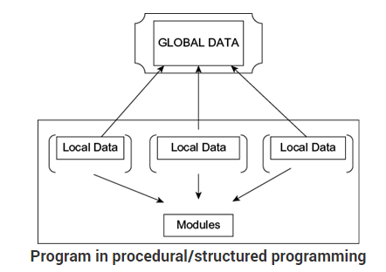

Slide 6
The use of modules and functions makes the program more comprehensible (understandable). It helps to write cleaner code and helps to maintain control over each function. This approach gives importance to functions rather than data.
It focuses on the development of large software applications. The programming languages: PASCAL and C follow this approach.
3. Object Oriented Programming Approach: The basic principal of the OOP approach is to combine both data and functions so that both can operate into a single unit. Such a unit is called an Object.
This approach secures data also. Now a days this approach is used mostly in applications. The programming languages: C++ and JAVA follow this approach. Using this approach we can write any lengthy code.

Slide 7
An approach to the solution of problems in which all computations are performed in context of objects.
The objects are instances of programming constructs, normally called as classes which are data abstractions with procedural abstractions that operate on objects.
A software system is a set of mechanism for performing certain action on certain data
Algorithm + Data structure = Program
Data Abstraction + Procedural Abstraction

Slide 8
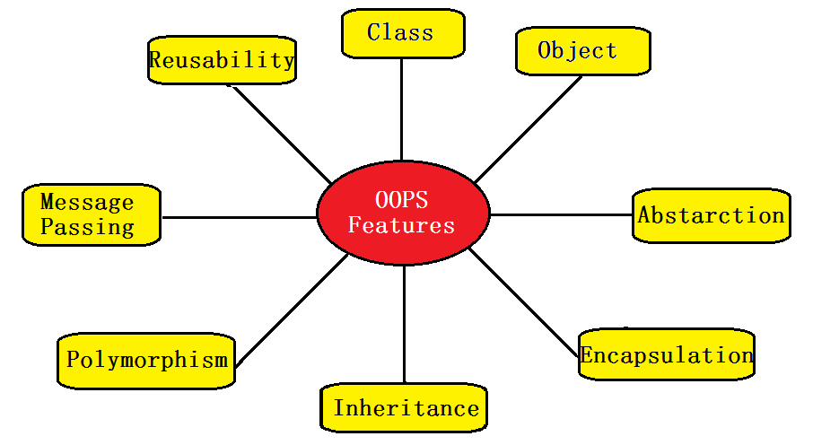
Object Orientated Features

Slide 9
Object Orientated Features
OBJECT - Object is a collection of number of entities. Objects take up space in the memory. Objects are instances of classes. When a program is executed , the objects interact by sending messages to one another. Each object contain data and code to manipulate the data. Objects can interact without having know details of each others data or code. Each instance of an object can hold its own relevant data.
CLASS - Class is a collection of objects of similar type. Objects are variables of the type class. Once a class has been defined, we can create any number of objects belonging to that class. Classes are user define data types. A class is a blueprint for any functional entity which defines its properties and its functions.

Slide 10
Object Orientated Features
3. DATA ENCAPSULATION – Combining data and functions into a single unit called class and the process is known as Encapsulation. Class variables are used for storing data and functions to specify various operations that can be performed on data. This process of wrapping up of data and functions that operate on data as a single unit is called as data encapsulation. Data is not accessible from the outside world and only those function which are present in the class can access the data.
4. DATA ABSTRACTION- Abstraction (from the Latin abs means away from and trahere means to draw) is the process of taking away or removing characteristics from something in order to reduce it to a set of essential characteristics. Advantage of data abstraction is security.

Slide 11
Object Orientated Features
5. INHERITANCE- It is the process by which object of one class acquire the properties or features of objects of another class. The concept of inheritance provide the idea of reusability means we can add additional features to an existing class without modifying it. This is possible by driving a new class from the existing one. Advantage of inheritance is reusability of the code.
6. MESSAGE PASSING - The process by which one object can interact with other object is called message passing.
7. POLYMORPHISM - A Greek term means ability to take more than one form. An operation may exhibit different behaviours in different instances. The behaviour depends upon the types of data used in the operation.

Slide 12
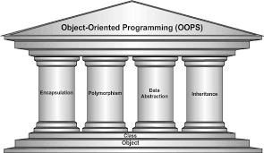
Object Orientated Features
8. PERSISTENCE - The process that allows the state of an object to be saved to non-volatile storage such as a file or a database and later restored even though the original creator of the object no longer exists.

Slide 13
Object Based programming Languages
Object based languages supports the usage of object and encapsulation.
They does not support inheritance or, polymorphism or, both.
These types of programming languages have built-in objects. Example: JavaScript has a window object.
VB is another example of object-based language as you can create and use classes and objects, but inheriting classes is not supported.

Slide 14
TRADE-OFFS OF A PROGRAMMING
Ease-of-use versus power
Safety versus efficiency
Rigidity versus extensibility
JAVA HISTORY
Java was conceived by James Gosling, Patrick Naughton, Chris Warth, Ed Frank, and Mike Sheridan at Sun Microsystems, Inc. in 1991.
It took 18 months to develop the first working version. This language was initially called “Oak,” but was renamed “Java” in 1995.

Slide 15
Java is a programming language that produces software for various platforms.
Sun Microsystems describe it as
"A simple, object- oriented, distributed, interpreted, robust, secure, architect neutral, portable, high- performance, multi- threaded and dynamic language."

Slide 16
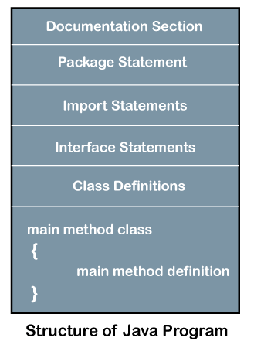
Structure of Java Program
Documentation Section
Package Declaration
Import Statements
Interface Section
Class Definition
Class Variables and Variables
Main Method Class
Methods and Behaviors

Slide 17
To write the statements in the documentation section
we use comments. The comments may be single-line, multi-line, and documentation comments.
Single-line Comment: It starts with a pair of forwarding slash (//). For example:
//First Java Program
Multi-line Comment: It starts with a /* and ends with */. We write between these two symbols. For example:
/*It is an example of
multiline comment*/
Documentation Comment: It starts with the delimiter (/**) and ends with */. For example:
/**It is an example of documentation comment*/

Slide 18
Package Declaration
The package declaration is optional. It is placed just after the documentation section. i. e.
package javatpoint; //where javatpoint is the package name
package com.javatpoint; //where com is the root directory and
javatpoint is the subdirectory
Import Statements
The package contains the many predefined classes and interfaces. If we want to use any class of a particular package, we need to import that class. The import statement represents the class stored in the other package. We use the import keyword to import the class. It is written before the class declaration and after the package statement
import java.util.Scanner; //it imports the Scanner class only
import java.util.*; //it imports all the class of the java.util package

Slide 19
Interface Section
We use the interface keyword to create an interface. An interface is a slightly different from the class. It contains only constants and method declarations. It provides total abstraction; means all the methods in an interface are declared with the empty body, and all the fields are public, static and final by default. A class that implements an interface must implement all the methods declared in the interface.
interface car
{
void start();
void stop();
}
Class Definition
It is vital part of a Java program. Without the class, we cannot create any Java program. A Java program may conation more than one class definition. We use the class keyword to define the class.

Slide 20
The class is a blueprint of a Java program. It contains information about user-defined methods, variables, and constants. Every Java program has at least one class that contains the main() method. For example:
class Student //class definition
{
}
Class Variables and Constants
In this section, we define variables and constants that are to be used later in the program. In a Java program, the variables and constants are defined just after the class definition. The variables and constants store values of the parameters.

Slide 21
class Student //class definition
{
String sname; //variable
int id;
double percentage;
}
Main Method Class
In this section, we define the main() method. It is essential for all Java programs. Because the execution of all Java programs starts from the main() method. In other words, it is an entry point of the class. It must be inside the class.

Slide 22
Methods and behavior
In this section, we define the functionality of the program by using the methods. The methods are the set of instructions that we want to perform. These instructions execute at runtime and perform the specified task
public class Demo //class definition
{
public static void main(String args[])
{
void display()
{
System.out.println("Welcome to javatpoint");
}
//statements
}
}

Slide 23
Why need JAVA
. Need for a platform-independence (architecture-neutral)
A language that could be used to create software to be embedded in various consumer electronic devices, such as microwave ovens and remote controls.
C and C++ are designed to be compiled for a specific target.
Compilers are expensive and time-consuming to create

Slide 24
Emergence of World Wide Web
Had the Web not taken shape Java might have remained a useful but obscure language for programming consumer electronics.
Java was propelled to the forefront of computer language design, because the Web, too, demanded portable programs.
While the desire for an architecture-neutral programming language provided the initial spark, the Internet ultimately led to Java’s large-scale success.

Slide 25
Object-oriented programming system
Object-Oriented Programming (OOP) System is a programming paradigm based on the concept of using classes and objects in your programming code. Object-Oriented Programming (OOP) used to structure a programming language into simple, reusable pieces of code that usually known as classes, which we can use as a user define Data Type to create instances of objects.

Slide 26
Popular OOP languages
C++
Java
C#
Ruby
Python

Slide 27
The Java SDK comes in three versions:
J2ME – (Java 2 Platform, Micro Edition) is a technology that allows programmers to use the Java programming language and related tools to develop programs for mobile wireless information devices such as cellular phones and personal digital assistants (PDAs).
J2SE - Java 2 Platform Standard Edition. Java Platform, Standard Edition is a computing platform for development and deployment of portable code for desktop and server environments.
J2EE - Enterprise Edition (provides a simplified approach to developing highly scalable and highly available internet or intranet based applications).

Slide 28
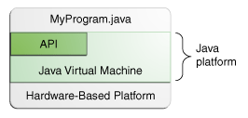
JAVA Platform
Java Platform has two components:
The Java Virtual Machine
The Java Application Programming Interface (API)

Slide 29
Java Architecture
Java Architecture is a collection of components, i.e., JVM, JRE, and JDK. It integrates the process of interpretation and compilation. It defines all the processes involved in creating a Java program. Java Architecture explains each and every step of how a program is compiled and executed.
Java Architecture can be explained by using the following steps:
There is a process of compilation and interpretation in Java.
Java compiler converts the Java code into byte code.
After that, the JVM converts the byte code into machine code.
The machine code is then executed by the machine.

Slide 30
Components of Java Architecture
The Java architecture includes the three main components:
Java Virtual Machine (JVM)
Java Runtime Environment (JRE)
Java Development Kit (JDK)

Slide 31
Components of Java Architecture
1. The Java Development Kit (JDK)- is a software development environment used for developing Java applications and applets. It includes the Java Runtime Environment (JRE), an interpreter/loader (Java), a compiler (javac), an archiver (jar), a documentation generator (Javadoc) and other tools needed in Java development.
2. JRE stands for “Java Runtime Environment” and may also be written as “Java RTE.” The Java Runtime Environment provides the minimum requirements for executing a Java application; it consists of the Java Virtual Machine (JVM), core classes, and supporting files.

Slide 32
3. JVM – Java Virtual machine(JVM) is a very important part of both JDK and JRE because it is contained or inbuilt in both. Whatever Java program you run using JRE or JDK goes into JVM and JVM is responsible for executing the java program line by line hence it is also known as interpreter.

Slide 33
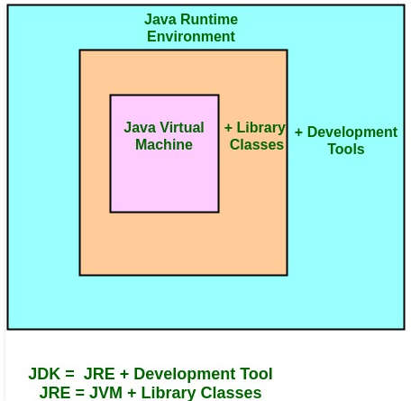

Slide 34
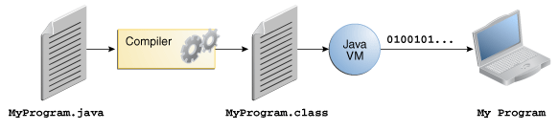

Slide 35
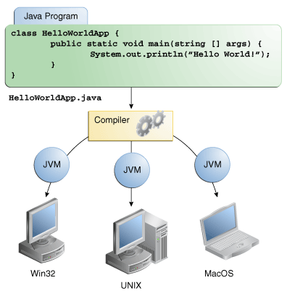

Slide 36
JVM Internals

Slide 37
JVM Architecture
JVM(Java Virtual Machine) acts as a run-time engine to run Java applications.
JVM is the one that actually calls the main method present in a java code.
JVM is a part of JRE(Java Runtime Environment).
When we compile a .java file, .class files(contains byte-code) with the same class names present in .java file are generated by the Java compiler. This .class file goes into various steps when we run it. These steps together describe the whole JVM.

Slide 38
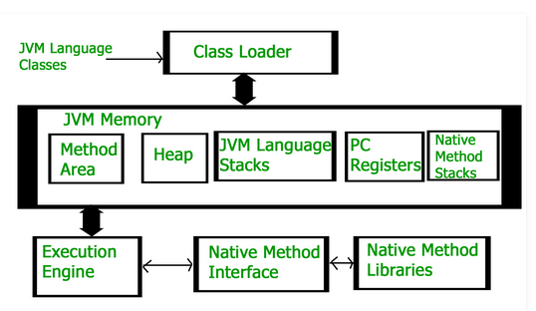
JVM Architecture

Slide 39
Class Loader Subsystem
It is mainly responsible for three activities.
Loading
Linking
Initialization

Slide 40
Loading
The Class loader reads the .class file, generate the corresponding binary data and save it in method area. For each .class file, JVM stores following information in method area.
Fully qualified name of the loaded class and its immediate parent class.
Whether .class file is related to Class or Interface or Enum
Modifier, Variables and Method information etc.
After loading .class file, JVM creates an object of type Class to represent this file in the heap memory.

Slide 41
Loading
This Class object can be used by the programmer for getting class level information like name of class, parent name, methods and variable information etc.
To get this object reference we can use getClass() method of Object class

Slide 42
Linking
Verification : It ensures the correctness of .class file i.e. it check whether this file is properly formatted and generated by valid compiler or not. If verification fails, we get run-time exception java.lang.VerifyError.
Preparation : JVM allocates memory for class variables and initializing the memory to default values.
Resolution : It is the process of replacing symbolic references from the type with direct references. It is done by searching into method area to locate the referenced entity.

Slide 43
Initialization
In this phase, all static variables are assigned with their values defined in the code and static block(if any).
This is executed from top to bottom in a class and from parent to child in class hierarchy.

Slide 44
Class Loaders
The Java ClassLoader is a part of the JRE that dynamically loads Java classes into the Java Virtual Machine.
The Java run time system does not need to know about files and file systems because of classloaders.
Java classes aren’t loaded into memory all at once, but when required by an application.
At this point, the Java ClassLoader is called by the JRE and these ClassLoaders load classes into memory dynamically.

Slide 45
Class Loaders
Depending on the type of class and the path of class, the ClassLoader that loads that particular class is decided.
To know the ClassLoader that loads a class the getClassLoader() method is used.
All classes are loaded based on their names and if any of these classes are not found then it returns a NoClassDefFoundError or ClassNotFoundException.

Slide 46
Class Loaders Types
BootStrap ClassLoader: A Bootstrap Classloader is a Machine code which kickstarts the operation when the JVM calls it. It is not a java class. Its job is to load the first pure Java ClassLoader. Bootstrap ClassLoader loads classes from the location rt.jar. Bootstrap ClassLoader doesn’t have any parent ClassLoaders. It is also called as the Primodial ClassLoader.
Extension ClassLoader: The Extension ClassLoader is a child of Bootstrap ClassLoader and loads the extensions of core java classes from the respective JDK Extension library. It loads files from jre/lib/ext directory or any other directory pointed by the system property java.ext.dirs.

Slide 47
Class Loaders Types
System ClassLoader: An Application ClassLoader is also known as a System ClassLoader. It loads the Application type classes found in the environment variable CLASSPATH, -classpath or -cp command line option. The Application ClassLoader is a child class of Extension ClassLoader.

Slide 48
Retrieving Class Loaders
public class Test
{
public static void main(String[] args)
{
// String class is loaded by bootstrap loader, and
// bootstrap loader is not Java object, hence null
System.out.println(String.class.getClassLoader());
// Test class is loaded by Application loader
System.out.println(Test.class.getClassLoader());
}
}

Slide 49
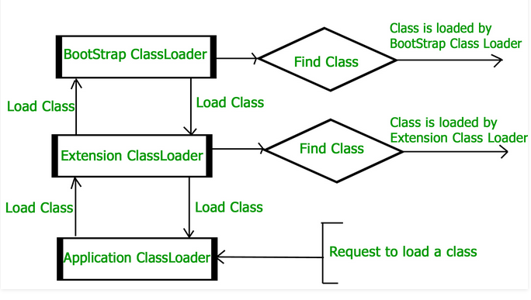
Class Loaders Delegation Model

Slide 50
JVM Memory
Method area :In method area, all class level information like class name, immediate parent class name, methods and variables information etc. are stored, including static variables. There is only one method area per JVM, and it is a shared resource.
Heap area :Information of all objects is stored in heap area. There is also one Heap Area per JVM. It is also a shared resource.
Stack area :For every thread, JVM create one run-time stack which is stored here. Every block of this stack is called activation record/stack frame which store methods calls. All local variables of that method are

Slide 51
JVM Memory
stored in their corresponding frame. After a thread terminate, it’s run-time stack will be destroyed by JVM. It is not a shared resource.
PC Registers :Store address of current execution instruction of a thread. Obviously each thread has separate PC Registers.
Native method stacks :For every thread, separate native stack is created. It stores native method information.

Slide 52
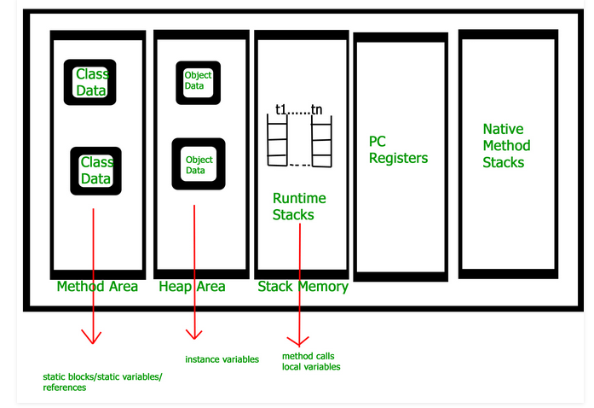
JVM Memory

Slide 53
Execution Engine
Execution engine execute the .class (bytecode). It reads the byte-code line by line, use data and information present in various memory area and execute instructions. It can be classified in three parts :-
Interpreter : It interprets the bytecode line by line and then executes. The disadvantage here is that when one method is called multiple times, every time interpretation is required.
Just-In-Time Compiler(JIT) : It is used to increase efficiency of interpreter.It compiles the entire bytecode and changes it to native code so whenever interpreter see repeated method

Slide 54
JVM Memory
calls,JIT provide direct native code for that part so re-interpretation is not required,thus efficiency is improved.
Garbage Collector : It destroy un-referenced objects.For more on Garbage Collector,refer Garbage Collector.

Slide 55
JVM Memory
Java Native Interface (JNI) : It is an interface which interacts with the Native Method Libraries and provides the native libraries(C, C++) required for the execution. It enables JVM to call C/C++ libraries and to be called by C/C++ libraries which may be specific to hardware.
Native Method Libraries : It is a collection of the Native Libraries(C, C++) which are required by the Execution Engine.

Slide 56
JIT Compiler
The Just-In-Time (JIT) compiler is a an essential part of the JRE i.e. Java Runtime Environment, that is responsible for performance optimization of java based applications at run time.
Compiler is one of the key aspects in deciding performance of an application for both parties i.e. the end user and the application developer.

Slide 57
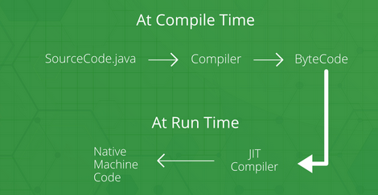
JIT Compiler

Slide 58
JIT Compiler
While using a JIT compiler, the hardware is able to execute the native code, as compared to having the JVM interpret the same sequence of bytecode repeatedly and incurring an overhead for the translation process.
This subsequently leads to performance gains in the execution speed, unless the compiled methods are executed less frequently.
Some of these optimizations performed by JIT compilers are data-analysis, reduction of memory accesses by register allocation, translation from stack operations to register operations, elimination of common expressions

Slide 59
JIT Compiler
The JIT compiler aids in improving the performance of Java programs by compiling bytecode into native machine code at run time.
The JIT compiler is enabled throughout, while it gets activated, when a method is invoked.
For a compiled method, the JVM directly calls the compiled code, instead of interpreting it.
When the java virtual machine first starts up, thousands of methods are invoked. Compiling all these methods can significantly affect startup time, even if the end result is a very good performance optimization.

Slide 60
Garbage Collection
In C/C++, programmer is responsible for both creation and destruction of objects. Usually programmer neglects destruction of useless objects. Due to this negligence, at certain point, for creation of new objects, sufficient memory may not be available and entire program will terminate abnormally causing OutOfMemoryErrors.
But in Java, the programmer need not to care for all those objects which are no longer in use. Garbage collector destroys these objects.
Garbage collector is best example of Daemon thread as it is always running in background.

Slide 61
Garbage Collection
Main objective of Garbage Collector is to free heap memory by destroying unreachable objects.
Integer i = new Integer(4); /* the new Integer object is reachable via the reference in 'i‘*/
i = null; // the Integer object is no longer reachable.

Slide 62
Eligible objects for GC
Even though programmer is not responsible to destroy useless objects but it is highly recommended to make an object unreachable(thus eligible for GC) if it is no longer required. There are generally four different ways to make an object eligible for garbage collection.
Nullifying the reference variable
Re-assigning the reference variable
Object created inside method
Island of Isolation

Slide 63
Requesting JVM to run GC
Once we made object eligible for garbage collection, it may not destroy immediately by garbage collector. Whenever JVM runs Garbage Collector program, then only object will be destroyed. But when JVM runs Garbage Collector, we can not expect. We can also request JVM to run Garbage Collector. There are two ways to do it :
Using System.gc() method : System class contain static method gc() for requesting JVM to run Garbage Collector.
Using Runtime.getRuntime().gc() method : Runtime class allows the application to interface with the JVM in which the application is running. Hence by using its gc() method, we can request JVM to run Garbage Collector.

Slide 64
Finalization
Just before destroying an object, Garbage Collector calls finalize() method on the object to perform cleanup activities.
Once finalize() method completes, Garbage Collector destroys that object. finalize() method is present in Object class with following prototype.
protected void finalize() throws Throwable
Based on our requirement, we can override finalize() method for perform our cleanup activities like closing connection from database.

Slide 65
.class File Format
A Java class file is a file containing Java bytecode and having .class extension that can be executed by JVM.
A Java class file is created by a Java compiler from .java files as a result of successful compilation.
As we know that a single Java programming language source file (or we can say .java file) may contain one class or more than one class.
So if a .java file has more than one class then each class will compile into a separate class files.

Slide 66
.class File Format
ClassFile { magic_number;
minor_version;
major_version;
constant_pool_count;
constant_pool[];
access_flags;
this_class;
super_class;
interfaces_count; interfaces[];
fields_count; fields[]; methods_count; methods[]; attributes_count; attributes[]; }

Slide 67
.class File Format
magic_number: The first 4 bytes of class file are termed as magic_number. This is a predefined value which the JVM use to identify whether the .class file is generated by valid compiler or not.
minor_version & major_version: These both together represents .class file version. JVM will use these versions to identify which version of the compiler generates the current .class file. We denotes the version of class file as M.m where M stands for major_version and m stands for minor_version

Slide 68
.class File Format
magic_number: The first 4 bytes of class file are termed as magic_number. This is a predefined value which the JVM use to identify whether the .class file is generated by valid compiler or not.
minor_version & major_version: These both together represents .class file version. JVM will use these versions to identify which version of the compiler generates the current .class file. We denotes the version of class file as M.m where M stands for major_version and m stands for minor_version

Slide 69
.class File Format
constant_pool_count: It represents the number of the constants present in the constant pool (When a Java file is compiled, all references to variables and methods are stored in the class’s constant pool as a symbolic reference).
constant_pool[]: It represents the information about constants present in constant pool file.
access_flags: It provide the information about the modifiers which are declared to the class file.
this_class: It represents fully qualified name of the class file.

Slide 70
.class File Format
super_class: It represents fully qualified name of the immediate super class of current class. Consider above Sample.java file. When we will compile it, then we can say this_class will be
Sample class and super_class will be Object class.
interface_count: It returns the number of interfaces implemented by current class file.
interface[]: It returns interfaces information implemented by current class file.
fields_count: It represents the number of fields (static variable) present in current class file.

Slide 71
.class File Format
12. fields[]: It represent fields (static variable) information present in current class file.
method_count: It represents number of methods present in current class file.
method[]: It returns information about all methods present in current class file.
attributes_count: It returns the number of attributes (instance variables) present in current class file.
attributes[]: It provides information about all attributes present in current class file.

Slide 72
Sandbox Model of Security
Sandbox is a security mechanism for separating running programs, usually in order to minimize system failures or software vulnerabilities from spreading.
The original security model provided by the Java platform is known as the sandbox model, which existed in order to provide a very restricted environment in which to run untrusted code obtained from the open network.
The essence of the sandbox model is that local code is trusted to have full access to vital system resources (such as the file system) while downloaded remote code (an applet) is not trusted and can access only the.

Slide 73
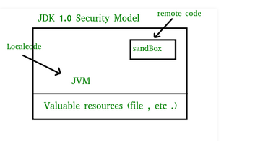
Sandbox Model of Security
limited resources provided inside the sandbox

Slide 74
Sandbox Model of Security
Overall security is provided through a number of mechanisms.The language is designed to be type-safe and easy to use i.e the hope is that the burden on the programmer is such that the likelihood of making mistakes is less compare to using other programming languages such as C or C++.
Language features such as automatic memory management, garbage collection, and range checking on strings and arrays are examples of how the language helps the programmer to write safe code.

Slide 75
Sandbox Model of Security
Compilers and a bytecode verifier ensure that only legitimate Java bytecodes are executed. The bytecode verifier, together with the Java Virtual Machine, guarantees language safety at run time.
A Classloader defines a local name space, which can be used to ensure that an untrusted applet cannot interfere with the running of other programs.
Finally, access to crucial system resources is mediated by the Java Virtual Machine and is checked in advance by a SecurityManager class that restricts the actions of a piece of untrusted code to the bare minimum.(SandBoxing)

Slide 76
Java’s Magic – The Byte code
The key that allows Java to solve both the security and the portability problems is that the output of a Java compiler is not executable code. Rather, it is bytecode.
“Bytecode is a highly optimized set of instructions designed to be executed by the Java run-time system, which is called the Java Virtual Machine (JVM)”.
JVM is the interpreter for bytecode.
Java code can run on any platform that has JVM implemented.
JVM is default implemented in most of the OS by virtue of contract with Sun Microsystems.

Slide 77
JVM also helps to make Java secure as it contains the program and prevent it from generating side effects outside of the system.
Java was designed as an interpreted language
But it can also on-the-fly compile bytecode into native code in order to boost performance by JIT.
JIT compiler compiles code as it is needed, during execution.

Slide 78
“Welcome" for Microsoft Windows
Download JDK
Follow installation directions
Set Execution Path
Install the library source & documentation
Install the Core Java Program examples
Java Directory Tree
Jdk
Bin
Demo
Docs
Include
Jre
Lib
Src

Slide 79
Creating Your First Application
Create a Source File
Compile the Source File into a .class File
Run the Program
Structure of a Java program (Welcome.java)
Class Welcome{
public static void main(String args[]){
System.out.println("Hello Java");
}
}

Slide 80
Language Basics
Lexicals Java source code consists of words or symbols called lexical elements or tokens. Java lexical elements include line terminators, whitespace, comments, keywords, identifiers, separators, operators, and literals.
Comments
Primitive Data Types
Variables
Constants
Operators
Expressions, Statements, and Blocks
Control Flow Statements
Array

Slide 81
Whitespace
--A character is called a whitespace character in Java if and only if Character. is Whitespace(char) method returns true. The most commonly used whitespace characters are \n, \t, \r and space.
Identifiers
Identifiers are used for class names, method names, and variable names. An identifier maybe any descriptive sequence of uppercase and lowercase letters, numbers, or the underscore and dollar-sign characters
3. Literals
A constant value in Java is created by using a literal representation of it.
4. Comments
A single-line comment: // ... to the end of the line
A multiple-line comment: /* ... */
A documentation (Javadoc) comment: /** ... */

Slide 82
String Literals
String literals in Java are specified like they are in most other languages—by enclosing a sequence of characters between a pair of double quotes.
Examples of string literals are
“Hello World”
“two\nlines”
“\”This is in quotes\”“

Slide 83
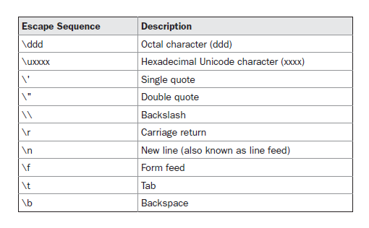
Escape Sequences
The escape sequences and octal/hexadecimal notations that were defined for character literals work the same way inside of string literals

Slide 84
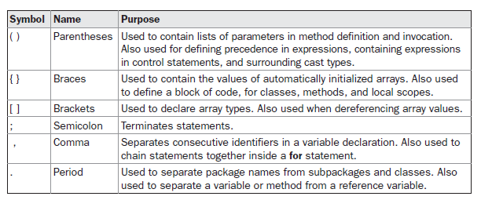
5. Seperators-A separator is a symbol that is used to separate a group of code from one another is called as separators in java. In java, there are few characters that are used as a separator. The most commonly used separator is a semicolon

Slide 85
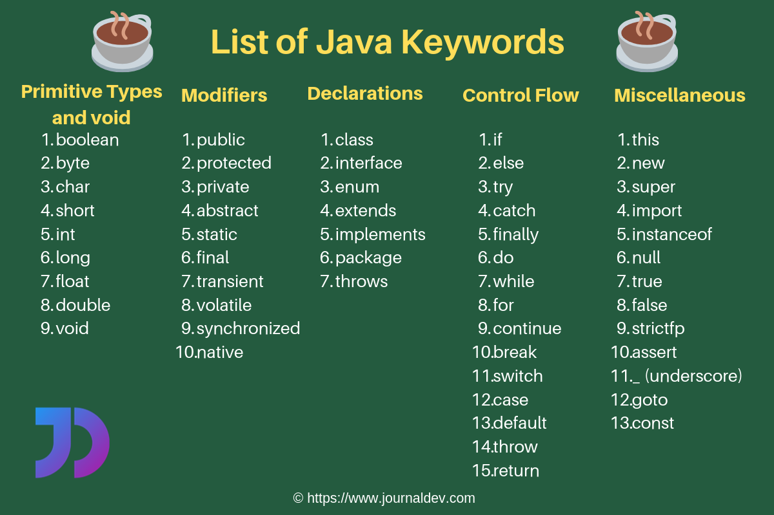
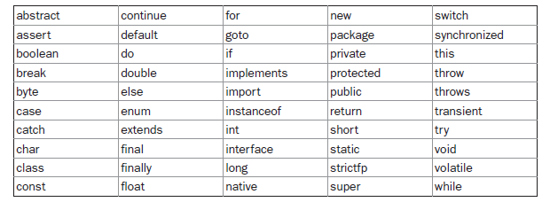
6. Keywords

Slide 86
Primitive Data Types
Strongly typed language
Eight primitive types
Four Integer types
int 4 bytes
short 2 bytes
long 8 bytes
byte 1 byte
Two Floating-point types
float 4 bytes (6-7 significant decimal digits)
double 8 bytes (15 significant decimal digits)
char type
boolean type

Slide 87
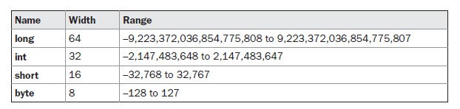
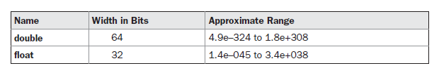
Primitive Data Types

Slide 88
Variables
The variable is the basic unit of storage in a Java program. A variable is defined by the combination of an identifier, a type, and an optional initializer.
In addition, all variables have a scope, which defines their visibility, and a lifetime.

Slide 89
Variables
Types of variables in JAVA
Instance Variables (Non-Static Fields)
Class Variables (Static Fields)
Local Variables
Parameters
Naming
Case-sensitive
Subsequent characters may be letters, digits, dollar signs, or underscore characters

Slide 90
Reference Variables
Store the reference value of an object
Reference type can be a class/an array or an interface name
Pizza yummyPizza = new Pizza("Hot&Spicy");
// Declaration with initializer

Slide 91
Default Values
Data Type Default Value
boolean false
char '\u0000'
Integer (byte, short, int, long) 0L for long, 0 for others
Floating-point (float, double) 0.0F or 0.0D
Reference types null
Local variable must be initialized explicitly

Slide 92
Constant
Include final Keyword in declaration
Final variables must be initialized upon declaration
final int MAX_BUFFER_SIZE = 256;
final float PI=3.14159;
Class constant can be setup using keyword
static final

Slide 93
Java’s Type Casting
Java’s automatic type conversion will take place if the following two conditions are met:
The two types are compatible.
The destination type is larger than the source type.
This type of conversion is called widening conversion.

Slide 94
Java’s Type Casting
Narrowing conversion explicitly making the value narrower so that it will fit into the target type.
To create a conversion between two incompatible types, you must use a cast. A cast is simply an explicit type conversion. Format is as follows:-
(target-type) value
For example, the following fragment casts an int to a byte. If the integer’s value is larger than the range of a byte, it will be reduced modulo (the remainder of an integer division by the) byte’s range.
int a;
byte b;
b = (byte) a;

Slide 95
Switching Constructs
If block
If-else ladder
Switch case

Slide 96
Looping Constructs
For Loop
For-each Loop
While Loop
Do-while Loop

Slide 97
Control Constructs
Break
Continue
goto

Slide 98
Access Constructs
Final
Static
Access Specifiers
Public
Private
Protected
Default/Package

Slide 99
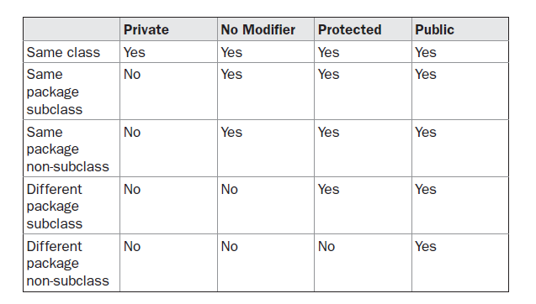
Access Constructs

Slide 100
Reference vs. Instance Variables
A reference variable is declared to be of a specific type and that type can never be changed.
Reference variables can be declared as
static variables- static member variables and there's only one copy of that variable that is shared with all instances of that class
instance variables - belong to the instance of a class, thus an object
local variables
method parameters

Slide 101
Array
An array is a container object that holds a fixed number of values of a single type
An array is a group of like-typed variables that are referred to by a common name.
Array declaration
int[] anArray;
Creating, Initializing, and Accessing an Array
anArray = new int[10];
int[] anArray = { 100, 200, 300, 400, 500, 600, 700, 800, 900, 1000 };
Once created size can’t be changed

Slide 102
1D Array
A one-dimensional array is, essentially, a list of like-typed variables.
The general form of a one-dimensional array declaration is
type var-name[ ]
type declares the base type of the array. The base type determines the data type of each element that comprises the array.
Alternative Declarative Syntax
int al[] = new int[3];
int[] a2 = new int[3];

Slide 103
Multi-dimensional Arrays
In Java, multidimensional arrays are actually arrays of arrays.
An instance of multi-dimensional array is:-
int twoD[][] = new int[4][5];
This allocates a 4 by 5 array and assigns it to twoD.
Internally this matrix is implemented as an array of arrays of int.

Slide 104
“for each” Loop
SE 5.0 introduced enhanced for loop construct to loop through each element
for (variable : collection) statement
for (int i : anArray) //for each element in anArray
System.out.println(element);
Traverses the element of the array not index
Class Arrays
java.util.Arrays
contains various methods for manipulating arrays (such as sorting and searching).

Slide 105
Ragged arrays
Arrays in which different rows have different lengths
First allocate the array holding the rows
int [][] ragg = new int[max][];
Next allocate the rows
for (int n =o; n < max; n++)
ragg[n]= new int[n+1];

Slide 106
String Arrays
Array of strings literals forms a compulated data type when multiple strings need to be grouped together.
String[] myFirstStringArray = new String[]{"String 1", "String 2", "String 3"};

Slide 107
Exercise
Q1.Give example usage and expected output for the following methods of Arrays class:
toString
copyOf
sort
BinarySearch
Fill
equals

Slide 108
Exercise
Q2. Demonstrate the usage of two dimensional arrays using any example.
Q.3 Use ragged array to provide the output given below
1
123
12345
1234567
123456789

Slide 109
String Class
Every string you create is actually an object of type String. Sequence of Unicode characters
String myString = "this is a test";
Strings are Immutable and shareable. Their values cannot be changed after they are created.
This is because strings are stored in String Literal Pool.
The == operator cannot be used to test String objects for equality
String Concatenation:-
String myString = "I" + " like " + "Java.";

Slide 110
String Literal Pool
String allocation, like all object allocation, proves costly in both time and memory.
To cut down the number of String objects created in the JVM, the String class keeps a pool of strings.
Each time your code create a string literal, the JVM checks the string literal pool first. If the string already exists in the pool, a reference to the pooled instance returns.
If the string does not exist in the pool, a new String object instantiates, then is placed in the pool.

Slide 111
String Class- Methods
equals()
length()
charAt()

Slide 112
String Command Line Args
Used for passing information into a program when you run it.
Accomplished by passing command-line arguments to main( ).
public static void main(String args[])

Slide 113
Building Strings- String Builder
Mutable Sequence of Characters.
Internally, these objects are treated like variable-length arrays that contain a sequence of characters
The principal operations StringBuilder are the append and insert methods, which are overloaded so as to accept data of any type.
Each effectively converts a given datum to a string and then appends or the characters of that string to the string builder.
Instances of StringBuilder are not safe for use by multiple threads.

Slide 114
String Buffer
A thread-safe, mutable sequence of characters.
The methods are synchronized where necessary so that all the operations on any particular instance behave as if they occur in some serial order.
Methods:-
Append()
Insert()
Replace()
Delete()
Reverse()
Capacity() //default 16
EnsureCapacity()

Slide 115
StringTokenizer
Allows an application to break a string into tokens.
StringTokenizer st = new StringTokenizer("this is a test");
while (st.hasMoreTokens()) { System.out.println(st.nextToken());
}

Slide 116
User Interactions
Enabling user to interact through console
Scanner in = new Scanner(System.in)
int i = in.nextInt();
String s = in.nextLine();

Slide 117
User Interactions
Reading password from console- Cannot store in String Literal Pool
No method for reading individual words or numbers
Console cons = System.console();
String username = cons.readLine("User name:");
char[] passwd = cons.readPassword("Password: ");

Slide 118
Object & Classes
Class is at core of Java
Any concept implemented in Java program is encapsulated within class
Class define new data type which is used to create object of that type.

Slide 119
Classes – The Blueprint !!
A class is a blueprint of an object.
A class is a group of objects that share common properties & behavior/ relationships.
In fact, objects are the variables of the type class.
Classes are user defined data types and behaves like the built-in types of a programming language.
Class are a concept, and the object is the embodiment of that concept.
Each class should be designed and programmed to accomplish one, and only one, thing, in accordance to single responsibility principle of SOLID design principles.
In the OOPs concept the variables declared inside a class are known as "Data Members" and the functions are known as "Member Functions"

Slide 120
Class Members
A class has different members, and developers in Microsoft suggest to program them in the following order:
Namespace: The namespace is a keyword that defines a distinctive name or last name for the class. A namespace categorizes and organizes the library (assembly) where the class belongs and avoids collisions with classes that share the same name.
Class declaration: Line of code where the class name and type are defined.
Fields: Set of variables declared in a class block.
Constants: Set of constants declared in a class block.
Constructors: A method or group of methods that contains code to initialize the class.

Slide 121
Class Members
Properties: The set of descriptive data of an object.
Events: Program responses that get fired after a user or application action.
Methods: Set of functions of the class.
Destructor: A method that is called when the class is destroyed. In managed code, the Garbage Collector is in charge of destroying objects; however, in some cases developers need to take extra actions when objects are being released, such as freeing handles or deallocating unmanaged objects.

Slide 122
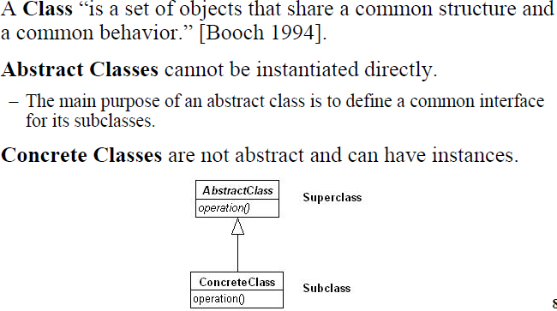
Classes – A Classification

Slide 123
Defining Classes..
Initializing data fields
By setting a value in a constructor
By assigning a value in the declaration
An initialization block
When constructor is called
All data fields are initialized to their default values
All fields initializers and initialization blocks are executed, in the order in which they occur in the class declaration
If the first line of the constructor calls a second constructor, then the body of the second constructor is executed
The body of the constructor is executed

Slide 124
Defining Classes..
Object Destruction & the finalize Method
Java doesn’t support destructors
finalize method can be added to any class
Called before the garbage collector deprecated alternative is Runtime.addShutdownHook

Slide 125
Object- The CRUX of the matter!!
“An object is an entity which has a state and a defined set of operations which operate on that state.”
The state is represented as a set of object attributes. The operations associated with the object provide services to other objects (clients) which request these services when some computation is required
Objects are created according to some object class definition. An object class definition serves as a template for objects. It includes declarations of all the attributes and services which should be associated with an object of that class.
An Object is anything, real or abstract, about which we store data and those methods that manipulate the data.
An object is a component of a program that knows how to perform certain actions and how to interact with other elements of the program.

Slide 126
Object- The CRUX of the matter!!
Each object is an instance of a particular class or subclass with the class's own methods or procedures and data variables. An object is what actually runs in the computer.
Objects are the basic run time entities in an object oriented system.
They match closely with real time objects.
Objects take up space in memory and have an associated address like a Record in Pascal and a Structure in C.
Objects interact by sending Message to one other. E.g. If “Customer” and “Account” are two objects in a program then the customer object may send a message to the account object requesting for bank balance without divulging the details of each other’s data or code.
Code in object-oriented programming is organized around objects.

Slide 127
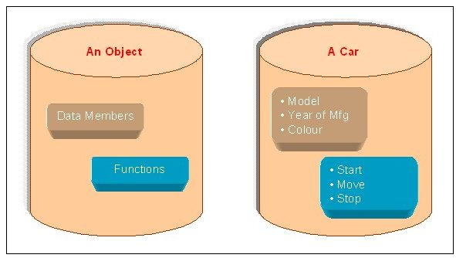
Object- A representation

Slide 128
Object- Attributes and Methods
Object’s Attributes
Attributes represented by data type.
They describe objects states.
In the Car example the car‘s attributes are: color, manufacturer, cost, owner, model, etc.
Object’s Methods
Methods define objects behavior and specify the way in which an Object‘s data are manipulated.
In the Car example the car‘s methods are: drive it, lock it, carry passenger in it.
Objects- blueprints of classes
The role of a class is to define the state and behavior of its instances.
The class car, for example, defines the property color.
Each individual car will have property such as "maroon," "yellow"

Slide 129
Packages
Grouping of classes
Standard Java packages are inside java and javax
A class can use all classes from its own package and all public classes from other packages
Import a specific class or entire package using import statement
Locating classes in package is an activity of package

Slide 130
Packages..
Static Imports
In Java SE 5.0, import statement enhanced to import static methods & fields
import static java.lang.System.*;
out.println(“---”);
Two practical uses
Mathematical functions: static import of Math class
sqrt(pow(x,2)+pow(y,2))
Math.sqrt(Math.pow(x,2)+Math.pow(y,2))
Cumbersome constants
if (d.get(DAY_OF_WEEK) == MONDAY)
if (d.get(Calender.DAY_OF_WEEK) == Calender.MONDAY)

Slide 131
Packages..
Import ONLY imports public classes from the specified package
Classes which are not public cannot be referenced from outside their package.
There is no way to "import all classes except one"
import either imports a single class or all classes within the package
Note: importing has no runtime or performance implications.
It is only importing a namespace so that the compiler can resolve class names.

Slide 132
Packages..
Addition of a class into a Package
Put the name of the package at the top of the calss
No package name, source file belong to default package

Slide 133
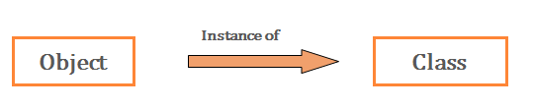
Object Orientated Features
Object orientation adapts to the following criteria's-
1. Changing requirements
2. Easier to maintain
3. More robust
4. Promote greater design
5. Code reuse
6. Higher level of abstraction
7. Encouragement of good programming techniques
8. Promotion of reusability

Slide 134
Inheritance
is-a relationship
Class subclass-name extends superclass-name
{
// body of class
}
Subclass have more functionality then superclass
Each Java class has one (and only one) superclass
There is no limit to the number of subclasses a class can have
There is no limit to the depth of the class tree.

Slide 135
Inheritance..
It is the responsibility of the subclass constructor to invoke the appropriate superclass constructors
Superclass constructors can be called using the "super" keyword in a manner similar to "this"
It must be the first line of code in the constructor
If a call to super is not made, the system will automatically attempt to invoke the no-argument constructor of the superclass.
Super has two general forms.
The first calls the superclass constructor
The second is used to access a member of the superclass that has been hidden by a member of a subclass
A superclass reference can refer to an instance of the superclass OR an instance of ANY class which inherits from the superclass.
Dynamic Method Dispatch will be applicable

Slide 136
Abstract Classes
Contain 0 or more abstract methods.
Act as place holders for abstraction
Used heavily in Design Patterns
Methods can also be abstracted
Any class which contains an abstract method MUST also be abstract
Abstract classes can contain both concrete and abstract methods
Can never be instantiated

Slide 137
Interfaces
Similar to an abstract class with the following
exceptions:
All methods defined in an interface are abstract. Interfaces can contain no implementation.
Interfaces cannot contain instance variables. However, they can contain public static final variables (i.e. constant class variables)
All methods are public by default & fields are public static final
Declared using the "interface" keyword
If an interface is public, it must be contained in a file which has
the same name.
Interfaces are more abstract than abstract classes
Interfaces are implemented by classes by "implements“ keyword.

Slide 138
Interfaces..
Interface can be implemented
One interface can inherit other
When a class implements an interface
it must provide implementation for all the methods defined within an interface chain
a class may implement several Interfaces
If an abstract class implements an interface, it NEED NOT implement all methods defined in the interface.
access class classname [extends superclass]
[implements interface[,interface…..]]{
//class body
}
Access is either public or not used

Slide 139
Interfaces..
Partial Implementation
If a class includes an interface but does not fully implements the methods defined by that interface then that class must be declared as abstract
Used in initial stages of Project Planning as a blueprint

Slide 140
Multiple Inheritance?
Allowing classes to implement multiple interfaces is the same thing as multiple inheritance
This is NOT true. When you implement an interface:
The implementing class does not inherit instance variables
The implementing class does not inherit methods (none are defined)
The Implementing class does not inherit associations
Implementation of interfaces is not inheritance.
An interface defines a list of methods which must be implemented.
Interfaces afford the benefits of multiple inheritance while avoiding the complexities and inefficiencies

Slide 141
Abstract Classes vs. Interfaces
When should one use an Abstract class instead of an interface?
If the subclass-superclass relationship is genuinely an "is a" relationship.
If the abstract class can provide an implementation at the appropriate level of abstraction
When should one use an interface in place of an Abstract Class?
When the methods defined represent a small portion of a class
When the subclass needs to inherit from another class
When you cannot reasonably implement any of the methods

Slide 142
Overloading vs. Overriding
Overloading occurs when two or more methods in one class have the same method name but different parameters.
Overriding means having two methods with the same method name and parameters (i.e., method signature). One of the methods is in the parent class and the other is in the child class.
Overriding allows a child class to provide a specific implementation of a method that is already provided its parent class.
Polymorphism applies to overriding, not to overloading.

Slide 143
Object: The Cosmic Superclass
Every class is a reference variable of type Object
It can refer to an object of any other class extends Object
Object class is defined in the java.lang package
Examine it in the Java API Specification

Slide 144
Object Wrapper and Autoboxing
All primitive types have class counterparts- Reason why java is fully OOPs and not Pure OOPs
Wrapper class
Integer
Long
Float
Double
Short
Byte
Character
Void
Boolean

Slide 145
Java Autoboxing
Converting a primitive value into an object of the corresponding wrapper class is called autoboxing.
For example, converting int to Integer Class.
The Java compiler applies autoboxing when a primitive value is:
Passed as a parameter to a method that expects an object of the corresponding wrapper class.
Assigned to a variable of the corresponding wrapper class.

Slide 146
Java Unboxing
Converting an object of a wrapper type to its corresponding primitive value is called unboxing.
For example conversion of Integer to int.
The Java compiler applies unboxing when an object of a wrapper class is:
Passed as a parameter to a method that expects a value of the corresponding primitive type.
Assigned to a variable of the corresponding primitive type.

Slide 147
Inner Classes
Class defined inside another class
Uses
Can access the data from the scope in which they are defines
Can be hidden from other classes in the same package
Anonymous inner classes are handy when you want to define callbacks without writing a lot of code
An object of an inner class always gets an implicit reference to the object that created it.
Only inner classes can be private.
Regular classes always have either package or public visibility

Slide 148
Nested Classes
Nested classes are divided into two categories:
Static nested class : Nested classes that are declared static are called static nested classes.
Inner class : An inner class is a non-static nested class.

Slide 149
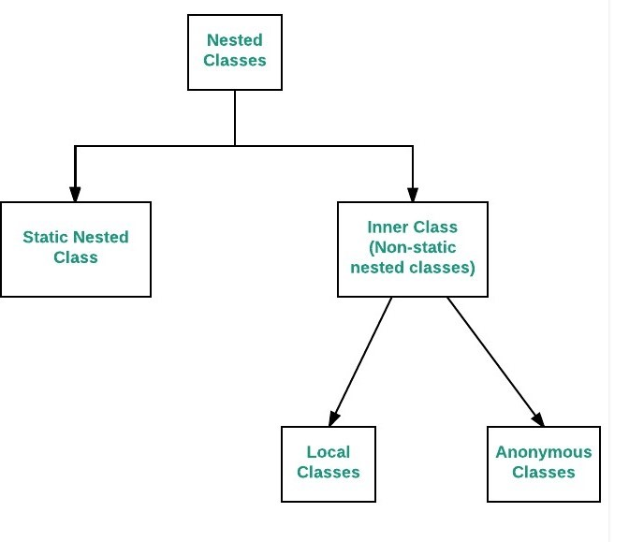
Inner Classes

Slide 150
Static Inner Classes
As with class methods and variables, a static nested class is associated with its outer class.
Like static class methods, a static nested class cannot refer directly to instance variables or methods defined in its enclosing class: it can use them only through an object reference.
They are accessed using the enclosing class name.
OuterClass.StaticNestedClass
For example, to create an object for the static nested class, use this syntax:
OuterClass.StaticNestedClass nestedObject = new OuterClass.StaticNestedClass();

Slide 151
Inner Classes
To instantiate an inner class, you must first instantiate the outer class. Then, create the inner object within the outer object with this syntax:
OuterClass.InnerClass innerObject = outerObject.new InnerClass();

Slide 152
Local Inner Classes
Local Inner Classes are the inner classes that are defined inside a block. Generally, this block is a method body.
These class have access to the fields of the class enclosing it.
Local inner class must be instantiated in the block they are defined in.

Slide 153
Anonymous Inner Classes
It is an inner class without a name and for which only a single object is created.
An anonymous inner class can be useful when making an instance of an object with certain “extras” such as overloading methods of a class or interface, without having to actually subclass a class.
Anonymous inner classes are useful in writing implementation classes for listener interfaces in graphics programming.

