Slide 1
Capstone Project
Cyclistic
Bike Share Analysis
By: Sakshi Gupta

Slide 2
Introduction
The project is about fictional company, Cyclistic.
In 2016, Cyclistic launched a successful bike-share offering. Since then, the program has grown to a feet of 5,824 bicycles that are geotracked and locked into a network of 692 stations across Chicago.
The company wants to design marketing strategies aimed at converting casual riders into annual members.

Slide 3
About the Dataset
The data has been made available by Motivate International Inc.
The dataset is made of 12 months historical trip data from 2023.
The dataset has 5719877 observations and 13 attributes.
This data set will be useful for analysing the trends and patterns related to how different customers use the company’ bikes.
Personally Identifiable Information has been restricted from the dataset to protect the customer’s privacy.

Slide 4
Is the Data ROCCC ?
Reliable - Data is not biased.
Original - The data is from first party source
Comprehensive - The data contains appropriate attributes related to riders and bike use.
Current - The data is from 2023.
Cited - Yes, it is cited.

Slide 5
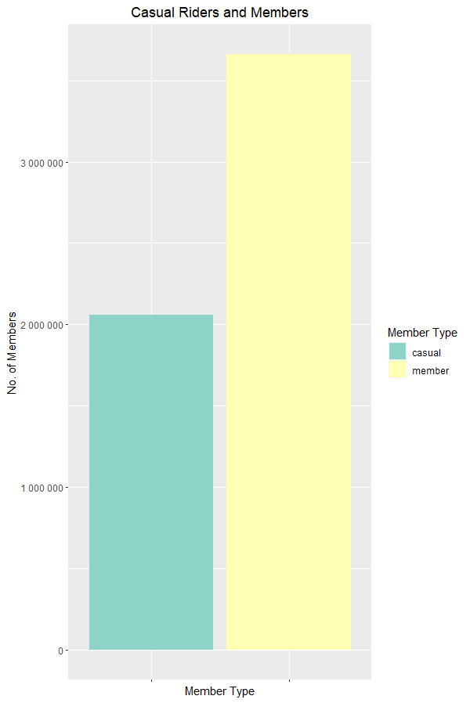
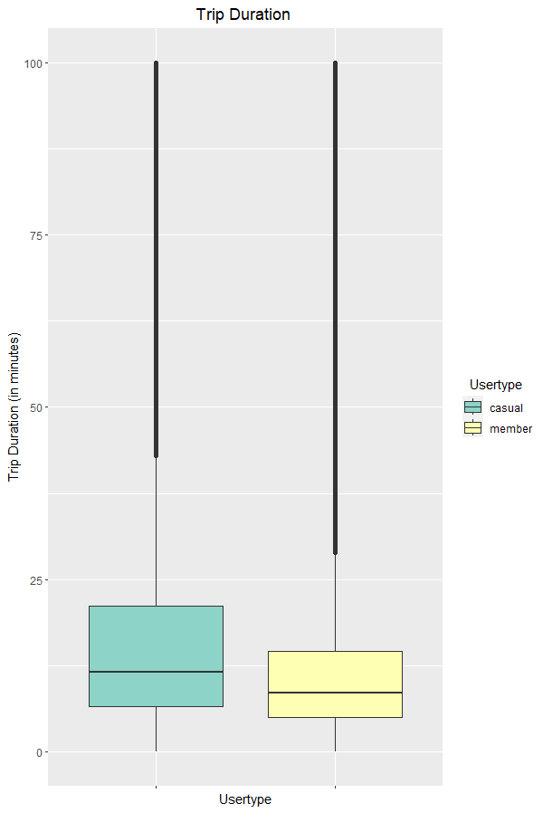
The data contains 2059037 observations about Causal riders and 3660568 observations about member riders.
The average ride length for casual riders is 28.25 mins and for member riders it is 12.53 mins which implies on average casual riders are travelling for longer distance

Slide 6
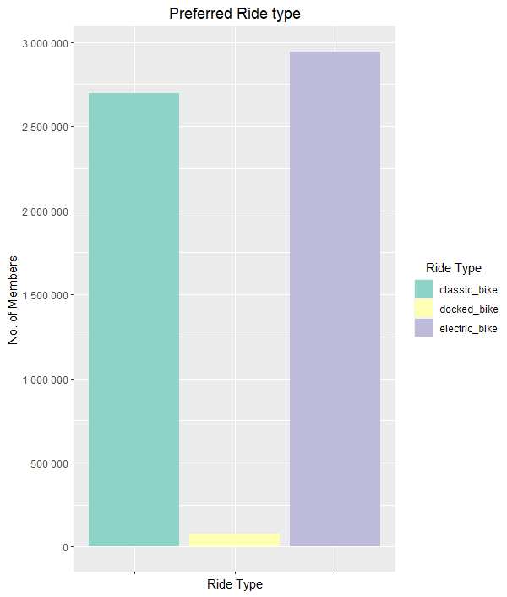
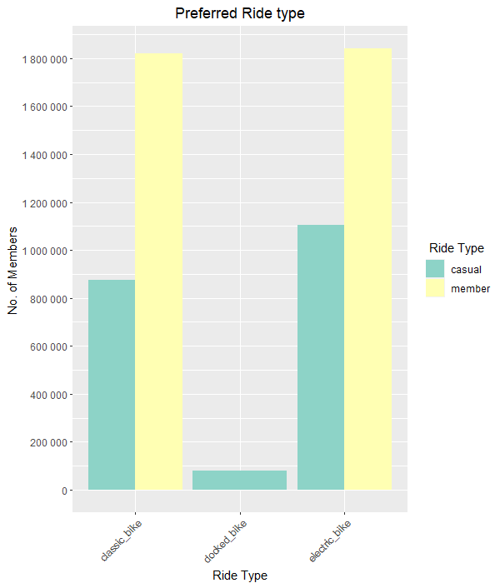
Docked Bike is the least preferred ride type and is entirely used by casual members.
Casual members prefer Electric bike over Classic Bike while member use both equally

Slide 7
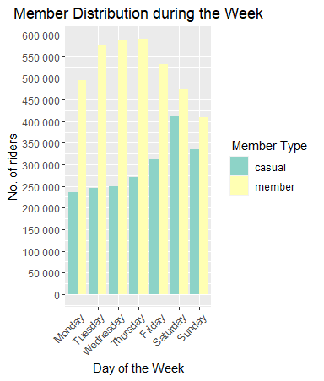
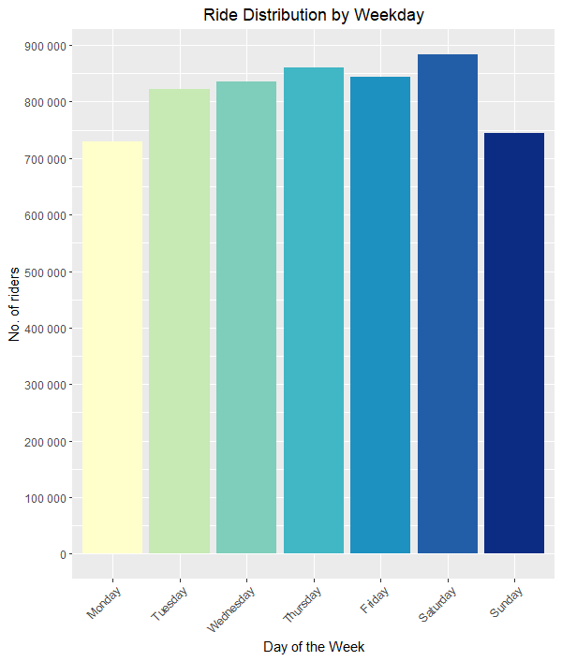
During the week, Friday is the busiest day and Monday the least busy day.
No. of Rides for Members peak during the weekdays and they use the bike least on weekends.
Ridership for Casual Members peaks on weekends and they do not use the bike service much on weekdays.

Slide 8
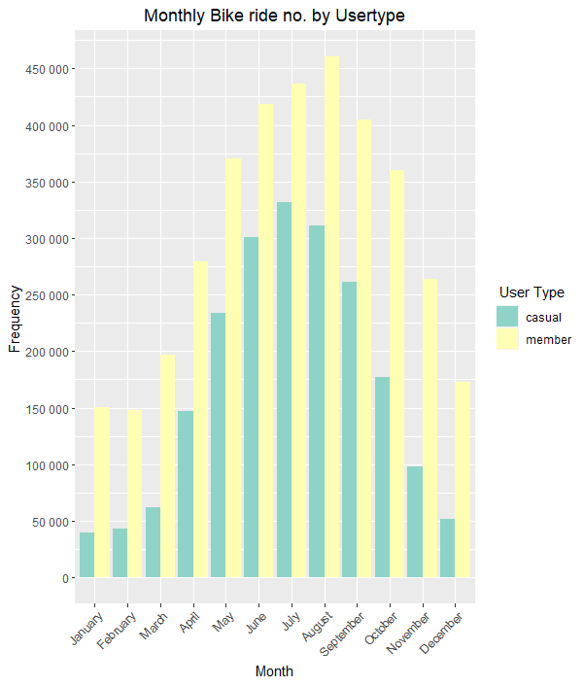
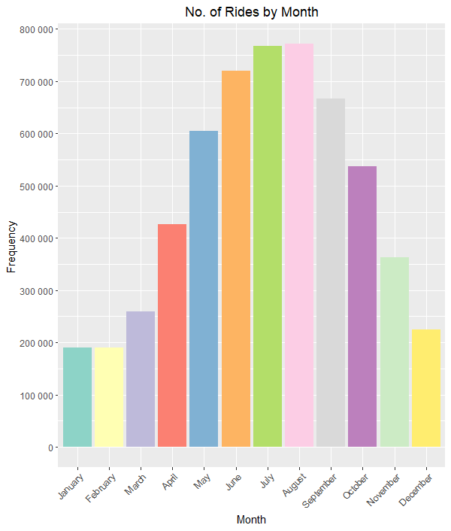
June, July and August are the months with most no. of trips.
Winter months of January, February and December witnessed the least no. of rides during the year for both the member types.

Slide 9
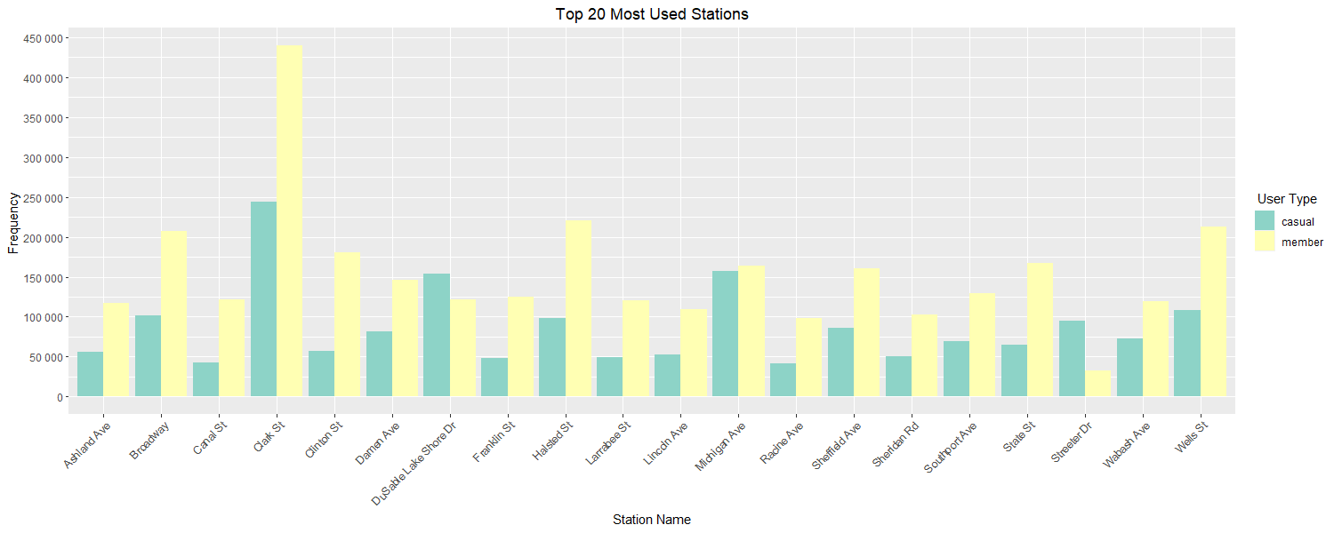

Slide 10
Conclusion
To encourage more people to become a member, the Cyclists can adopt some of the following strategies:
Launch a point based reward system based on distance traveled for members.
Casual riders use the services more on weekend for recreational and leisure activities so marketing schemes should be launched around areas like cafes, parks, community centres and theatres and offer group discounts.
Increasing marketing activities in the top popular stations along with promotional offers.
Devise a promotional scheme for winter months to help pickup low ridership during these months.
Offering Discounted campaigns during weekdays to encourage more casual riders to use the service during the week

