Slide 1

CROSSWORD PUZZLE
(USING BACKTRACKING)
DAA Seminar

Slide 2
TEAM MEMBERS
Prince Nandha (U19CS045)
Sakshi Jain (U19CS048)
Lisa Verma (U19CS071)
Himani Verma (U19CS075)

Slide 3
PROBLEM STATEMENT
We are provided a crossword of 10*10 grid. The grid contains '+' or '-' as its cell values. Now, you are also provided with a word list that needs to placed accurately in the grid. Cells marked with '-' are to be filled with word list.
For example, The following is an example for the input crossword grid and the word list.
+ - + + + + + + + +
+ - + + + + + + + +
+ - + + + + + + + +
+ - - - - - + + + +
+ - + + + - + + + +
+ - + + + - + + + +
+ + + + + - + + + +
+ + - - - - - - + +
+ + + + + - + + + +
+ + + + + - + + + +
Words : { DELHI, ICELAND, ANKARA, LONDON }

Slide 4

Output for the given input should be:
+ L + + + + + + + +
+ O + + + + + + + +
+ N + + + + + + + +
+ D E L H I + + + +
+ O + + + C + + + +
+ N + + + E + + + +
+ + + + + L + + + +
+ + A N K A R A + +
+ + + + + N + + + +
+ + + + + D + + + +
Note: We have provided such test cases that there is only one solution for the given input.

Slide 5

Input format:
The first 10 lines of input contain crossword. Each of 10 lines has a character array of size 10. Input characters are either '+' or '-'.
The next line of input contains the word list, in which each word is separated by ';'.
Output format:
Print the crossword grid, after placing the words of word list in '-' cells.

Slide 6
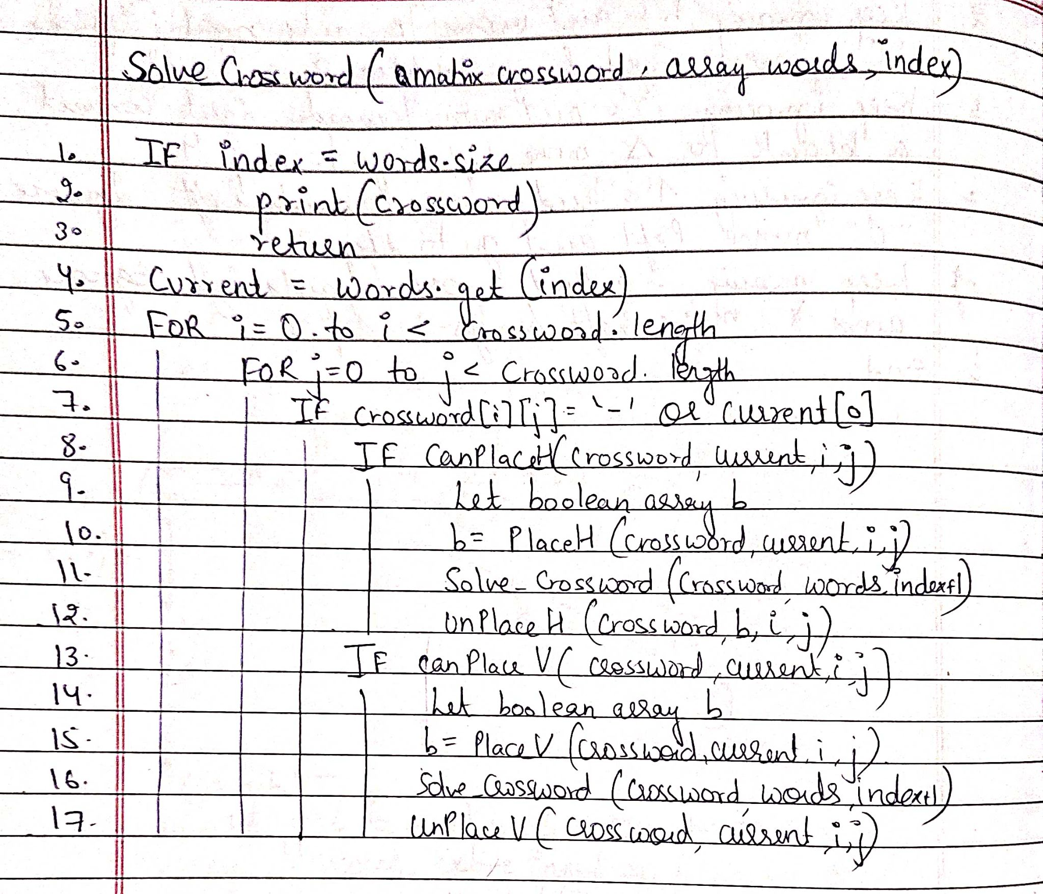

PSEUDO CODE

Slide 7
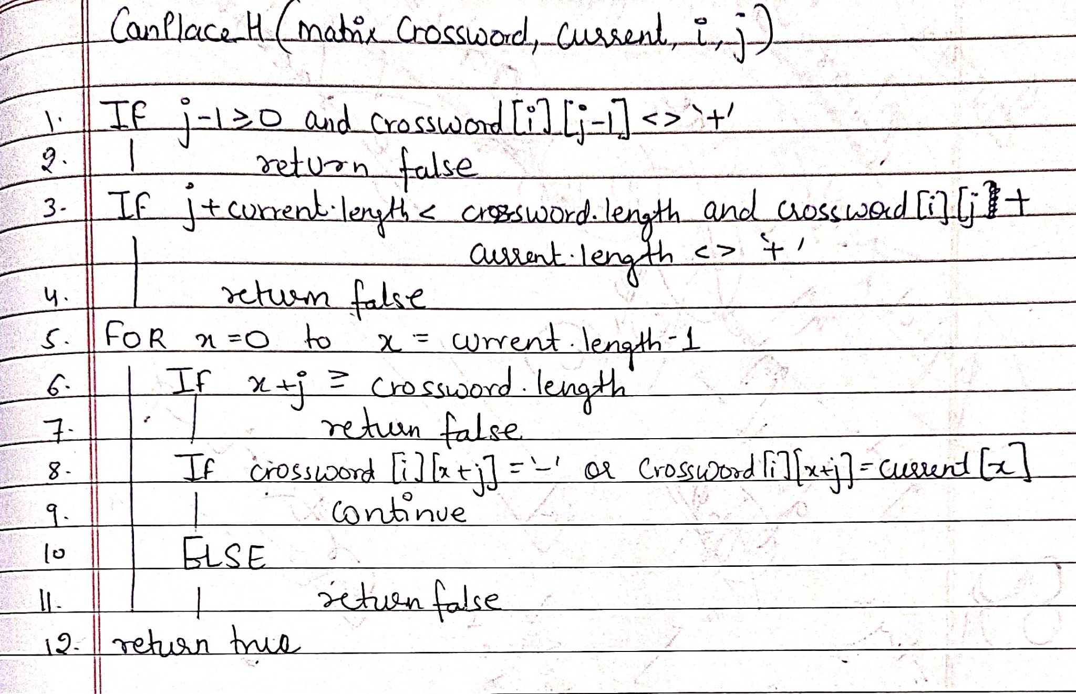

Slide 8
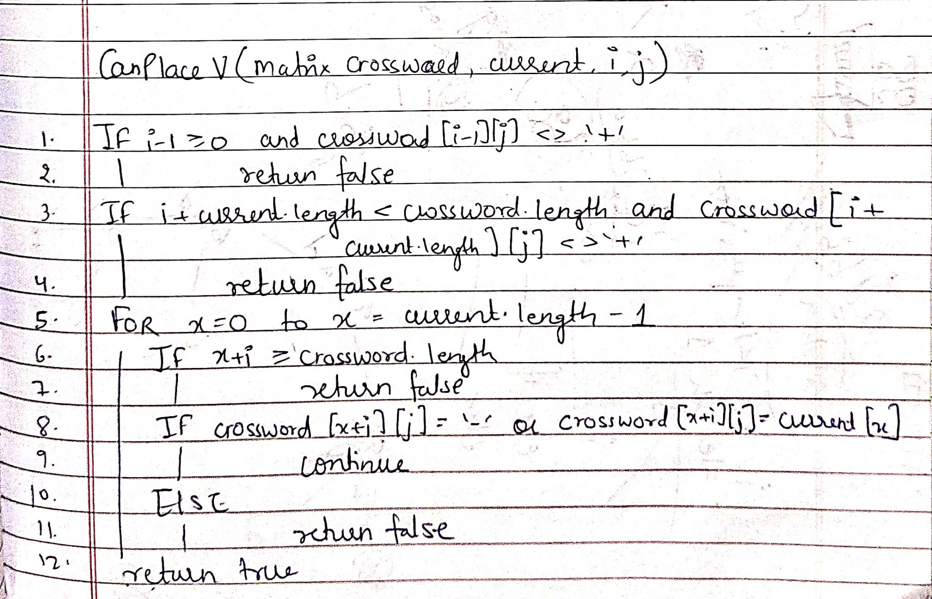

Slide 9
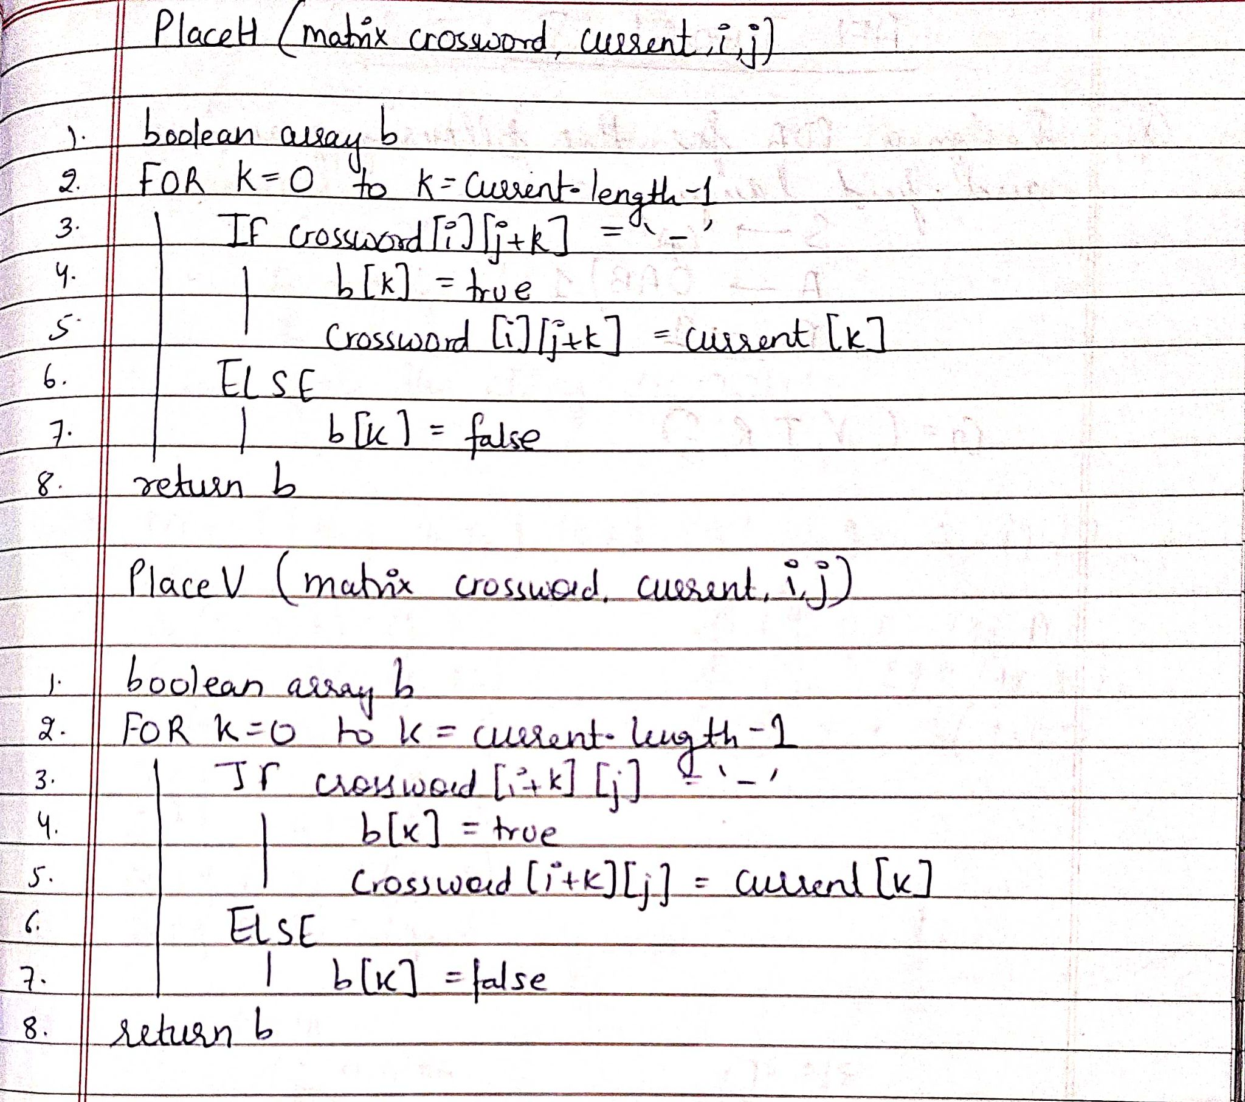


Slide 10
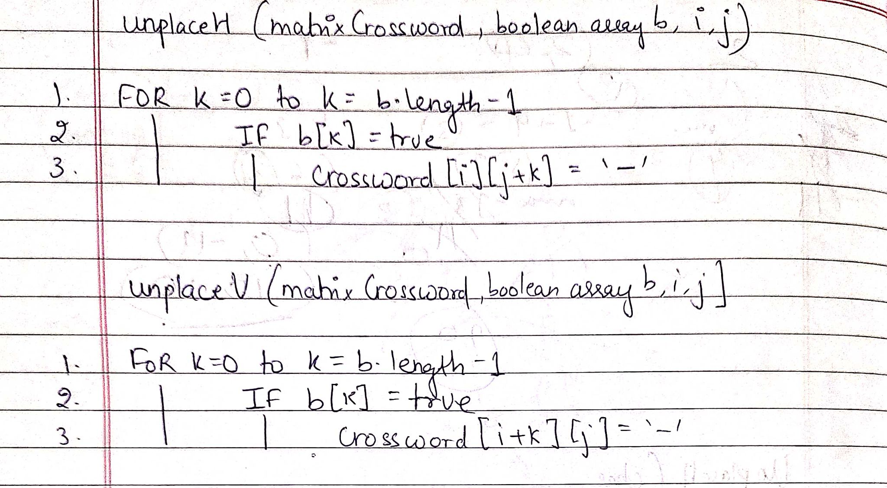

Slide 11

IMPLEMENTATION
public static void solveCr(char[][] crossword,ArrayList<String> words,int index){
/* This prints the different ways crossword can be filled */
if (index==words.size()){
printC(crossword);
return;
}
String current = words.get(index);

Slide 12
for (int i = 0; i < crossword.length; i++) {
for (int j = 0; j < crossword.length; j++) {
if (crossword[i][j]=='-' || crossword[i][j]==current.charAt(0)){
if (canplaceH(crossword,current,i,j)==true){
boolean[] wePlaced = placeH(crossword,current,i,j); //Boolean array to use in backtracking
solveCr(crossword,words,index+1); //Recursive call
unplaceH(crossword,wePlaced,i,j); //Backtracking
}
if (canplaceV(crossword,current,i,j)==true){
boolean[] wePlaced = placeV(crossword,current,i,j); //Boolean array to use in backtracking
solveCr(crossword,words,index+1); //Recursive call
unplaceV(crossword,wePlaced,i,j); //Backtracking
}
}
}
}

Slide 13
/* This function checks if the word can be placed horizontally from index i,j */
public static boolean canplaceH(char[][] crossword,String current,int i,int j){
//First two if conditions make sure the assumed part of puzzle is bounded with + symbol
if (j-1>=0 && crossword[i][j-1]!='+') return false;
if (j+current.length()<crossword.length && crossword[i][j+current.length()]!='+')
return false;
for (int x = 0; x < current.length(); x++) {
if (x+j>=crossword.length) return false;
if (crossword[i][x+j]=='-' || crossword[i][x+j]==current.charAt(x)){
continue;
}else {
return false;
}
}
return true;
}

Slide 14
/* This function checks if the word can be vertically from index i,j */
public static boolean canplaceV(char[][] crossword,String current,int i,int j){
//First two if conditions make sure the assumed part of puzzle is bounded with + symbol
if (i-1>=0 && crossword[i-1][j]!='+') return false;
if (i+current.length()<crossword.length && crossword[i+current.length()][j]!='+')
return false;
for (int x = 0; x < current.length(); x++) {
if (x+i>=crossword.length) return false;
if (crossword[i+x][j]=='-' || crossword[i+x][j]==current.charAt(x)){
continue;
}else {
return false;
}
}
return true;
}

Slide 15

/* This function places the word horizontally from index i,j */
public static boolean[] placeH(char[][] crossword,String current,int i,int j){
boolean[] res=new boolean[current.length()];
for (int k = 0; k < current.length(); k++) {
if (crossword[i][j+k]=='-'){
res[k] = true;
crossword[i][j+k] = current.charAt(k);
}
else res[k] = false;
}
return res;
}
/* This function places the word vertically from index i,j */
public static boolean[] placeV(char[][] crossword,String current,int i,int j){
boolean[] res=new boolean[current.length()];
for (int k = 0; k < current.length(); k++) {
if (crossword[i+k][j]=='-'){
res[k] = true;
crossword[i+k][j] = current.charAt(k);
}
else res[k] = false;
}
return res;
}

Slide 16
/* This function is used to backtrack using the boolean array that was generated horizontally */
public static void unplaceH(char[][] crossword,boolean[] arr,int i,int j){
for (int k = 0; k < arr.length; k++) {
if (arr[k]){ //If boolean value is true then we replace the word with -
crossword[i][j+k]='-';
}
}
}
/* This function is used to backtrack using the boolean array that was generated vertically */
public static void unplaceV(char[][] crossword,boolean[] arr,int i,int j){
for (int k = 0; k < arr.length; k++) {
if (arr[k]){ //If boolean value is true then we replace the word with -
crossword[i+k][j]='-';
}
}
}

Slide 17
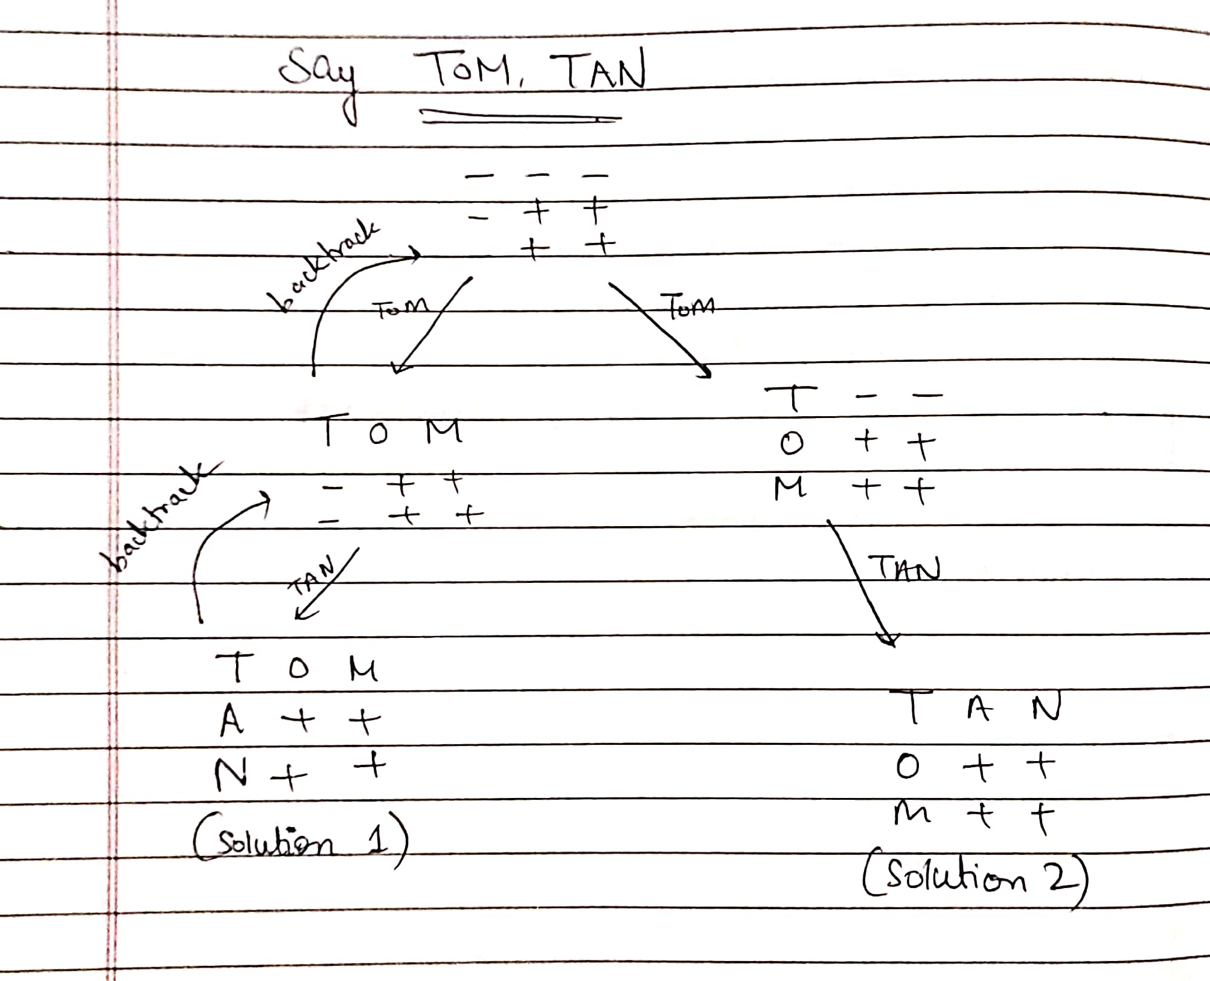
LETS THINK

Slide 18
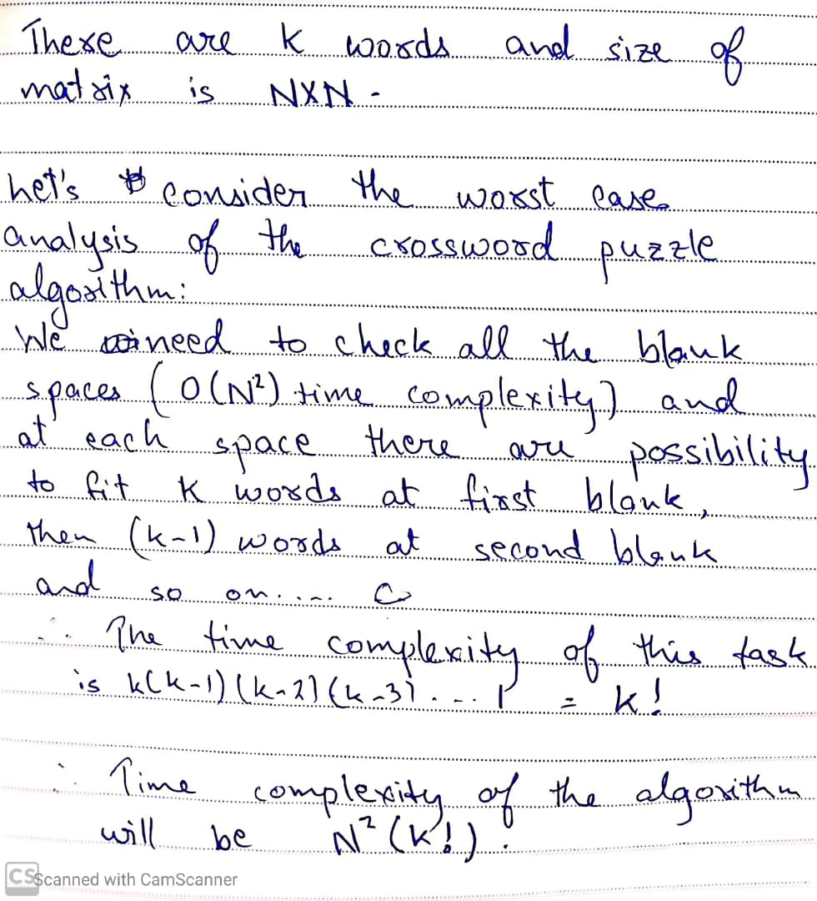

ANALYSIS
Space Complexity : O(n^2 + k)
O(N^2* K!)

Slide 19

CONCLUSION
Hence we conclude that we successfully explained, implemented and analysed the crossword puzzle algorithm using backtracking.

Slide 20

THANK YOU

