Slide 1

Credit Card Fraud Detection
Project of buan 6340.501-Programming for Data Science
Made By: Sakshi JAIN (Net id: sxj166030)

Slide 2

Data Set
Credit Card Transaction data Set by European cardholders from Kaggle
30 input variables (V1,V2, V3,…, V28, Amount, Time)
V1 to V28 features are PCA transformed due to confidentiality issues
1 output variable (Class-1 in case of fraud and 0 otherwise)
Total Transactions 284,807

Slide 3


Aim To Achieve
Predict Fraud Transactions (Anomalies) through Machine Learning Algorithms

Slide 4
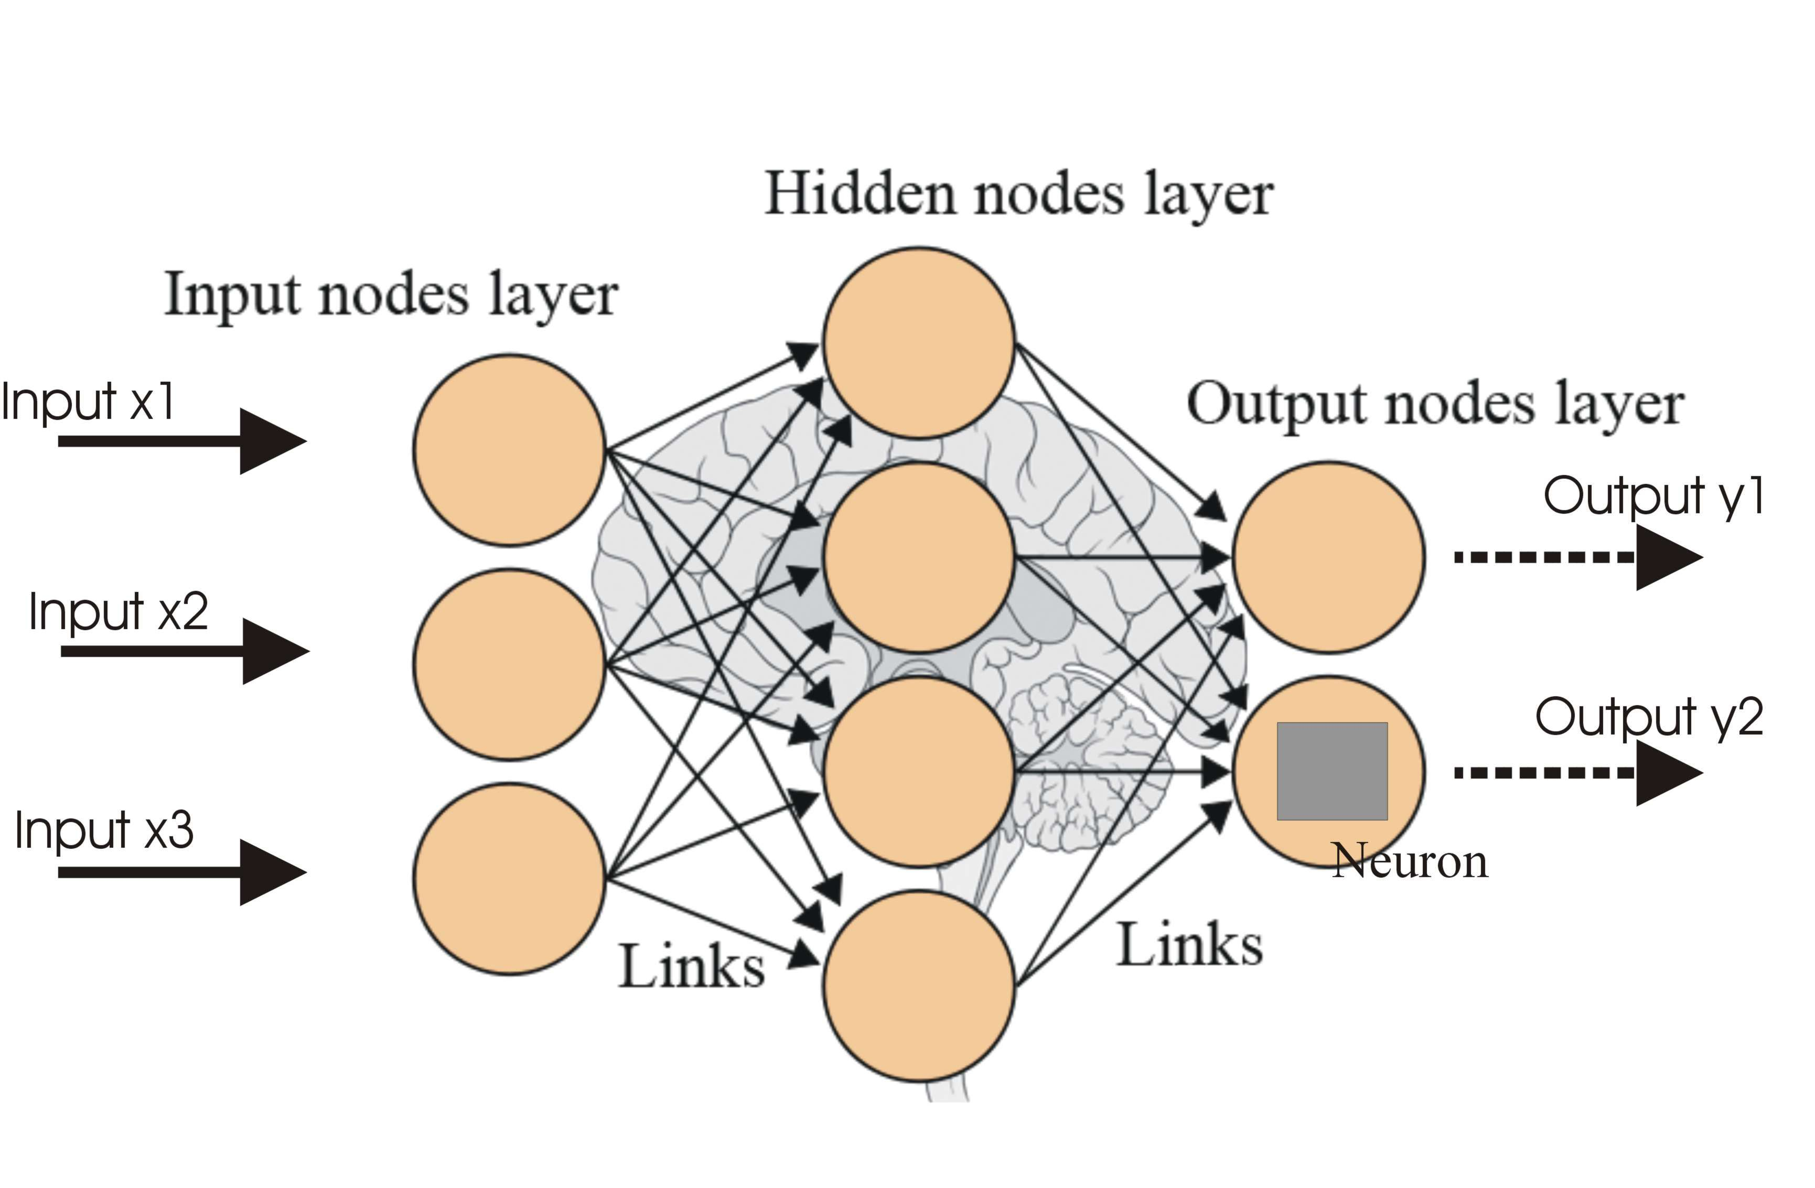
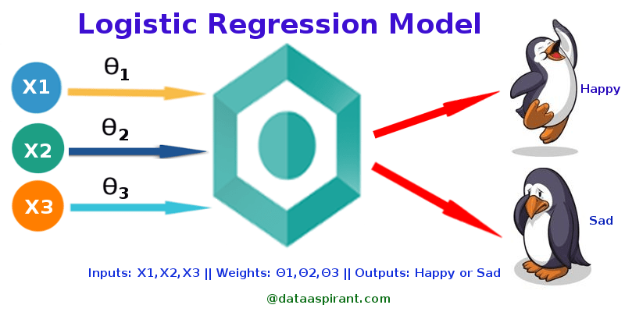
Algorithms
Artificial Neural Network Using Keras
Logistic Regression

Slide 5
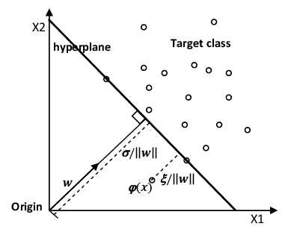
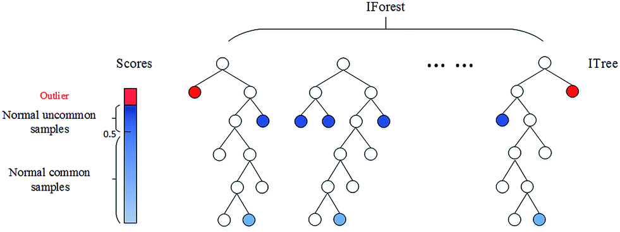
Algorithms- Anomaly Detection
One Class SVM
Isolation Forest

Slide 6
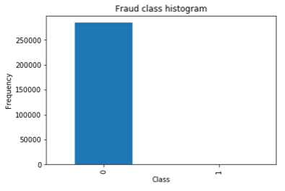

Data Exploration
Highly Skewed Data
Class 1 denotes Fraud: 492 transactions
Class 0 denoted Valid: 284,315 transactions
Frauds accounts for 0.172% of Total
No Nulls so no imputations

Slide 7
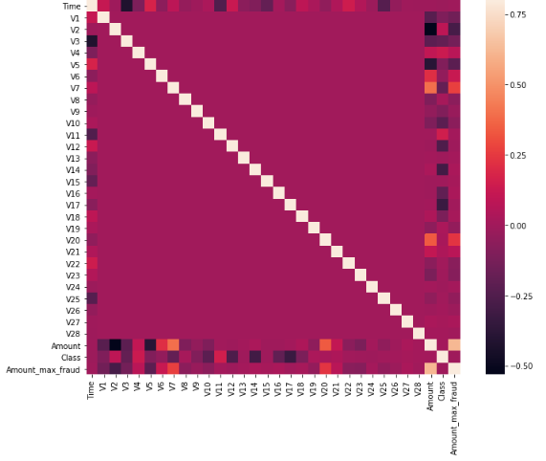
Data Exploration
Figure is Correlation Matrix with Heat Map
No relation between V parameters
Most parameters are clustered around 0
Some are affecting Target “Class” Variable
Ex: V11 is strongly positive correlated with Class
Ex: V17 is strongly negative correlated

Slide 8
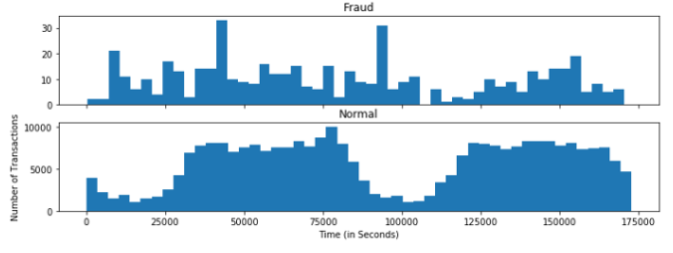
Data Exploration
Fraud and normal transaction vs. time
Frauds are more uniformly distributed
Valid have a cyclical distribution
Valid transactions is less between1 to 5am
So, easy to detect frauds during at an 'off-peak' time

Slide 9
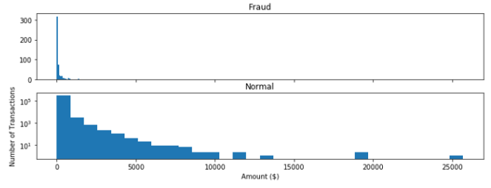
Data Exploration
Fraud and normal transaction vs. amount of transaction
Most Transactions are small amounts, less than 100.
Frauds have maximum value of $2,125.87 much less than Valid
Valid transactions have maximum value of $25,691.16

Slide 10
Data Preprocessing- ANN
Add Extra Column
One categorial column Amount_max_fraud
Value(Amount_max_fraud) = 0 if amount <= 2125.87 (Max Value of Fraud)
Value(Amount_max_fraud) = 1 if amount > 2125.87
Feature Centering and scaling
Rescaling means Z-score normalization with mean of 0 and a standard deviation of 1.
All columns are between 0 and 1 except amount and time

Slide 11
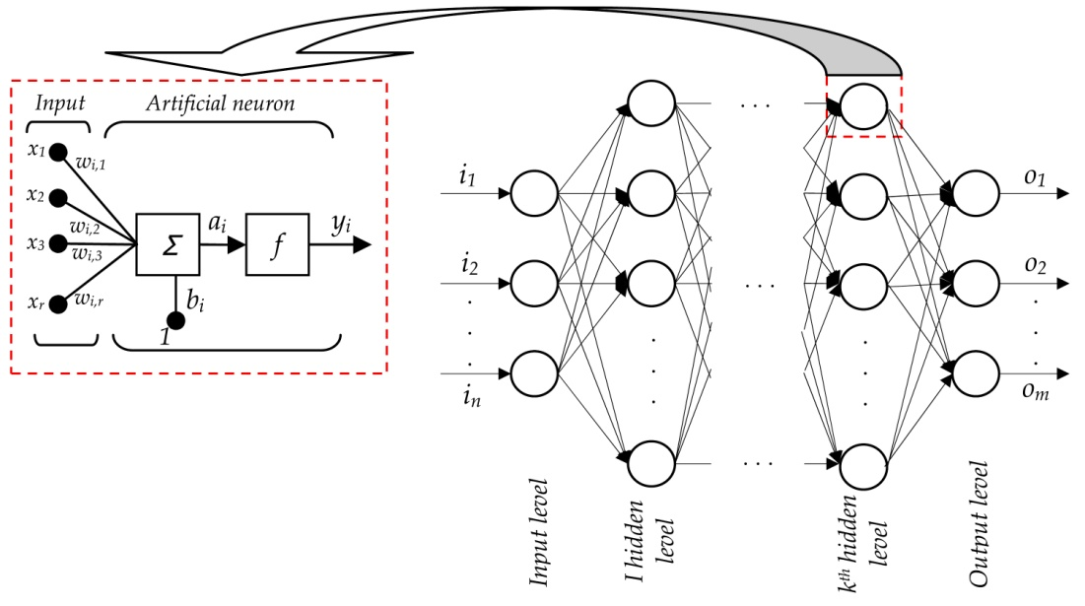
Data Model- ANN Algorithm
Major Components and Values:
Input nodes: No. of input variables - 31
Hidden Layer: 3
Activation Function: ReLu and softmax ReLu: Rectifier Linear Unit at Hidden Layers Softmax: Sigmoid Function at output Layer
Epochs: 20
Batch Size: 2048
Output Layer

Slide 12
Data Model- ANN Algorithm
Algorithm Steps:
Randomly Initialize weights to small numbers close to 0(but not 0)
Input the first observation of your dataset in input layer, each feature in one input node
Forward Propagation: from left to right, the neurons are activated in a way that impact of each neuron's activation is limited by the weights. Propagate them until predicted result Y
Compare the predicted result to the actual result. Measure the generated error.
Back Propagation: from right to left, error is back propagated. Update Weights according to how much they are responsible for error. Learning rates decides updates
Repeat Step 1 to 5 and update weights after batch of observations (Batch Learning)
When the whole training set passed through ANN, that makes an Epoch. Redo more epochs

Slide 13
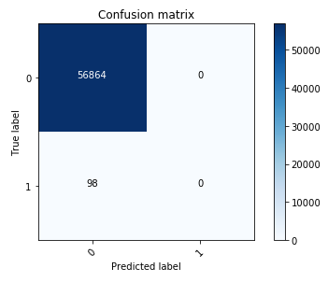
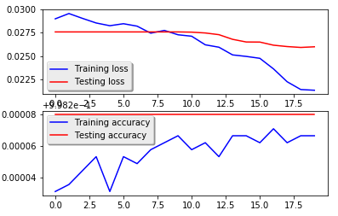
Data Model- ANN Algorithm
Result: Accuracy: 99.83%
Model didn’t predict frauds. But did predict valid transactions correctly.

Slide 14

Let us try this other way…!

Slide 15
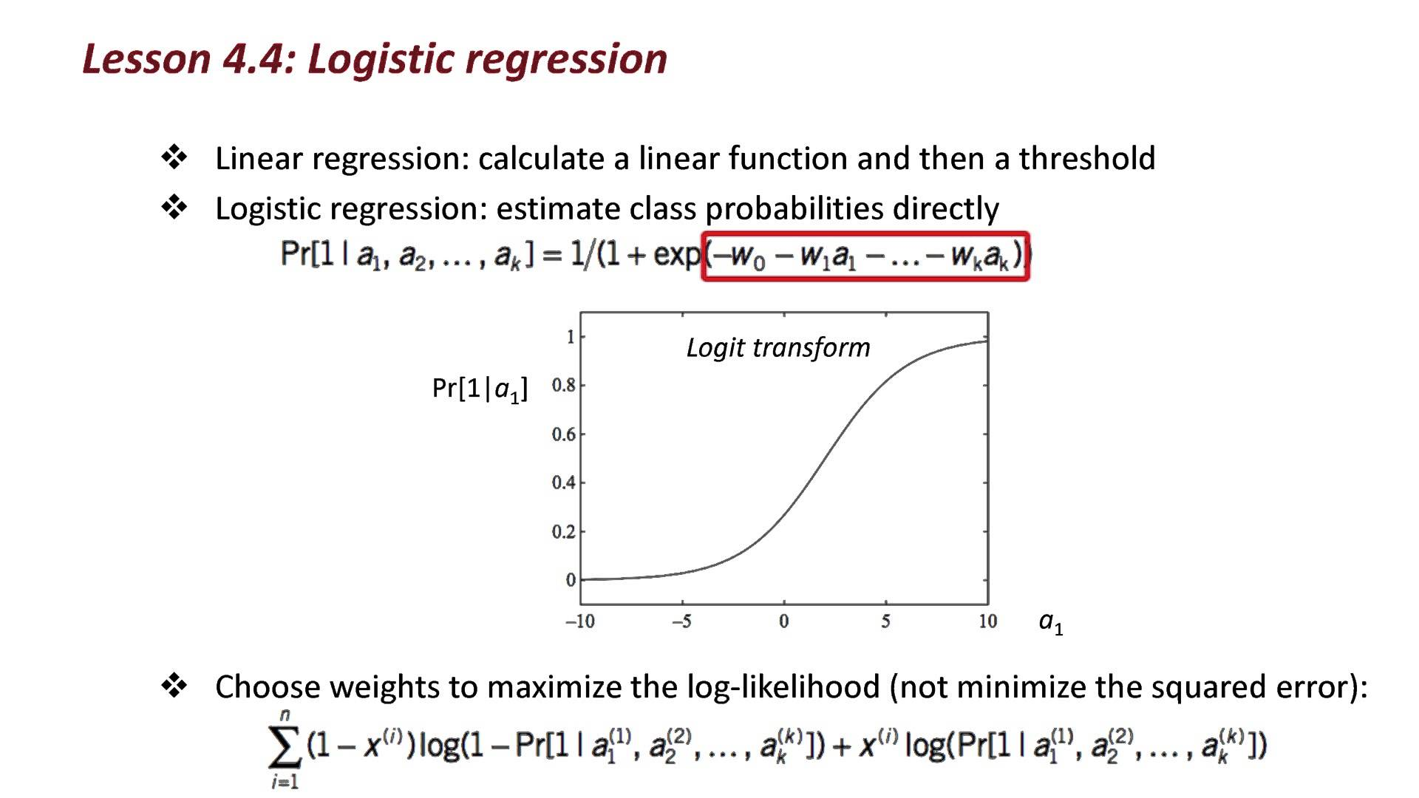
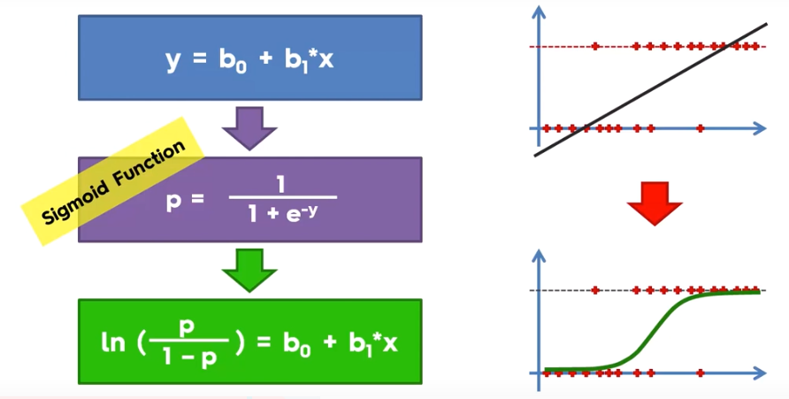
Data Model- Logistic Regression
About It…

Slide 16
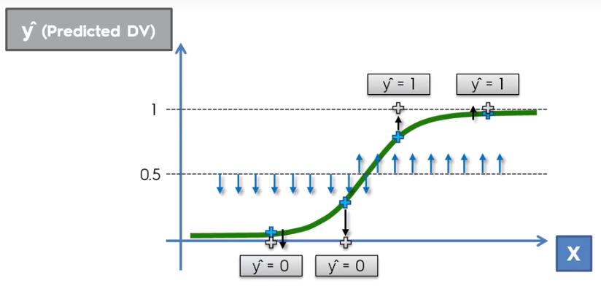
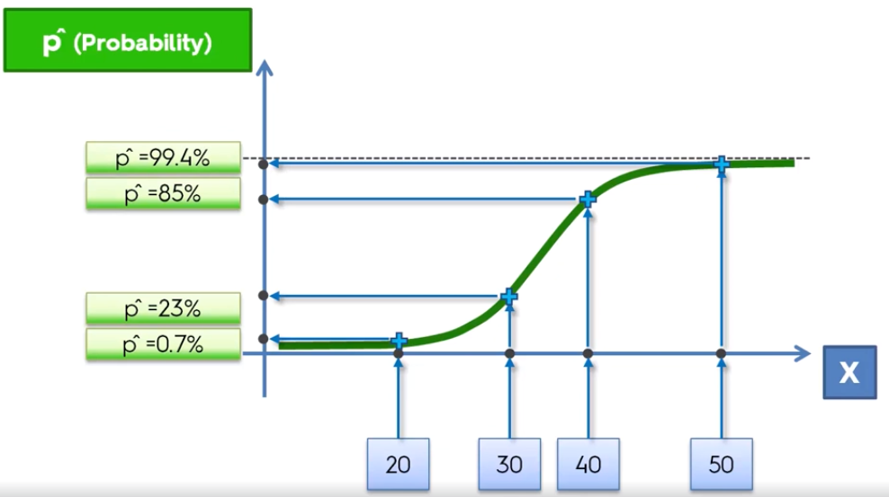
Data Model- Logistic Regression
About It…
Predict the probability if transaction is fraud or not.

Slide 17
Data Model- Logistic Regression
Data Preprocessing
Problem: Highly Skewed Data
Solutions available in market:
Oversampling : duplicate the observations of the minority class to obtain a balanced dataset. (Better when less data)
Under sampling : drop observations of the majority class to obtain a balanced dataset. (Better when lot’s of data)
We Chose Under Sampling by creating a 50/50 ratio.
Used Logistic Regression with Cross Validation for hyperparameter tuning to have best model

Slide 18
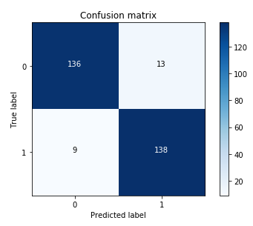
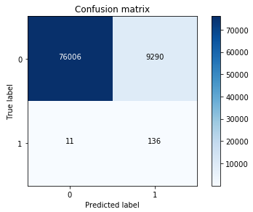
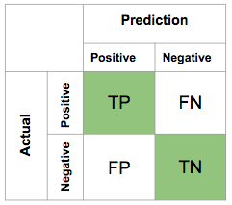
Data Model- Logistic Regression
Interested more in Recall Accuracy because it will capture most Frauds
Under Sample Data
Recall Accuracy: 93.87
Whole Data
Recall Accuracy: 92.51

Slide 19
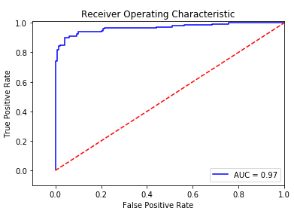
Data Model- Logistic Regression
ROC Curve (sensitivity/specificity ratio)
Area under the under 97%

Slide 20
Let us try it again…!

Slide 21
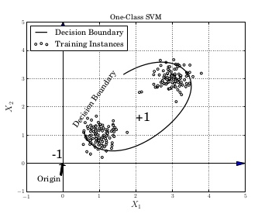

Anomaly Detection- One Class SVM
Anomaly detection model which uses the maximum margin separating hyper plane.
Sch¨olkopf et al. proposed a training methodology that handles only one class classiﬁcation called as ”one-class” classiﬁcation.
The method ﬁnds soft boundaries of the data set. Then model determines whether new instance belongs to this dataset or not

Slide 22

Anomaly Detection- One Class SVM
Output:
Training: One Class SVM (Linear) : 90%
Test: One Class SVM (Linear) : 18.90%

Slide 23
Let us try this one last time…!

Slide 24
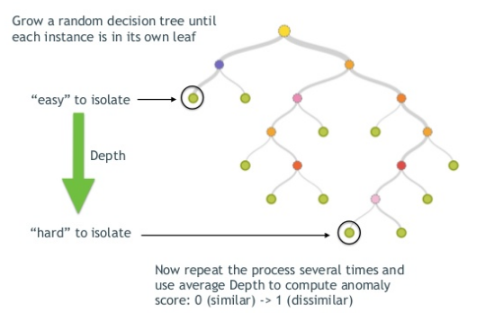
Anomaly Detection- Isolation Forest
Isolation forest is the new technique to detect anomalies.
The way that the algorithm constructs the separation is by first creating isolation trees, or random decision trees.
Then, the score is calculated as the path length to isolate the observation.
Reference: http://blog.easysol.net/using-isolation-forests-anamoly-detection/

Slide 25

Anomaly Detection- Isolation Forest
Output:
Training: Isolation Forest: 88.99%
Test: Isolation Forest : 90.04%
THIS IS GREAT !!!

Slide 26
Results
We can use either Logistic Regression (LR) done with Cross Validation or Isolation Forest Model as our final model.
Its because though ANN model has high accuracy but failed to predict anomalies
LR model has low accuracy but at least predicting some anomalies which was our aim to achieve
Also, Isolation Forest has outperformed SVM on test data set with accuracy of 90.04%. I will consider it as best anomaly detection model in our case.
To make LR model better, we can repeat the process with different under sample configurations and check if the previous chosen parameters are still the most effective.

Slide 27
Thank You!

