Slide 1

IMDB Movie Data
Analysis
Made By:-
Sakshi Jain

Slide 2

Agenda
Introduction
What are we hunting for? (Objective)
What is Given (Data Exploration)
Data Cleansing / Massage
Feature Selection
Model Building
Testing and Evaluation
Summary
IMDB Movie Data
Analysis

Slide 3


Introduction
Movie industry is very big.
100s of movies are released every year.
There are two kinds of movies great movies and profitable movies.
Is there anyway we can differentiate the Good / Great movies with Box-office success.
Are these IMDb ratings any good in evaluating movies?

Slide 4




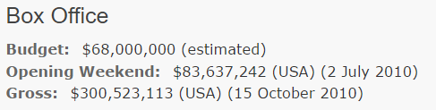

What are we hunting for ? (Objective)
Profit % : ~ 13%
Profit % : ~ 342%

Slide 5
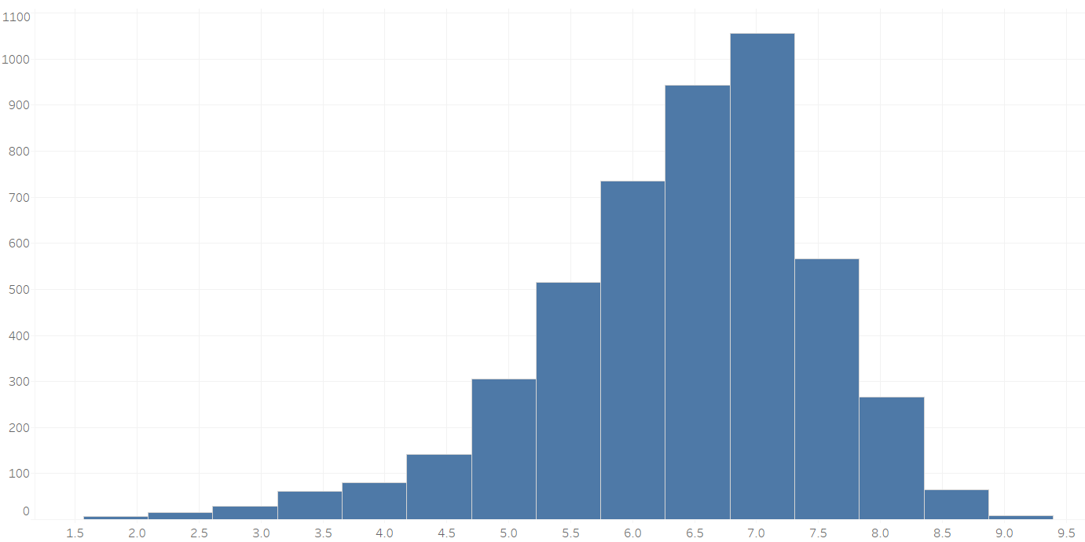
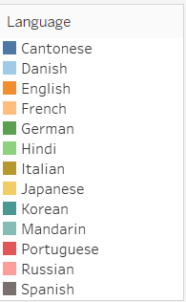
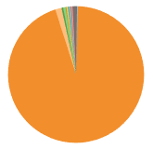

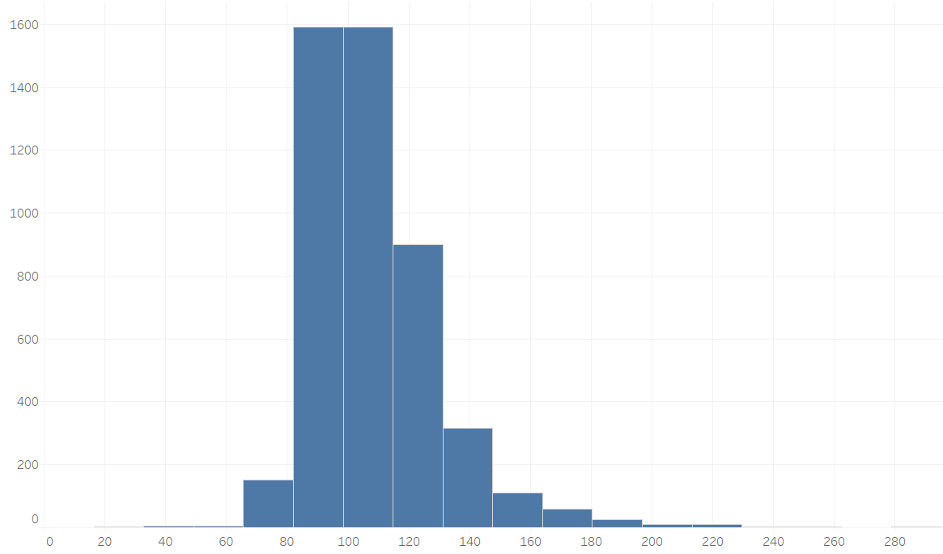
What is Given ? (Data Exploration)
Total Records : 4,795
Rating Distribution
Rating Distribution
Other than English
Duration of Movies

Slide 6
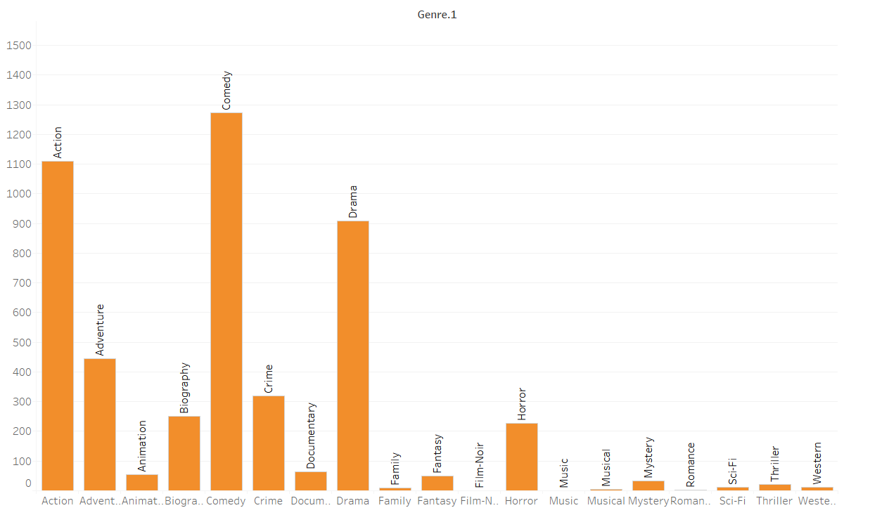
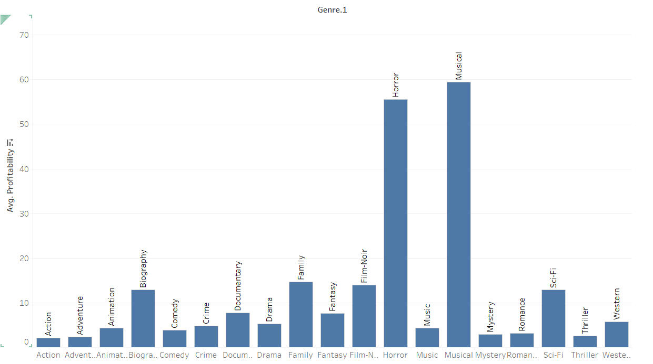
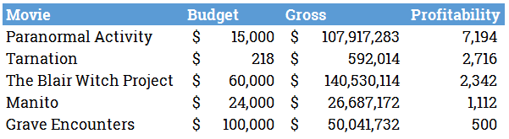
What is Given ? (Data Exploration)
# of Movies by Genre
Avg. Profitability by Genre
Outperformers or Outliers ??

Slide 7

Data Cleansing – Missing Data
Used Mice in Gross and Budget column for Data Imputation
Created a Financial Ratio using Gross and Budget (Multiple Currencies)
Decided movie Profit based on Financial ratio
200 Missing Values in Content Rating column
Removed IMDB link- Irrelevant attribute to predict IMDB rating
Removed those movies having rare languages
Transform continuous data to categorical data through “Binning”

Slide 8
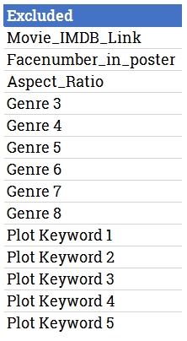
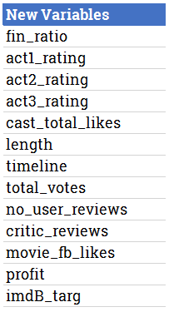


Data Cleansing / Massage
Total Variables : 41

Slide 9
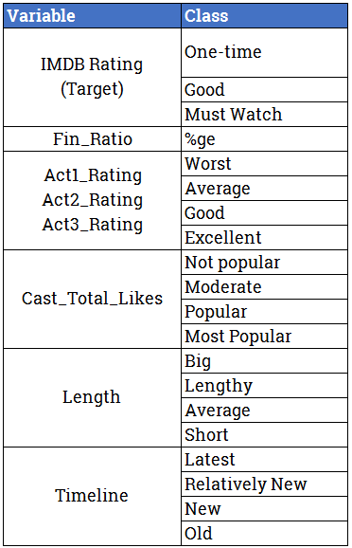
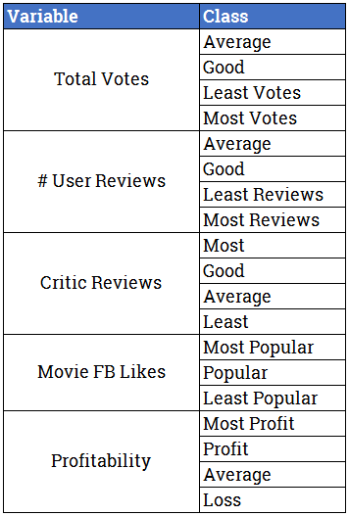
Feature Selection

Slide 10
Model Process
Random Forest (without SMOTE)
SMOTE
Boosting (MaBoost)
Random Forests (multiple)
Naïve Bayes

Slide 11
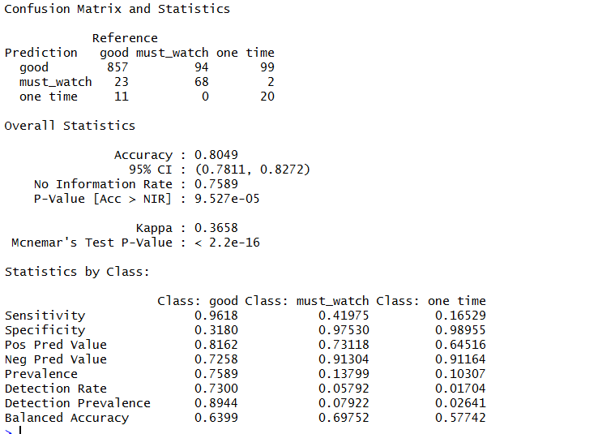
Model Building
Random Forest (without SMOTE)
 | Good | Must Watch | One Time
Good | 857 | 23 | 11
Must Watch | 94 | 68 | 0
One Time | 99 | 2 | 20

Slide 12
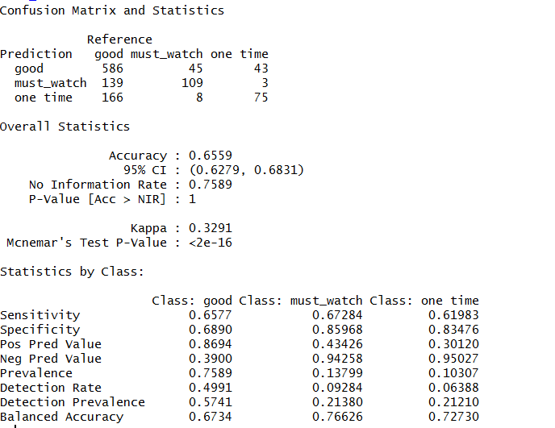
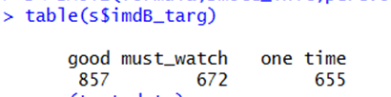
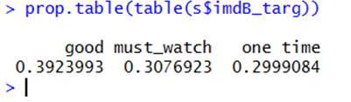
Model Building - SMOTE
SMOTE:

Slide 13
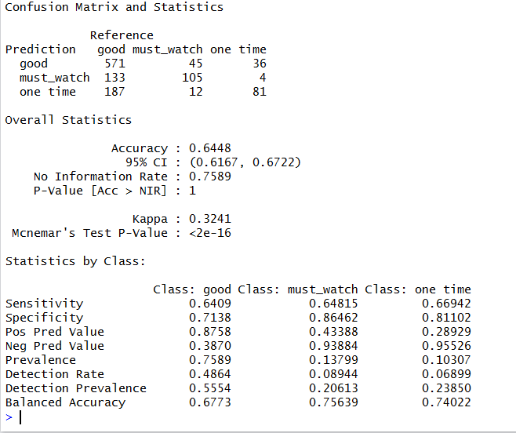
Model Building -- BOOSTING
BOOSTING - MABOOST
 | Good | Must Watch | One Time
Good | 571 | 133 | 187
Must Watch | 45 | 105 | 12
One Time | 36 | 4 | 81

Slide 14
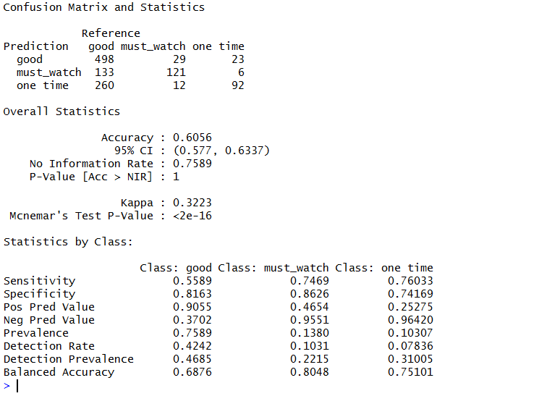
Model Building – Naïve Bayes
Naïve Bayes
 | Good | Must Watch | One Time
Good | 498 | 133 | 260
Must Watch | 29 | 121 | 12
One Time | 23 | 6 | 92

Slide 15
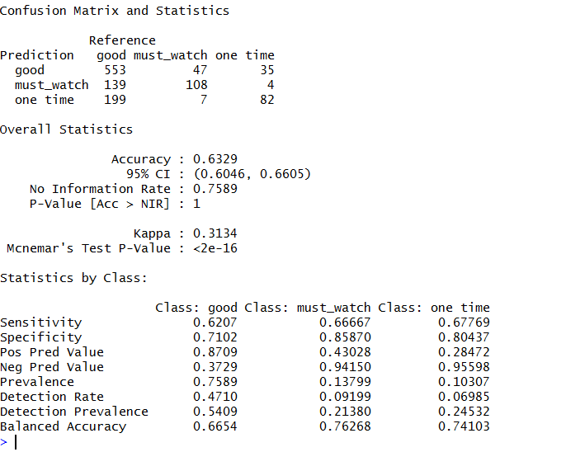

Model Building – Multiple Random Forests
Multiple Random Forests
 | Good | Must Watch | One Time
Good | 553 | 139 | 199
Must Watch | 47 | 108 | 7
One Time | 35 | 4 | 82
Multiple Random Forest

Slide 16
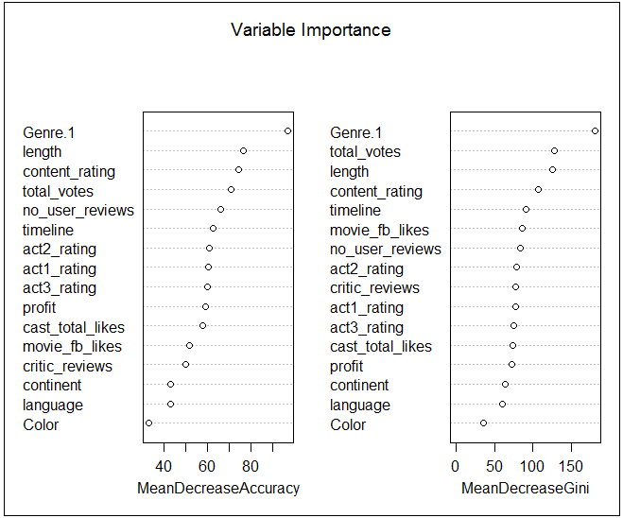
What affects Movie Rating

Slide 17
Summary
Top Genres
Biography
Drama
Documentary
Cast Likes
Most Popular (14k+)
Length of Movie
Lengthy (2 Hrs+ )
Total Votes
Most Votes (Around 100K Votes)
Profitability
Average ( 1-5 Times)

Slide 18
Thank You!

