Slide 1
NEXUS- Repository Manager

Slide 2
Need of Repository Management
Managing access to public repositories
Caching components in Central repository
Storing components that are not in public repositories
Hosting components developed by organisation
Managing releases and snapshots
Managing internal releases and development components

Slide 3
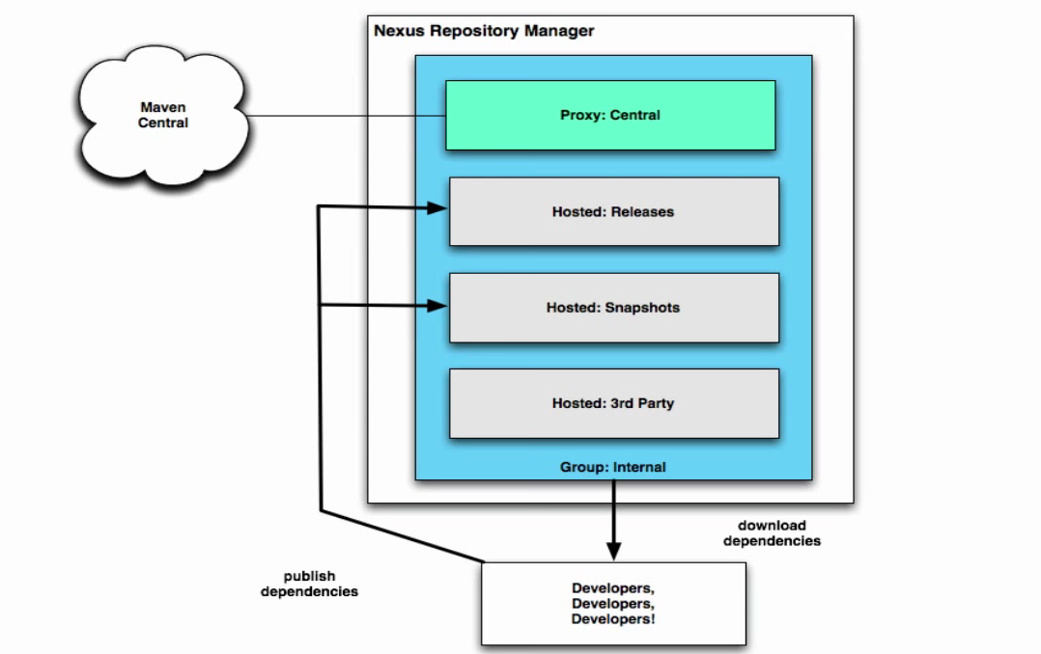
Nexus - Overview

Slide 4
Nexus Features
Repository health check
Smart proxy for distributed teams
Crowd and LDAP support
Proxy repositories and Hosted repositories
Staging repositories for improved build promotion
Seamless Integration with Existing Tools such as Eclipse, Jenkins, Chef, Docker, RunDeck, and more

Slide 5
Nexus – Repository Types
Proxy repository: A proxy repository is a proxy of remote repository
Hosted repository: A Hosted repository is hosted by Nexus and used to store internal artifact generated by Corporate companies
Virtual repository: This serves as an adapter to and from different types of repositories (currently Maven1 and Maven2 are supported)

Slide 6
More on Nexus Repositories..
Formats
Maven
NuGet
P2
OBR etc
Policy
Snapshot
Release

Slide 7
Repository Formats Component coordinates
Unique "GAV" coordinates: groupId, artifactId, version
optionally classifier and packaging

Slide 8
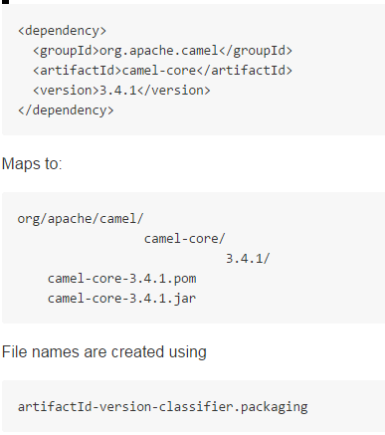
Repository Formats Maven Repository format

Slide 9
Repository Policy Release vs Snapshot Repositories
Release Repositories
Store "point-in-time" Releases
Releases never change
Publish a Release → Both the artifact and meta-data "live forever"
Snapshot Repositories
Used for development-only
Transient
No promise SNAPSHOT artifacts will remain the same

Slide 10
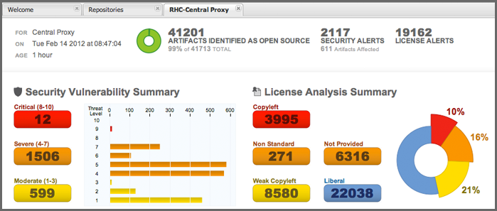
Repository Health Check
Checks for security vulnerabilities
Licensing issues
Threat Level

Slide 11
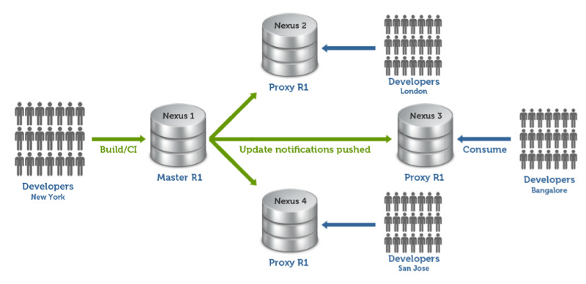
Smart proxy
Improves collaboration between geographically distributed teams

Slide 12
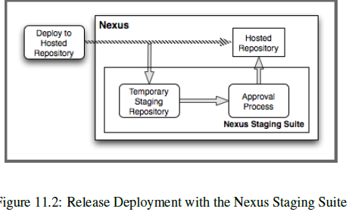
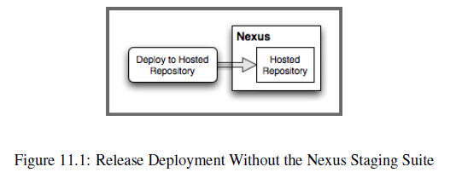
Staging Repositories

Slide 13
Nexus Advantages
Increased speed and more reliable builds
Reduced bandwidth usage
Improved management of 3rd party artifacts
Internal collaboration enabled
Distribution of components made possible
Improved security

Slide 14
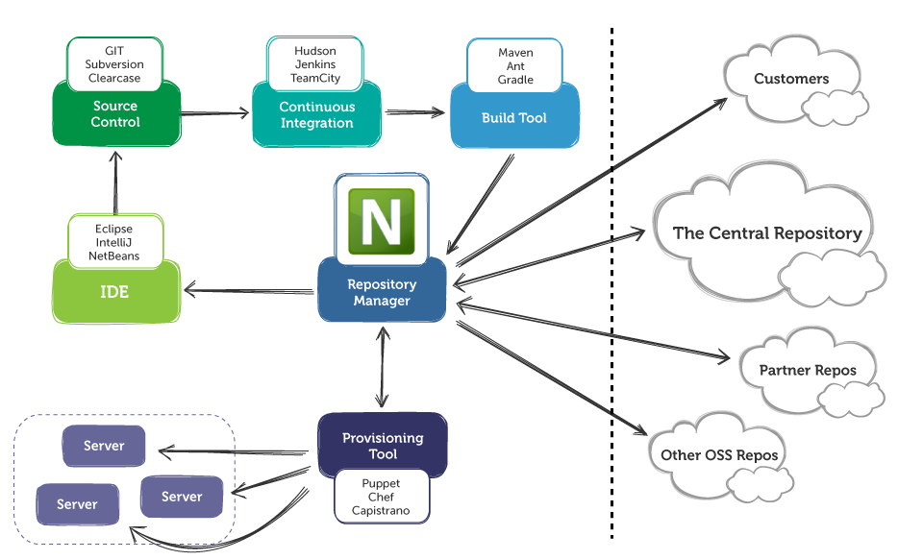
Nexus and ALM

Slide 15
Thank You!

