Slide 1
SVN
Presented by: Sakshi Kathuria

Slide 2
Agenda
Why Version Control System?
What is VCS?
CVCS
What is SVN?
SVN Repository Layout
Workflow of SVN
Permissions in SVN
Repository creation
Basic Commands
Limitations
Demo

Slide 3
Why Version Control System (VCS) ?
Collaboration
Version tracking
Backup
Understanding who made a change and when it happened.
Making changes with confidence, and even reverting when needed.

Slide 4
What is Version control System?
Version control is a system that records changes to a file or set of files over time so that you can recall specific versions later.
If you screw things up or lose files, you can easily recover.
Coordinate work of multiple authors.
Avoid conflicts ...and help resolve them.
Permissions: authenticate and control access to files.
Show differences between versions of a file.
There are two types of VCS:
Centralized Version Control System
Distributed Version control system

Slide 5
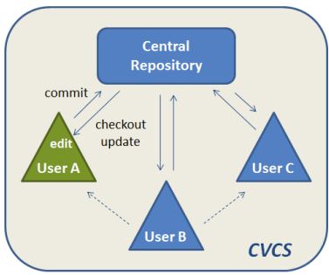
Centralized Version control System (CVCS)
There is a single “central” copy of your project somewhere and programmers will “commit” their changes to this central copy.
“Committing” a change simply means recording the change in the central system.
Other programmers can then see this change. They can also pull down the change, and the version control tool will automatically update the contents of any files that were changed.

Slide 6
What is SVN?
Subversion was created by CollabNet Inc. in 2000, but now it is developed as a project of the Apache Software Foundation.
It is a free/open source version control system.
SVN is a Centralized Version Control System (CVCS).
Developers use Subversion to maintain current and historical versions of files such as source code, web pages, and documentation.

Slide 7






SVN Repository Layout
One repository, many projects
One project per repository
Root
Repository parent dir
Project 1
Project 1
trunk
trunk
tags
tags
branches
branches
Project 2
Project 2
trunk
trunk
tags
tags
branches
branches

Slide 8
SVN Repository Layout Contd..
A trunk in SVN is main development area, where major development happens.
A branch in SVN is sub development area where parallel development on different functionalities happens. After completion of a functionality, a branch is usually merged back into trunk.
A tag in SVN is read only copy of source code from branch or tag at any point of time. Tag is mostly used to create a copy of released source code for restore and backup.

Slide 9









Workflow of SVN
Create a local copy
Submit your changes
svn commit
svn checkout
svn update
Subversion
Repository
106
100
Resolve conflicts
(Merge your changes)
Make changes
svn diff
svn resolved
svn add
svn move
svn delete
105
See what was changed
in the repository in the meantime
Update your local copy
svn update
svn status -u

Slide 10
Permissions in SVN (repo folder structure)
Authz file : to provide access to users, groups, project, repo
Passwd file : to set users
Svnserve.conf file : to provide global access.

Slide 11
How to setup Repository for SVN?
Creating a Repository with the Command Line Client:
1. Create an empty folder with the name SVN (e.g. D:\SVN\), which is used as root for all your repositories.
2. Create another folder MyNewRepository inside D:\SVN\
3. Open the command prompt, and type
svnadmin create MyNewRepository

Slide 12
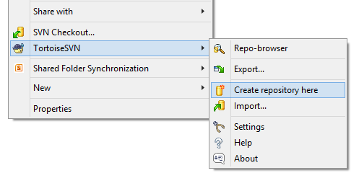
How to setup Repository for SVN? Contd..
Creating Repository with Tortoise SVN:
Right click on the newly created folder and
select TortoiseSVN → Create Repository here....

Slide 13
SVN Basic Commands
Import
Checkout
Add
Commit
Update
Revert
Resolved
Copy
Export
Status
Delete
Log
List

Slide 14
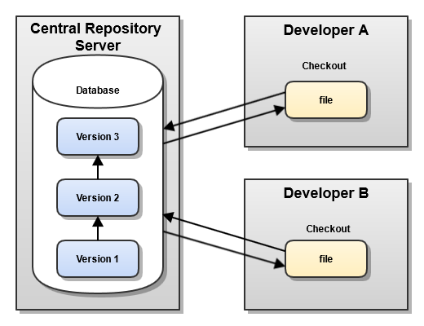
Limitations
Single point of failure
•Dependent on access to the server
•Hard to manage a server and backups
•It can be slower because every command connects to the server.
•Branching and merging tools are difficult to use.
•Multi-developer conflicts

Slide 15

Demo

Slide 16
Bibliography, Important Links
https://wiki.centos.org/HowTos/Subversion
http://svnbook.red-bean.com/en/1.7/svn.intro.whatis.html
http://svn.apache.org/repos/asf/subversion/trunk/notes/subversion-design.html

Slide 17
Any Questions?

Slide 18
Thank you!

