Slide 1
SVN
Presented by: Sakshi Kathuria & Ritu Singh

Slide 2
Document History
Version No. | Authored/Modified by | Remark/Change History | Date <dd- mon-yy >
1.0 | Sakshi Kathuria |  | 18-Aug-15

Slide 3
Learning Objectives
Subversion basics
Tortoise SVN

Slide 4
Course Structure
Target audience | Beginners
Level | Beginners
Pre-requisites | Version Control System
Training methods | Presentation and Demo
Evaluation | Q&A

Slide 5
Agenda
Why Version Control System?
What is VCS?
Types of VCS
CVCS
What is SVN?
SVN Repository Layout
Workflow of SVN
Repository creation
Basic Commands
Permissions in SVN
Demo
Limitations

Slide 6
Why Version Control System (VCS) ?
Collaboration
Version tracking
Backup
Understanding who made a change and when it happened.
Making changes with confidence, and even reverting when needed.

Slide 7
What is Version control System?
Manage documents over time
Keep a history of all changes - multiple versions of every file
Coordinate work of multiple authors
Avoid conflicts ...and help resolve them
Permissions: authenticate and control access to files
Show differences between versions of a file
Document changes -- reason for change
There are two types of VCS:
Centralized Version Control System
Distributed Version control system

Slide 8
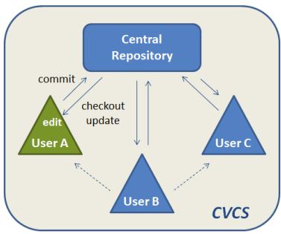
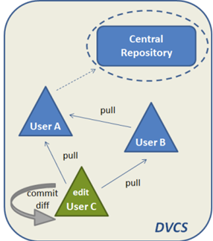
Types of version control system
Centralized version control system Distributed version control system
e.g. SVN e.g. GIT, Mercurial

Slide 9
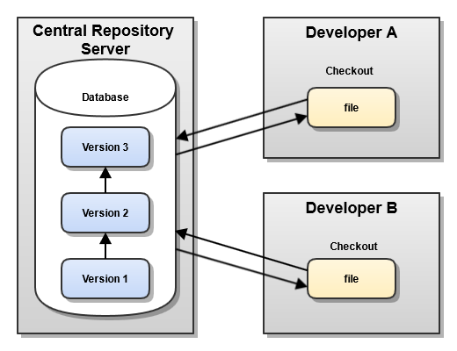
Centralized Version control System (CVCS)
There is a single “central” copy of your project somewhere and programmers will “commit” their changes to this central copy.
“Committing” a change simply means recording the change in the central system.
Other programmers can then see this change. They can also pull down the change, and the version control tool will automatically update the contents of any files that were changed.

Slide 10
What is SVN?
It is a free/open source version control system.
Developers use Subversion to maintain current and historical versions of files such as source code, web pages, and documentation.
SVN is a centralized version control system (CVCS).

Slide 11






SVN Repository Layout (1)
One repository, many projects
One project per repository
Root
Repository parent dir
Project 1
Project 1
trunk
trunk
tags
tags
branches
branches
Project 2
Project 2
trunk
trunk
tags
tags
branches
branches

Slide 12
SVN Repository Layout (2)
A trunk in SVN is main development area, where major development happens.
A branch in SVN is sub development area where parallel development on different functionalities happens. After completion of a functionality, a branch is usually merged back into trunk.
A tag in SVN is read only copy of source code from branch or tag at any point of time. tag is mostly used to create a copy of released source code for restore and backup.

Slide 13









Workflow of SVN
Create a local copy
Submit your changes
svn commit
svn checkout
svn update
Subversion
Repository
106
100
Resolve conflicts
(Merge your changes)
Make changes
svn diff
svn resolved
svn add
svn move
svn delete
105
See what was changed
in the repository in the meantime
Update your local copy
svn update
svn status -u

Slide 14
How to setup Repository for SVN? (1)
Creating a Repository with the Command Line Client:
1. Create an empty folder with the name SVN (e.g. D:\SVN\), which is used as root for all your repositories.
2. Create another folder MyNewRepository inside D:\SVN\
3. Open the command prompt, and type
svnadmin create MyNewRepository

Slide 15
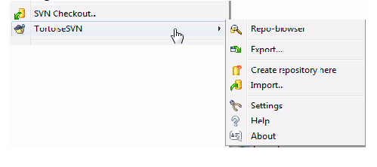
How to setup Repository for SVN? (2)
Creating Repository with Tortoise SVN:
Right click on the newly created folder and select TortoiseSVN → Create Repository here....

Slide 16
SVN Basic Commands
Import
Checkout
Add
Commit
Update
Revert
Resolved
Copy
Export
Status
Delete
Log
List

Slide 17
Permissions in SVN (repo folder structure)
Authz file : To provide access to users, groups, project, repository.
Passwd file : To create users.
Svnserve.conf file : To provide access control to your repository.

Slide 18

Demo

Slide 19
Limitations
Single point of failure
•Dependent on access to the server
•Hard to manage a server and backups
•It can be slower because every command connects to the server.
•Branching and merging tools are difficult to use.
•Multi-developer conflicts
https://youtu.be/_yQlKEq-Ueg

Slide 20
Bibliography, Important Links
https://wiki.centos.org/HowTos/Subversion
http://svnbook.red-bean.com/en/1.7/svn.intro.whatis.html
http://svn.apache.org/repos/asf/subversion/trunk/notes/subversion-design.html

Slide 21
Any Questions?

Slide 22
Thank you!

