Slide 1
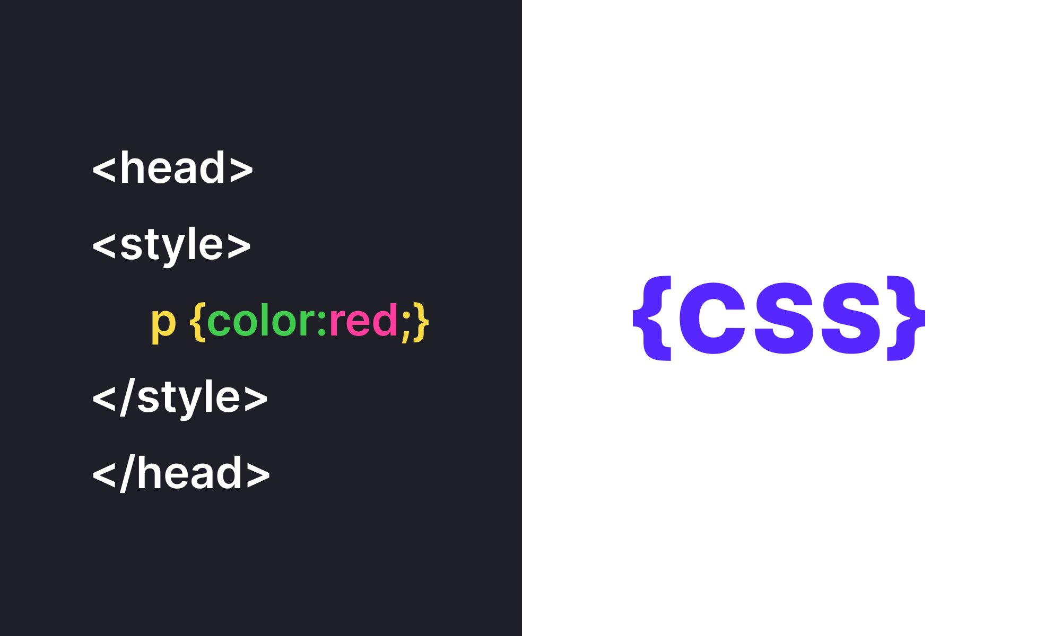

Slide 2
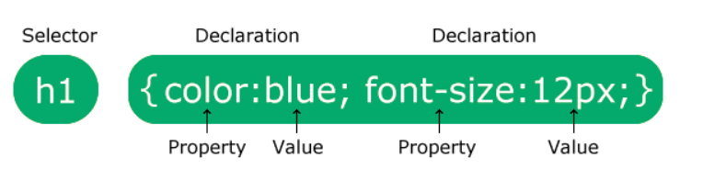
Introduction
CSS is the language we use to style an HTML document.
CSS describes how HTML elements should be displayed.
CSS saves a lot of work. It can control the layout of multiple web pages all at once

Slide 3
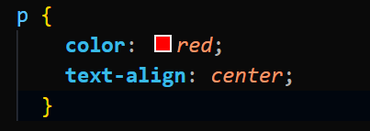
The selector points to the HTML element you want to style.
The declaration block contains one or more declarations separated by semicolons.
Each declaration includes a CSS property name and a value, separated by a colon.
p is a selector in CSS (it points to the HTML element you want to style: <p>).
color is a property, and red is the property value
text-align is a property, and center is the property value

Slide 4
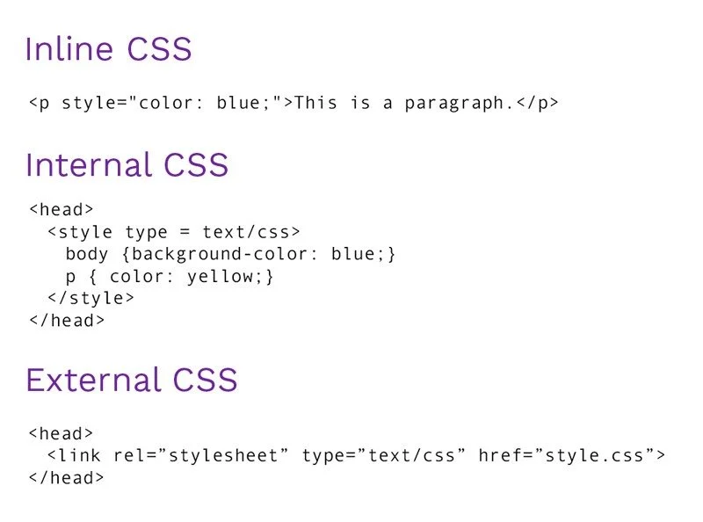
How to Add CSS
Three Ways to Insert CSS
External CSS
Internal CSS
Inline CSS

Slide 5
CSS Selectors
A CSS selector selects the HTML element(s) you want to style
Selector | Example | Example description
#id | #firstname | Selects the element with id="firstname"
.class | .intro | Selects all elements with class="intro"
element.class | p.intro | Selects only <p> elements with class="intro"
* | * | Selects all elements
element | p | Selects all <p> elements
element,element,.. | div, p | Selects all <div> elements and all <p> elements

Slide 6
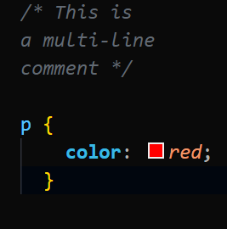
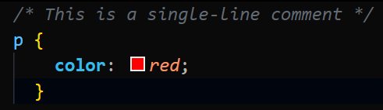
CSS Comments
Comments are used to explain the code, and may help when you edit the source code at a later date.
Comments are ignored by browsers.
A CSS comment is placed inside the <style> element, and starts with /* and ends with
*/:

Slide 7
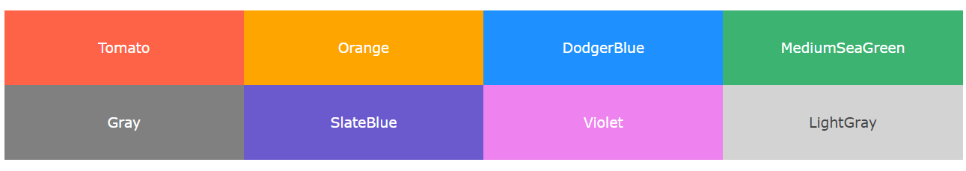
CSS Colors
Colors are specified using predefined color names, or RGB, HEX, HSL, RGBA, HSLA values
https://www.fffuel.co/cccolor/
https://htmlcolorcodes.com/color-picker/

Slide 8
CSS Backgrounds
background-color
background-image
background-repeat
background-position
background-attachment

Slide 9
background-repeat
By default, the background-image property repeats an image both horizontally and vertically.
Some images should be repeated only horizontally or vertically, or they will look strange, like this:
body {
background-image: url("gradient_bg.png");
background-repeat: repeat-x;
}

Slide 10
background-position
The background-position property is used to specify the position of the background image.
body {
background-image: url("img_tree.png");
background-repeat: no-repeat;
background-position: right top;
}

Slide 11
background-attachment
The background-attachment property specifies whether the background image should scroll or be fixed (will not scroll with the rest of the page):
body {
background-image: url("img_tree.png");
background-repeat: no-repeat;
background-position: right top;
background-attachment: fixed;
}
body {
background-image: url("img_tree.png");
background-repeat: no-repeat;
background-position: right top;
background-attachment: scroll;
}

Slide 12
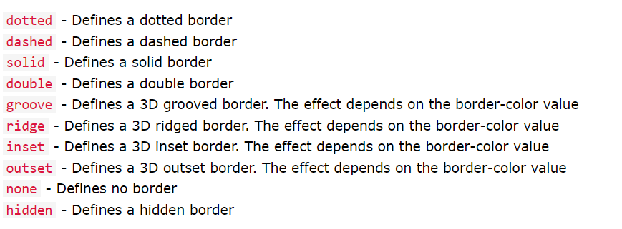
CSS Borders
The CSS border properties allow you to specify the style, width, and color of an element's border.

Slide 13
CSS Margins
Margins are used to create space around elements, outside of any defined borders.
Property | Description
margin | A shorthand property for setting all the margin properties in one declaration
margin-bottom | Sets the bottom margin of an element
margin-left | Sets the left margin of an element
margin-right | Sets the right margin of an element
margin-top | Sets the top margin of an element

Slide 14
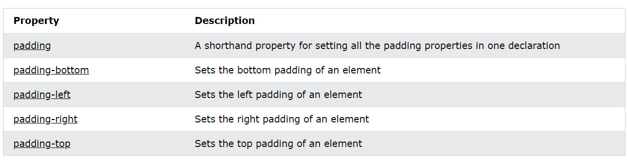
CSS Padding
The CSS padding properties are used to generate space around an element's content, inside of any defined borders.
With CSS, you have full control over the padding. There are properties for setting the padding for each side of an element (top, right, bottom, and left).

Slide 15
CSS Height, Width and Max-width
The CSS Height and Width properties are used to set height and width of an element
CSS height and width Values
The height and width properties may have the following values:
auto - This is default. The browser calculates the height and width
length - Defines the height/width in px, cm, etc.
% - Defines the height/width in percent of the containing block
initial - Sets the height/width to its default value
inherit - The height/width will be inherited from its parent value

Slide 16
Property | Description
height | Sets the height of an element
max-height | Sets the maximum height of an element
max-width | Sets the maximum width of an element
min-height | Sets the minimum height of an element
min-width | Sets the minimum width of an element
width | Sets the width of an element

Slide 17

CSS Box Model
In CSS, the term "box model" is used when talking about design and layout.
The CSS box model is essentially a box that wraps around every HTML element. It consists of: content, padding, borders and margins. The image below illustrates the box model:

Slide 18
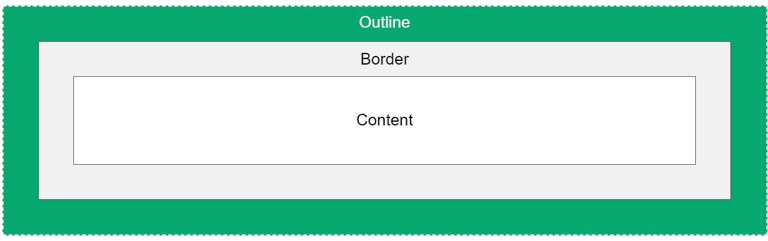
CSS Outline
An outline is a line drawn outside the element's border
An outline is a line that is drawn around elements, OUTSIDE the borders, to make the element "stand out".
CSS has the following outline properties:
outline-style
outline-color
outline-width
outline-offset
outline

Slide 19
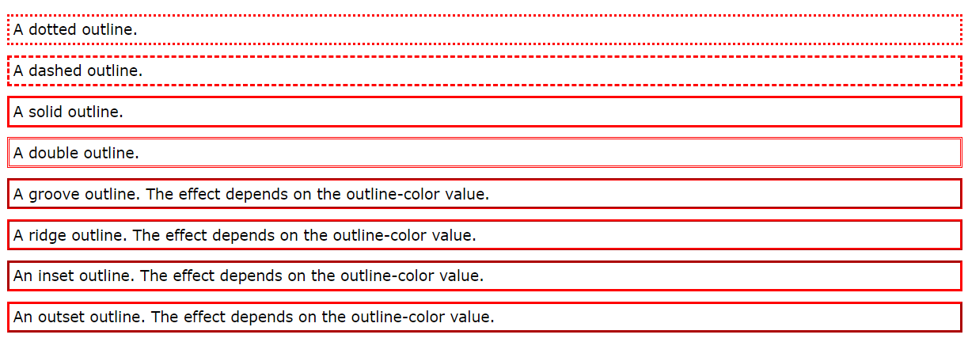
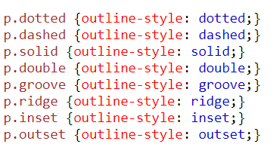
CSS Outline Style
The outline-style property specifies the style of the outline, and can have one of the following values:

Slide 20
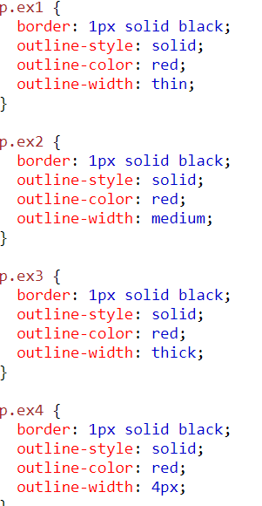
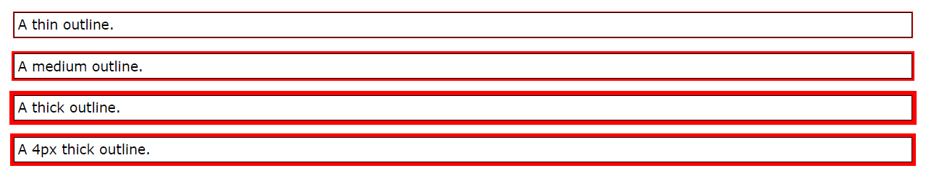
CSS Outline Width
The outline-width property specifies the width of the outline, and
can have one of the following values:
thin (typically 1px)
medium (typically 3px)
thick (typically 5px)
A specific size (in px, pt, cm, em, etc)

Slide 21
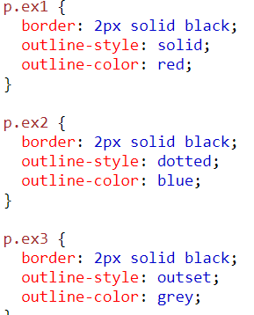
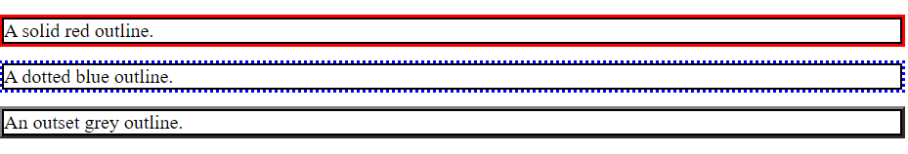
CSS Outline Color
The outline-color property is used to set the color of the outline.
The color can be set by:
name - specify a color name, like "red"
HEX - specify a hex value, like "#ff0000"
RGB - specify a RGB value, like "rgb(255,0,0)"
HSL - specify a HSL value, like "hsl(0, 100%, 50%)"
invert - performs a color inversion (which ensures that the outline is visible, regardless of color background)

Slide 22

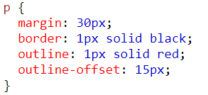
CSS Outline Offset
The outline-offset property adds space between an outline and the edge/border of an element. The space between an element and its outline is transparent.
The following example specifies an outline 15px outside the border edge:

Slide 23
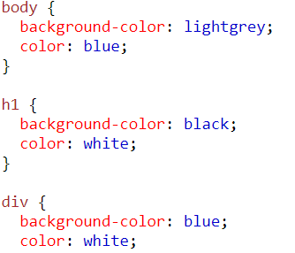
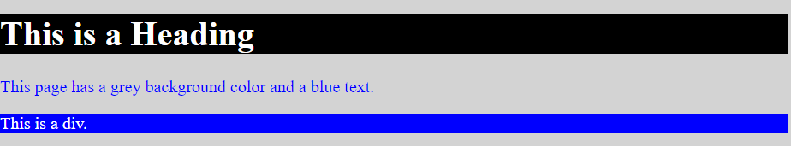
Text Color and Background Color
CSS has a lot of properties for formatting text.
The color property is used to set the color of the text.
The color is specified by:
  a color name - like "red"
  a HEX value - like "#ff0000"
  an RGB value - like "rgb(255,0,0)"

Slide 24
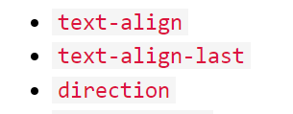
Text Alignment and Text Direction

Slide 25
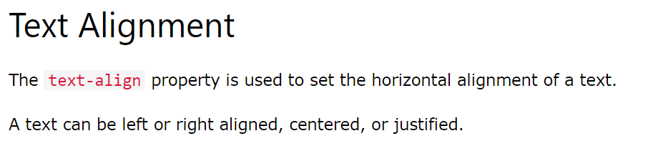
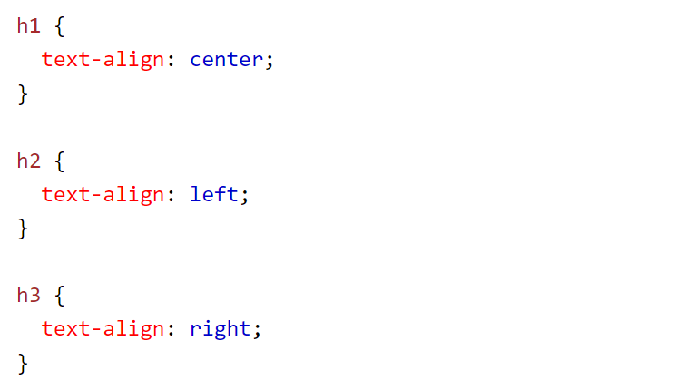

Slide 26
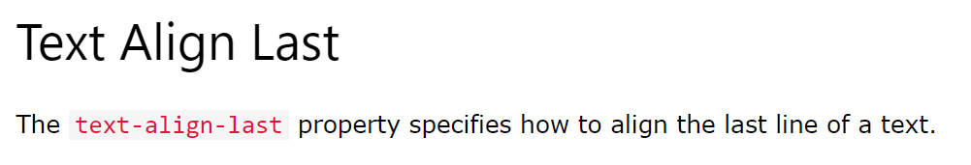
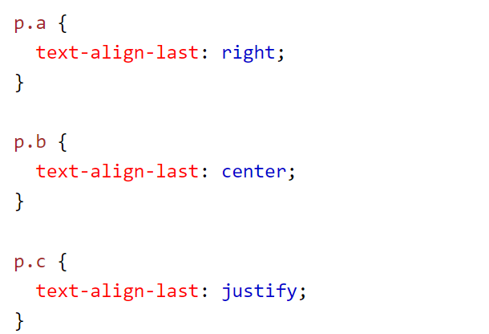

Slide 27
