Slide 1

DON BOSCO INSTITUTE OF TECHNOLOGY DEPARTMENT OF EXTC
MINI PROJECT 2A
AUTOMATIC PCB DRILLER
GROUP MEMBERS:
Russel Dmello 13
Sakshi kaveri 24
Sanskar Kumar 30
Shreyas Nanaware 41
PROJECT GUIDE:
Mr. Jithin Issac

Slide 2
AIM:
To design and implement an STM32 controlled automatic
Printed Circuit Board (PCB) drilling machine.
OUTCOME:
To enable beginners in the field to use an automated PCB drilling machine with path planning capability to complete the job
efficiently.

Slide 3
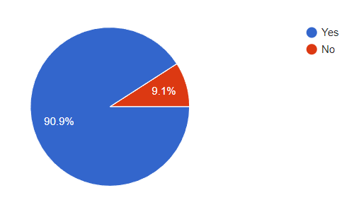
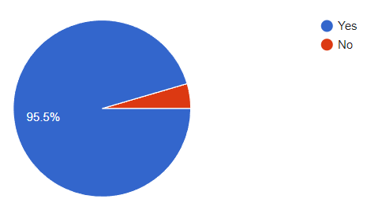
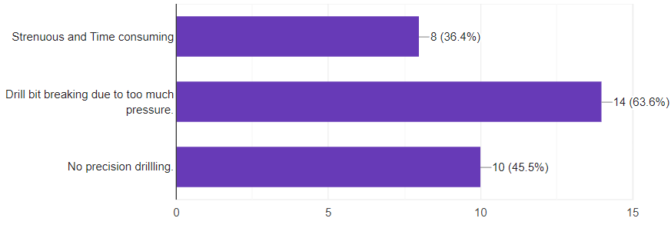
LITERATURE SURVEY
Have you used a Manual PCB driller ?
Do you think there is a need for an Automatic PCB driller ?
If yes, what problems have you faced ?

Slide 4
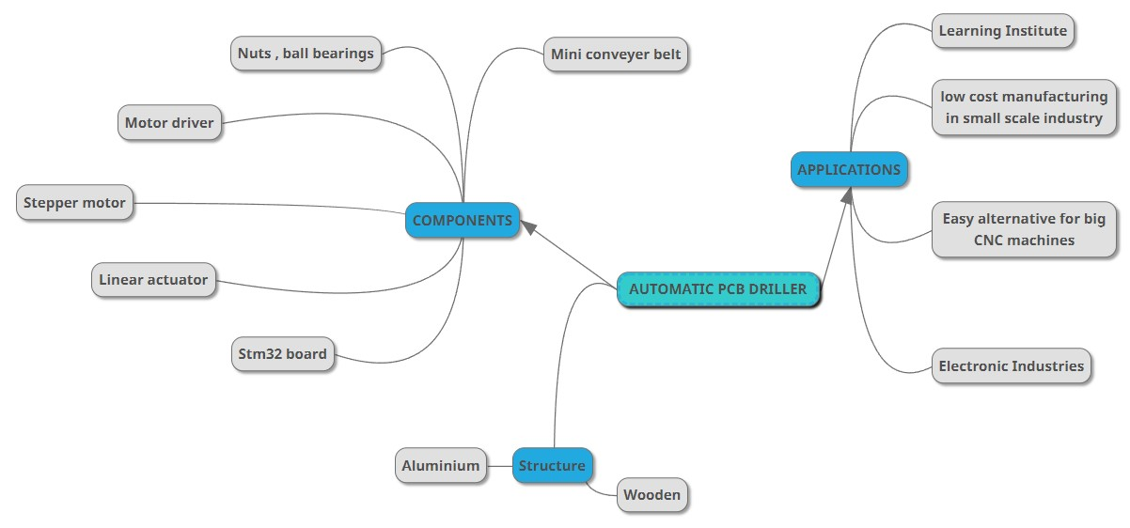
MINDMAP

Slide 5
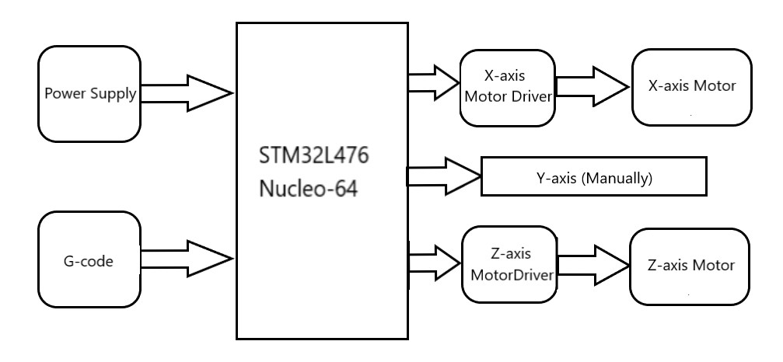
BLOCK DIAGRAM

Slide 6
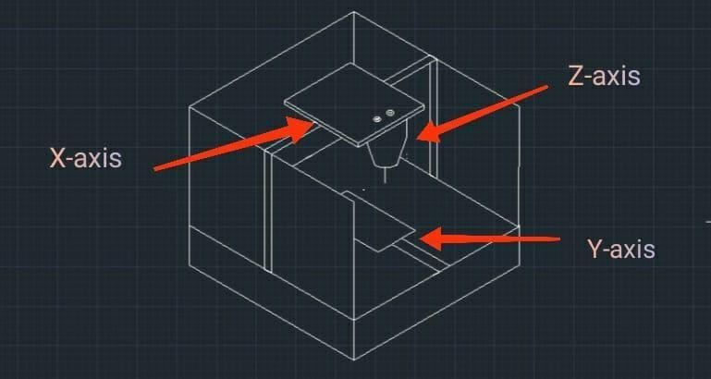
DRILLER STRUCTURE
X-axis (Unipolar Motor)
Y-axis (Manually)
Z-axis (Bipolar Motor)

Slide 7
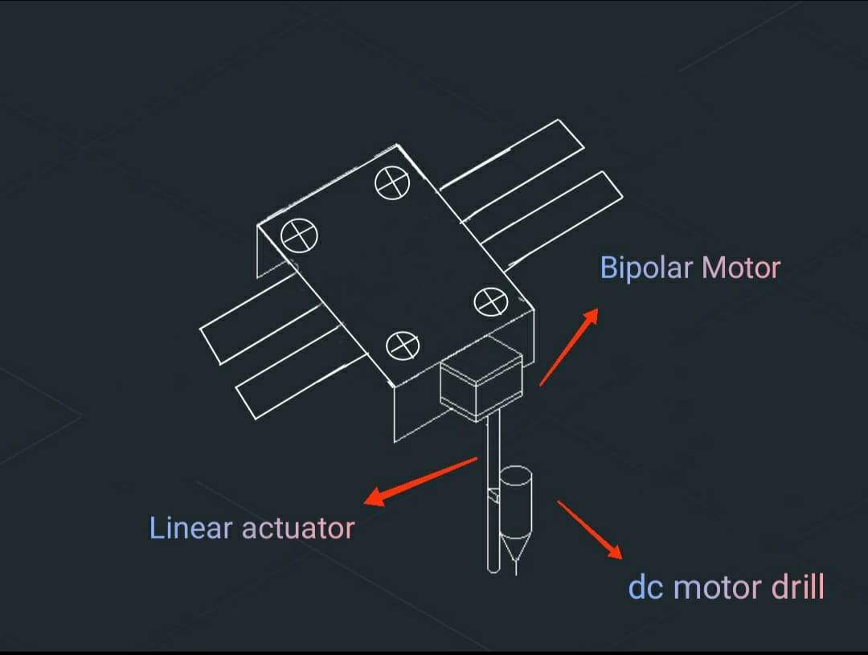
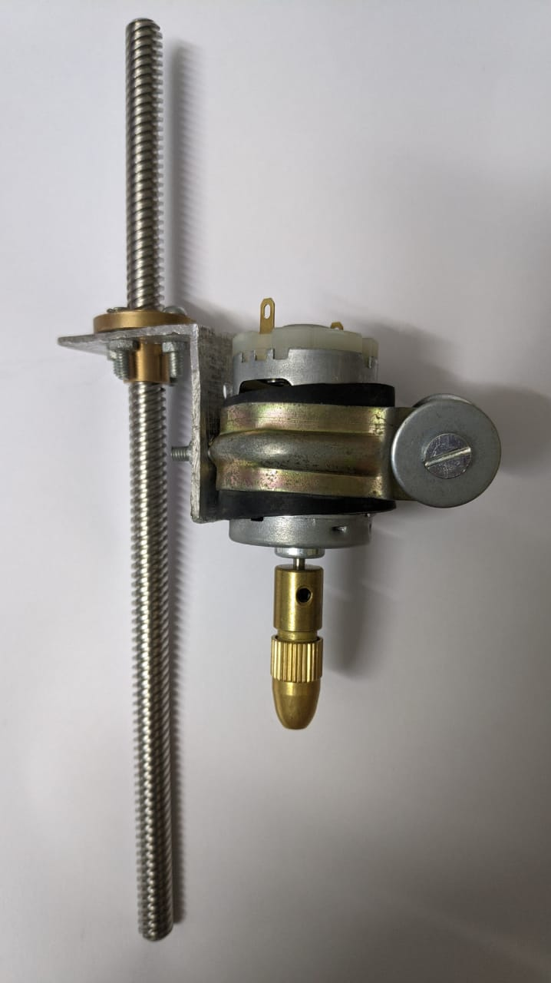
LAYOUT FOR Z-AXIS
DRILL BIT

Slide 8
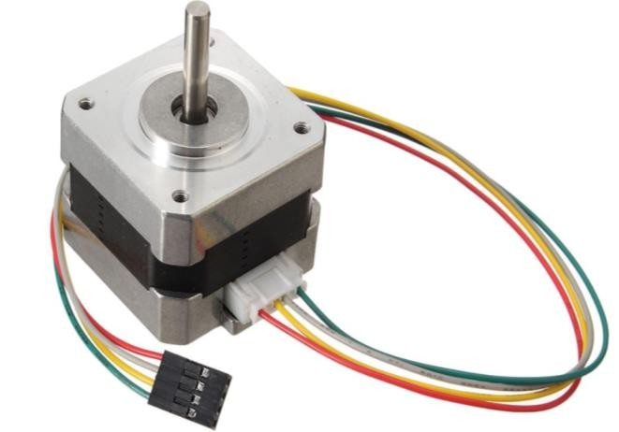
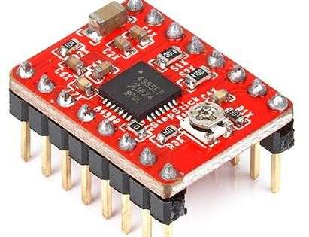
BIPOLAR STEPPER MOTOR
MOTORS & DRIVERS
DRIVER IC (A4988)

Slide 9
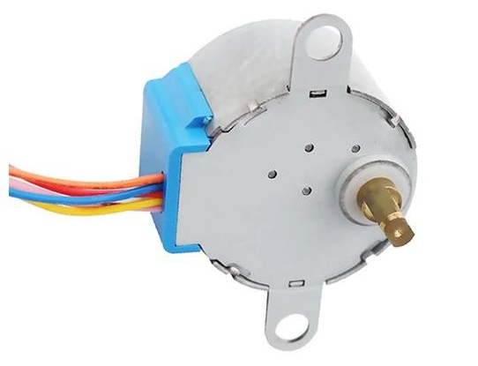
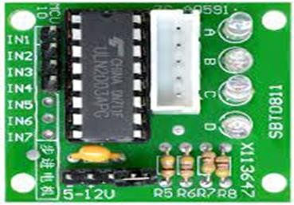
UNIPOLAR STEPPER MOTOR
DRIVER IC (ULN2003)

Slide 10
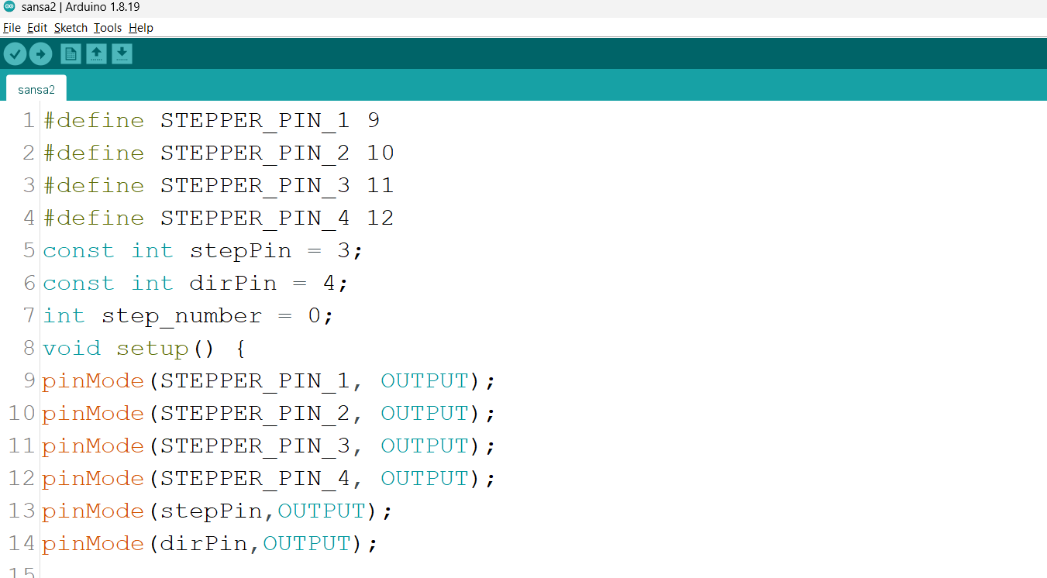
ARDUINO IDE CODE

Slide 11
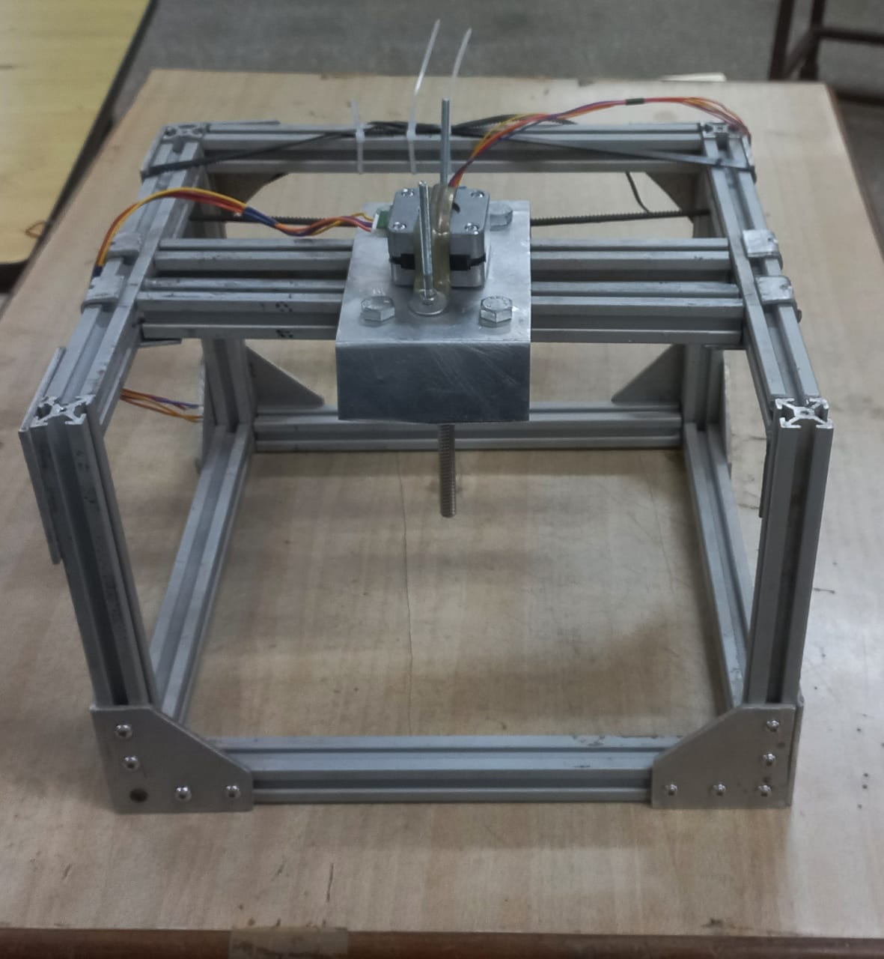
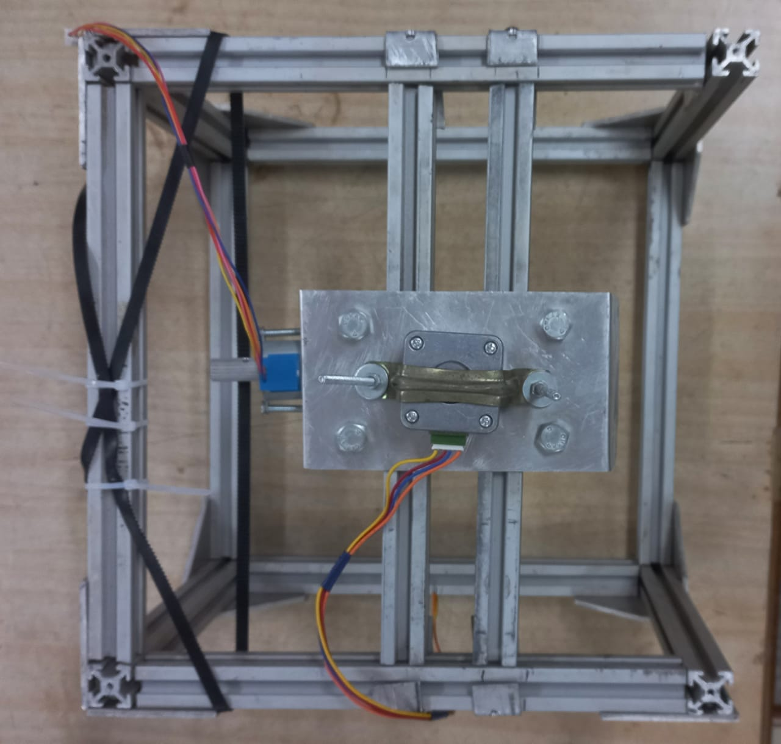
DRILLER STRUCTURE

Slide 12
Bill of components
Components | Quantity | Cost
10mm 20x20 4T aluminium extrusion | 7 | 1400
Unipolar stepper motor | 1 | 350
Unipolar stepper motor driver | 2 | 150
Bipolar stepper motor | 1 | 300
Bipolar stepper motor driver | 3 | 330
Ball bearing | 4 | 40
Capacitor(100uF, 47uF) | 4 | 8
Sliding T-nut | 100 | 1500
Allen bolt | 100 | 690
Track belt | 1 | 90
Chuck set, Bit, Lead Screw | 3 | 350
Total |  | 5208

Slide 13
Image references
https://www.google.com/search?q=Bipolar+motor&rlz=1C1RXQR_enIN964IN964&sxsrf=ALiCzsYDln1qn555MFhRqjT6J8v_3KJmzg:1667793836415&source=lnms&tbm=isch&sa=X&ved=2ahUKEwjr7rWZmJv7AhWA8DgGHUMcDw0Q_AUoAXoECAIQAw&biw=1536&bih=656&dpr=1.25#imgrc=ikY3QsJrnwPhbM
https://ifuturetech.org/product/nema-17-4-2-kg-cm-bipolar-stepper-motor-for-cnc-robotics-reprap-3d-printer/

Slide 14
Thank You

