Slide 1
BLUESTOCK FINTECH
Mutual Fund Analytics Platform
End-to-end data engineering, ETL pipeline and interactive dashboard
Capstone Project I | Sakshi Mane, Data Analyst Intern | October 2026
Notes:
Introduce yourself and the project: a full mutual fund analytics stack built on public AMFI data.

Slide 2
The problem and the objective
Why this project
What I built
Data is scattered across AMFI reports, APIs and exchange files
Raw NAV needs heavy work before risk-adjusted metrics exist
Investors cannot see if a fund beats its benchmark
Monthly reports are static PDFs
Automated ETL pipeline: one command
SQLite star schema with 10 SQL queries
EDA and risk analytics in Python (5 notebooks)
Fund scorecard, VaR, cohorts, recommender
Four-page interactive Power BI dashboard
Notes:
Five problems from the brief: fragmentation, performance comparison, benchmark tracking, investor behaviour, slow reporting.

Slide 3
Data sources and datasets
40
46,000
32,778
10
schemes, 10 fund houses
daily NAV values
investor transactions
datasets provided
Sources: AMFI India, mfapi.in, NSE and BSE public data
NAV Jan 2022 to May 2026; AUM, SIP, folios, benchmarks, holdings
Transactions are simulated but follow real patterns
All AMFI codes validated: 0 unknown codes, 0 duplicates
Notes:
Mention that NAVs are anchored to real values and investor transactions are synthetic.

Slide 4
Architecture: extract, transform, load, analyse, visualise
Extract
10 CSVs + mfapi.in live NAV
Transform
Clean, validate, forward-fill NAV
Load
SQLite star schema, 8 tables
Analyse
Metrics, EDA, risk (Python)
Visualise
Power BI, 4 pages
Run everything with: python run_pipeline.py
Logging, error handling, non-zero exit on failure
Row counts verified against source; 0 foreign-key violations

Slide 5
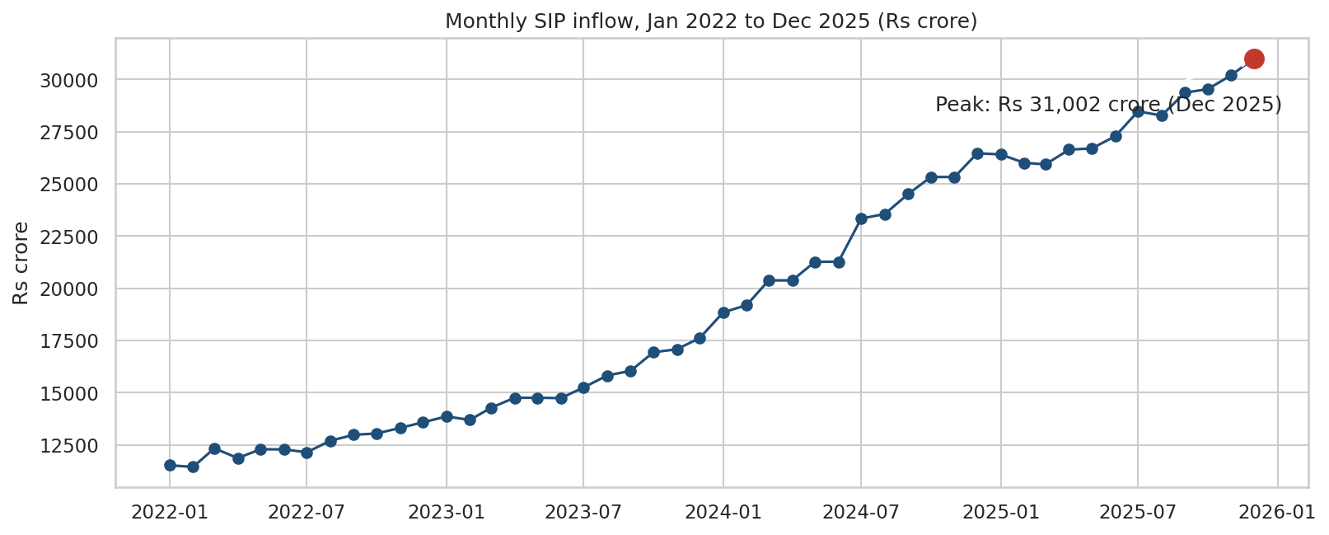
EDA highlight: industry growth
SIP inflow: Rs 11,517 crore to Rs 31,002 crore
Top-10 AMC AUM: 30.18 to 62.74 lakh crore
Folios: 13.26 to 26.12 crore
SBI is the largest AMC (12.5 lakh crore)

Slide 6
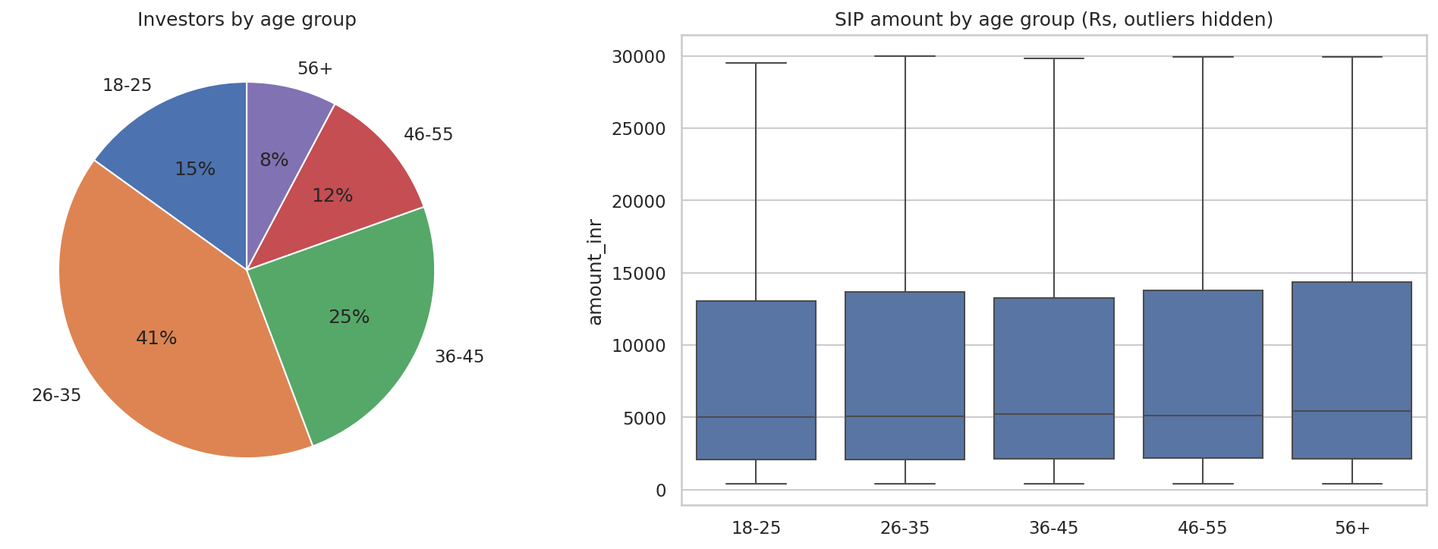
EDA highlight: investors and costs
41% of investors are aged 26-35
B30 cities give 34% of investment value
Lumpsum is 58.5% of amount; SIPs are 60% of transactions
Direct plans cost 0.57 points less a year

Slide 7
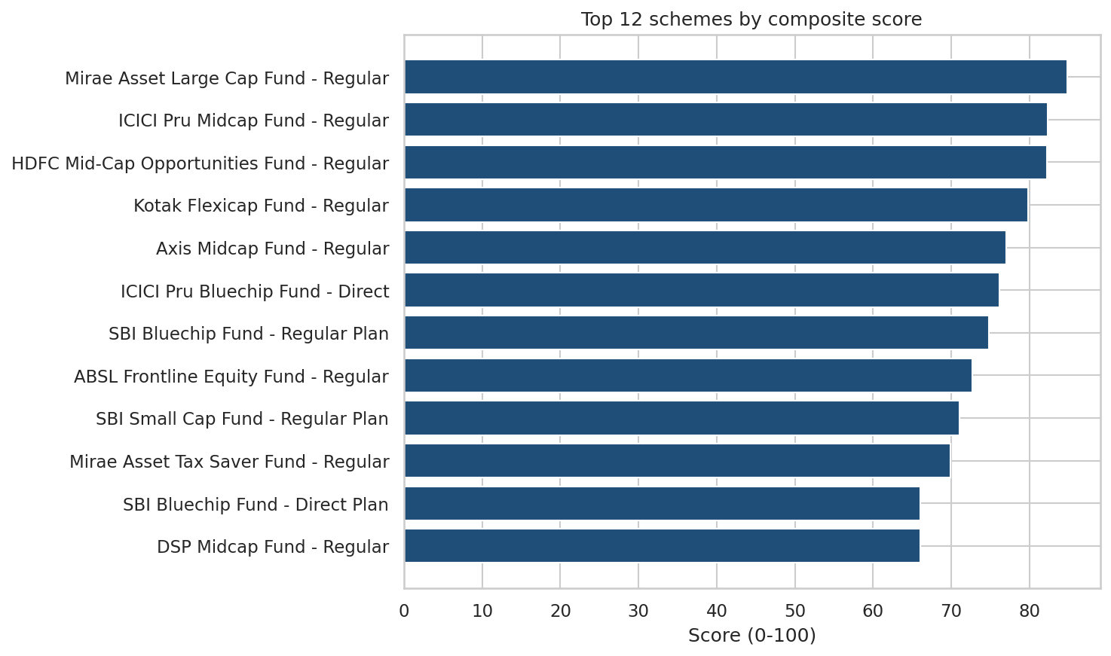
Performance: composite fund scorecard
Score weights
3-year CAGR 30%
Sharpe ratio 25%
Alpha 20%
Expense ratio 15%
Max drawdown 10%
Top: Mirae Asset Large Cap Fund (84.8)

Slide 8
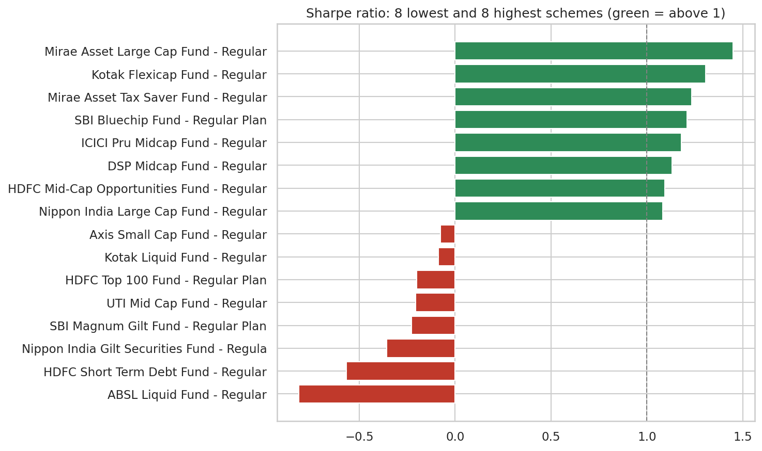
Performance: risk-adjusted view
16.6%
10 of 40
-53%
8x
median 3-year CAGR
schemes with Sharpe above 1
deepest drawdown
equity vs debt volatility
Raw returns hide risk
Equity 95% VaR: -1.69% a day
No 5-year CAGR: history is 4.6 years
Alpha and beta not meaningful: NAVs do not track benchmarks

Slide 9
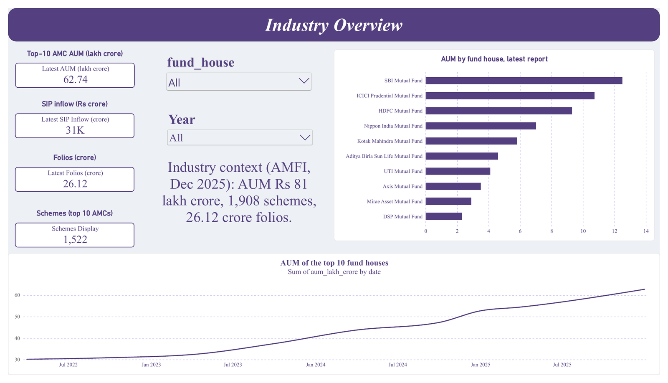
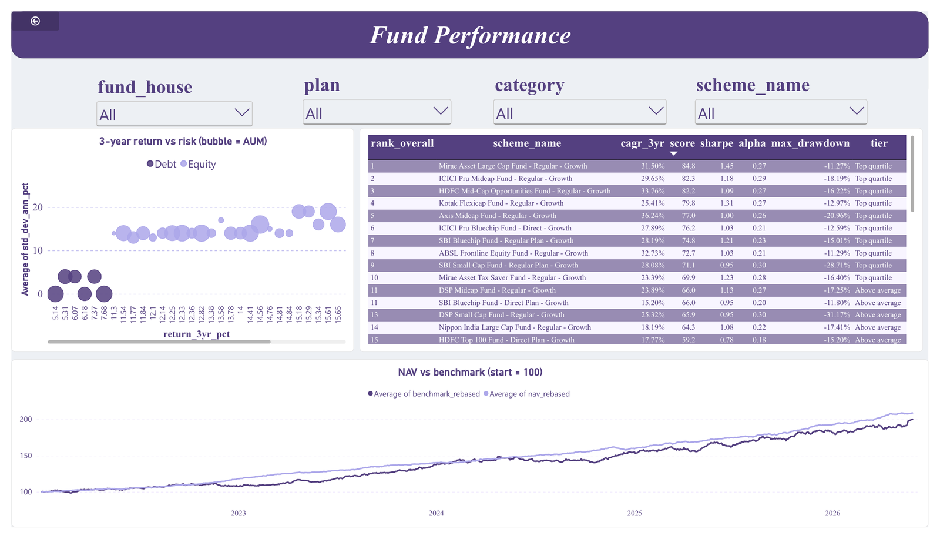
Dashboard: industry and fund performance
Page 1: Industry Overview
Page 2: Fund Performance
KPI cards: Top-10 AMC AUM 62.74 lakh crore, SIP inflow 31K crore, folios 26.12 crore. SBI leads the AUM ranking.
Return vs risk bubbles (size = AUM), sortable scorecard, NAV vs benchmark; slicers for fund house, plan, category, scheme.
Notes:
Demo the slicers and the drill-through from the scorecard to Fund Detail.

Slide 10
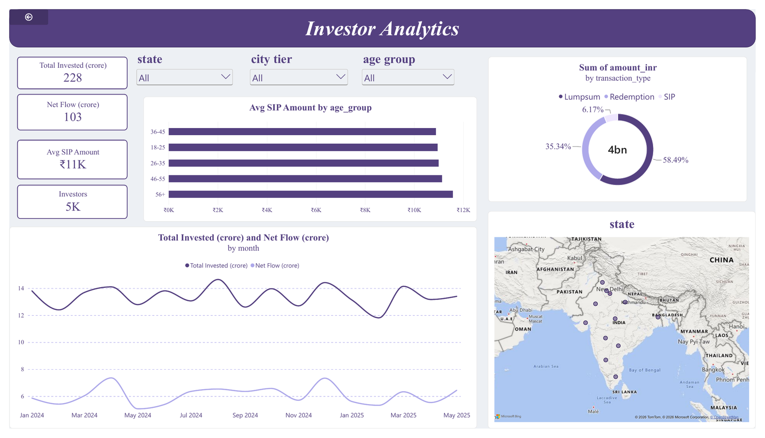
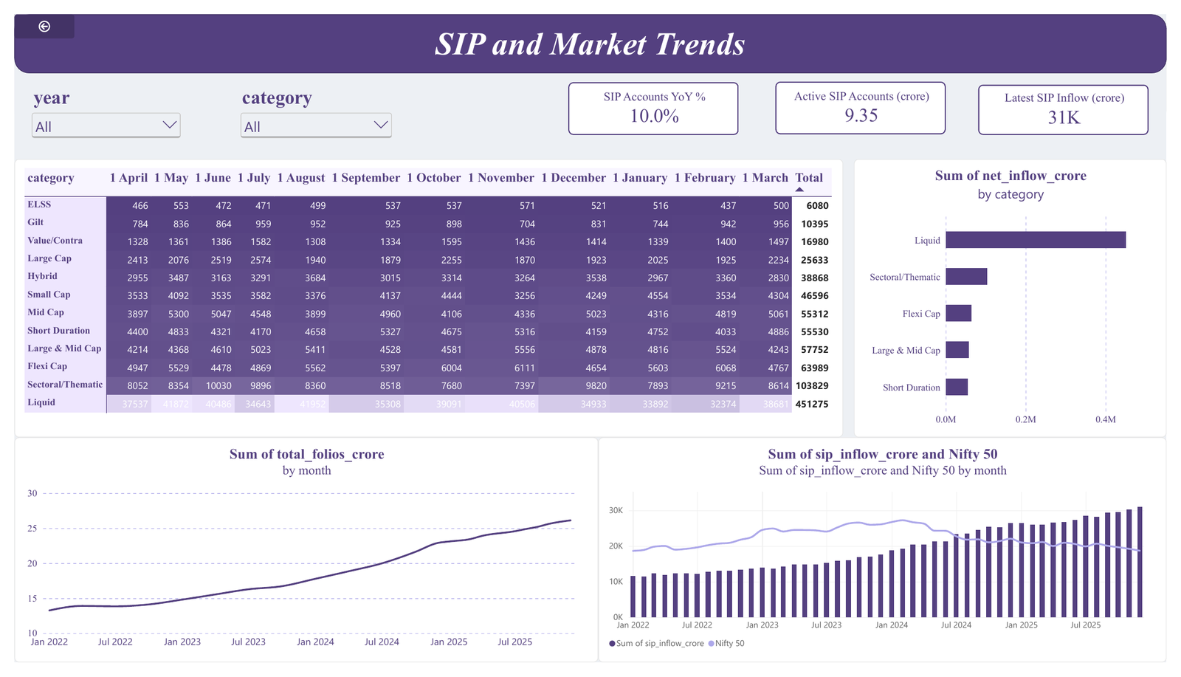
Dashboard: investors and SIP trends
Page 3: Investor Analytics
Page 4: SIP and Market Trends
Lumpsum 58.5% of amount, redemptions 35.3%, SIP 6.2%. Average SIP is about Rs 11K and highest for ages 56+.
Category heat map (Liquid dominates FY25 inflows), top 5 categories, SIP accounts up 10.0% year on year.

Slide 11
Key findings
Growth is broad: AUM doubled, SIP inflow nearly tripled in four years
Cost matters: Direct plans are 0.57 points cheaper per year
Only 10 of 40 schemes have a Sharpe ratio above 1; 9 are below 0
SIP continuity is the main retention risk: 137 investors have the longest gaps
Four equity schemes are sector-concentrated (HHI above 2,500)
Data quality is a finding: NAVs do not track benchmarks; reported and calculated metrics differ
Notes:
End with the data limitations: be open about them.

Slide 12
Thank you
Questions?
Sakshi Mane | Code, data and report: see the GitHub repository (README.md)

