Slide 1
PRESENTATION ON CORE JAVA
Name : Sakshi Kiran Mohite
Roll No : 4254
Class : TY BCA (SCIENCE)

Slide 2
CONTENT
What is java ?
Features of java
Hello java program
What happens at compile time?
What happens at runtime?
JDK, JRE, and JVM
Java Variables
Types of Variables
Data Types in Java
What is a method in Java?
Constructors in Java
Types of Java constructors

Slide 3
WHAT IS JAVA ?
Java is a programming language and computing platform that's used to create a variety of applications, including mobile apps, web apps, enterprise software
Java is an extremely transferable programming language used across platforms and different types of devices, from smartphones to smart TVs.
It's used for creating mobile and web apps, enterprise software, Internet of Things (IoT) devices, gaming, big data, distributed, and cloud-based applications among other types.
Java refers to a compiled and interpreted language.

Slide 4
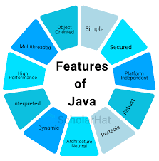
FEATURES OF JAVA
Simple
Object-Oriented
Portable
Platform independent
Secured
Robust
Architecture neutral
Interpreted
High Performance
Multithreaded
Distributed
Dynamic

Slide 5
HELLO JAVA PROGRAM
Creating Hello World Example
Let's create the hello java program:
class Simple{
public static void main(String args[])
{
System.out.println("Hello Java");
}
}

Slide 6
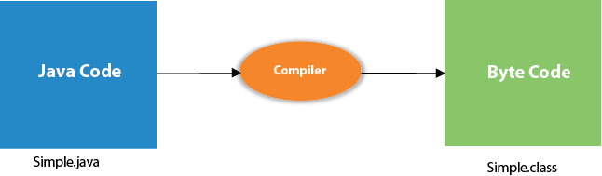
WHAT HAPPENS AT COMPILE TIME?
At compile time, the Java file is compiled by Java Compiler (It does not interact with OS) and converts the Java code into bytecode.

Slide 7
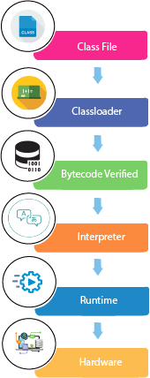
WHAT HAPPENS AT RUNTIME?
At runtime, the following steps are performed:

Slide 8
JDK, JRE, and JVM
JVM
JVM (Java Virtual Machine) is an abstract machine. It is called a virtual machine because it doesn't physically exist. It is a specification that provides a runtime environment in which Java bytecode can be executed
JRE
JRE is an acronym for Java Runtime Environment. It is also written as Java RTE. The Java Runtime Environment is a set of software tools which are used for developing Java applications. It is used to provide the runtime environment. It is the implementation of JVM. It physically exists
JDK
JDK is an acronym for Java Development Kit. The Java Development Kit (JDK) is a software development environment which is used to develop Java applications and applets. It physically exists. It contains JRE + development tools.

Slide 9
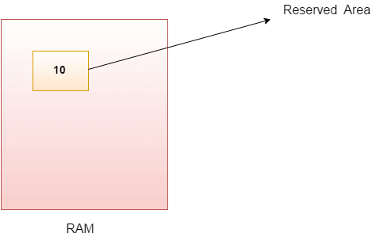
Java Variables
A variable is a container which holds the value while the Java program is executed. A variable is assigned with a data type.
Variable is a name of memory location. There are three types of variables in java: local, instance and static.
A variable is the name of a reserved area allocated in memory. In other words, it is a name of the memory location. It is a combination of "vary + able" which means its value can be changed.

Slide 10
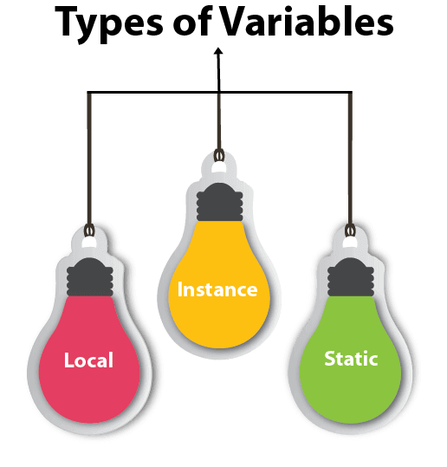
TYPES OF VARIABLES
There are three types of variables in Java:
local variable
instance variable
static variable

Slide 11
Local Variable
A variable declared inside the body of the method is called local variable. You can use this variable only within that method and the other methods in the class aren't even aware that the variable exists.
A local variable cannot be defined with "static" keyword.
Instance Variable
A variable declared inside the class but outside the body of the method, is called an instance variable. It is not declared as static.
It is called an instance variable because its value is instance-specific and is not shared among instances.
Static variable
A variable that is declared as static is called a static variable. It cannot be local. You can create a single copy of the static variable and share it among all the instances of the class. Memory allocation for static variables happens only once when the class is loaded in the memory.

Slide 12
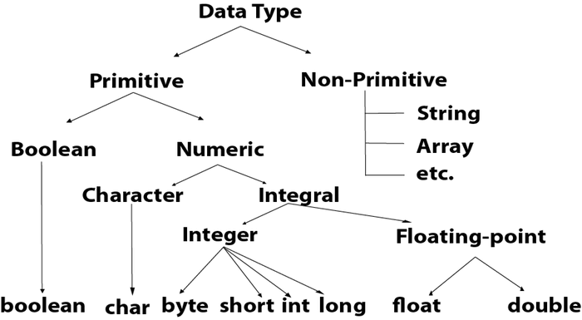
DATA TYPES IN JAVA
Data types specify the different sizes and values that can be stored in the variable. There are two types of data types in Java:
Primitive data types: The primitive data types include boolean, char, byte, short, int, long, float and double.
Non-primitive data types: The non-primitive data types include Classes, Interfaces, and Arrays.

Slide 13
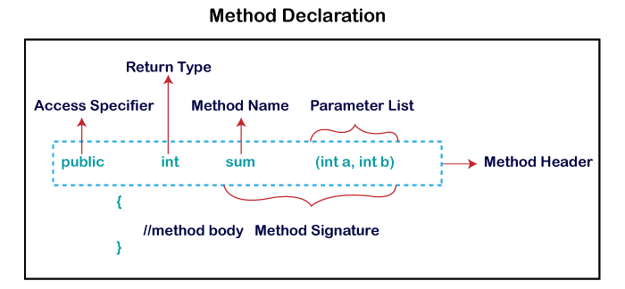
What is a method in Java?
A method is a block of code or collection of statements or a set of code grouped together to perform a certain task or operation. It is used to achieve the reusability of code. We write a method once and use it many times. We do not require to write code again and again. It also provides the easy modification and readability of code, just by adding or removing a chunk of code. The method is executed only when we call or invoke it.
Method Declaration
The method declaration provides information about method attributes, such as visibility, return-type, name, and arguments.

Slide 14
CONSTRUCTORS IN JAVA
In Java, a constructor is a block of codes similar to the method. It is called when an instance of the class is created. At the time of calling constructor, memory for the object is allocated in the memory
Rules for creating Java constructor
There are two rules defined for the constructor.
Constructor name must be the same as its class name
A Constructor must have no explicit return type
A Java constructor cannot be abstract, static, final, and synchronized

Slide 15
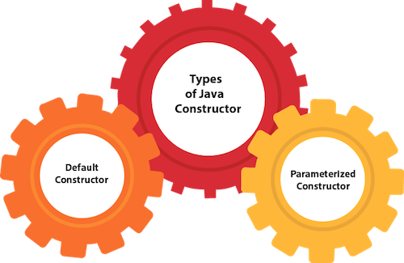
TYPES OF JAVA CONSTRUCTORS
There are two types of constructors in Java:
Default constructor (no-args constructor)
Parameterized constructor

Slide 16


