Slide 1
GROUP PROJECT
Cloud Analytics and Data Warehouse implementation for historical data TEAM 8
Shashank Reddy Kandimalla Rohith Reddy Vangala Yamini Muthyala
Swati
Sakshi Manish Mukkirwar

Slide 2
Introduction
Importance Of Dataset Cloud SQL
Cloud Architecture
Extract Transformation Loading Apache Airflow Pipeline Visualizations
Data Analysis with Queries Conclusion
CONTENTS

Slide 3
Introduction
The aim of the project is to analyze the historical data from an insurance company to determine whether the company's policyholders will also be interested in the vehicle insurance it offers.

Slide 4

Importance Of Dataset
The dataset helps in gaining insights into customer behavior and their preferences, identify potential target groups, and optimize business strategies accordingly.
It also help company to identify opportunities to target customers with offers and promotions and improve customer retention.

Slide 5
CLOUD SQL
Fully-managed Relational Database Service
Compatible with popular database engines such as MySQL, PostgreSQL, and SQL Server
Provides various monitoring and logging features that helps to keep track of database performance, health, and security.
For the purpose of storing our normalized client data, we used Amazon RDS as a cloud, a service offered by Amazon Web Services that provided a dependable and scalable database solution that worked well with our cloud-based ETL process.

Slide 6
ER-Diagram

Slide 7
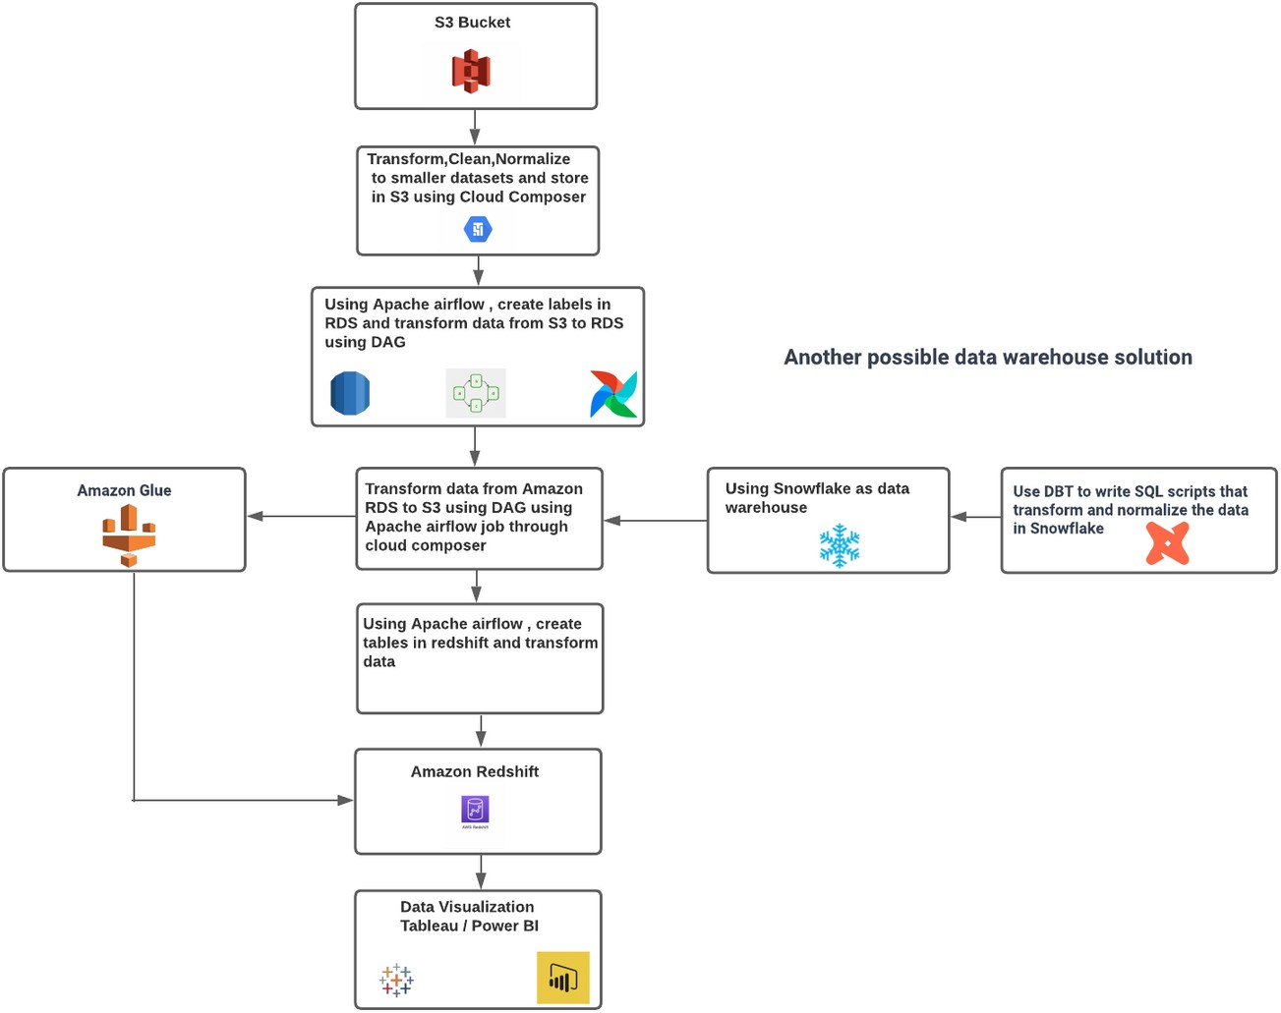
CLOUD ARCHITECTURE

Slide 8
Extract Transformation Loading
The ETL process is orchestrated using Apache Airflow, using DAG files to design and schedule the workflow.
EXTRACT
TRANSFORM
LOADING
Data is extracted from S3 Bucket
Data is transformed and normalized using custom Python scripts in DAGs
Data is loaded into Amazon Redshift using cloud client libraries.

Slide 9
Apache Airflow Pipeline
Extraction and Preprocessing of Data from S3 Bucket
Data is transferred from S3 to Redshift
Transferred Data from S3 Bucket to RDS
Apache Airflow
Data is transferred from RDS to S3

Slide 10
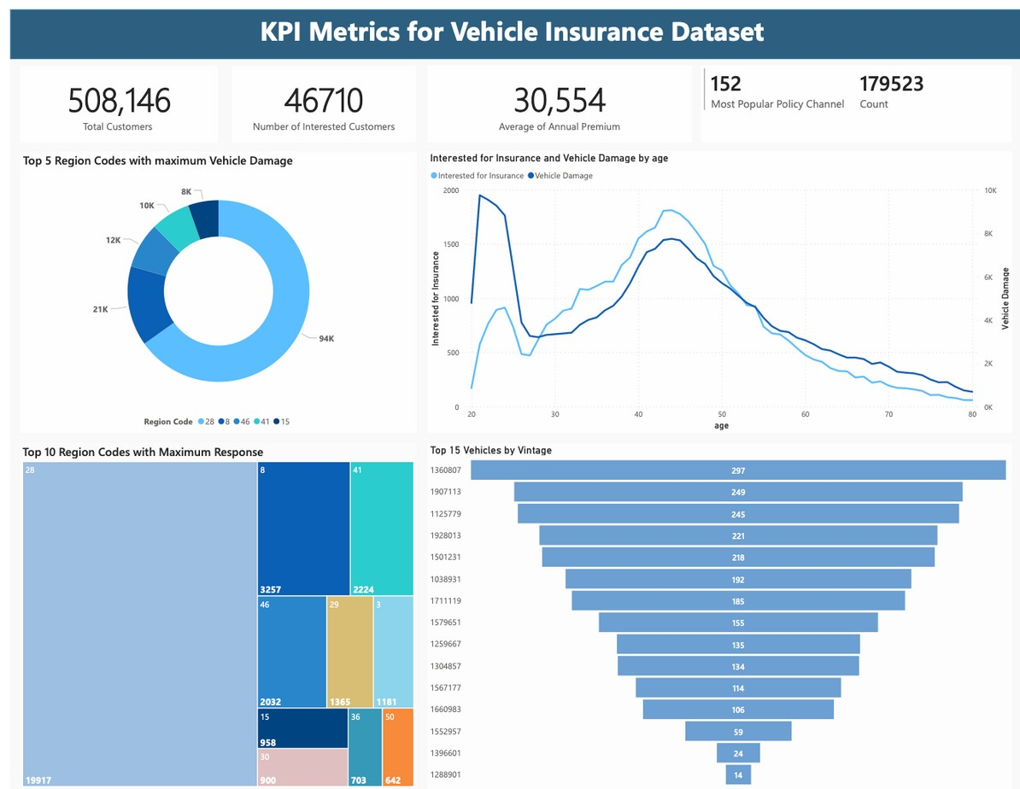
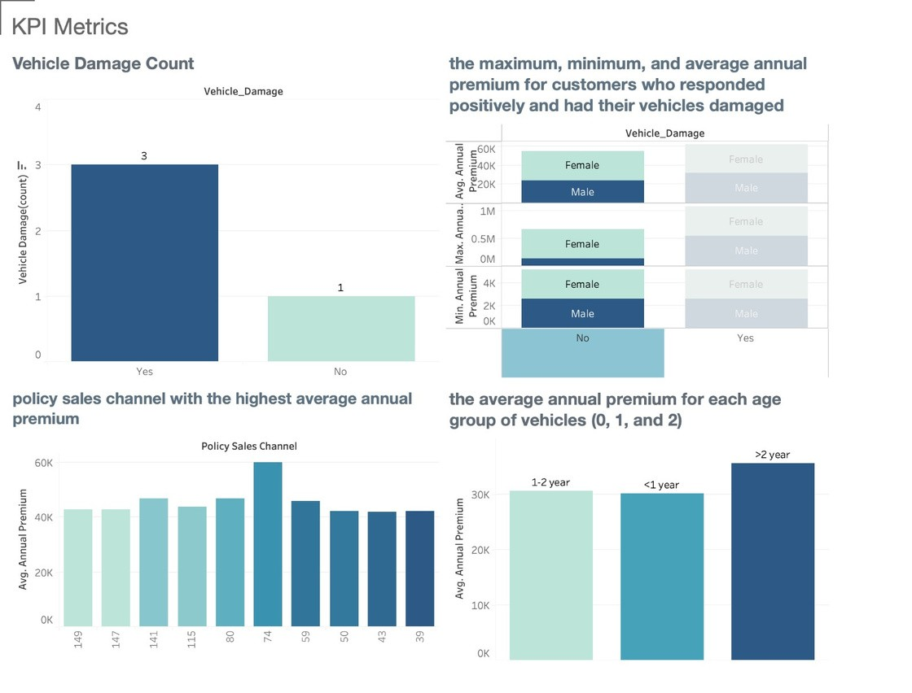
Visualizations
Tools Used : Power B I and Tableau

Slide 11
Customers who have previously been insured and target them with offers for vehicle insurance
SELECT COUNT(*) AS Total_Customers, SUM(Response) AS Interested_In_Vehicle_Insurance
FROM "dbms".Customers WHERE Previously_Insured = 1;
Data Analysis
Average Annual Premium for policies purchased by customers who also have vehicle insurance
SELECT AVG(Annual_Premium) AS Avg_Annual_Premium FROM "dbms".Policies
WHERE id IN ( SELECT id
FROM "dbms".Vehicles
WHERE Vehicle_Age IS NOT NULL
);
Average Annual Premium for customers who have both health and vehicle insurance policies
SELECT AVG(p.Annual_Premium) AS Average_Annual_Premium FROM "dbms".Customers c
INNER JOIN "dbms".Policies p ON c.id = p.id INNER JOIN "dbms".Vehicles v ON c.id = v.id
WHERE c.Response = 1 AND v.Vehicle_Age IS NOT NULL;

Slide 12
SELECT Region_Code, COUNT(*) AS Total_Customers,
SUM(Response) AS Interested_In_Vehicle_Insurance FROM "dbms".Customers
GROUP BY Region_Code order by Interested_In_Vehicle_Insurance desc;
Relationship between region code and interest in vehicle insurance
Data Analysis
Relationship between vintage (time since customer was acquired) and interest in vehicle insurance
SELECT Vintage,
COUNT(*) AS Total_Customers,
SUM(Response) AS Interested_In_Vehicle_Insurance FROM "dbms".Policies p inner join "dbms".customers c on p.id=c.id
GROUP BY p.Vintage order by Interested_In_Vehicle_Insurance desc;
Customers who have a high annual premium but have not yet purchased Vehicle Insurance
SELECT Customers.id, Policies.Annual_Premium, Vehicles.Vehicle_Age, Vehicles.Vehicle_Damage FROM "dbms".Customers
INNER JOIN "dbms".Policies ON Customers.id = Policies.id INNER JOIN "dbms".Vehicles ON Customers.id = Vehicles.id WHERE Customers.Response = 0
AND Policies.Annual_Premium > 100000 ;

Slide 13
SELECT c.id, c.Age, c.Gender, p.Annual_Premium, v.Vehicle_Age, v.Vehicle_Damage
FROM "dbms".Customers c
JOIN "dbms".Policies p ON c.id = p.id JOIN "dbms".Vehicles v ON c.id = v.id
WHERE c.Response = 1 AND p.Annual_Premium >= (SELECT AVG(Annual_Premium) FROM "dbms".Policies WHERE id = c.id) ORDER BY p.Annual_Premium DESC;
Customers associated with the company for a longer time and are interested in vehicle insurance
Data Analysis
Count of customers who responded positively and had their vehicles damaged order by gender
SELECT c.Gender, COUNT(*) AS count FROM dbms.Customers c
INNER JOIN dbms.Vehicles v ON c.id = v.id
WHERE c.Response = 1 AND v.Vehicle_Damage = 1 GROUP BY c.Gender;
Average Annual Premium by policy sales channel
SELECT Vehicle_Damage, COUNT(*) AS count FROM dbms.Vehicles
GROUP BY Vehicle_Damage;

Slide 14
Conclusion
The implementation of a cloud analytics and data warehouse solution for historical vehicle insurance data has enabled to gain insights into customer behavior and preferences.
By leveraging cloud-based resources and technologies, such as Amazon Redshift, Apache Airflow, and Tableau, we have created a scalable and efficient solution for analyzing and visualizing the historical dataset.
We were able to preprocess and modify the auto insurance dataset using ETL procedures, and then store it in a cloud SQL database.
From there, we used Tableau to run analytics and produce visualizations, enabling us to investigate trends and pinpoint key performance indicators (KPIs) associated with customer behavior.

