Slide 1

J.A.R.V.I.S
Dr. D. Y. Patil Institute of Technology, Pimpri, Pune-18.
Department of Computer Engineering
(2022-23)
Submitted by: Sakshi Navalkar
Pranali Navgrahe
Sanika Bhandari
Neha Thorat
Under the Guidance of:
Prof: Smita Khot
Prof: Pradhya Tapkir

Slide 2
Contents:
Introduction
Features
How It Works?
Advantages & Disadvantages
Overview
Conclusion

Slide 3
Introduction
The character has appeared heavily in media adaptations of Iron Man and Avengers story.
Jarvis is a free, open-source personal voice assistant that takes your commands and turn them into actions. It also allows you to create and train new skills.
Jarvis package is written using Python, and it comes with developer-friendly API and documentation. Unlike its competitors, Jarvis does not have a complex setup or configuration.

Slide 4
JARVIS: Just A Rather Very Intelligent System
JARVIS is an acronym derived from the name of Tony Stark's AI assistant in the Marvel Cinematic Universe.
In real-life applications, JARVIS represents an advanced AI assistant designed to enhance productivity and efficiency.

Slide 5
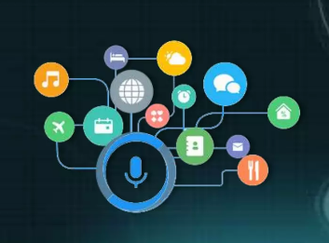
Features
Answering complex questions.
Solving math's equations.
Reading social network messages.
Conversing.
Energy saving efficiency.

Slide 6
How It Works?
Speak something (for eg. “ Hello ”)
Jarvis records the voice and works according to the commands given by us.
If it is available then proper response is given.
After listening to the command, action is taken accordingly.

Slide 7
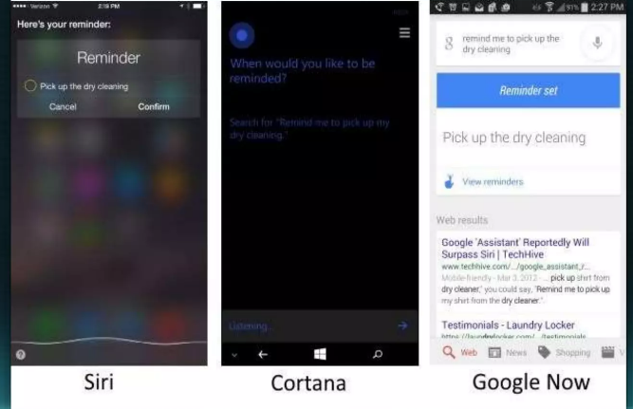
Available Applications:

Slide 8
Overview
Jarvis is a Digital life assistant
Jarvis is an open source software
Based on DOS language
Jarvis assists with your daily life by acting as an-
Alarm Clock
providing latest news headlines
forecast weather for upcoming days

Slide 9
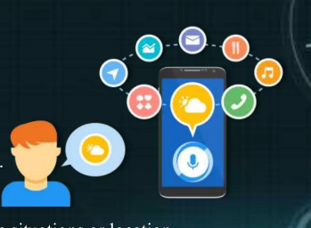
Advantages of J.A.R.V.I.S
Easy to use.
It can easily work with multiple commands.
JARVIS can be programmed with custom command option.
It is a secure system to involve in your daily life.
Helpful and useful system for disabled people.
Notes:
It is quite easy to use as compared to other AI assistance.
It can easily work with multiple commands. Usually, the AI systems are limited to a certain number of commands and fail to function properly beyond that. However, JARVIS can handle multiple commands.
JARVIS can be programmed with custom command option. Hence, it does not stick to a single command type.
It is a secure system to involve in your daily life.
It is an extremely helpful and useful system for disabled people. With the help of JARVIS, disabled people can manage their everyday life on their own without having to depend on any other human being.

Slide 10
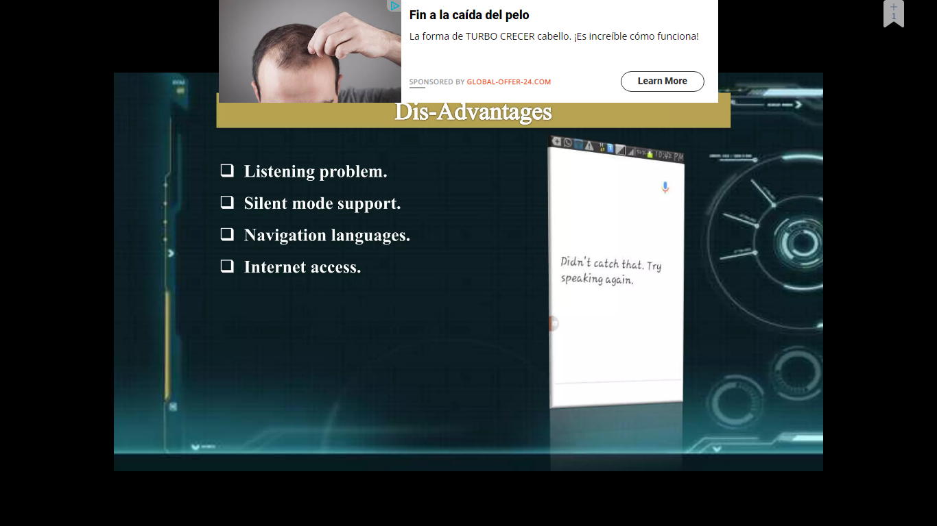
Disadvantages of J.A.R.V.I.S
Limited language support.
Expensive equipments.
Silent mode support.
Listening problem.
Notes:
Addressing Cost Factors: It is important to note that the development and implementation of JARVIS can involve significant costs, including expenses related to equipment and infrastructure.
Limitations in operating efficiently in a noisy environment.
While JARVIS excels in understanding and interpreting human language, it may face limitations in operating efficiently in a noisy environment.

Slide 11
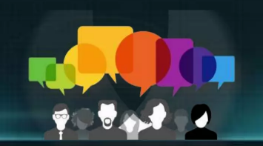
Conclusion
JARVIS, as an advanced AI assistant, offers streamlined task automation, intuitive interactions through natural language processing, intelligent information retrieval, and personalized recommendations.
Its advanced analytical capabilities and enhanced time management features further enhance productivity and efficiency.
By leveraging JARVIS, individuals and organizations can transform their work processes, improve collaboration, and make data-driven decisions.
Embracing the potential of AI assistants like JARVIS opens up new possibilities for achieving success in various domains.

Slide 12


