Slide 1
Sentiment Analysis of British Airways Customer Reviews
A data-driven insight into passenger experiences based on Skytrax reviews
Sakshi Patel
May 2025

Slide 2
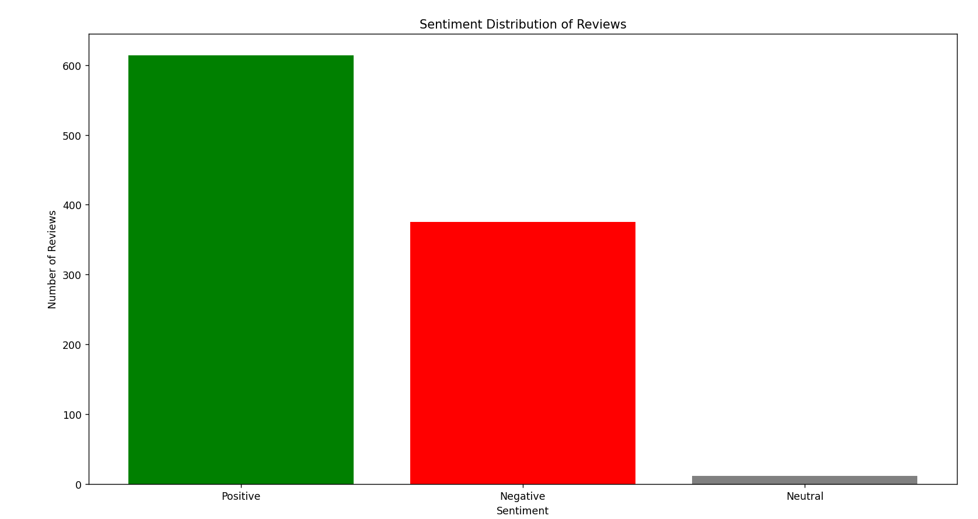
Customer Sentiment Overview
Title: Key Insights
61% Positive: Customers praised crew behavior and comfort.
38% Negative: Complaints about delays, baggage, and food quality.
Most Common Terms: “flight”, “crew”, “service”, “delayed”, “comfortable”.
✅ Positive Reviews: 61.4%
❌ Negative Reviews: 37.5%
🔁 Neutral Reviews: 1.1%
Quick Stats :
Total Reviews: 1000
Positive: 614
Negative: 375
Neutral: 11

