Slide 1

0.9917
MISM 6212 · Data Mining & Machine Learning · April 2026
ROC-AUC
Skincare Product
Safety Prediction
& Recommendation
Engine
96.8%
F1 Score (irritation)
6 Models
Compared + SHAP
Using ML & NLP on Sephora Reviews
1.09M+
Reviews analyzed
Harshmeet Kaur · Sai Athale · Shreya Pandey · Sakshi Patil
D'Amore-McKim School of Business, Northeastern University
Notes:
Hi everyone, we're Team 4. Today we're presenting a skincare irritation prediction system — built on machine learning and NLP, trained on over a million real Sephora reviews. The headline: our best model hit a ROC-AUC of 0.9917. We benchmarked six classifiers, ran full SHAP analysis to understand why predictions happen, and wrapped it all into an interactive recommendation dashboard.

Slide 2
The
Problem
BUSINESS QUESTIONS
01
Can we predict the likelihood of a cosmetic product causing skin irritation based on its ingredient composition?
Consumers rely on anecdotal reviews or marketing claims when assessing product safety. There is no scalable, data-driven way to evaluate irritation risk from ingredients or consumer feedback.
02
Can unstructured review text data detect early signals of product safety concerns at scale?
STAKEHOLDERS
Cosmetic brands
03
Which specific ingredients or ingredient combinations are most strongly associated with negative skin reactions?
E-commerce retailers
Consumers
Regulatory bodies
2
Notes:
Here's the core problem: Today when we have so many, almost too many choices in all kinds of skincare products, Consumers have no data-driven way to evaluate whether a product will irritate their skin. They rely on scattered reviews and marketing claims.
We built around three questions. One — can ingredient composition alone predict irritation? Two — can review text detect safety signals at scale? Words like "this burned my face" or "I had to switch products." which are present in product reviews. And three — which specific ingredients, or combinations of ingredients, are actually the worst offenders? The answers matter across the board: brands want fewer returns, retailers want smarter recommendations, consumers want safer choices, and regulators want transparency.

Slide 3
DATA SOURCES & QUALITY
Three datasets, one merged pipeline
1.09M
~8K
INCI
Sephora reviews with
ratings, skin type, text
Products with full
ingredient lists & metadata
Standardized ingredient
names with hazard flags
DATA QUALITY CONCERNS
Ingredient columns mix marketing text with actual INCI lists, making clean extraction difficult
Review text is user-generated with no standard vocabulary ('broke me out' = 'caused a rash')
Self-reported skin_type is unverified and may introduce response bias
7.3:1 class imbalance (88% no irritation vs 12% irritation) requires deliberate balancing
INCI names differ from trade names/abbreviations in Sephora data, needing approximate matching
3
Notes:
We pulled from three sources. 1.09 million Sephora reviews — with ratings, skin type, and text. Product metadata for roughly 8,000 products with full ingredient lists. And the INCI reference list for standardized hazard flagging.
The data wasn't clean. Ingredient columns mixed marketing copy with actual ingredients. Reviews have no standard vocabulary — "broke me out" and "caused a rash" mean the same thing, but a model doesn't know that. Skin type is self-reported, so there's real noise there. And critically, only 12% of reviews mention irritation — a 7.3-to-1 class imbalance that required deliberate handling.

Slide 4
METHODOLOGY
Feature engineering & NLP pipeline
Allergen flags
Aggregate risk
NLP features
10 binary indicators for: fragrance, alcohol, paraben, sulfate, essential oils, retinol, formaldehyde releasers, phthalates, mineral oil, silicones
allergen_count: total flagged allergens per product
toxicity_score: severity-weighted sum (formaldehyde=5, phthalates=4, fragrance/sulfate/retinol=3, oils/alcohol=2, others=1)
INCI risk mapping: restricted ingredient count
TF-IDF: 5,000 features, unigrams + bigrams, fitted on training data only
VADER sentiment: compound, positive, and negative scores per review
CountVectorizer lift analysis for discriminative n-grams
+ 8 pairwise interaction features (e.g., fragrance × alcohol, alcohol × retinol)
TARGET VARIABLE
CLASS BALANCING
irritation_flag (binary) from keywords: rash, burn, itch, irritation, allergy, breakout, redness
Random undersampling: 106,846 samples per class (213,692 total). Identical performance to class weighting but 4× faster with TF-IDF.
4
Notes:
Our features came from three places.
First, ingredient flags. We tagged 10 known allergens — fragrance, alcohol, parabens, sulfates — and added 8 combination features, because some ingredients are more irritating together than alone.
Second, risk scores. Rather than just counting allergens, we weighted them by severity and rolled that into a single toxicity score per product.
Third, review text. We used TF-IDF to identify which words and phrases show up more in irritation reviews, plus sentiment scoring to capture how negative a review actually sounds.
The target was a simple yes/no irritation flag For class balancing, we equalized the training set to 107,000 samples per class — same accuracy as fancier methods, four times faster.

Slide 5
EXPLORATORY DATA ANALYSIS
What the data revealed
87.8%
12.2%
vs
no irritation
irritation flagged
7.3:1 imbalance · 133K of 1.09M reviews
Critical finding: Structural features alone are not enough
All three imbalance strategies produced ROC-AUC 0.74–0.76 on structural features alone (interactions, toxicity, sentiment). Meaningful improvement over the original 0.57, but still far from sufficient without text features.
Fragrance paradox
Skin type matters
Products WITHOUT fragrance had higher irritation rates (13.5%) than those WITH (9.5%). Ingredient flags alone miss the full picture.
Users who disclose skin type are less likely to report irritation. Unknown skin type had the highest irritation rate (13.4%).
5
Notes:
Looking at our 1.09 million reviews, the first thing we noticed is the class imbalance where 87.8% contributed to no irritation whereas 12.2% were flagged. That's a 7.3-to-1 ratio, which means a naive model that always predicts 'no irritation' is still 88% accurate. That's exactly why we can't rely on accuracy alone so we chose F1 and AUC-ROC as our metric.
We also found that products WITHOUT fragrance had higher irritation rates of around 13.5% versus 9.5%. Ingredient flags alone do not capture the entire picture.
Even after engineering allergen flags, interaction terms, and toxicity scores, AUC flattened at 0.76. Better than random, but not nearly good enough — and that's why we used NLP."

Slide 6

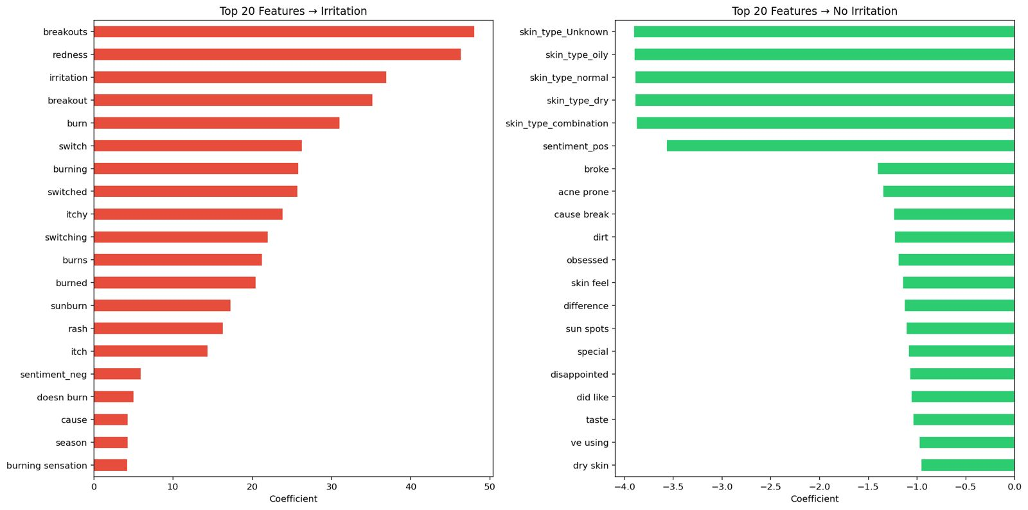
NLP & FEATURE ANALYSIS
The transformation that changed everything
STRUCTURAL FEATURES ONLY
+ TF-IDF TEXT FEATURES
ROC-AUC
0.76
ROC-AUC
0.99
+30%
F1 Score
0.33
F1 Score
0.97
+194%
Recall
0.70
Recall
0.96
+37%
6
Notes:
Considering the structural features alone: AUC is 0.76, and F1 is 0.33 — the model was identifying irritation but there were a lot of false positives. On adding TF-IDF, AUC rises to 0.99, F1 to 0.97, Recall to 0.96. A 30% AUC gain and 194% F1.
The bottom left chart shows the top 20 features predicting irritation and these are the words that the consumers use like "Breakouts" and "redness" have by far the highest positive coefficients, followed by "irritation," "burn," "itchy," and "rash." We also noticed that “switch,” “switched,” and “switching” also appear. People who experience irritation talk about switching products, and the model learned that behavioral signal on its own. It was not in our original keyword list.
In green on the right, skin type disclosure variables dominate the no-irritation side, followed by positive sentiment. Users who share their skin type and express satisfaction are less likely to report irritation.

Slide 7
MODEL RESULTS
Six models, all above 0.985 AUC
Model | Accuracy | Precision | Recall | F1 Score | ROC-AUC
Logistic Regression | 0.9922 | 0.9783 | 0.9578 | 0.9679 | 0.9917
LinearSVC | 0.9927 | 0.9802 | 0.9592 | 0.9696 | 0.9915
Random Forest | 0.9588 | 0.7594 | 0.9701 | 0.8519 | 0.9906
XGBoost | 0.9945 | 0.9973 | 0.9576 | 0.9770 | 0.9916
LightGBM | 0.9944 | 0.9964 | 0.9575 | 0.9765 | 0.9914
Gradient Boosting | 0.9946 | 0.9999 | 0.9560 | 0.9774 | 0.9881
KEY OBSERVATIONS
Best AUC:
LR (0.9917) and XGBoost (0.9916) — best interpretability-performance balance
Highest recall:
Random Forest (97.0%) catches most irritation but has more false positives
Highest F1:
Gradient Boosting (0.9774) and XGBoost (0.9770) — best precision-recall tradeoff
Near-perfect precision:
Gradient Boosting (99.99%) — virtually zero false positives across 191K reviews
7
Notes:
Six models on the held-out test set of 218,000 reviews, all above 0.985 AUC. Logistic Regression and XGBoost are essentially tied for best AUC at 0.9917 and 0.9916. Random Forest catches the most irritation cases with 97% recall but has more false positives. Gradient Boosting achieves near-perfect precision at 99.99%. The choice depends on the use case: LR for interpretability, Random Forest for maximum recall, XGBoost or Gradient Boosting for best F1.

Slide 8
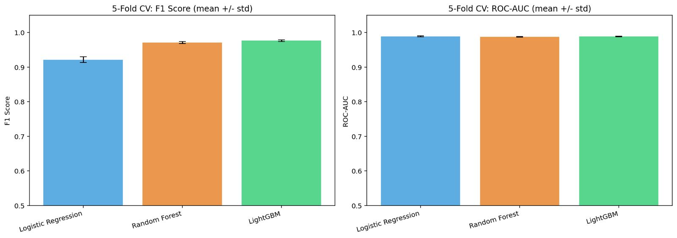
CROSS-VALIDATION
Confirming stability across folds
5-fold stratified cross-validation on a 100K stratified subsample. TF-IDF fitted independently inside each fold to prevent data leakage.
Logistic Regression
Random Forest
LightGBM
Accuracy
Accuracy
Accuracy
0.9822 ± 0.0017
0.9931 ± 0.0007
0.9944 ± 0.0006
F1 Score
F1 Score
F1 Score
0.9215 ± 0.0080
0.9708 ± 0.0029
0.9765 ± 0.0025
ROC-AUC
ROC-AUC
ROC-AUC
0.9888 ± 0.0014
0.9873 ± 0.0010
0.9884 ± 0.0013
8
Notes:
Thanks. Numbers this high naturally raise a question — are they too good to be true? So we stress-tested them with 5-fold cross-validation, making sure the model never saw test data during training.
The results held up. Logistic Regression came in at 0.98, within a hair of the held-out result. LightGBM had the highest F1 at 0.97. And those error bars in the charts? Barely visible. Every model was stable across folds. These aren't lucky numbers.

Slide 9
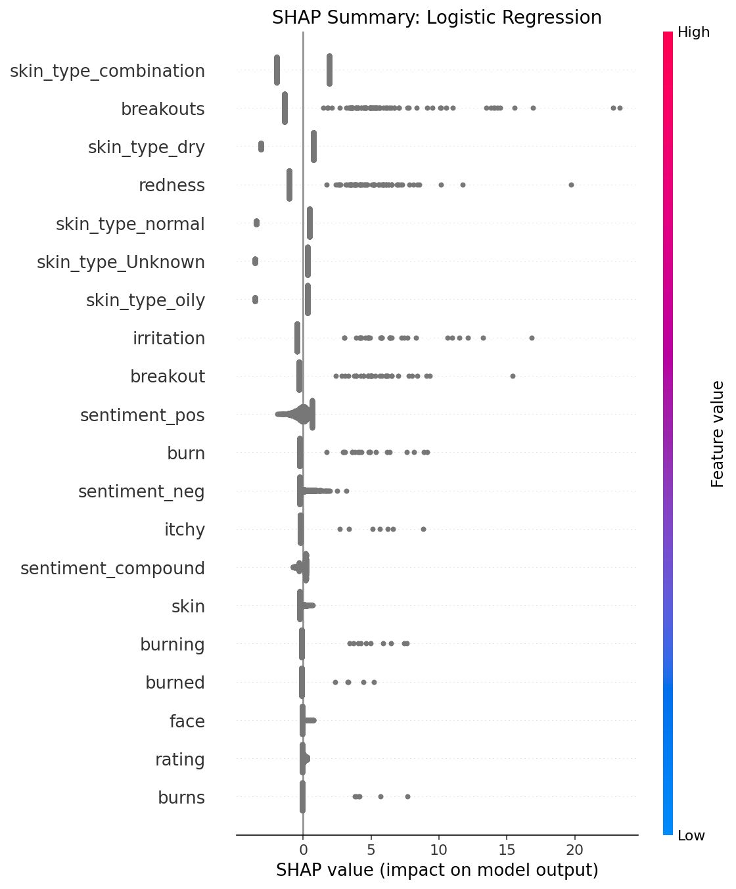
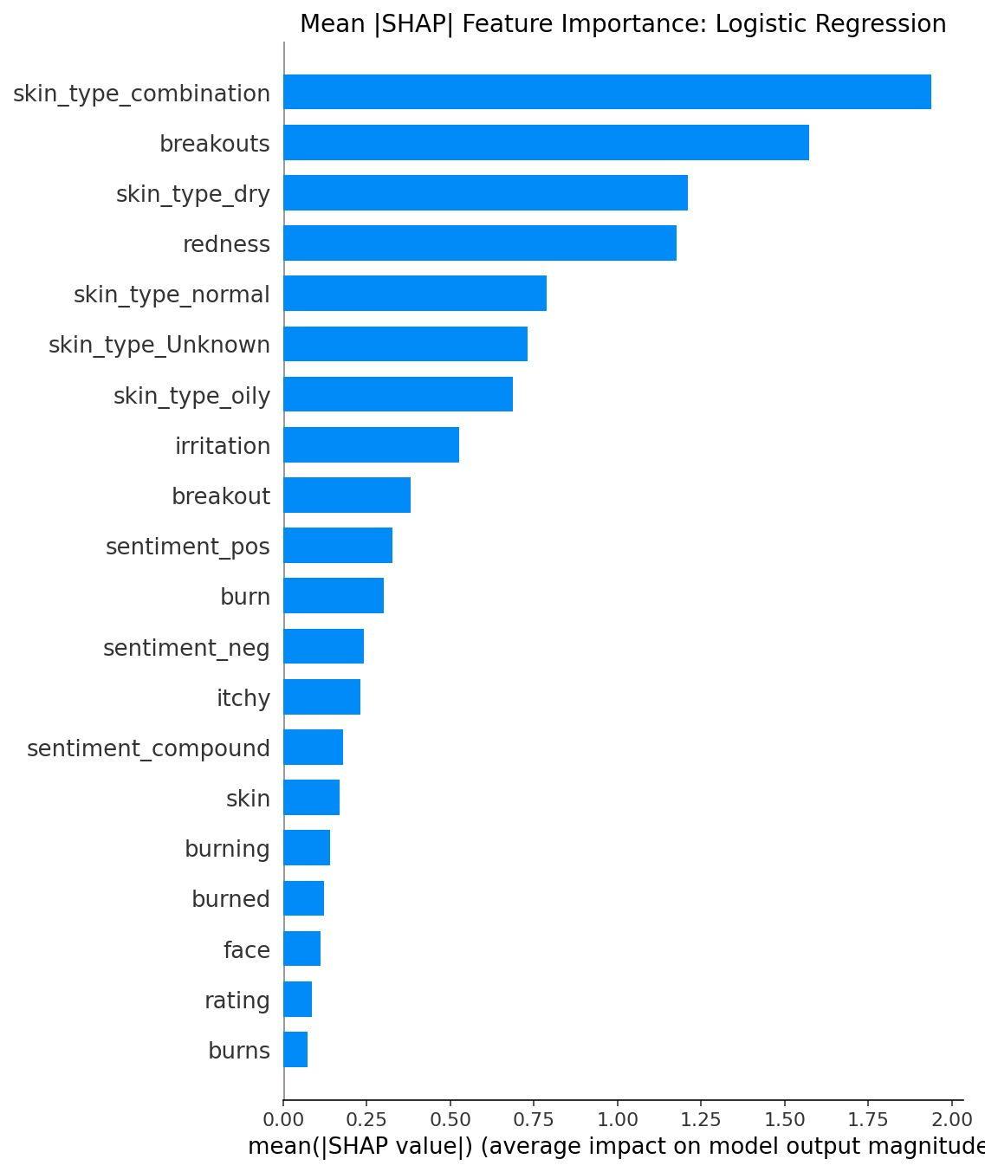
SHAP ANALYSIS
Model interpretability
SHAP values computed on 2,000-row test sample for LR (LinearExplainer), XGBoost and LightGBM (TreeExplainer).
Key finding: Text and ingredient features contribute approximately equally to predictions across all three models.
SHAP highlights
LR: skin_type_combination leads mean |SHAP| (1.97), followed by 'breakouts' (1.59) and skin_type_dry (1.22). Sentiment features rank 10–15.
XGBoost: SHAP values up to +9. 'Switch'/'switched' emerge as behavioral signals.
LightGBM: Largest |SHAP| overall. 'Sensitive' and 'love' show bidirectional effects.
9
Notes:
SHAP helps us open the black box — it shows why the model makes each prediction, not just what it predicts.
The key finding is that ingredient features and review text contribute roughly equally. Neither one carries the model alone — they work together.
Looking at the top features: skin type combination leads, followed closely by words like "breakouts" and "redness." For XGBoost, product-switching language emerges as a strong signal — again, something the model learned entirely on its own. And for LightGBM, words like "sensitive" can push predictions in either direction depending on context.
Over to Harshmeet

Slide 10
INTERACTIVE DASHBOARD
From model to product
Streamlit-powered recommendation engine making model outputs accessible without technical expertise.
Skin type selector
Skin concerns
Ingredient search
All scores recalculate for selected type
6 categories mapped to beneficial ingredients
20 popular actives (Niacinamide, Vit C, HA...)
Allergen avoidance
Category & price
Paginated results
10 checkboxes to exclude risky ingredients
Filter by product type and price range
Cards with badges, ratings, irritation rates
SUITABILITY SCORE
40%
Safety
+
30%
Quality
+
30%
Endorsement
1 − Irritation Rate
Average Rating / 5
Recommendation Rate
Score 0–100 · Computed per skin type · 85+ Excellent · 70–84 Good · 55–69 Fair · <55 Low
10
Notes:
Thanks. The Streamlit dashboard makes our model accessible to non-technical users. You select your skin type and all scores recalculate. You can filter by concerns like acne or sensitivity, search for desired ingredients, and exclude allergen families.
The suitability score combines three things: 40% weight on safety from irritation rate, 30% on quality from ratings, and 30% on endorsement from recommendation rate. All computed per skin type. 85 and above is Excellent, down to below 55 for Low. Let’s go to the dashboard.

Slide 11
ANSWERS TO BUSINESS QUESTIONS
Tying it all together
01
Can ingredient composition predict irritation?
Partially, but not in isolation. Enhanced structural features (interactions, toxicity, sentiment) achieved ROC-AUC ~0.76, up from 0.57 with basic flags. But combined with TF-IDF, SHAP shows ingredient and text features contribute approximately equally. Features like toxicity_score, allergen_count, and interaction flags (fragrance × alcohol) appear in SHAP rankings. Ingredients encode real safety info, amplified by review language.
02
Can review text detect early safety signals?
Yes, and decisively. TF-IDF drove ROC-AUC from 0.76 to 0.9917. Top phrases ('breakouts', 'redness', 'burn') correspond to consumer-reported adverse reactions and are dominant predictors across all three SHAP analyses. In deployment, the model could monitor incoming reviews and flag products for safety review in near-real-time.
03
Which ingredients are most associated with negative reactions?
Highest-risk: formaldehyde-releasing preservatives (DMDM hydantoin, quaternium-15), phthalates, fragrances, sulfates, retinol compounds. Co-irritant pairs fragrance × alcohol and alcohol × retinol show elevated rates. Alcohol disrupts the skin barrier, increasing penetration of co-applied irritants — consistent with known dermatological mechanisms.
11
Notes:
Tying it back. Question one: ingredients alone reached 0.76 AUC, not enough by themselves. But combined with text, SHAP shows they contribute equally. Toxicity scores, allergen counts, and interaction flags all appear in SHAP rankings.
Question two: review text decisively detects safety signals. TF-IDF drove AUC from 0.76 to 0.9917. In deployment, you could monitor reviews in near-real-time and flag products automatically.
Question three: formaldehyde releasers, phthalates, fragrances, and sulfates are highest risk. Fragrance-alcohol and alcohol-retinol are top co-irritant pairs, consistent with known dermatological mechanisms.

Slide 12

01
Review text features are the strongest individual predictors. Enhanced structural features reached AUC 0.76; adding TF-IDF pushed it to 0.9917.
Conclusions
& Future
Work
02
Ingredient features carry genuine signal when combined with text. SHAP confirms approximately equal contribution from both feature types.
03
Highest-risk ingredients: formaldehyde releasers, phthalates, fragrances, sulfates. Co-irritant pairs: fragrance × alcohol, alcohol × retinol.
LIMITATIONS
• Keyword target may miss subtle adverse reactions
• INCI matching is approximate; fuzzy matching would help
04
All 6 models achieved ROC-AUC > 0.985. 5-fold cross-validation confirmed stability with std < 0.002 for AUC.
• Skin-type-specific models could personalize further
• Transformers (BERT) could extract richer semantics
05
The Streamlit dashboard translates predictions into personalized, skin-type-specific recommendations with transparent scoring. Dashboard : Skincare Allergy Dashboard
Team 4 · MISM 6212 · Spring 2026
12
Notes:
Five takeaways. Review text is the strongest single predictor — it's what took us from 0.76 to 0.9917. But SHAP shows ingredient features pull equal weight once you add them together. The highest-risk ingredients are formaldehyde releasers, phthalates, fragrances, and sulfates — with fragrance-alcohol and alcohol-retinol as the most dangerous combinations. All six models are stable and cross-validated. And the dashboard makes this accessible to anyone, not just analysts.
A few honest limitations: our irritation labels come from keywords, not clinical diagnosis. INCI matching isn't perfect. And there's room to go further with more advanced language models.
Thank you.

