Slide 1
Deletion
In
Binary
Search
Tree

Slide 2
introduction
Binary search tree
Properties of binary search tree
Deletion in bst
Searching in bst
Deletion algorithm

Slide 3
Binary search tree(BST)
Binary search tree is a data structure that quickly allows us to maintain a sorted list of numbers.
It is called a binary tree because each tree node has a maximum of two children.

Slide 4
Properties of binary search tree
All nodes of left subtree are less than the root node.
All nodes of right subtree are more than the root node

Slide 5
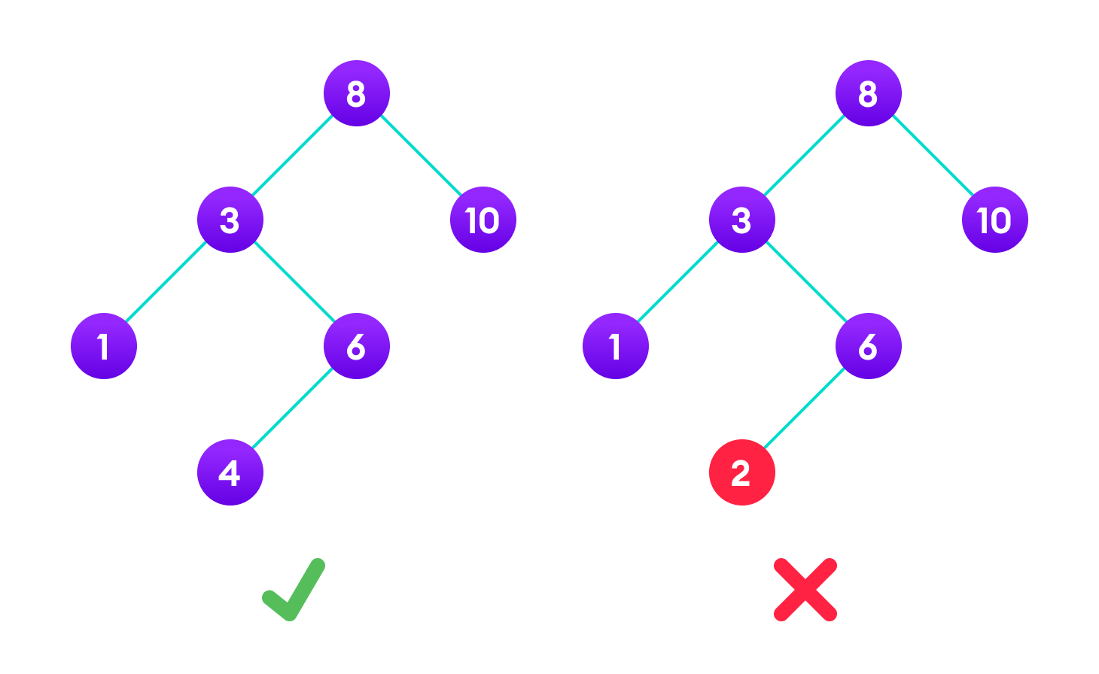
Here is an example of bst
The binary tree on the right isn't a binary search tree because the right subtree of the node "3" contains a value smaller than it.

Slide 6
Deletion in bST
There are 3 cases in deletion in bst .
If node has no child,
we can simply remove the node.
if the node has one child,
we can use its child to replace itself.
if the node has two children,
replace the node with its in order successor
or predecessor node and delete that node.

Slide 7
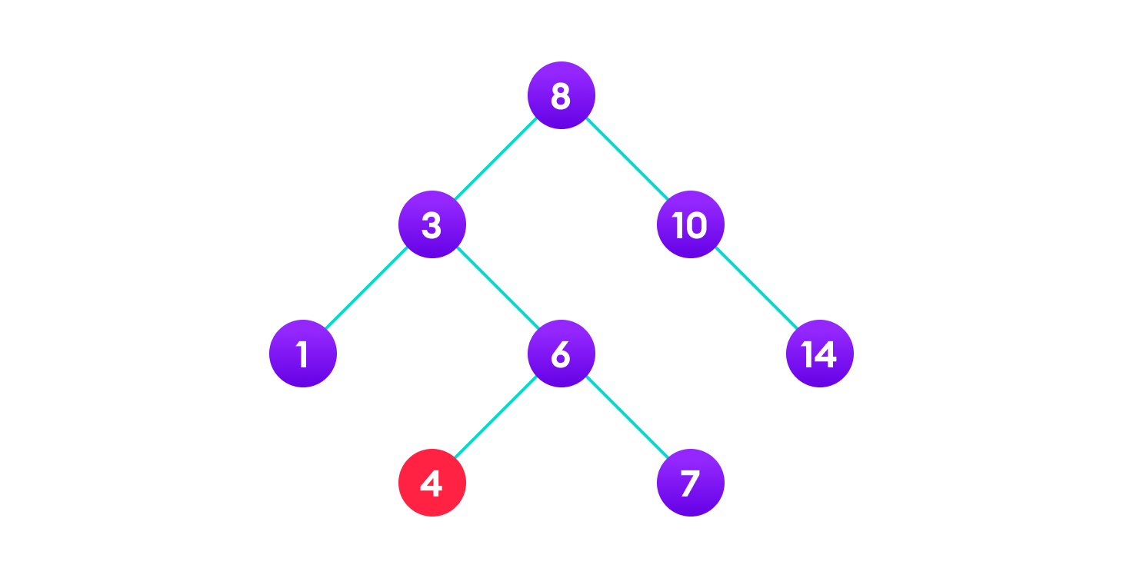
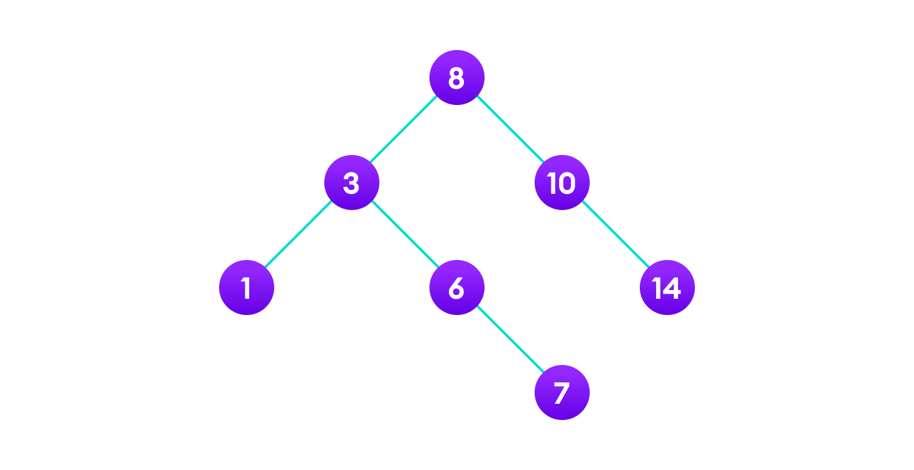
Case I = no child
4 is to be deleted
Delete the node

Slide 8
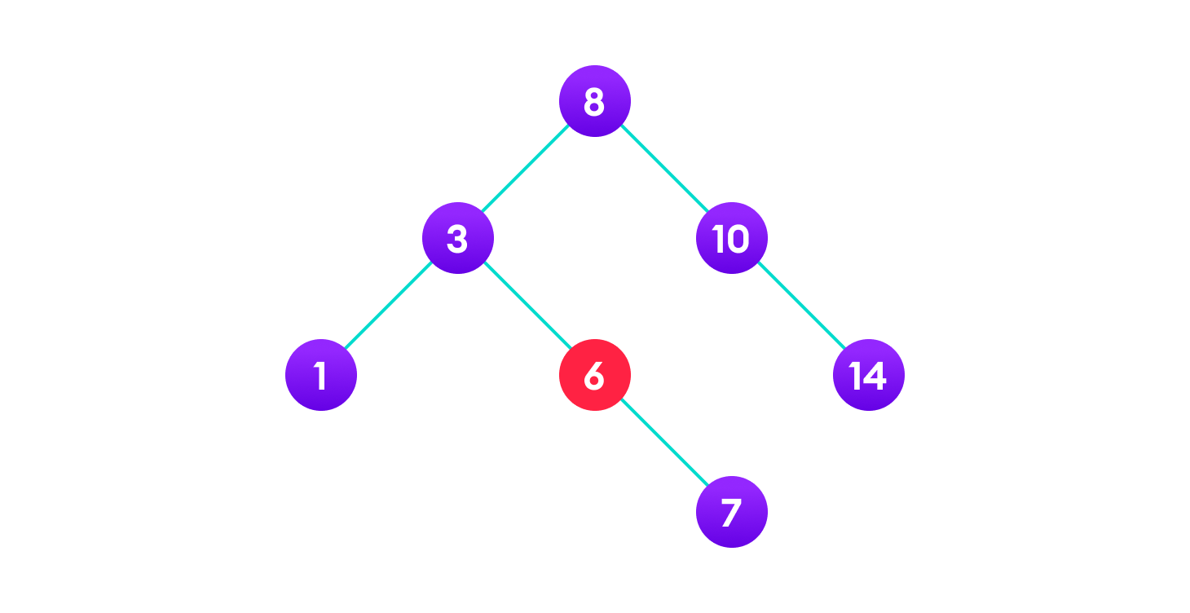
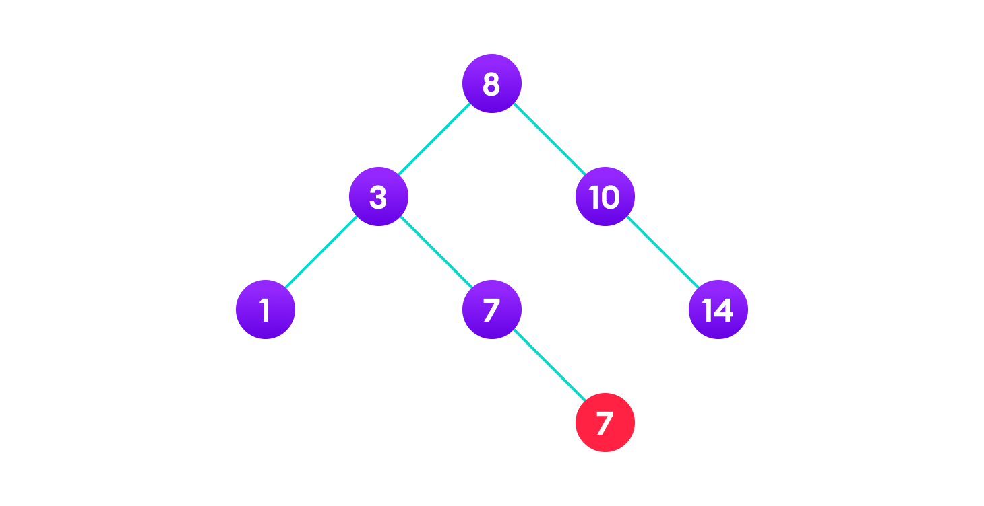
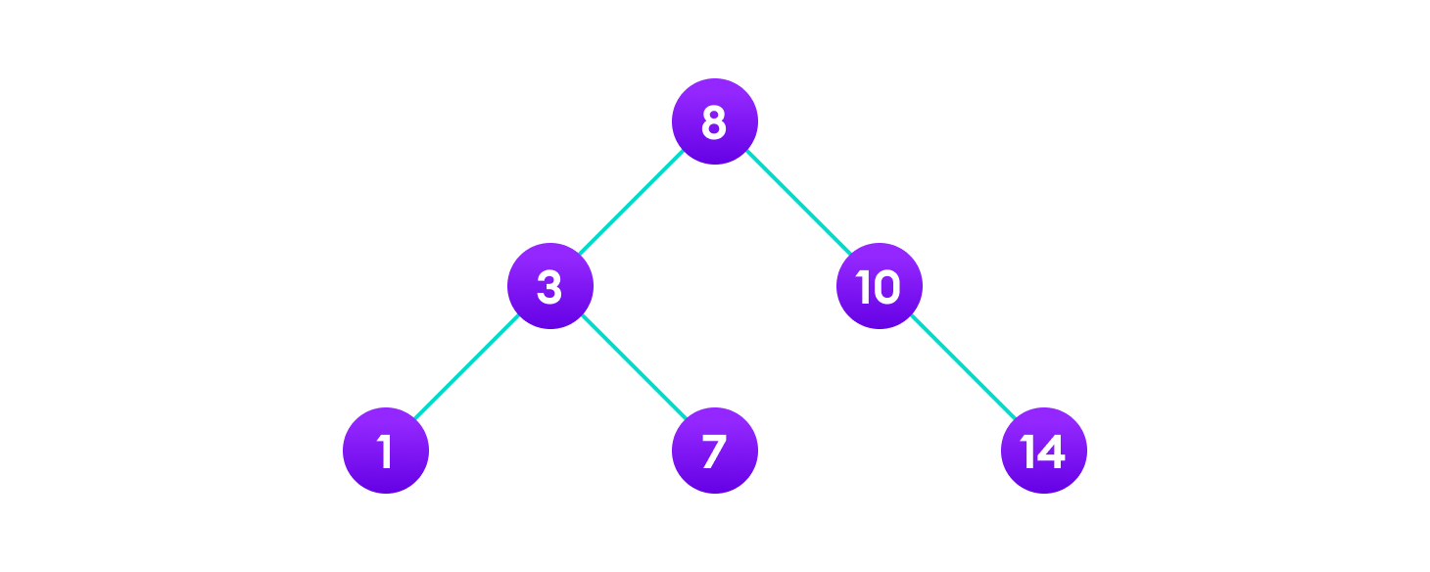
Case II = one child
copy the value of its child to the node
and delete the child
Final tree
6 is to be deleted

Slide 9
Algorithm for case I,II
Procedure : case I,II(INFO,RPTR,ROOT,LOC,PAR)
Step 1 [initializes the pointer CHILD]
if LPTR[LOC] := NULL and RPTR[LOC] := NULL then
Set CHILD := NULL
Else if RPTR[LOC] <> NULL then
Set CHILD := RPTR[LOC]
Else
Set CHILD := LPTR[LOC]
[End of if statement]

Slide 10
Step 2 if PAR <> NULL then if LOC = LPTR[PAR] then Set LPTR [PAR] := CHILD Else Set RPTR [PAR] := CHILD [End of Inner if statement] Else Set ROOT := CHILD [End of outer if statement] Step 3 [Finished] Return

Slide 11
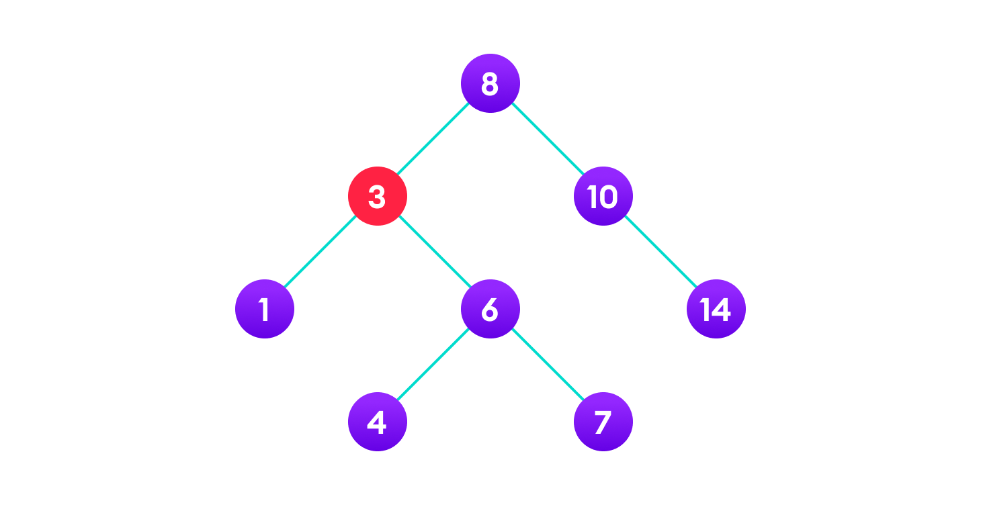

Case III = two children
Copy the value of the in-order
successor (4) to the node
Delete the in-order successor
3 is to be deleted

Slide 12
Algorithm for case III
Procedure : case III (INFO,LPTR,RPTR,ROOT,LOC,PAR)
In this procedure the pointer SUC gives the location of the in-order successor of N and PSUC gives the location of parent of the in-order successor.
Step 1 [find SUC and PSUC]
(i) Set PTR := RPTR[LOC] and
TEMP := LOC
(ii) Repeat while LPTR[PTR] <> NULL
Set TEMP := PTR and
PTR := LPTR[PTR]
[End of loop]
(iii) Set SUC := PTR and
PSUC := TEMP

Slide 13
Step 2 [Delete in-order successor using procedure 5.2] Call CASE I,II (INFO,LPTR,RPTR,ROOT,SUC,PSUC) Step 3 [Repeat node N by its in-order successor] (i) if PAR <> NULL then if LOC = LPTR[PAR] then Set LPTR[PAR] := SUC Else Set RPTR[PAR] := SUC [End of inner if statement] Else Set ROOT := SUC [End of outer if statement] (ii) Set LPTR[SUC] := LPTR[LOC] and RPTR[SUC] := RPTR[LOC] Step 4 [Finished] Return

Slide 14
Searching in bst
The algorithm depends on the property of BST that if each left subtree has values below root and each right subtree has values above the root.
If the value is below the root, we can say for sure that the value is not in the right subtree; we need to only search in the left subtree and if the value is above the root, we can say for sure that the value is not in the left subtree; we need to only search in the right subtree.

Slide 15
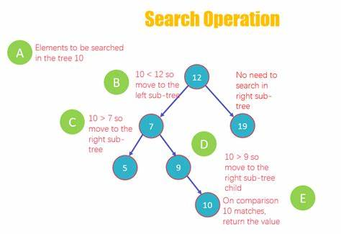
Here is an example of search algorithm

Slide 16
Search algorithm
Procedure : SEARCH(INFO,LPTR,RPTR,ROOT,ITEM,LOC,PAR)
Here LOC is the location of given ITEM and PAR in the location of the parent of ITEM. The procedure traverse down the tree using the pointer PTR and the pointer TEMP for the parent node.
Step 1 [Is tree empty ?]
If ROOT = NULL then
Set LOC := NULL, PAR := NULL and Return
[End of if statement]
Step 2 [Is ITEM at root?]
If ITEM = INFO[ROOT] then
Set LOC := ROOT,PAR := NULL and Return
[End of if statement]

Slide 17
Step 3 [Initialize pointers PTR and TEMP] If ITEM < INFO[ROOT] then Set PTR := LPTR[ROOT] and TEMP := ROOT Else Set PTR := RPTR[ROOT] and TEMP := ROOT [End of if statement] Step 4 Repeat steps 5 and 6 while PTR <>NULL Step 5 [ITEM found ?] If ITEM = INFO[PTR] then Set LOC := PTR and PAR :-= TEMP and Return [End of if statement] Step 6 If ITEM < INFO[PTR] then Set PTR := LPTR[PTR] and TEMP := PTR Else Set PTR := RPTR[PTR] and TEMP := PTR [End of if statement] [End of step 4 loop] Step 7 [Search unsuccessful] Set LOC := NULL and PAR := TEMP Step 8 [Finished] Return

Slide 18
Delete algorithm
Algorithm : DELETE(INFO,LPTR,RPTR,ROOT,AVAIL,ITEM)
A binary search tree T is in memory and an ITEM of information is given. This algorithm is used to delete the node of given ITEM.
Step 1 [Find the location of ITEM and its parent by using procedure
5.1]
call SEARCH(INFO, LPTR,RPTR,ROOT,ITEM,LOC,PAR)
Step 2 [if item is not in tree]
if LOC = NULL then
write “ITEM not in tree”
Exit
[End of if statement]

Slide 19
Step 3 [Delete node containing ITEM] If RPTR[L0C] <> NULL and LPTR[LOC] <> NULL then call CASE III (INFO,LPTR,RPTR,ROOT,LOC,PAR) Else call CASE I,II(INFO,LPTR,RPTR,ROOT,LOC.PAR) [End of if statement] Step 4 [Add deleted node to the AVAIL list] Set LPTR[LOC] := AVAIL and AVAIL := LOC Step 5 [Finished] Exit

