Slide 1
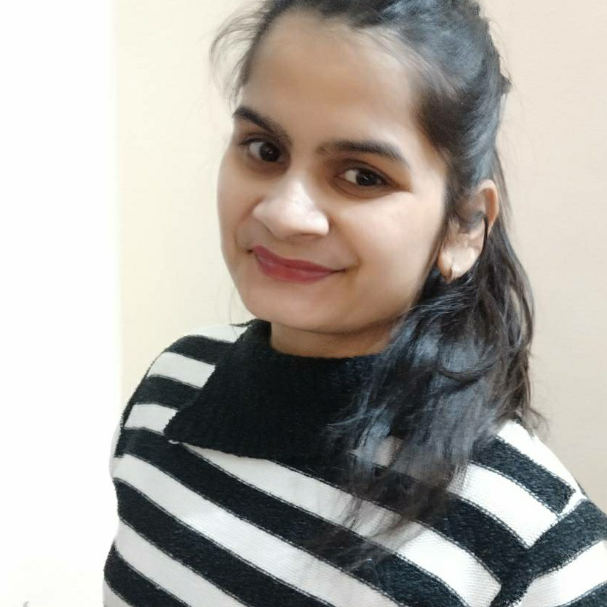



Sakshi Panwar
Analyst/Software Engineer
Master of Computer
Application(MCA) : 2020 - 2022
Skills
Java 8 /J2EE | Java Basics, OOPS, Generics, Collections, Arrays, Loops, Lambda Expressions
Spring core | IOC & Dependency Injection, Autowire
Spring REST | REST controllers, Implementation of GET, POST, PUT & DELETE, Bean Validation & Exception Handling, Controller & Repository layer
Spring Data JPA | Implement DAO layer using spring Data repositories,
Spring Boot Microservices | Spring Boot Starters, annotations, Messaging Service, Swagger API documents
Spring Cloud | Eureka, Spring Cloud API Gateway
Database | MongoDB
UI Tech | HTML 5 & CSS 3,JavaScript, ReactJS
Tools | Git, Postman, IDE
Add On skills | Communications, Team management. Peer learning
Mumbai
sakshi.panwar@capgemini.com
+91 9528133463
A4
Full Stack Developer
Hands on experience in creating microservices with Springboot, Spring Security, Spring Cloud API Gateway, Eureka server,
Proficient in creating Sigle page Web Application in react
Experience in creating documentation with swagger and in unit testing using Junit, in messaging service using RabbitMQ, in email service
Understanding of AWS Cloud environment
Project:
On demand Car Wash
Completed end to end case study of On Demand Car Wash System along with JWT authentication, Swagger and payment implementation using Paytm gateway , UI with React JS used for user interface.
Certifications:
AWS Certified Cloud Practitioner.
Agile Software development from coursera.
Check out my work on GitHub & Video Profile

