Slide 1
A Presentation On: WIRELESS BASED TRAFFIC VIOLATON DETECTION
PADMBHOOSHAN VASANTRAODADA PATIL INSTITUTE OF TECHNOLOGY SANGLI (BUDHGAON)

Slide 2
DEPARTMENT :- ELECTRONICS AND TELECOMMUNICATION
PRESENTED BY :- PRATIK D. NIKAM
SAKSHI S. PATIL
PRATIKSHA V. SAWANT
SAKSHI K. PATIL
CLASS :- B. TECH
ROLL NO :- 09, 10, 11, 12
BATCH :- B1
UNDER THE GUIDANCE :- Dr. B. P. KULKARNI

Slide 3
INDEX
Introduction
Objective
Circuit Diagram
Components
Block Diagram
Working Principle
Application
Advantages
Conclusion
Reference

Slide 4
Introduction
The increasing number of traffic violations, such as signal jumping, and reckless driving, has led to rising road accidents and congestion.
Traditional camera-based systems face challenges such as poor visibility in bad weather conditions and high implementation costs.
To overcome these issues, we propose a wireless-based traffic violation detection system. This system will automatically detect violations, such as signal break detection, accident detection, alcohol detection, location tracking, and signal camera capture.

Slide 5
Objective
To ensure real-time vehicle tracking and identification.
To improve road safety by integrating accident detection and emergency response.
To enhance law enforcement efficiency by automating violation reports and penalties.

Slide 6
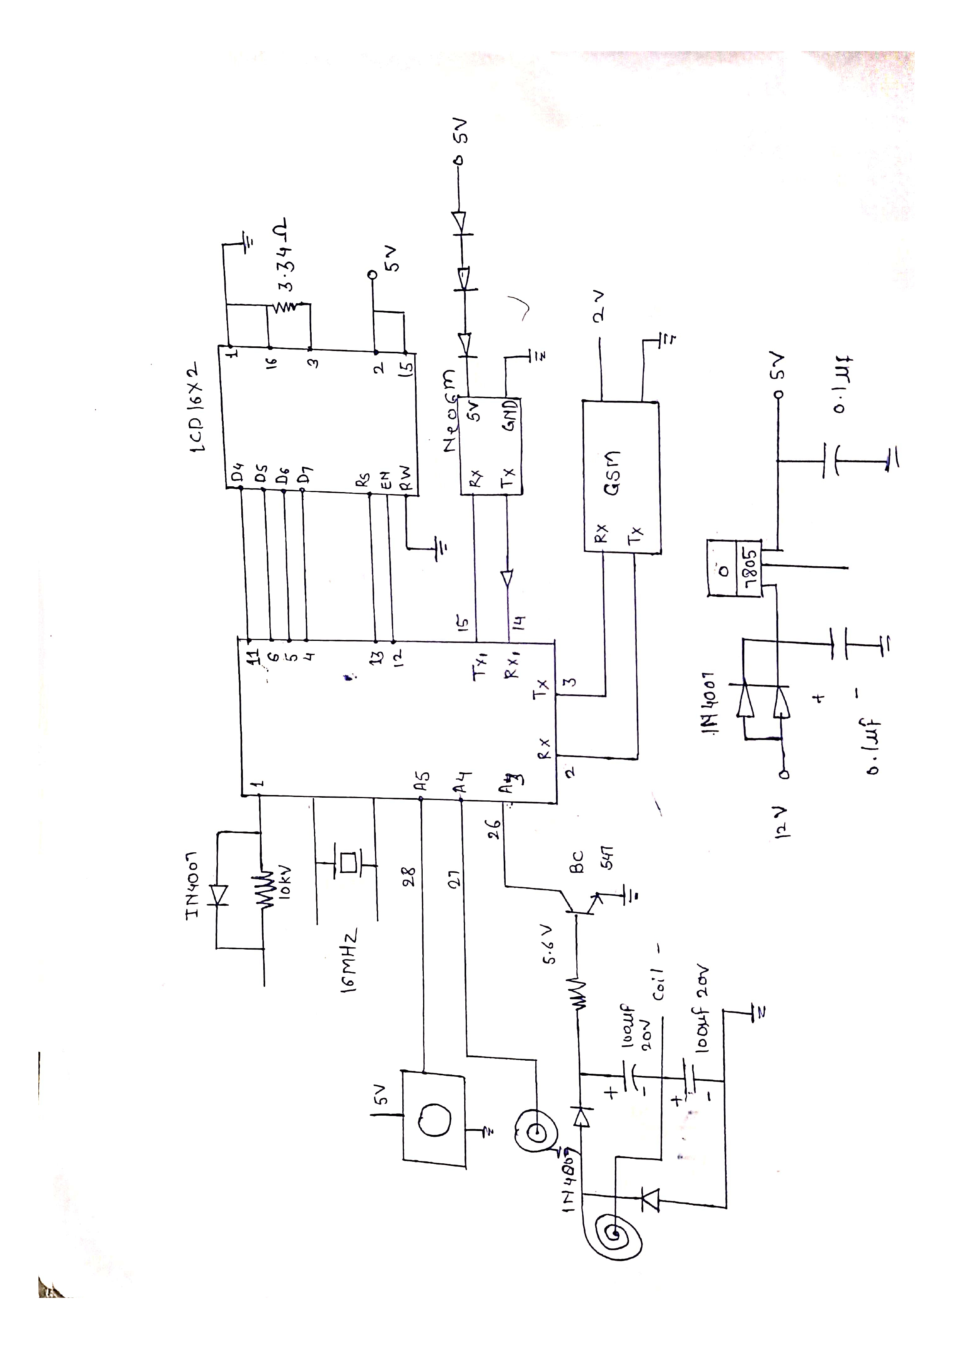
Circuit Diagram

Slide 7
COMPONENTS
Alcohol Sensor
Pressure Sensor
Microcontroller AVR atmega 328
GSM/GPS SIM
Coil
AT89C2051 Microcontroller

Slide 8
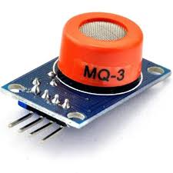
Alcohol Sensor detects if the driver has consumed alcohol.
The driver breathes near the sensor. If there is alcohol, the sensor gives a signal to the microcontroller. The system can then send an alert if the alcohol level is high.
Alcohol Sensor

Slide 9
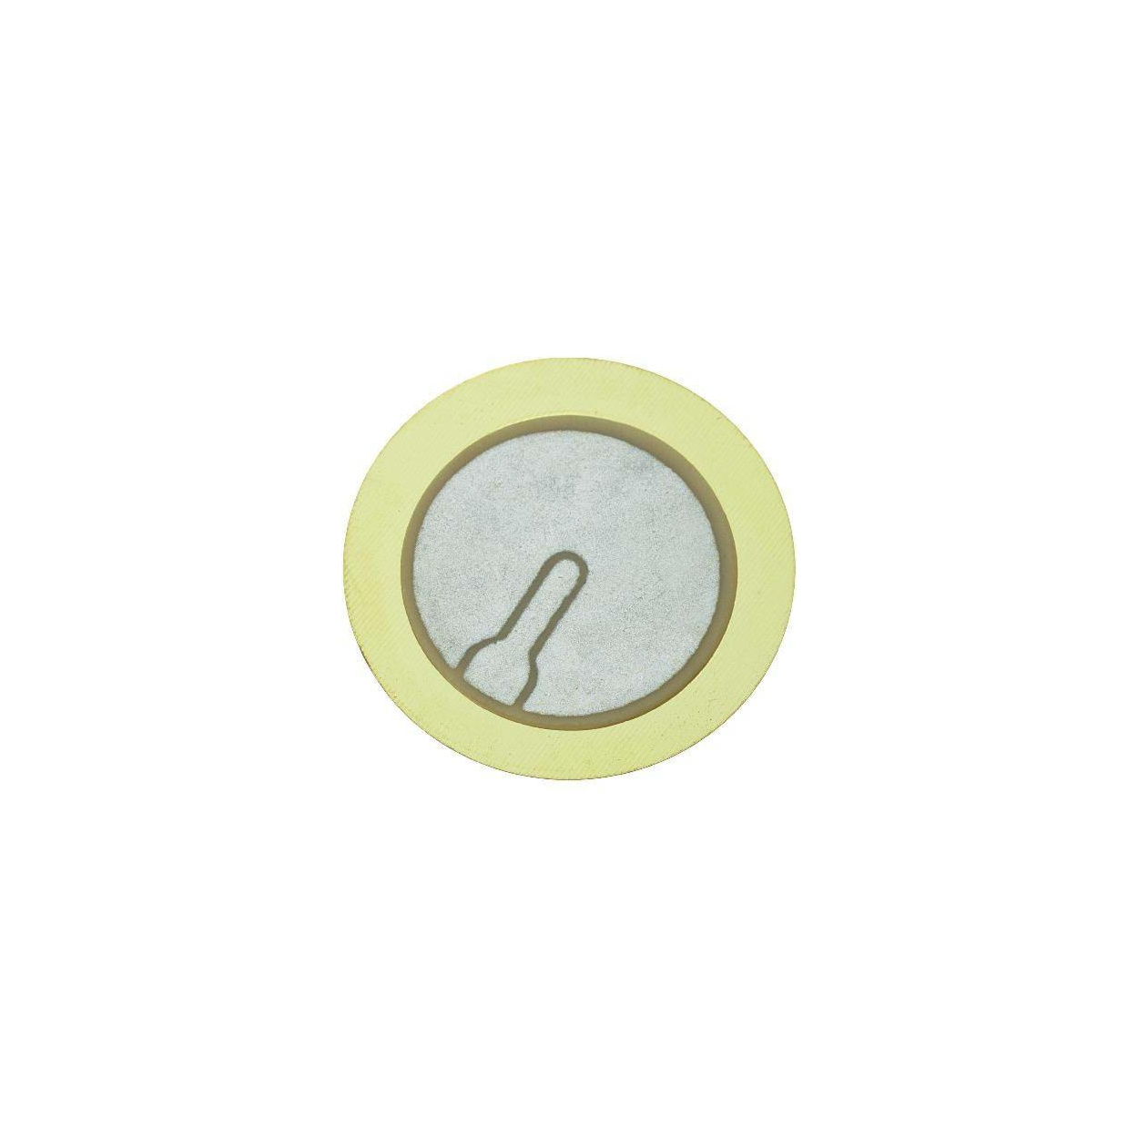
Pressure Sensor detects the pressure applied by vehicles on the road surface.
When a vehicle passes over the sensor, it detects the pressure change and sends a signal to the microcontroller.
The system can then use this data to monitor vehicle presence, speed, or trigger traffic violation alerts.
Pressure Sensor

Slide 10
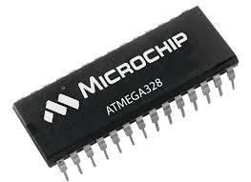
Microcontroller AVR atmega 328 acts like the brain of the system.
It collects information from all sensors (alcohol sensor, pressure sensor).
If a rule is broken (like drunk driving or signal jump), it sends alerts and activates the camera or GSM module.
Microcontroller AVR atmega 328

Slide 11
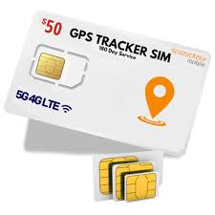
GPS (Location tracking): Tells the exact location of the vehicle when the rule was broken.
GSM (SMS sending): Sends a message to the police or control center if there is a violation.
GSM/GPS SIM

Slide 12
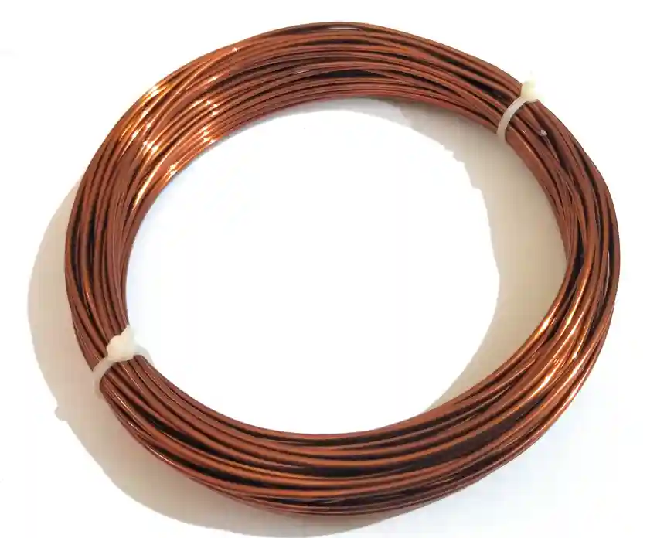
Coil detects if a vehicle crosses the red signal.
A wire is placed under the road. When a vehicle passes over it, the system knows a car has moved forward. If it’s during a red light, it’s counted as a violation.
Coil

Slide 13
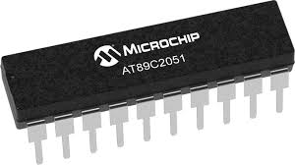
AT89C2051 Microcontroller helps with small tasks.
It can handle simple jobs like turning on LEDs, buzzers, or controlling other parts. It works along with the main ATmega328 chip.
AT89C2051 Microcontroller

Slide 14
Web-CAM
Webcam Takes a photo or video of the violation.
When a violation is detected, the microcontroller tells the laptop or PC to take a picture using Python code. This image is used as proof.

Slide 15
IDE-TOOL
IDE Tool helps write and upload code.
It is used by developers to write programs (code), upload it to the microcontrollers, and run Python scripts to control the camera or store data.

Slide 16
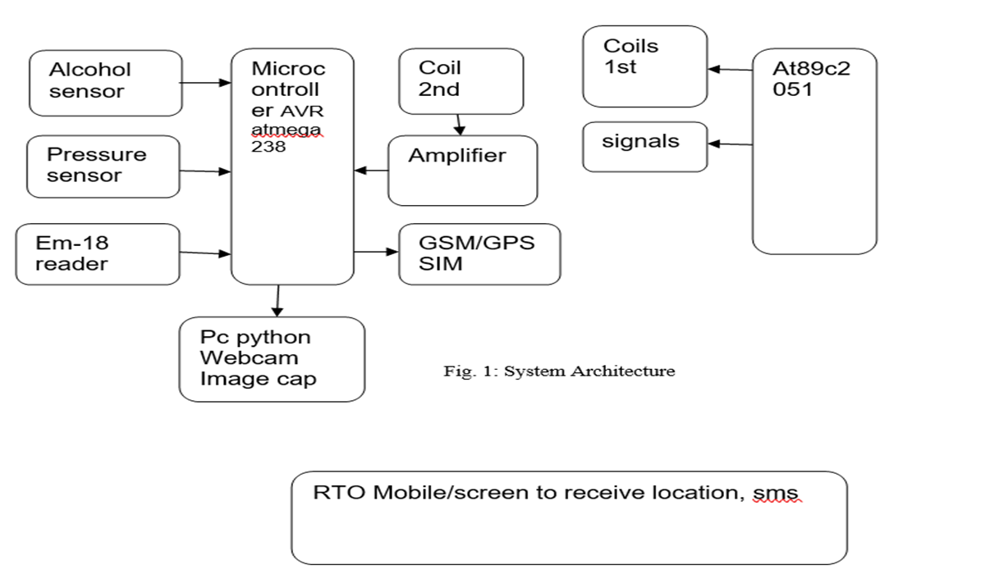
BLOCK DIAGRAM
Rectifier

Slide 17
WORKING
The Wireless-Based Traffic Violation Detection System is designed to monitor and report some key issues: red signal violations and road accidents. The system uses an ATmega328 microcontroller as its core, along with a set of sensors and communication modules. Copper coils are embedded in both the vehicle and the zebra crossing. When the traffic signal turns red, the zebra crossing coil is powered with AC. If a vehicle crosses the line during this time, electromagnetic induction occurs between the two coils, generating a voltage. This voltage is then rectified and detected by the microcontroller, which considers it a violation. The vehicle’s location is obtained using a GPS module, and an alert message is sent to the RTO via a GSM module. For accident detection, a pressure sensor is installed in the vehicle. In case of a sudden impact, the sensor is triggered, and the system sends an emergency alert with location details to the RTO and a nearby hospital. An optional alcohol sensor can be added to detect if the driver is intoxicated before starting the vehicle, and if so, the system can either prevent the vehicle from starting or send an alert to the authorities. This project provides a smart and automated way to enforce traffic rules and respond quickly to road emergencies.

Slide 18
APPLICATION
Traffic Rule Enforcement: Detects and logs vehicles that jump signals, overspeed, or violate road rules using sensors and real-time data.
Drunk Driving Prevention: The alcohol sensor can detect drivers under the influence and immediately alert authorities or disable vehicle ignition.
Stolen Vehicle Tracking: The RFID reader and GPS module can be used to locate and track stolen vehicles tagged with RFID chips.
Accident Detection & Reporting: Cameras and sensors can detect accidents and send real-time alerts with GPS location for quick response.

Slide 19
ADVANTAGES
Enables real-time traffic violation detection.
Increases accuracy and reduces human error.
Wireless communication allows remote access and control.
Helps improve road safety and traffic management.

Slide 20
DISADVANTAGES
Initial setup cost can be high (hardware, sensors, network).
System may face interference or signal loss in bad weather.
Maintenance of sensors and network devices is required.
Helps improve road safety and traffic management.

Slide 21
CONCLUSION
The wireless-based traffic violation detection system effectively demonstrates how modern wireless technologies and sensor networks can be used to monitor and identify traffic rule violations in real time. By using wireless communication, the system ensures fast data transmission and remote monitoring, reducing human intervention and improving accuracy. This project highlights the potential of smart traffic management solutions to enhance road safety, enforce traffic laws efficiently, and the way for intelligent transportation systems in the future.

Slide 22
REFERENCE
S. M. Park, "Wireless Sensor Network Based Traffic Monitoring System for Metropolitan Area," International Journal of Distributed Sensor Networks, vol. 2012, Article ID 760598.
R. Rajesh and V. Bharathidasan, "Wireless Sensor Networks for Traffic Monitoring and Detection of Violations," International Journal of Engineering and Technology (IJET), Vol 5 No 2, 2013.
E. S. Kim, "Development of Intelligent Traffic Violation Detection System using Wireless Sensor Networks," IEEE Transactions on Intelligent Transportation Systems, vol. 15, no. 2, 2014.

