Slide 1
EduLearn Hub — 6‑Month Product Roadmap
Oct 2025 – Mar 2026 • Product & Marketing Plan

Slide 2
Goals & North Star
Goal: Increase course starts, completion rate, and paid conversion while reducing time-to-value.
North Star: Weekly Learning Minutes per Active Learner (WLM).
Primary KPIs: Course Start Rate, D30 Completion, Paid CVR, DAU/MAU, NPS.

Slide 3
Key Milestones
Oct–Nov: AI Recommendations MVP; Quiz Engine v1; Analytics dashboards.
Nov–Dec: Course Launch Wave Q4 (20 new courses); Learning Paths 1.0.
Dec: Holiday marketing campaign.
Jan–Feb: Mobile App Beta (offline) + Gamification Lite; New Year 'Upskill 2026' campaign.
Feb–Mar: Spaced Repetition; Creator Tools 2.0; Certificates & Employer Verification; Partnerships pilots.

Slide 4
Feature Prioritization (RICE-style, summarized)
High priority (R1): AI Recommendations MVP, Quiz Engine v1, Learning Paths 1.0, Analytics dashboards.
Medium: Mobile App Beta + Offline, Gamification Lite, Spaced Repetition.
Next: Creator Tools 2.0, Certificates & Verification, Partnerships.

Slide 5
Dependencies & Risks
Data: content metadata quality required for recommendations & learning paths.
Mobile: app store approvals; offline DRM for paid content.
Compliance: certificates/verification & employer partnerships (data privacy).
Risk mitigations: phased rollouts, feature flags, shadow traffic for AI, fallback rules.

Slide 6
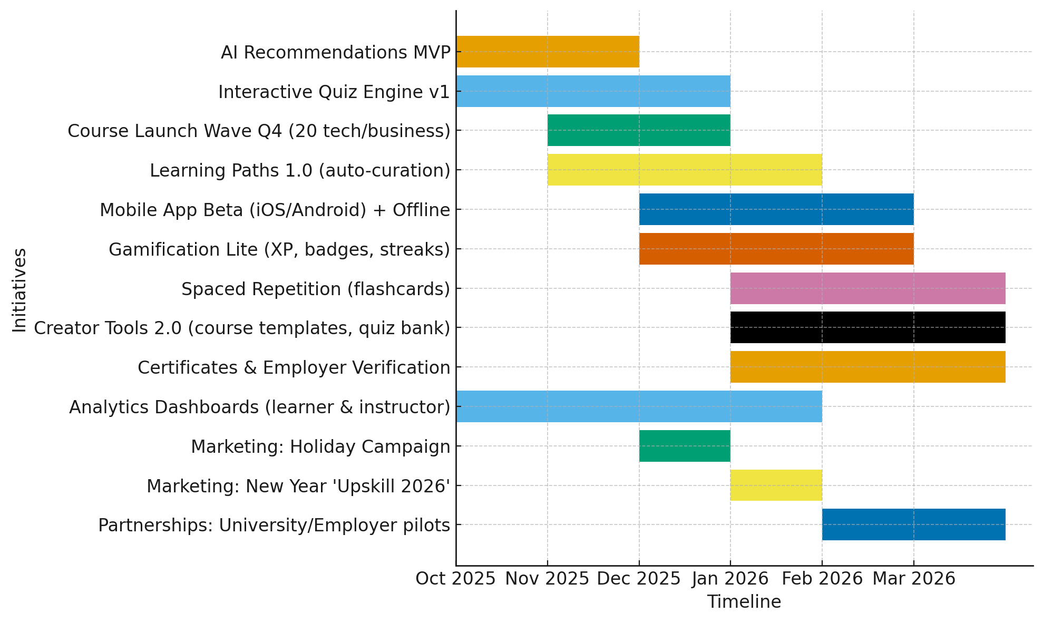
Roadmap Timeline (Oct 2025 – Mar 2026)

