Slide 1
CFP C- Code Presentation
Sakshi Ranode
Roll No=25
Batch=L-2
“Character Classification Using If-Else in C”
An if–else statement is a decision-making structure in C that allows a program to choose between two actions.
The if part runs when a condition is true.
The else part runs when the condition is false.
It helps the program make choices and execute different code based on conditions.

Slide 2
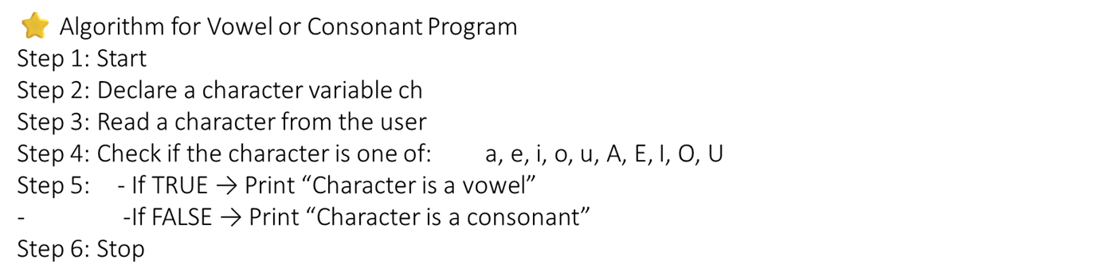

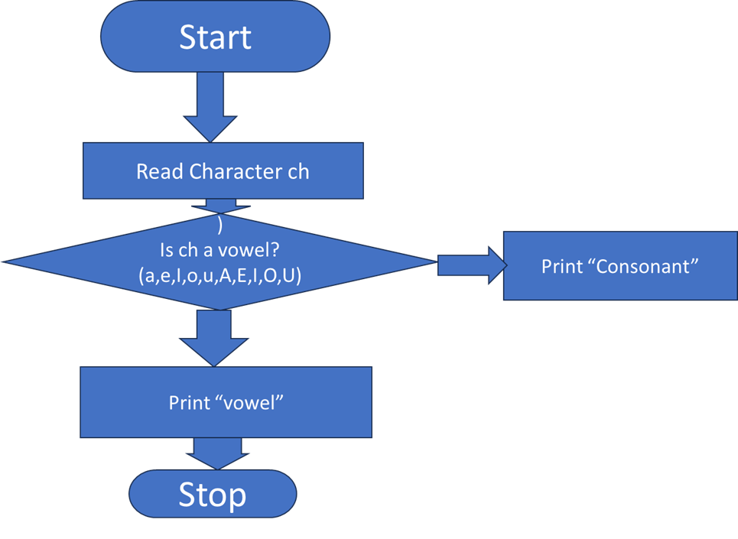



Slide 3

#include <stdio.h>
int main() {
char ch ;
printf(“Enter an alphabet:”);
scanf(“%c”,&ch);
if (ch=='a' || ch=='e' || ch=='i' || ch=='o' || ch=='u' ||
ch=='A' || ch=='E' || ch=='I' || ch=='O' || ch=='U')
{
printf(“ %c is a Vowel\n“,ch);
}
else {
printf(“%c is a Consonant\n“,ch);
}
return 0;
}
Enter a character: e
e is a vowel.

Slide 4
Conclusion :
This program checks whether an entered character is a vowel or a consonant using simple conditional statements. It compares the input with all vowel letters and prints the result accordingly, making it an easy and effective demonstration of decision-making in C.

