Slide 1

Project Title - Seasonal Agriculture
Performance
Student Name: Sakshi Raut
College Name: Usha Pravin Gandhi College
AICTE STU ID: STU68865b997a28c1753635737

Slide 2

PROBLEM STATEMENT
Agricultural performance is influenced by seasonal variations in environmental conditions, farming practices, resource availability, and market conditions. However, raw agricultural data does not clearly explain how performance changes across seasons or what patterns exist under different seasonal conditions.
• Analyze seasonal differences in agricultural performance.
• Identify meaningful patterns, trends, relationships, and variations.
• Examine environmental conditions, resource usage, and economic outcomes.
• Support evidence-based agricultural planning.

Slide 3
This project analyzes a structured agricultural dataset containing 4,000 records and 28 variables covering seasons, crops, locations, environmental conditions, farming inputs, irrigation methods, production, and economic performance.
PROJECT DESCRIPTION
• Explore and clean the agricultural dataset.
• Compare yield, production, revenue, cost, and profit across seasons.
• Analyze environmental conditions and resource usage.
• Study relationships between agricultural variables using correlation analysis.
• Present data-driven insights through clear visualizations.

Slide 4

WHO ARE THE END USERS?
• Farmers and agricultural producers
• Agricultural planners and extension officers
• Agribusiness and farm-management organizations
• Researchers and students
• Policy makers and resource-management stakeholders

Slide 5

Technology Used
• Python — Programming language for data analysis
• Jupyter Notebook — Interactive coding and documentation
• Pandas — Data loading, cleaning, grouping, and analysis
• NumPy — Numerical operations
• Matplotlib — Visualization
• Seaborn — Statistical charts and heatmaps
• CSV — Dataset format

Slide 6
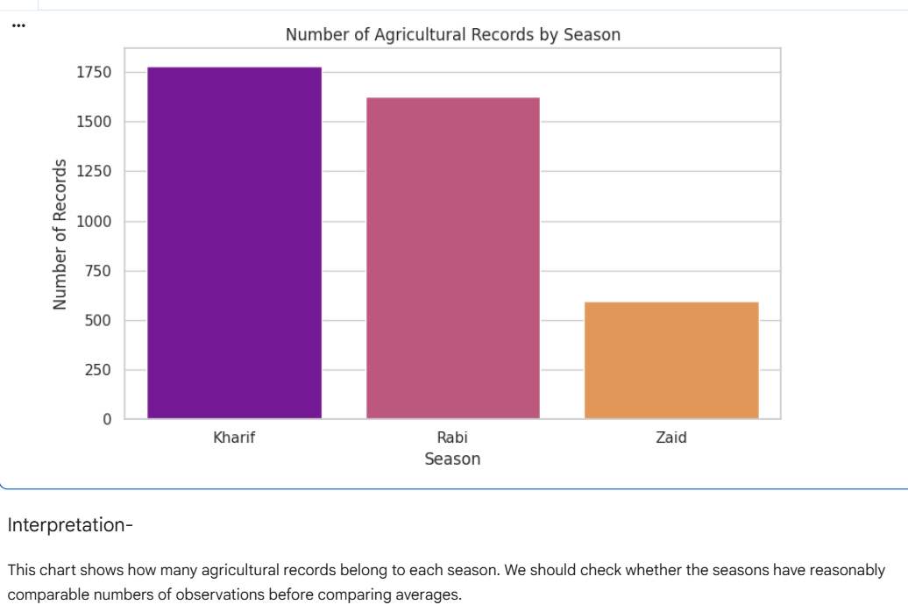
RESULTS
Key Finding
The dataset contains the highest number of agricultural records for the Kharif season, followed by Rabi and Zaid.
Kharif: Approximately 1,779 records
Rabi: Approximately 1,627 records
Zaid: Approximately 594 records

Slide 7
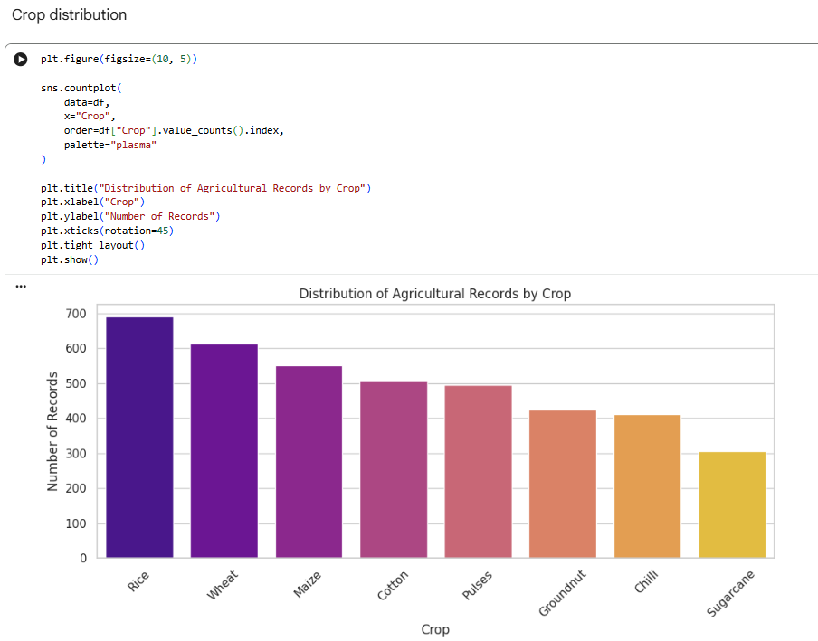
RESULTS
Key Finding
Rice has the highest number of agricultural records, followed by Wheat and Maize.
Sugarcane has the lowest number of records in the dataset.
The crop records are distributed unevenly across the different crop categories.

Slide 8
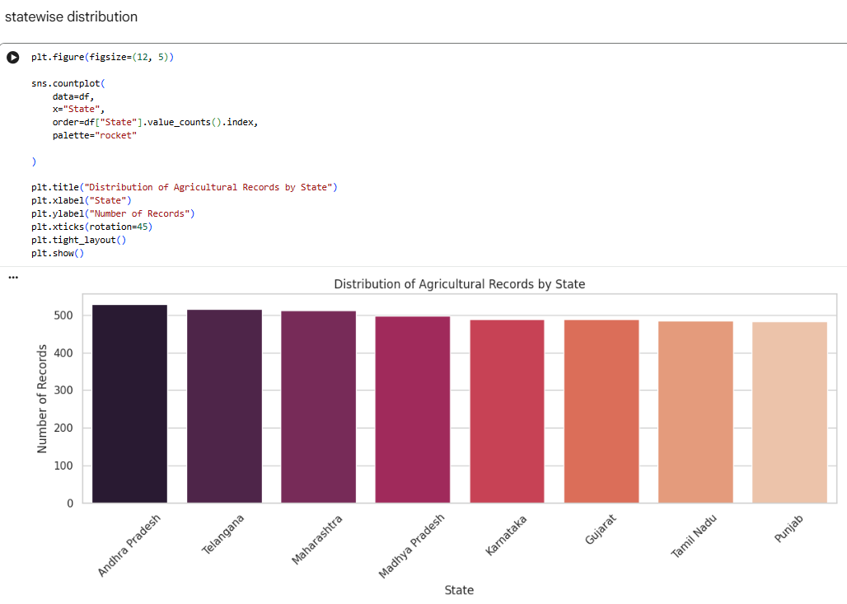
RESULTS
Key Finding
Andhra Pradesh has the highest number of agricultural records.
Telangana and Maharashtra follow closely.
Punjab has the lowest number of records among the states shown.
The difference between the states is relatively small, indicating a fairly balanced state-wise distribution.

Slide 9
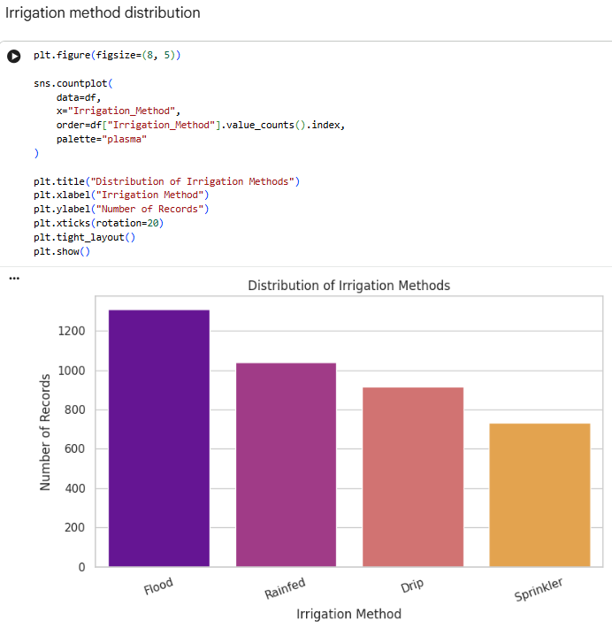
RESULTS
Key Finding
Flood irrigation is the most commonly used irrigation method in the dataset.
Rainfed irrigation/farming is the second most represented method.
Drip irrigation has fewer records than Flood and Rainfed methods.
Sprinkler irrigation has the lowest number of records.

Slide 10
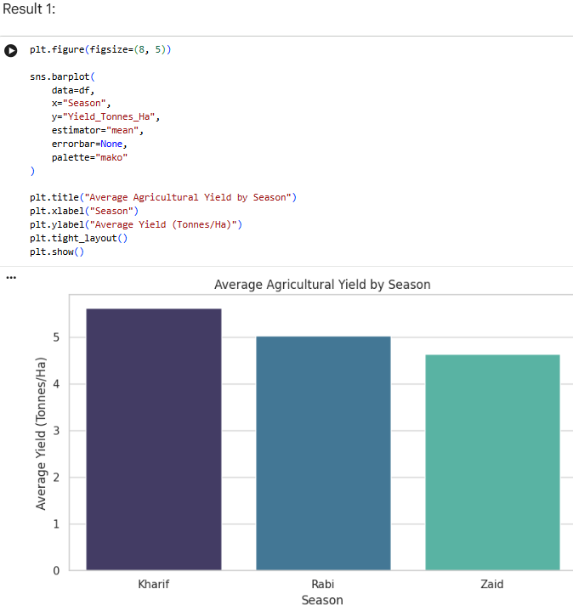
RESULTS
Key Finding
Kharif season has the highest average agricultural yield.
Rabi season has the second-highest average yield.
Zaid season has the lowest average yield among the three seasons.

Slide 11
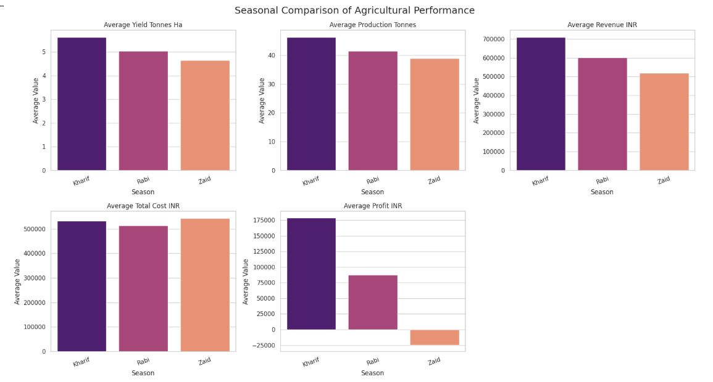
RESULTS
Key Findings
The chart compares the three seasons using average yield, production, revenue, total cost, and profit.

Slide 12
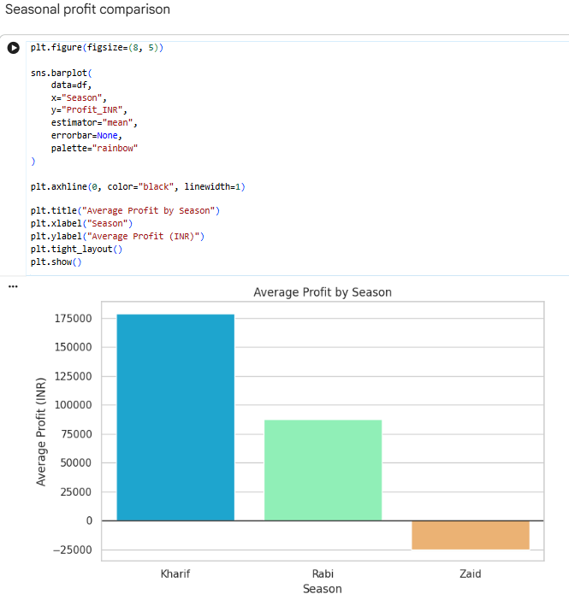
RESULTS
Key Finding
Kharif is the most profitable season.
Rabi also generates a positive average profit but performs below Kharif.
Zaid records a negative average profit, indicating an average financial loss.

Slide 13
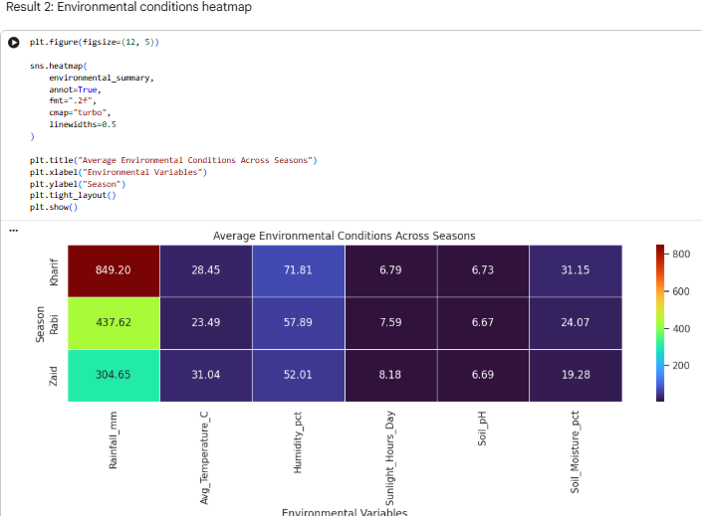
RESULTS
Key Finding
The highest rainfall and humidity values are observed in Kharif.
Zaid has the highest temperature and sunlight duration.
Kharif has the highest soil moisture.
Soil pH is almost similar across all three seasons.

Slide 14
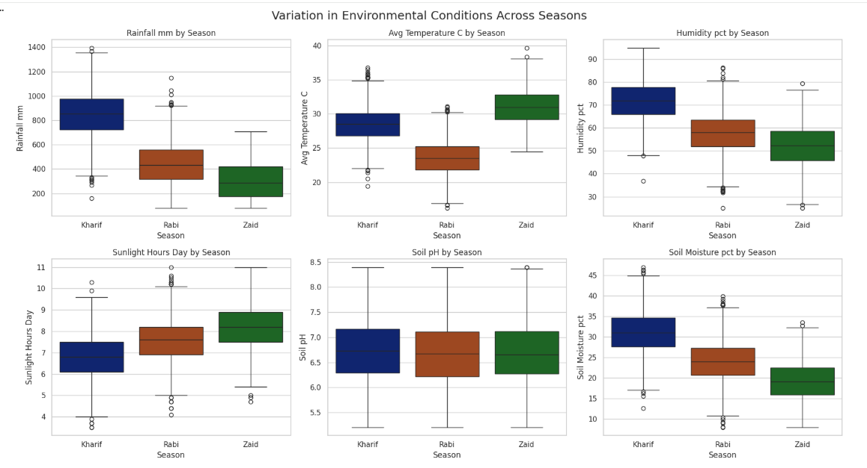
RESULTS
Key Findings
Kharif has the highest rainfall, humidity, and soil moisture levels.
Zaid has the highest temperature and sunlight hours.
Zaid also records the lowest soil moisture, indicating a greater need for irrigation.
Rabi has comparatively lower temperatures and moderate environmental conditions.
Soil pH remains relatively similar across all three seasons.
The outliers show that some farms experience environmental conditions different from the usual seasonal range.

Slide 15
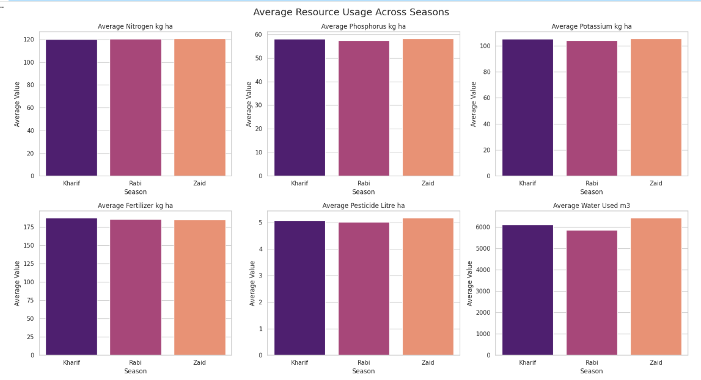
RESULTS
Key Findings
Nitrogen usage remains almost the same across all seasons, at approximately 119–120 kg/ha.
Zaid has the highest average phosphorus and potassium usage, although the seasonal differences are very small.
Kharif records slightly higher average fertilizer usage than Rabi and Zaid.
Zaid has the highest average pesticide usage, while Rabi has the lowest.
Zaid uses the highest average amount of water, approximately 6,400 m³.
Rabi has the lowest average water usage, approximately 5,850 m³.
Overall, nutrient and fertilizer usage is relatively consistent across seasons, but water usage varies more noticeabl

Slide 16
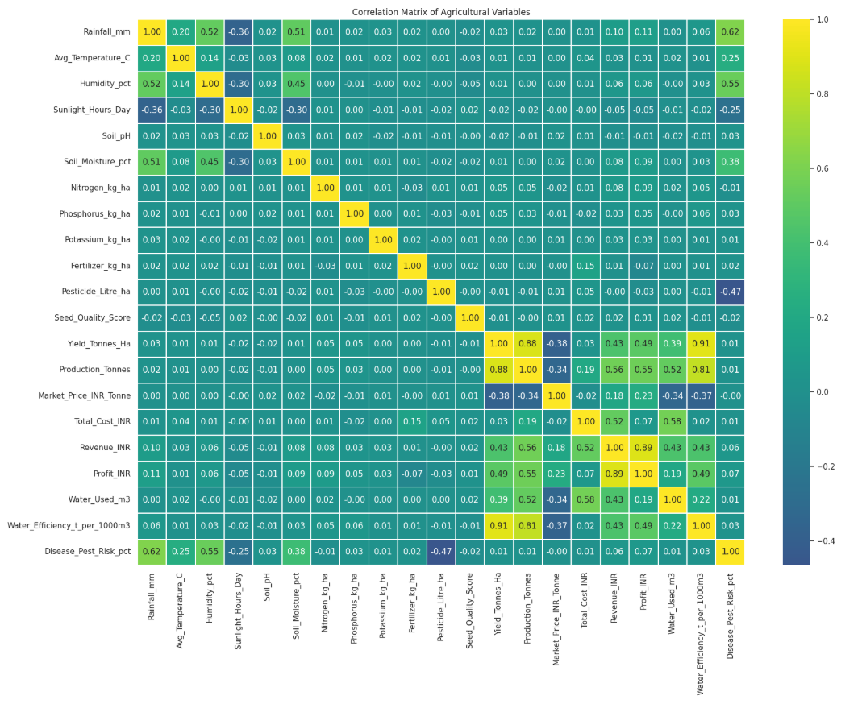
RESULTS
Key Findings
Yield and production have a strong positive correlation (0.88).
Water efficiency has a very strong positive correlation with yield (0.91).
Revenue and profit are strongly correlated (0.89).
Rainfall and disease/pest risk show a positive correlation (0.62).
Pesticide usage has a negative correlation with disease/pest risk (–0.47).
Correlation shows association, not causation.

Slide 17
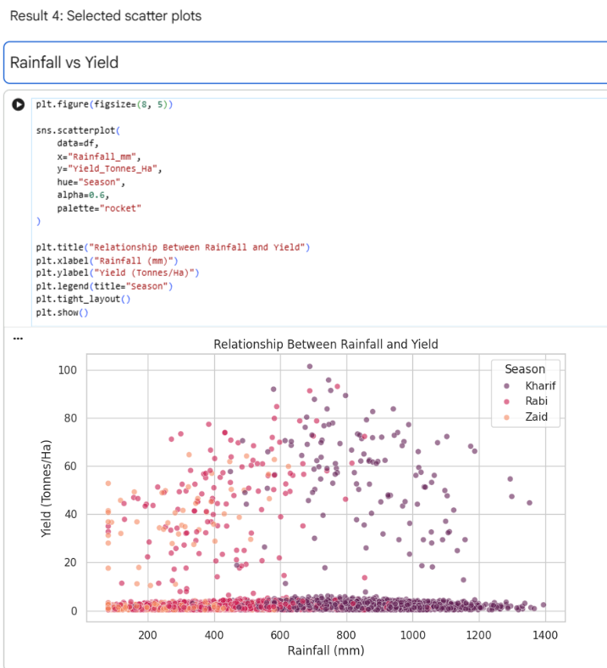
RESULTS
Key Finding – Rainfall vs Yield
Higher rainfall generally shows higher yield, especially for Kharif and Rabi seasons.
The relationship is positive but not very strong, as the points are widely scattered.
Kharif has more observations at higher rainfall and yield levels.
Zaid generally has lower rainfall and lower yield compared with Kharif.
There are many observations with very low yield despite different rainfall levels, suggesting rainfall is not the only factor affecting yield.

Slide 18
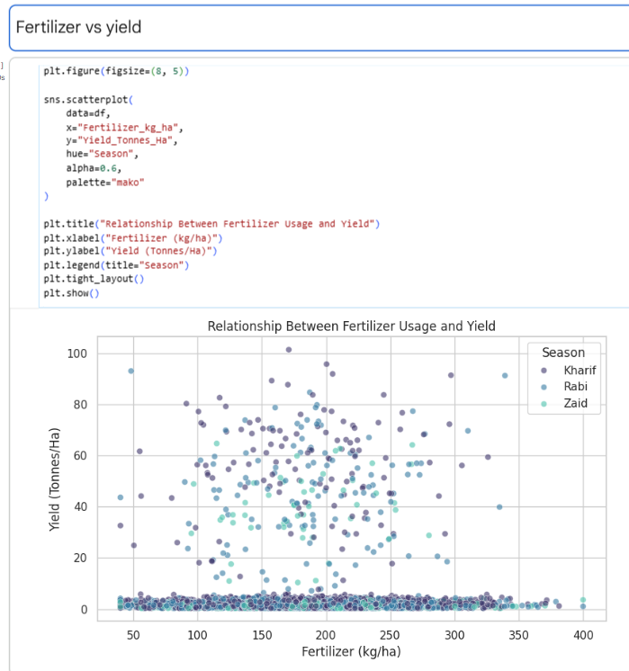
RESULTS
Key Finding – Fertilizer vs Yield
Fertilizer usage shows a weak positive relationship with yield, but the points are widely scattered.
Most observations use around 100–250 kg/ha of fertilizer.
Higher yields (around 50–80+ tonnes/ha) occur mainly in the 100–250 kg/ha range.
There are many cases of low yield despite fertilizer use, indicating fertilizer alone does not determine yield.
Kharif and Rabi show more high-yield observations compared with Zaid.

Slide 19
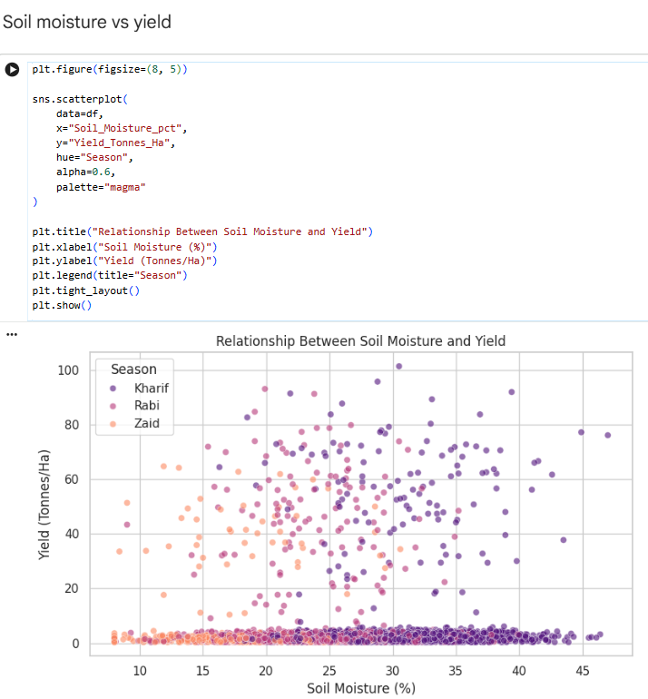
RESULTS
Key Finding – Soil Moisture vs Yield
Soil moisture shows a moderate positive relationship with yield—higher moisture levels generally have more high-yield observations.
Most high yields occur around 20–35% soil moisture.
Kharif shows the widest range of soil moisture and several of the highest yields.
At very low moisture levels, yields are generally low.
However, the relationship is not consistent, showing that soil moisture alone does not determine yield

Slide 20
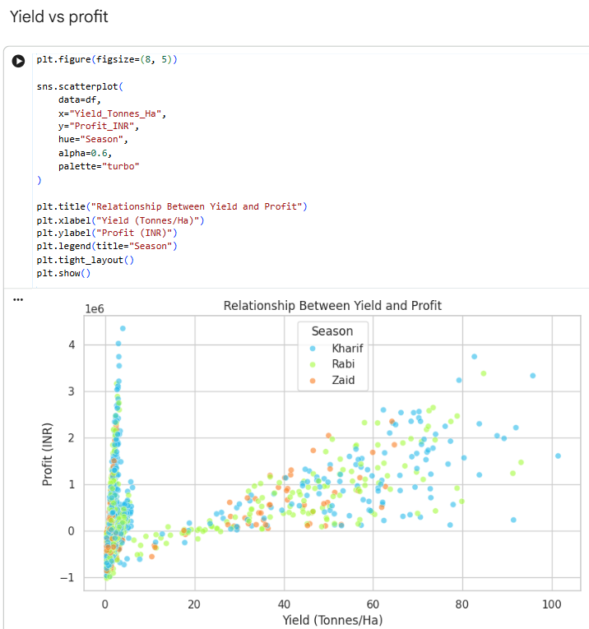
RESULTS
Key Finding – Yield vs Profit
There is a strong positive relationship between yield and profit—as yield increases, profit generally increases.
Very low yields show high variation in profit, including some losses.
Higher yields, especially above 40 tonnes/ha, are generally associated with higher and more consistent profits.
Kharif has many of the highest-yield and highest-profit observations.
Overall, increasing yield appears to be strongly linked with greater profitability, making yield an important factor in farm performance.

Slide 21
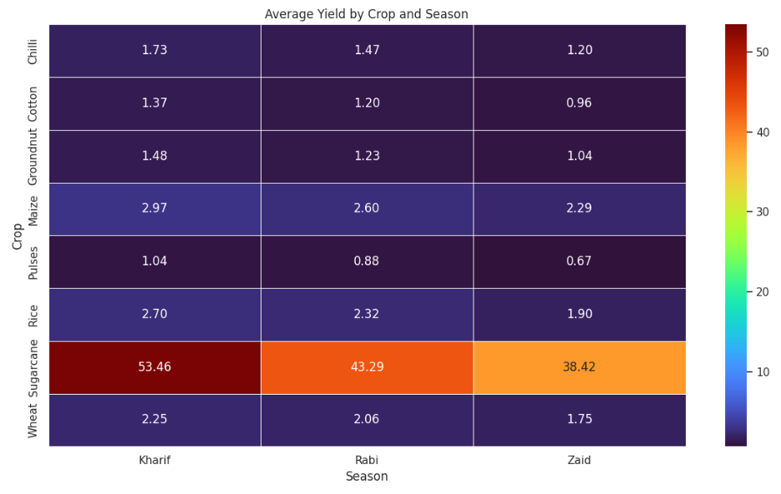
RESULTS
Key Finding – Average Yield by Crop and Season
Sugarcane has by far the highest average yield in all seasons, with 53.46 (Kharif), 43.29 (Rabi), and 38.42 (Zaid).
Maize and Rice have the next highest average yields, while Pulses and Cotton have relatively lower yields.
Kharif has the highest average yield for every crop shown.
Average yield generally decreases from Kharif → Rabi → Zaid across all crops.
Chilli has the highest average yield among the non-sugarcane crops, while Pulses has the lowest.
Overall, crop type and season both have a clear influence on average yield, with Sugarcane and the Kharif season performing best.

Slide 22
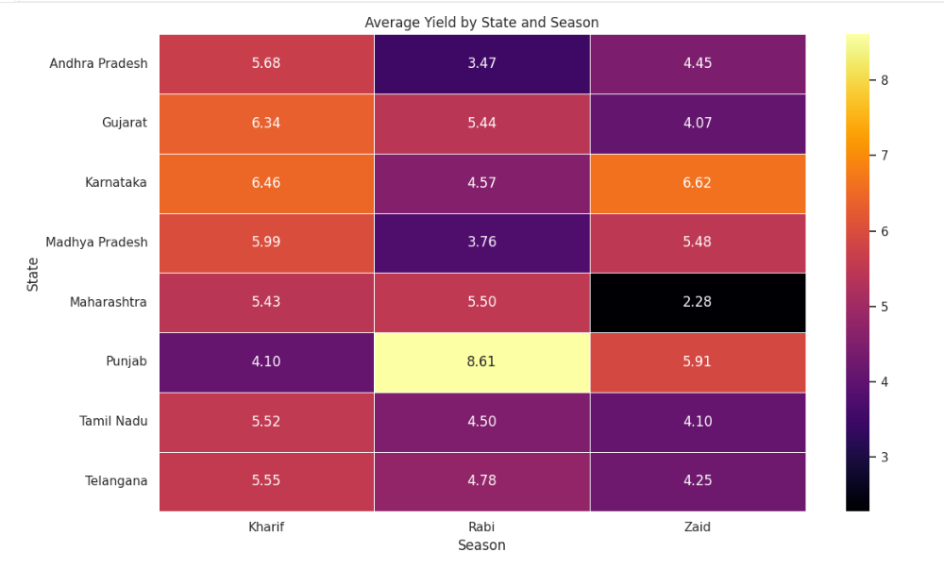
RESULTS
Key Finding – Average Yield by State and Season
Karnataka has the highest Kharif yield (6.46), while Punjab has the highest Rabi yield (8.61).
Karnataka also has the highest Zaid yield (6.62).
Maharashtra shows a sharp decline in Zaid yield, with the lowest value (2.28).
Kharif generally performs well across most states, while Rabi varies significantly by state.
Punjab stands out as the strongest state in Rabi, whereas Karnataka performs particularly well in Kharif and Zaid.
Overall, yield varies considerably by both state and season, indicating that regional and seasonal conditions strongly influence agricultural productivity.

Slide 23
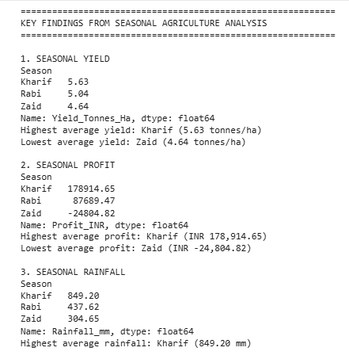
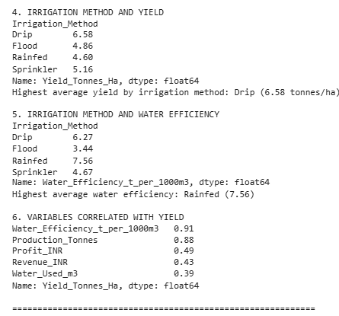
RESULTS

Slide 24
Future scope
• Integrate real-time weather and soil-monitoring data.
• Develop predictive models for crop yield and profitability.
• Expand the dataset to include more years, regions, and crop varieties.
• Build an interactive dashboard for farmers and planners.
• Use advanced statistical or machine-learning methods to study seasonal effects.
• Validate recommendations using field-level agricultural data.

Slide 25
GitHub Link
https://github.com/sakshiraut425-ui/Seasonal_Agriculture_Performance-

Slide 26

VOIS Course completion certificate –
Course name- Data Visualization

Slide 27
Thank you
.

