Slide 1
A Research Agent is an AI system designed to assist with academic and scientific research tasks
CAPSTONE PROJECT
Presented By:
1.Sakshi-Graphic Era Hill University-B.Tech CSE

Slide 2
OUTLINE
Problem Statement
Proposed System/Solution
System Development Approach (Technology Used)
Algorithm & Deployment
Result (Output Image)
Conclusion
Future Scope
References

Slide 3
Problem Statement
A Research Agent is an AI system designed to assist with academic and scientific research tasks. It can autonomously search for literature, summarize papers, and organize references. Using natural language processing, it understands research questions and retrieves relevant information. The agent can generate reports, suggest hypotheses, and even draft sections of research papers. It saves time by automating repetitive tasks like citation management and data extraction. Research Agents enhance efficiency, accuracy, and innovation in both academic and industrial R&D

Slide 4
Proposed Solution
The proposed system is designed to assist researchers by automating key tasks in academic research using IBM Cloud Lite and IBM Granite models. The Research Agent streamlines literature search, summarization, citation, and content generation using AI.
Literature Search:
Uses external APIs (like ArXiv or Semantic Scholar) to search for research papers related to user queries.
Integrates real-time data retrieval via API calls.
Summarization & Content Generation:
Uses IBM Watsonx Granite models to summarize papers, generate hypotheses, and draft sections like abstracts or related work.
Prompts like "Summarize this paper in 5 points" or "Write an abstract based on these findings" are used.
Hypothesis Generation:
Uses chain-of-thought prompting to suggest new research hypotheses based on paper summaries and user inputs.
Deployment:
Built using Python Flask or Node.js backend.
Deployed on IBM Cloud using Cloud Functions and optionally Code Engine.
Storage & Database:
Stores papers and summaries in IBM Cloud Object Storage.
Stores metadata and references in IBM Cloudant (NoSQL).

Slide 5
System Approach
IBM Watsonx Granite Models: Used for natural language understanding, summarization, and content generation.
IBM Cloud Functions: Handles backend processing and integrates with external APIs (e.g., ArXiv, Semantic Scholar).
IBM Cloud Object Storage: Stores PDFs, research documents, and output files.
IBM Cloudant (NoSQL DB): Manages and organizes reference metadata, summaries, and user queries.
IBM Code Engine (Optional): Deploys the Flask or Node.js web application in a scalable serverless environment.
IBM Cloud Lite Plan: Project is fully built on free-tier services, making it cost-effective for student and prototype use.

Slide 6
Algorithm & Deployment
Algorithm (Granite-based NLP)
Model Used: IBM Watsonx Granite (13B-chat)
Task Types:
Summarization of papers
Hypothesis generation
Citation formatting
Paragraph/section drafting
Prompt Examples:
“Summarize this abstract in 5 points”
“Suggest a research hypothesis from these papers”
Deployment (IBM Cloud Services)
Backend Logic: IBM Cloud Functions (serverless compute)
Frontend App: Deployed via IBM Code Engine (optional)
Data Storage:
IBM Cloudant for reference metadata
IBM Object Storage for storing files
Integration: External APIs (ArXiv, Semantic Scholar) connected through Cloud Functions

Slide 7
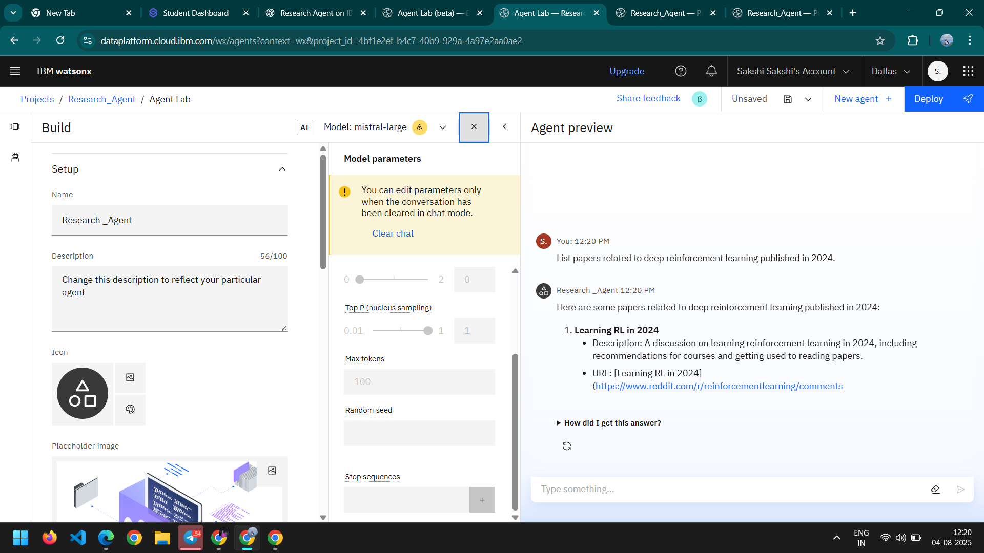
Result

Slide 8
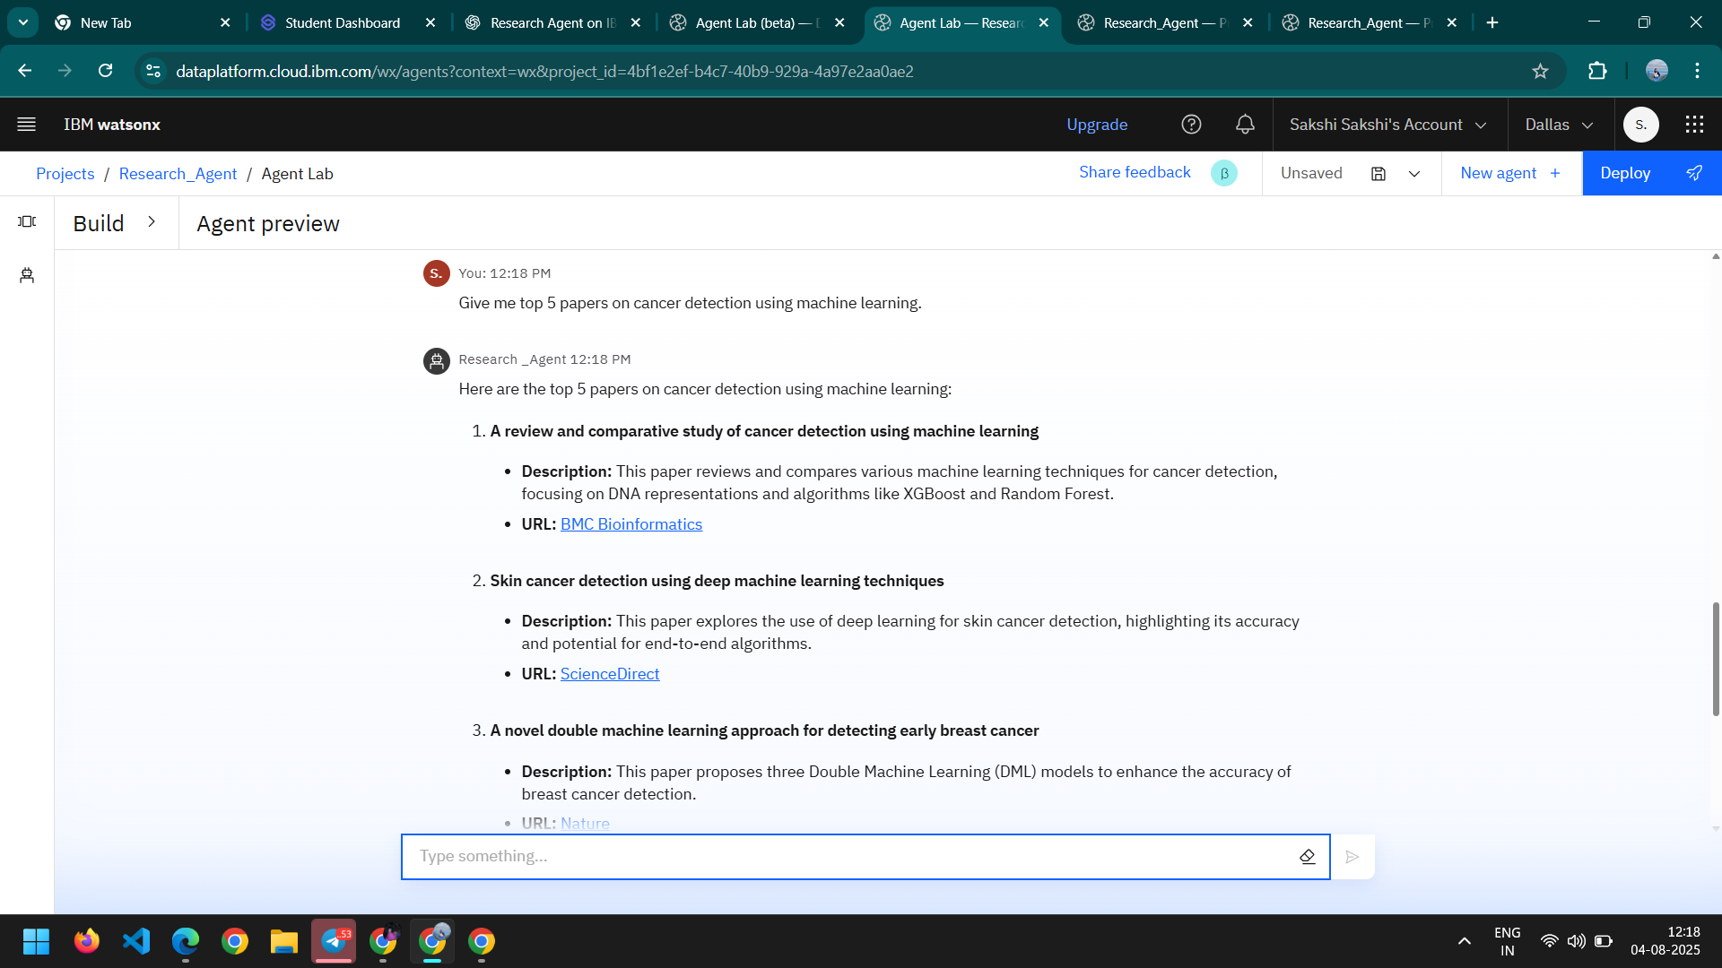
RESULT

Slide 9
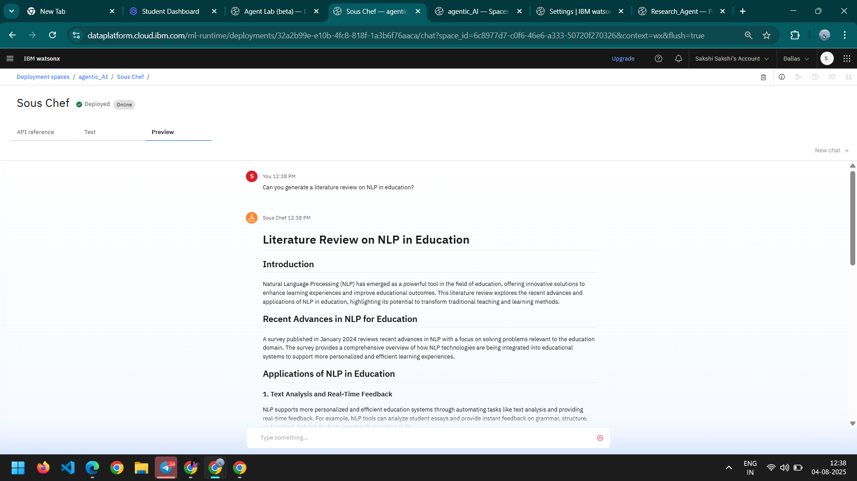
RESULT

Slide 10
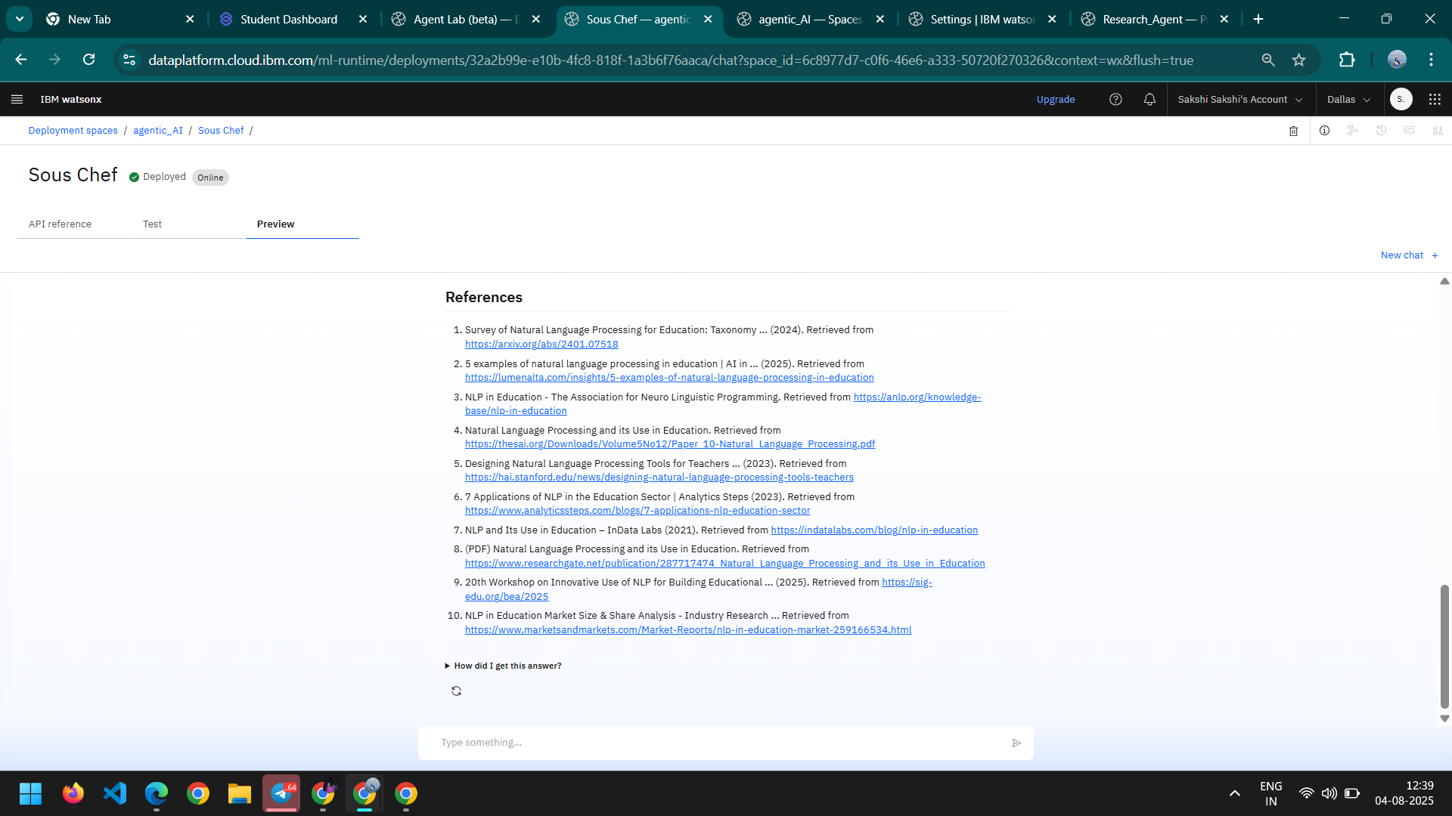
RESULT

Slide 11
Conclusion
The Research Agent successfully automates key research tasks using IBM Cloud services.
It leverages IBM Watsonx Granite models for understanding, summarizing, and generating academic content.
By integrating APIs and using Cloud Functions, it delivers real-time results to user queries.
Reference data is efficiently stored using Cloudant and Object Storage.
The system enhances research efficiency, reduces manual effort, and supports faster knowledge discovery.
IBM Cloud Lite enabled cost-effective and scalable deployment of the complete solution.

Slide 12
Future scope
🔍 Integration with more databases like IEEE Xplore, PubMed, and Springer.
📄 Full PDF parsing to summarize entire research papers, not just abstracts.
📱 Mobile app or chatbot interface for easier access on the go.
🧠 Multilingual support using Watsonx to assist global researchers.
🤝 Collaborative features for shared research boards or team workspaces.
⚙️ Voice input support using IBM Watson Speech-to-Text.
📊 Advanced analytics to track research trends and publication patterns.

Slide 13
References
IBM Watsonx.ai – Granite Models Used for NLP tasks like summarization, hypothesis generation, and drafting content. 🔗 https://www.ibm.com/watsonx
IBM Cloud Functions Used to build serverless backend logic for API calls and model integration. 🔗 https://www.ibm.com/cloud/functions
IBM Cloudant (NoSQL Database) Used to store and organize research metadata, summaries, and citations. 🔗 https://www.ibm.com/cloud/cloudant
IBM Cloud Object Storage Used to store uploaded PDFs and generated documents. 🔗 https://www.ibm.com/cloud/object-storage
ArXiv API Used to search research literature for summarization and reference generation. 🔗 https://arxiv.org/help/api/
IBM SkillsBuild & RAG Lab Hands-on learning resources for implementing Retrieval-Augmented Generation (RAG) with IBM tools. 🔗 https://skillsbuild.org

Slide 14
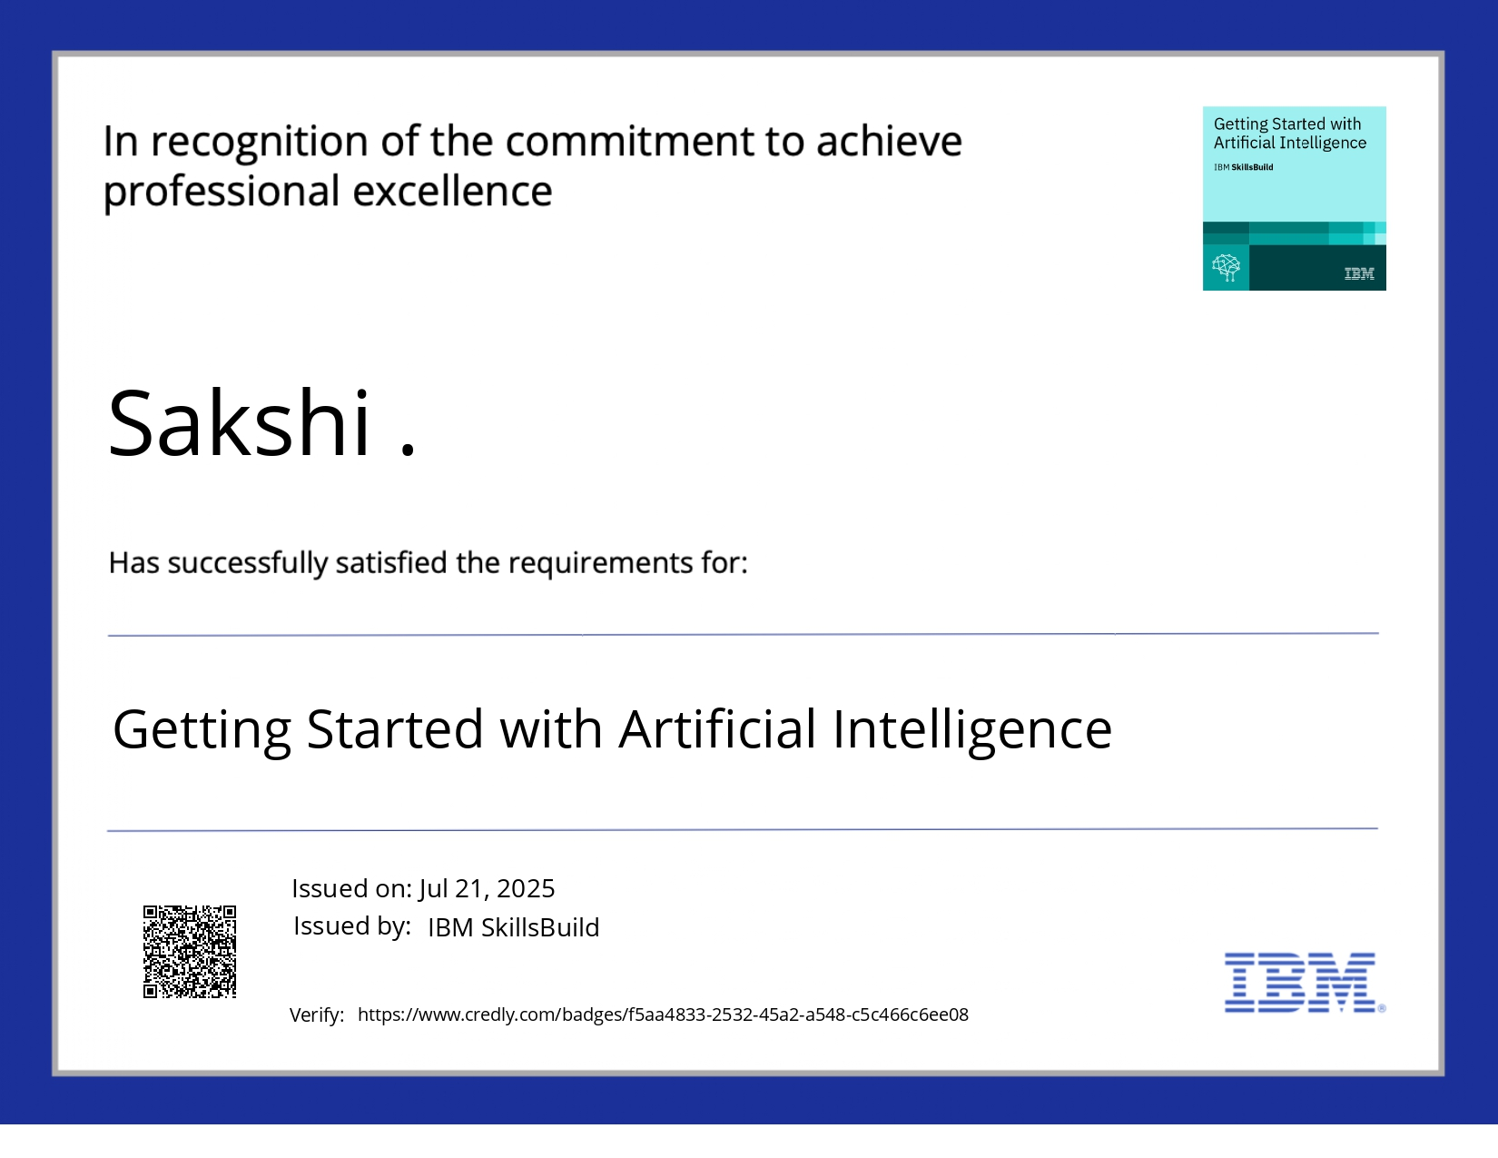
IBM Certifications

Slide 15
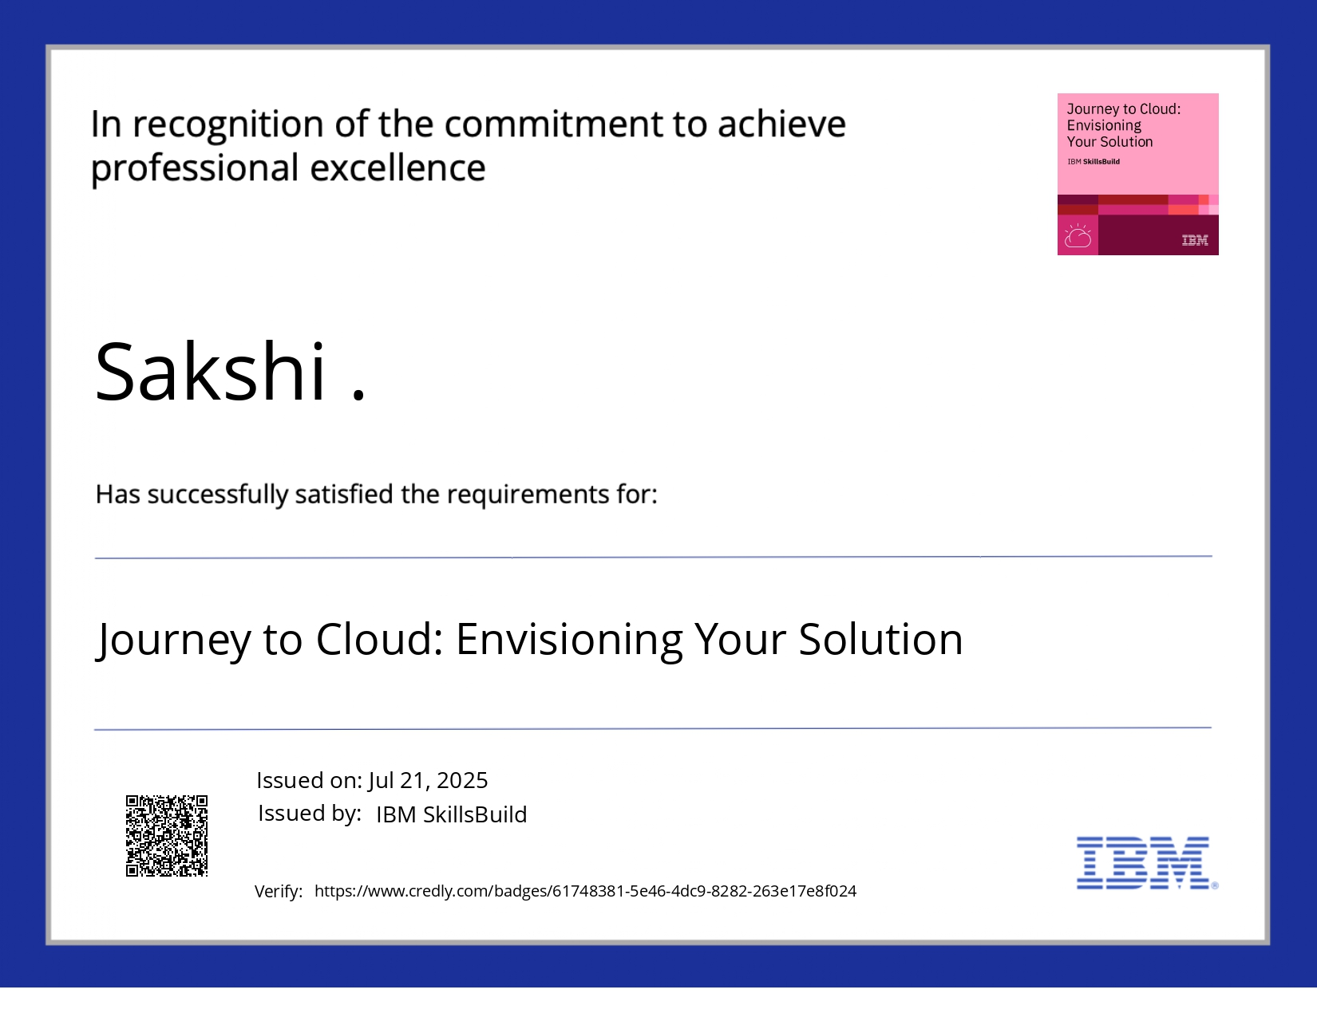
IBM Certifications

Slide 16
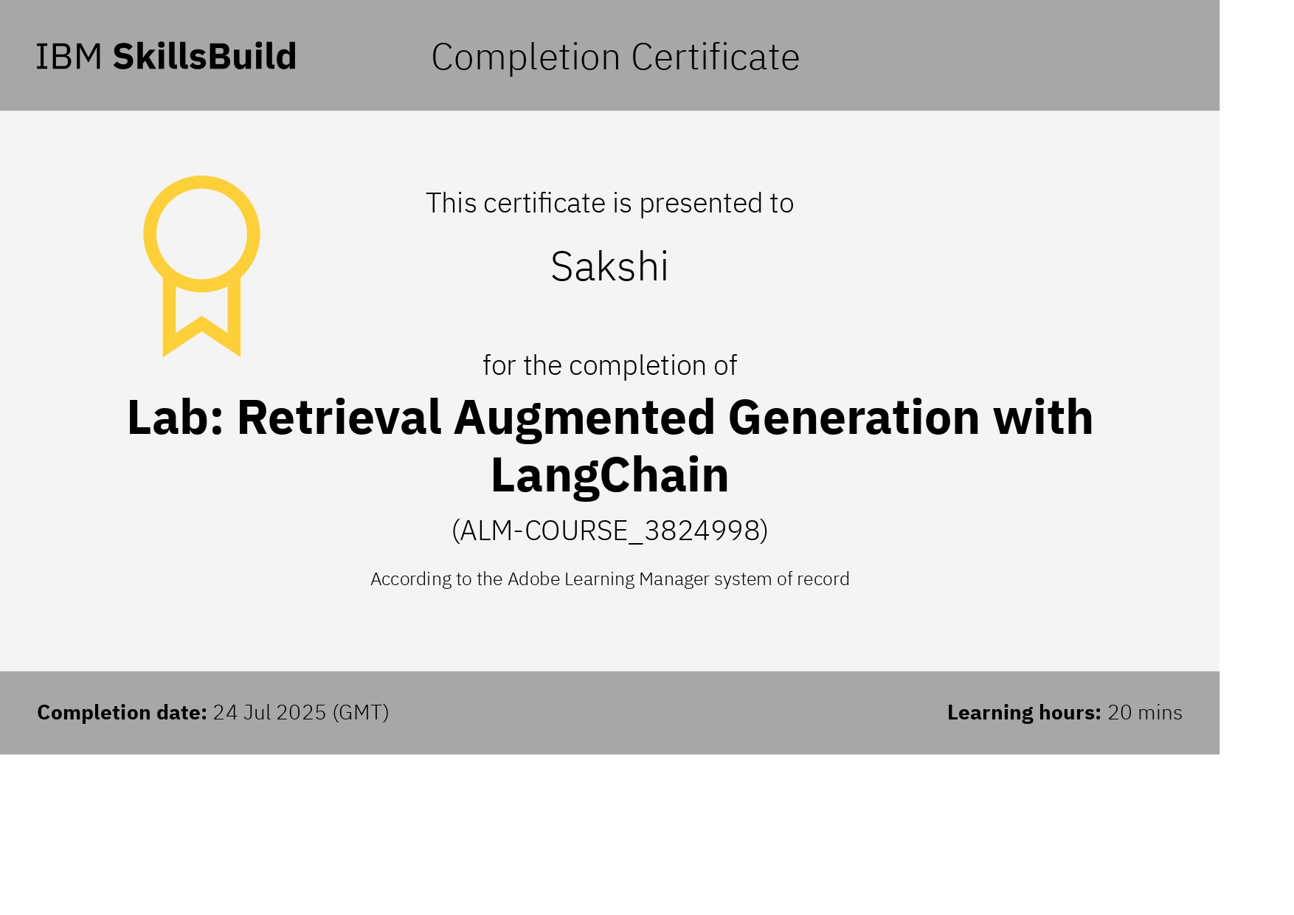
IBM Certifications

Slide 17
THANK YOU

