Slide 1

Library Management System
Name: Shinde Sakshi
TAP INTERN 2024

Slide 2


Introduction
Libraries act as centers for education, research, and civic involvement. They are the source of all knowledge and information.
There is need for effective library administration, so to address this issue library management system created with Flask, a Python micro web framework.
This system is intended to change how librarians and library users manage their library resources. The system ensures both librarians and users will have no trouble using the Library.

Slide 3
Objectives & Goals
Showcase book management functions that enable librarians to add or delete books, collect fines, and update returned books.
Display user profile management tools that permit users to create and manage their profiles.
Present the borrowing system that empowers users to easily borrow and reserve books.
Illustrate the fine management function that automatically calculates overdue book fines.
Showcase the librarian dashboard designed to manage users, books, and to view available and borrowed books.
Display the security features, including password hash capabilities, and login authentication to ensure data safety.
Highlight the logging and error handling mechanism employed to record and maintain system activity for swift system maintenance.

Slide 4
Problem Statement
In the digital age, managing library resources poses substantial difficulties. While ensuring that users have a seamless experience, libraries must manage the diversifying range of books. A web-based library management system that simplifies resource administration and improves user experiences for both librarians and users is urgently needed.

Slide 5
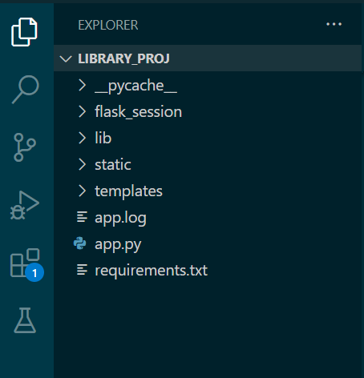
Project Structure
library_project: This is the main project folder, which contains all the other subfolders and files for the project.
lib: Virtual environment
static: This folder contains all the static files for the project, such as CSS, JavaScript, and image files.
templates: This folder contains all the HTML template files that are used to generate the web pages for the project.
app.py: This is the main Python file that contains the Flask code for the project. This file is responsible for defining the routes, handling the requests and responses, and rendering the templates.

Slide 6
Why flask?
Simple and Easy-to-Use: Flask's minimalistic design makes it easy to use and understand, even for developers who are new to web programming.
Flexible Architecture: Flask's modular design allows developers to choose only the components they need, allowing for greater flexibility and optimization.
Large and Supportive Community: Flask has a large and supportive community that provides resources, tools, and support to help developers get started and be successful.
Python-Based: Flask is a Python-based web framework, which means that developers are able to benefit from the many features and libraries available in Python, making it a great choice for developers who are already familiar with the language.

Slide 7
Why Specific Technologies were used?
MongoDB
Flexible Schema
Easy Scaling
Python Integration
Flask
Light weight
Flexible Architecture
Python based

Slide 8
Features Implemented
User Authentication:
Performed based on Login
Book Management:
Librarians can add or delete books
Update returned books and collect fines
User Profiles:
users can create and manage their profiles.
Borrowing System:
users can borrow books and reserve them
automatic due dates are generated a period of 14 days is given
Reservation System:
users can reserve books that are currently checked out.

Slide 9
Features Implemented
Fine Management:
fines are calculated automatically for overdue books.
late fees of Rs.5 per day is applied
Librarian Dashboard:
View available, borrowed books
Librarian can also manage users and books
Security:
Password hash is generated so that password in not visible even in the database
Login authentication is performed
Logging and Error Handling:
Logging and error handling is performed, logs are maintained

Slide 10
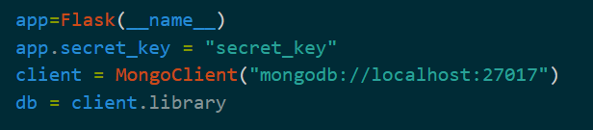
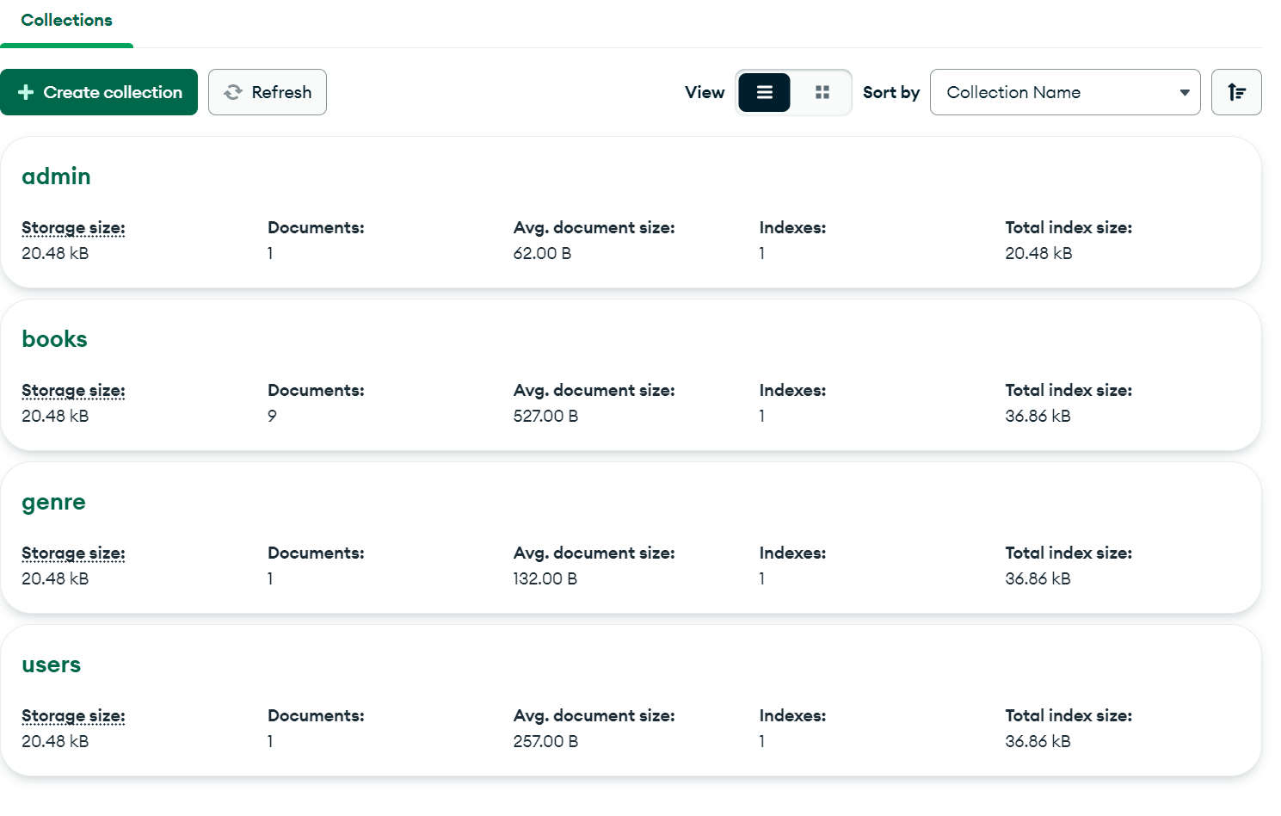
Database Integration

Slide 11
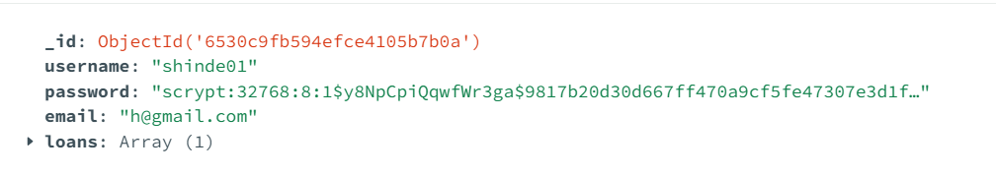
Security Features
Users do not have admin Privileges to add or remove books
Admin(librarian) collects borrowed books and fines so, no fines remain uncollected, and all the books are returned to the library
Implemented Password Hashing So, It is not visible

Slide 12
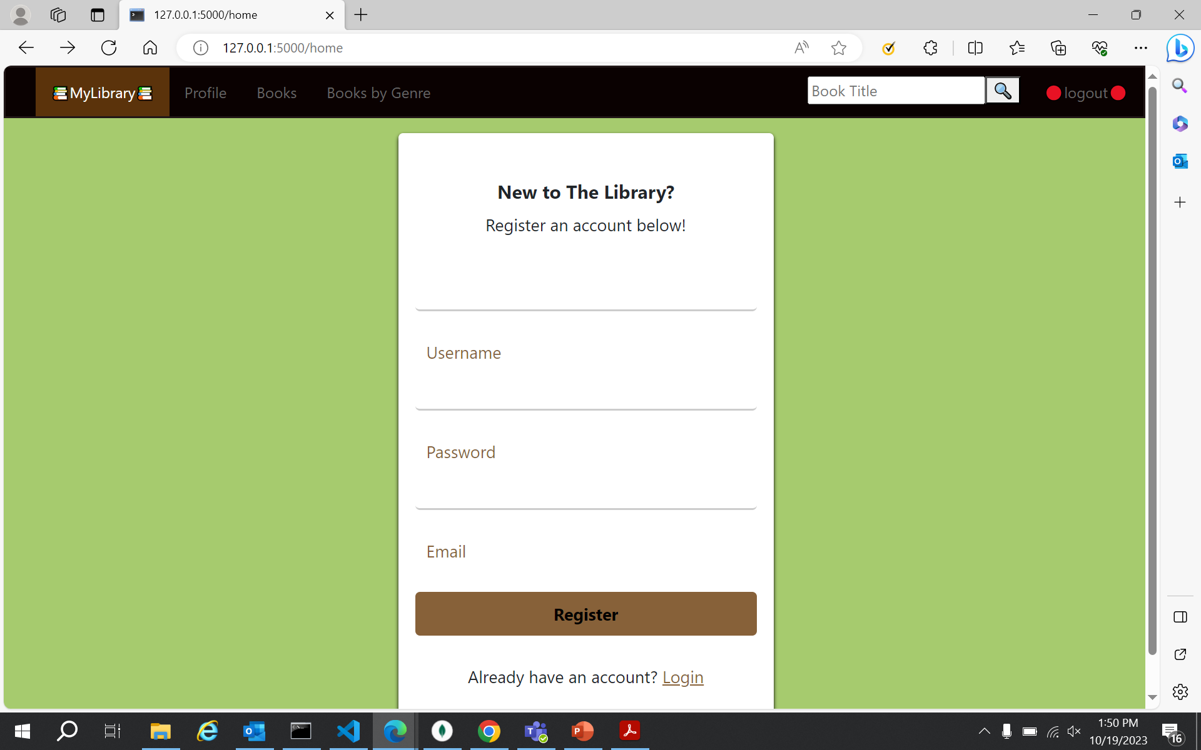
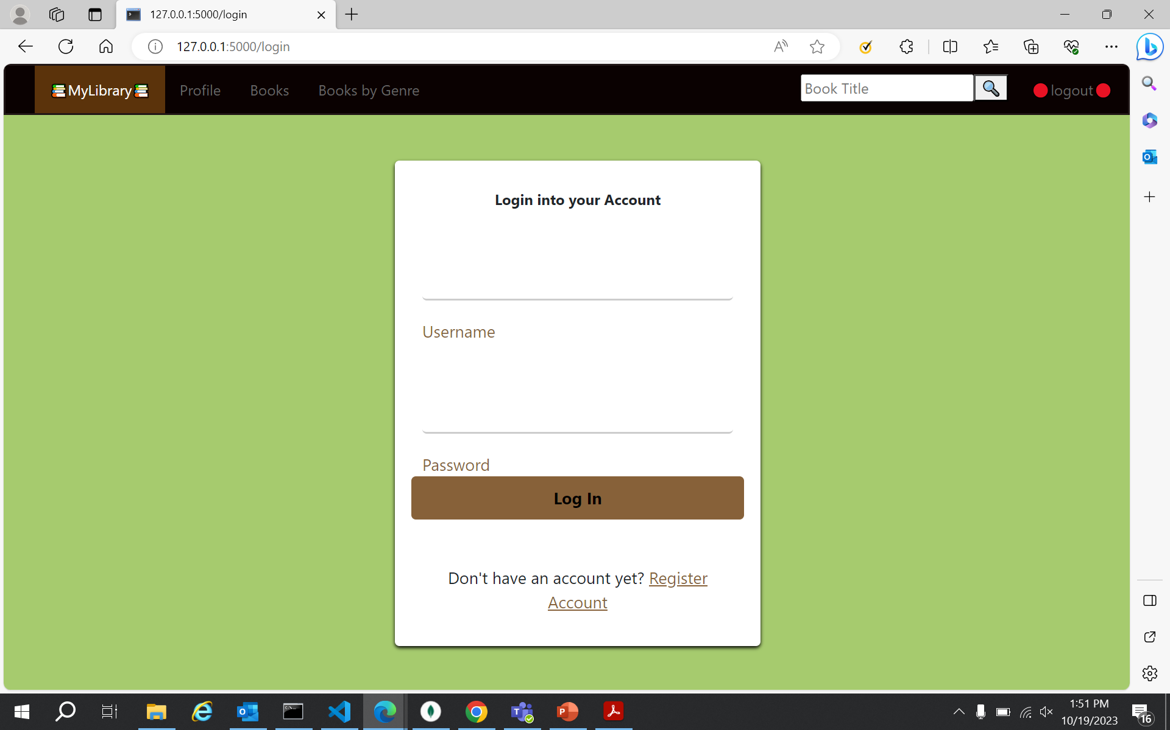
User Interface
Sign Up Page
Login Page

Slide 13
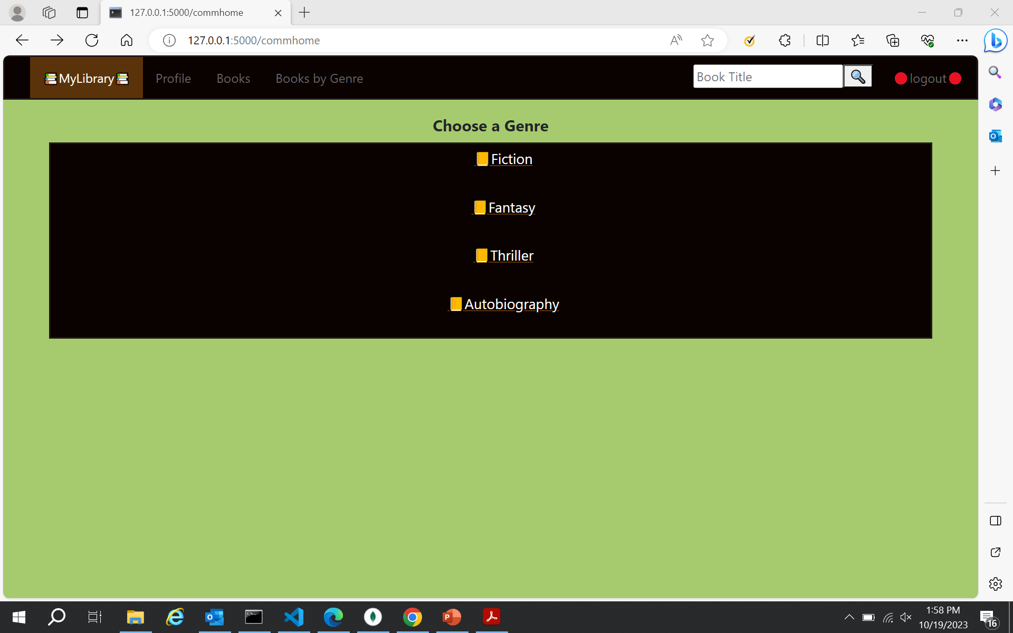
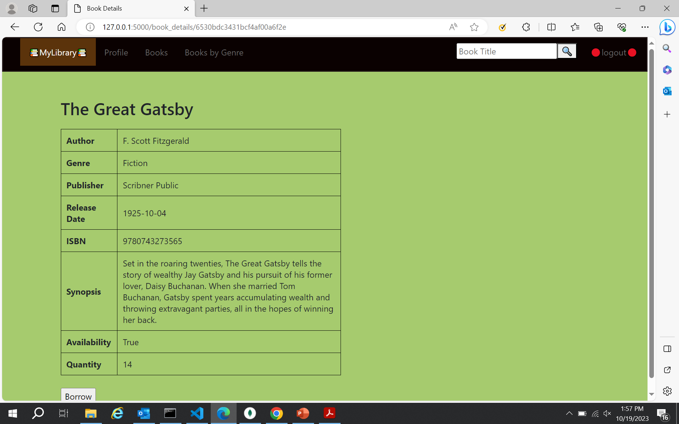
User Interface
Available Genres
Particular Book

Slide 14
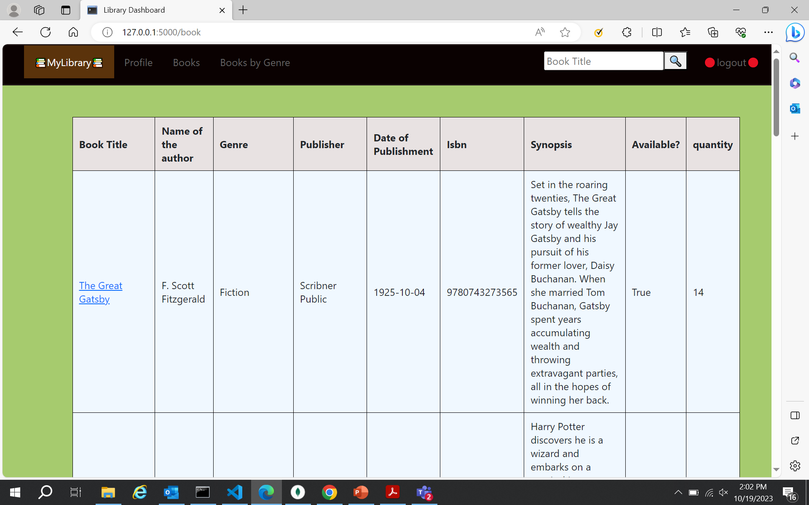
User Interface
Books List

Slide 15
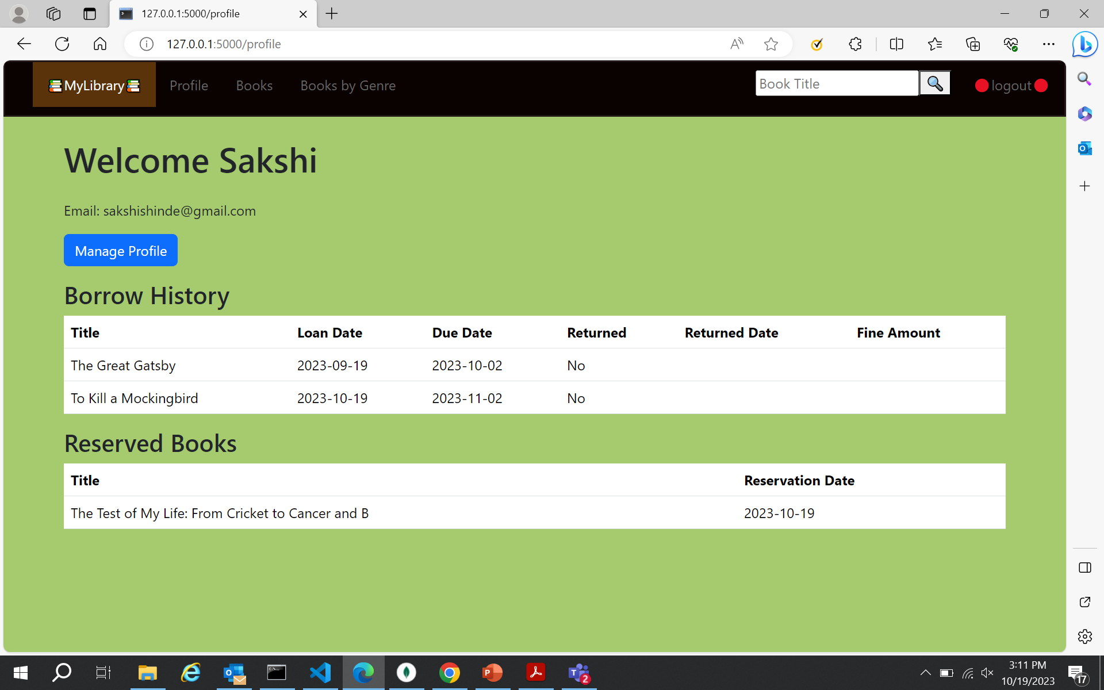
User Interface
User Profile

Slide 16
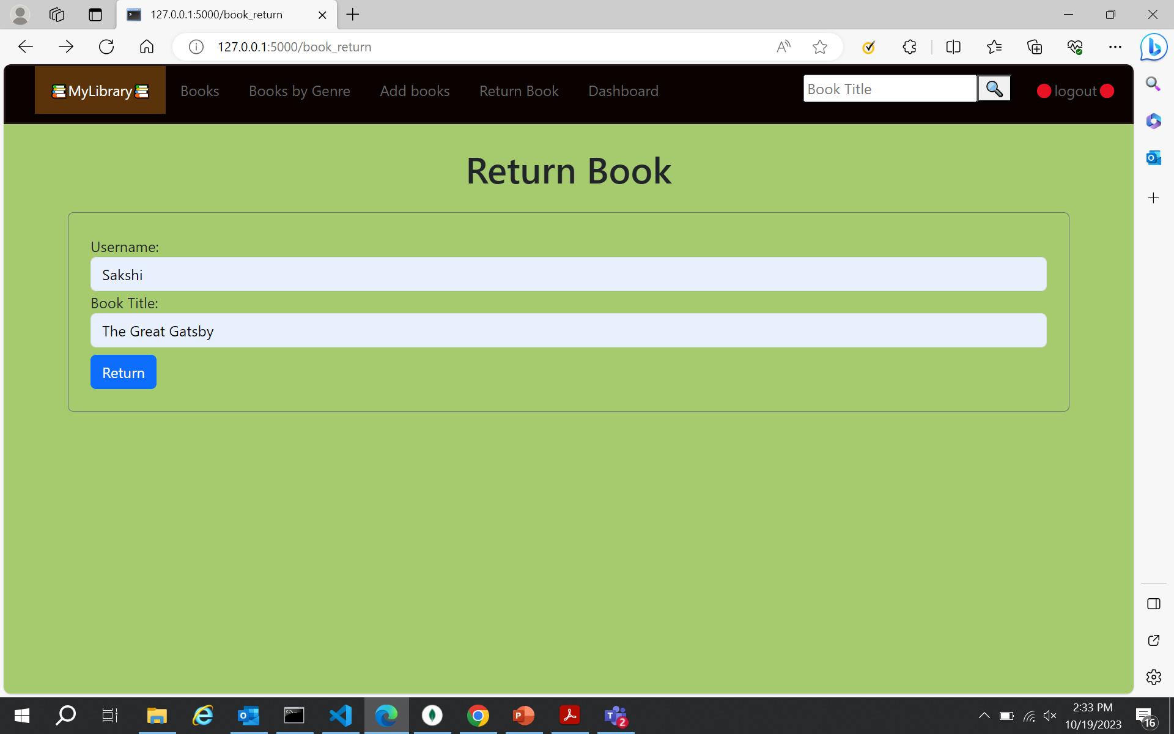
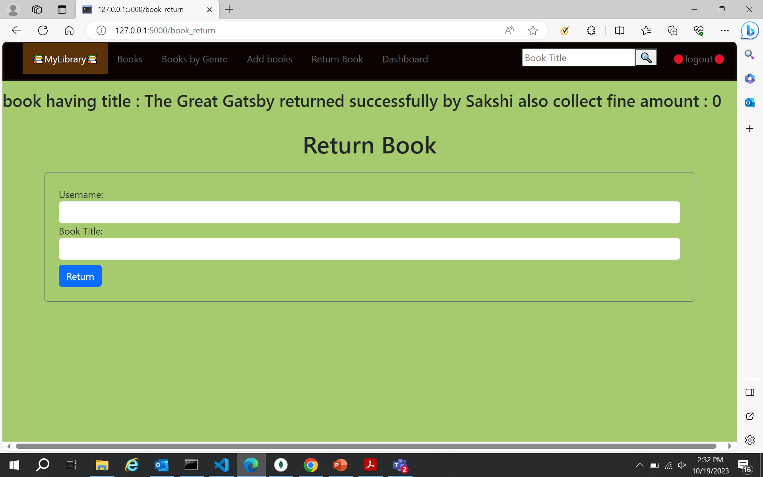
Admin Interface
Book Return

Slide 17
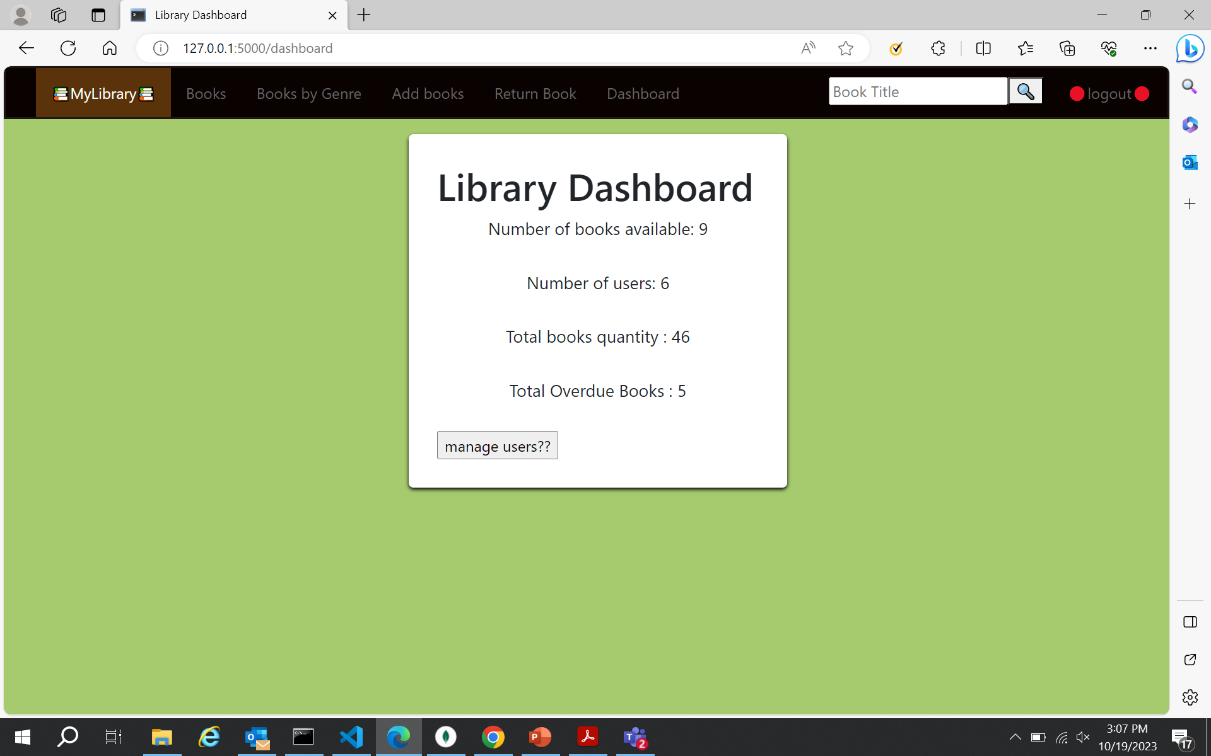
Admin Interface
Library Dashboard

Slide 18
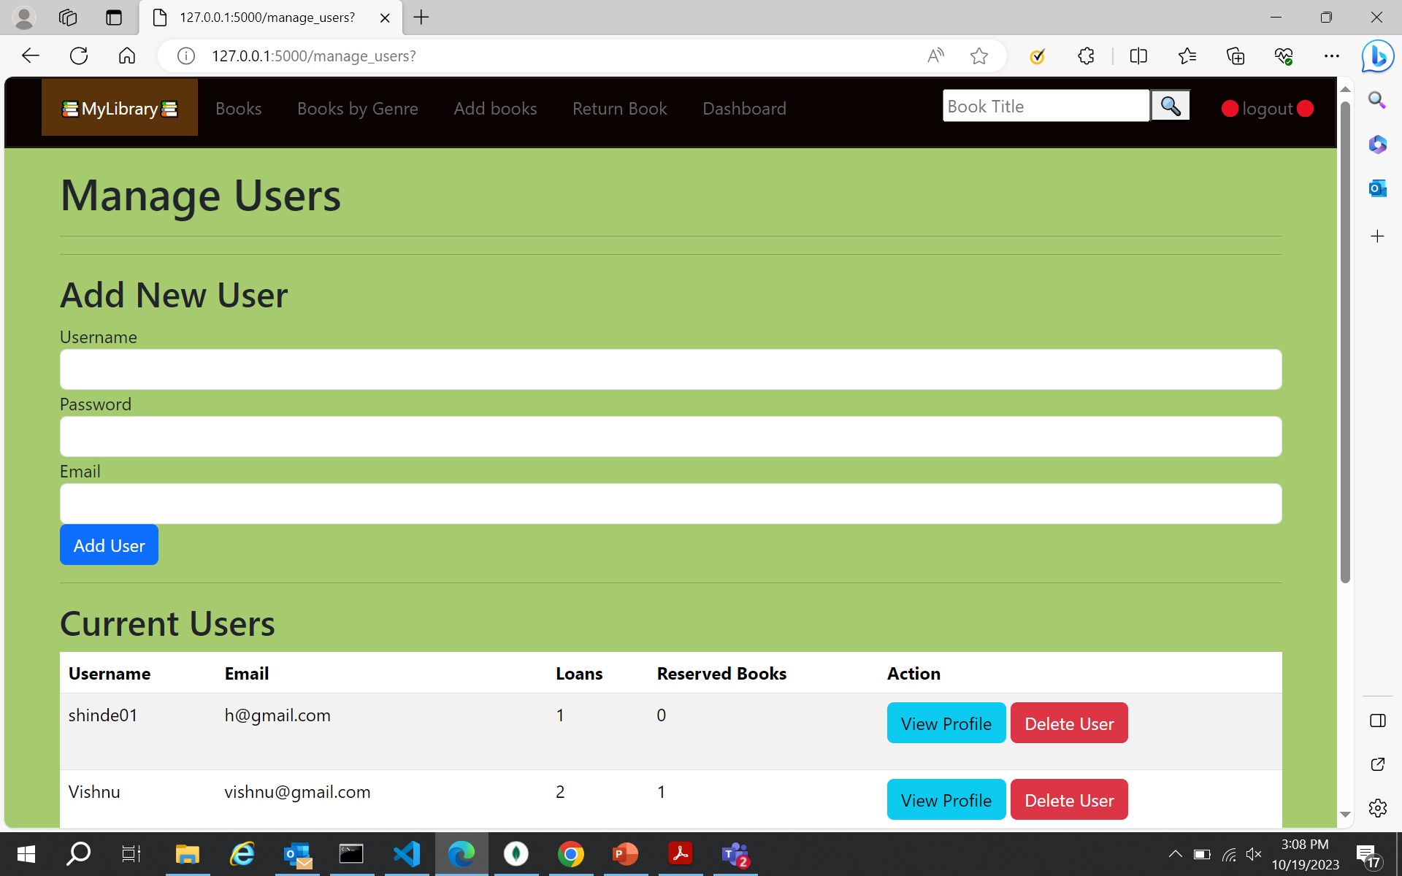
Admin Interface
Manage Users

Slide 19
Challenges faced
Ensuring secure storage and handling of user passwords
Preventing unauthorized access to system resources
Handling updates and deletions of books when they have been checked out or are overdue
Automatically calculating and applying fines accurately
Future Scope
As more and more people access the internet on their mobile devices, developing a mobile app version of the Library Management System could provide users with a better user experience and more accessibility.
In case the library resources are insufficient, the Library Management System could be integrated with external libraries or book rental services to provide a wider range of resources to users.

Slide 20
Thank you!

