Slide 1

COMPARISON OF MACHINE LEARNING AND DEEP LEARNING CLASSIFICATION ALGORITHM
Student Details :
SATYANSHU SINGH (1900320150046)
VIDIT DIXIT(1900320150060)
YASH BHARDWAJ(1900320150063)
Guide-Ms. Poonam Rana
Department- Deptt of CS:CE (2019-2023)
ABES EC, Ghaziabad
Affiliated to Dr. A.P.J. Abdul Kalam Technical University, Uttar Pradesh, Lucknow
2020-2021

Slide 2
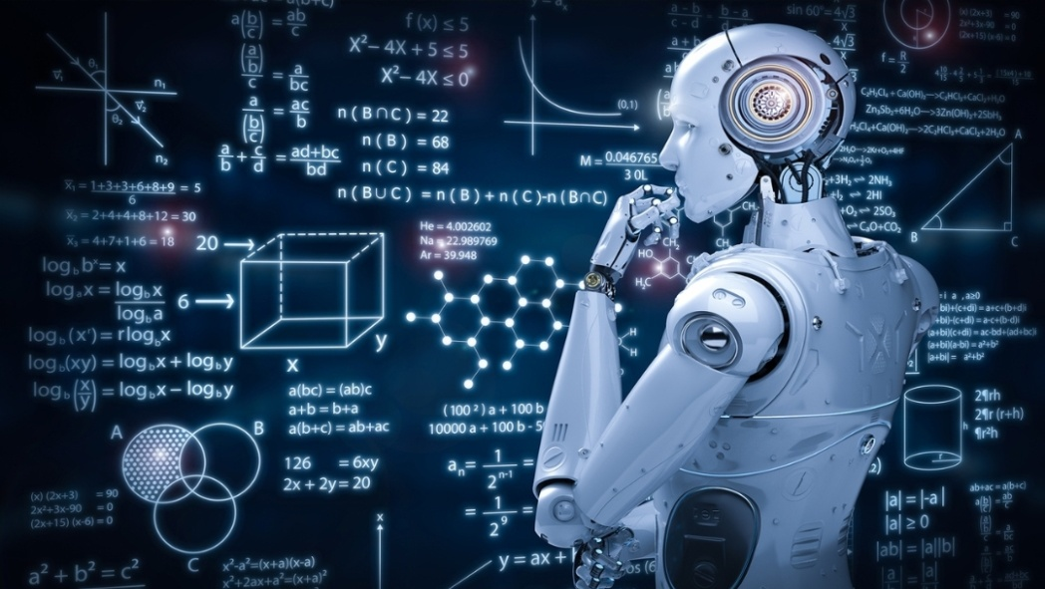
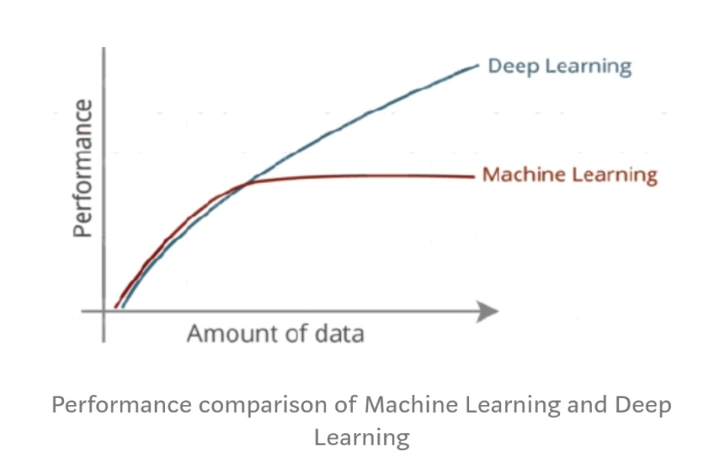
CONTANT
1.ABSTRACT
HOW MACHINE LEARNING IS TRANSFORMING DIFFERENT FIELD
HOW DEEP LEARNING IS TRANSFORMING DIFFERENT FIELD
2.INTRODUCTION
MACHINE LEARNING
DEEP LEARNING
COMPARISON
3.LITERATURE REVIEW
Different type of algorithm is used to discuss different type of problems.
1.MACHINE LEARNING ALGORITHM
2.DEEP LEARNING ALGORITHM

Slide 3
HOW MACHINE LEARNING IS TRANSFORMING DIFFERENT FIELD
ABSTRACT
1.ARTIFICIAL INTELLEGENCE:-Most scientist community says ML grew out from AI. They trying to approach the problem with different symbolic methods. ML is different field and started to flourish in 1990s. Beside some practitioners, say’s that ML and AI are separate.
2. DATA MINING:-
ML and data mining execute same methods and overlap properly, but while ML focuses on bodment , learned from the training data(known properties), data mining focuses on the discovery of unknown properties in the data
3. EDUCATION:-
The digital system collect each records and can give accurate classified report as they needed. This doesn’t means no need of teacher because of innovation of these technology though these can’t fulfill various roles as teacher play but can be automated through machine learning
4.HEALTHCARE:-
ML programs can predict health queries based on age, socioeconomic status, and ancestral history which helps restrict sickness. ML algorithm find out cancer more accurately than the best pathologist, freeing doctors for making the treatment decision more accurate and fast .

Slide 4
HOW DEEP LEARNING IS TRANSFORMING DIFFERENT FIELD
1. IMAGE RESTORATION –
Deep learning application include method such as "Shrinkage Fields for Effective Image Restoration" which exercise
on an image dataset, and Deep Image Prior, which exercise on the image that needs restoration.
2. BIOINFROMATICS –
Gene ontology annotations and gene-function kinship is predicted by auto-encoder ANN in bioinformatics .Sleep quality
and health complication are bodment by deep learning on the basis of recorded data
3.NATURAL IMAGE PROCESSING –
Since in early 2000s Neural networks have been used for implementing language models .LSTM
used to reform machine translation and language modeling.
4.MILITARY-
The US Department of Defense applied deep learning used to exercising robots in new tasks through scanning.

Slide 5
INTRODUCTION
MACHINE LEARNING
“Machine Learning is study of computers to learn and behave like humans by providing them data and information from observations and real-world interactions or communication and upgrade their learning over time in self-governing style.”
DEEP LEARNING
“Deep learning is a part of machine learning in artificial intelligence .Deep learning is a machine learning process in which a computer system learns to perform classification tasks directly from images, text, or sound .”

Slide 6
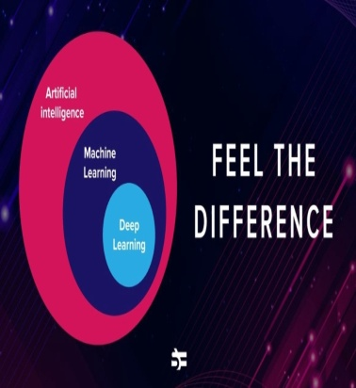
COMPARISON BETWEEN MACHINE LEARNING AND DEEP LEARNING ALGORITHM
MACHINE LEARNING
DEEP LEARNING
1. DATA DEPENDENCIES- Machine learning algorithms perform well when data is small.
2.HARDWARE DEPENDENCIES- Machine learning algorithm can work on low end machines.
3.Problem Solving Approach-
In Machine learning algorithms, it is recommended to break the problem into different parts ,solve them individually and combine the result.
4.Execution Time- Machine Learning Algorithms take shorter time to execute.
1. DATA DEPENDENCIES- Deep Learning algorithms don't perform that well when the data is small as they need a large amount of data to understand it perfectly.
2.HARDWARE DEPENDENCIES-Deep Learning algorithm depend heavily on high end machine.
3.Problem Solving Approach- Deep Learning algorithms solve the problem end to end.
4.Execution Time- Deep learning algorithms generally takes longer time to execute.

Slide 7
LITERATURE REVIEW
A data set can be converted into model using machine learning and deep learning.
Different type of algorithm is used to discuss different type of problems.
Different types of machine learning are:-
Principal Component Analysis (PCA) –
PCA is a statistical procedure that uses an extraneous transformation which converts a set of matchup variables to a set of unrelated variables
KNN (k-nearest neighbor)-
KNN requires no learning as it has no model other than storing entire dataset.
SVM (Support Vector Machine) –
SVM is a technique for characterization. In this calculation, we plot every information thing as a point in n-dimensional space with the estimation of each component being the estimation of a specific organize.

Slide 8
Different type of deep learning algorithm ARE:-
1. CONVENTIONAL NEURAL NETWORK -
A Convolutional Neural Network (ConvNet/CNN) is a Deep Learning algorithm which can take in an input image, assign importance (learnable weights and biases) to various aspects/objects in the image and be able to differentiate one from the other.
2. Alex-Net -
Alex-Net is a Convolutional neural network that is 8 layers deep. You can load a pre-trained version of the network trained on more than a million images from the Image-Net database . The pre-trained network can classify images into 1000 object categories, such as keyboard, mouse, pencil, and many animals.
3. Google Net –
GoogLeNet is a convolutional neural network that is 22 layers deep. You can load a pretrained version of the network trained on either the ImageNet or Places365 data sets. The network trained on ImageNet classifies images into 1000 object categories, such as keyboard, mouse, pencil, and many animals.

Slide 9
4. IMAGE NET -
ImageNet is an enormous database or dataset of more than 14 million pictures. It was planned by scholastics proposed for computer vision research. It was the first of its sort in parameter of scale.
5. Recurrent Neural Network (RNN) –
The recurrent neural network (RNN) is designed to recognize a data set's sequential attribute and use patterns to predict the next likely scenario. It is a powerful approach to processing sequential data like sound, time series data, and written natural language.
6. Long Short-Term Memory (LSTM)- The long short-term memory (LSTM) algorithm is a type of RNN that allows deep recurrent networks to be trained without making the gradients that update weights become unstable. Patterns can be stored in memory for more extended periods, with the ability to selectively recall or delete data.

Slide 10
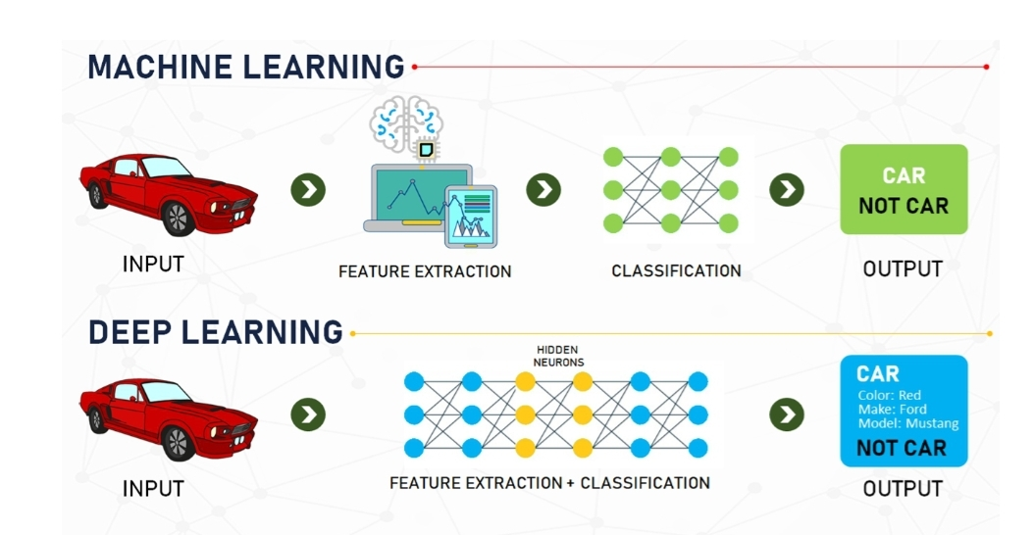
7. Generative Adversarial Network (GAN) - The Generative Adversarial Network (GAN) is a robust algorithm used for unsupervised learning.

Slide 11
Methodology
Start
Enter the dataset to be examined
Use Various ML and DL algorithms on dataset
Select the fastest algorithm depending upon accurracy and time complexity
Stop

Slide 12
CONCLUSION
We will try to make our algorithm code more precise and has less complexity. We will improve the error and prediction within the code so that it will take less time . We use linear regression within machine learning on E-commerce data set and found that scores comes up to 98.55% and in KNN we found it comes up to 88.09 %and if we use another algorithm like alex net , google net SVM then prediction will be more precise but we need large data set for this . We will use python as a coding language so we can use ML and Deep learning. It is also fast and easy to understand. This algorithm can solve our basic day – to – day problems so that everybody can easily get profit of that and we can teach ongoing generation the real purpose of coding for which it is invented i.e welfare of our society

Slide 13
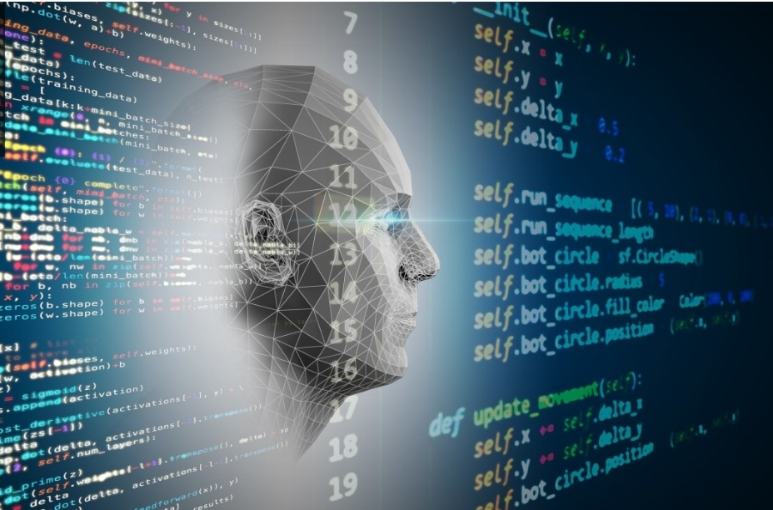
FUTURE WORK
The results show that the proposed approach can objectively classify the algorithm of ML and Deep learning on the basis of accuracy and less time complexity. By applying these algorithm we can make our life easier I . e Virtual Assistants (Smart Speaker), Predictions while Commuting(Traffic Predictions, Online Transportation Networks), Social Media Services, People You May Know, Face Recognition, Email Spam and Malware Filtering , Online Customer Support , Search Engine Result Refining , Product Recommendations , Online Fraud Detection

Slide 14

THANK YOU

