Slide 1

School of Engineering & Sciences
Department of Electronics & Communication Engineering
“SMART CANTEEN MANAGEMENT SYSTEM”
Group Code:- ECOII2526UGMP3-28 Course Code :23SCL002
Roll No. | Div. | Enrolment No. | Name of Student
2313024110 | ECO-II | ADT23SESB0407 | ANIMESH R. KHEDKAR
D2413024003 | ECO-II | ADT24SESBD073 | ARPITA A. KHOT
D2413024002 | ECO-II | ADT24SESBD072 | AKSHADA S. JAGTAP
2313024086 | ECO-II | ADT23SESB0383 | SAKSHI S. SUDRIK
Name of Guide | Prof. Anup Date

Slide 2

Contents
Introduction
Problem Statement
Objectives
Methodology
Actual project work (Own Contribution)
Result and Discussion
Conclusion
Future Scope
Project Work Action Plan
Project Based Accolades
Reference

Slide 3
Introduction
In campus life, food ordering and mess management play a crucial role.
Current system faces problems like long queues, manual ordering, and wastage.
This project focuses on creating a digital food ordering and mess management system.
It aims to reduce waiting time,simplify the ordering process, and provide transparency for both students and management.
By using mobile/web applications, secure payments, and real-time updates, the system ensures convenience, efficiency, and better overall management.

Slide 4
Problem Statement
Traditional mess and food ordering systems are slow, manual, and inefficient, leading to delays, wastage, and poor student satisfaction. A smart, digital solution is needed to streamline ordering, payments, and management in campus canteens
Objectives
The main objective of this project is to develop a smart food ordering and mess management system that simplifies the process of ordering and payments. It aims to provide real-time menu updates and transparency for both students and the mess staff. The system also focuses on improving efficiency, reducing food wastage, and enhancing overall user convenience

Slide 5
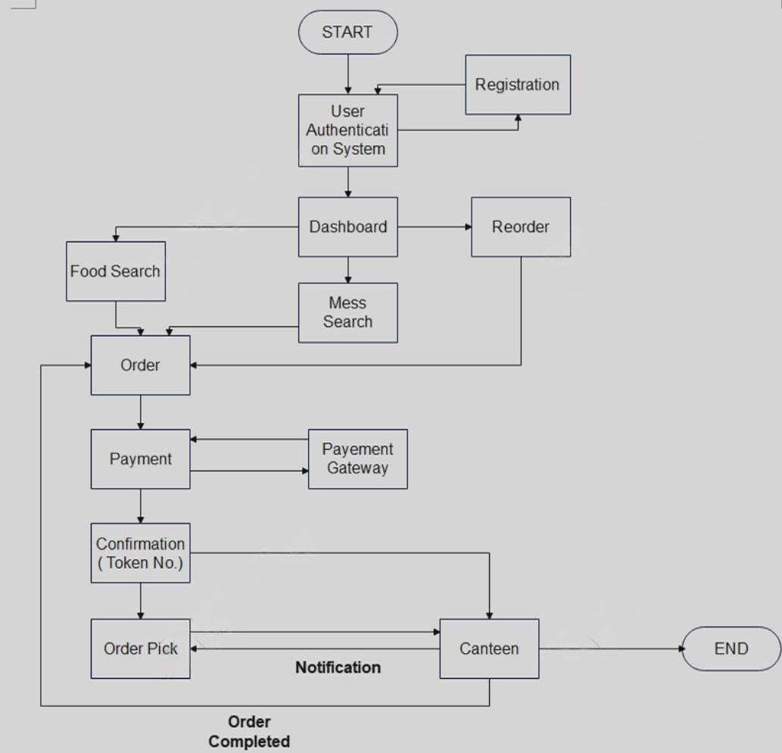
Methodology

Slide 6
Working
Start & Registration- The process begins when a user opens the system.If the user is new, they must register; otherwise, they can directly log in.
User Authentication- The system verifies the user's login credentials to allow access.
Dashboard Access- After successful login, the user reaches the dashboard where they can:Search for foodSearch mess optionsReorder previous items
Food / Mess Search- The user can browse and select food items or mess services as per their preference
Placing an Order- Once items are selected, the user proceeds to the order section.

Slide 7
Working
Payment Process- The user chooses a payment method and completes the transaction via the payment gateway.
Confirmation & Token Generation- After a successful payment, the system generates a confirmation token number.
Order Pick-Up & Notification- The system sends a notification to the canteen for order preparation.Once the order is ready, the user can pick it up using the token.
Order Completed -The order is successfully completed, and the process ends.

Slide 8
Fundamental Background
Background of Food Ordering Systems
Traditional mess/canteen systems are manual and time-consuming. Students face delays in ordering and receiving food.
No proper tracking of demand → leads to food wastage.
Need for a digital solution to make process faster and transparent

Slide 9
Fundamental Background
Role of Smart Systems in Canteen Management
Smart systems automate ordering, billing, and notifications.
Digital payment integration ensures secure and cashless transactions.
Real-time menu updates keep students informed.
Helps mess staff plan food preparation based on actual demand.

Slide 10
Fundamental Background
Technology Fundamentals Used
Database Management – Stores student, order, and payment records.
Networking – Connects app/web portal with mess staff in real-time.
Payment Gateway – Enables secure online transactions.
Notification System – Sends order confirmation and pickup alerts.

Slide 11
Actual Project Work (own contribution)
Conceptual Design
User Registration & Authentication
Dashboard with Food Search & Reorder
Order Placement & Token Generation
Secure Payment via Gateway
Notifications to User & Canteen
Order Preparation & Pickup
Efficient & Transparent Process Flow
Note: Topic heading and contents vary with respect to project work

Slide 12
Actual Project Work (own contribution)
Analytical Design
Inputs/Outputs: Inputs → login details, food selection, payment info Outputs → order token, confirmation, notifications, receipts
Data Model (Entities): User, Menu, Order, Payment, Token, Inventory, Notification
Process Flow: Validation → Price Calculation → Inventory Check → Payment → Token Generation → Order Confirmation → Notification
Business Rules:
Only authenticated users can order
Token generated after successful payment
Inventory auto-updates after order
Cancellation allowed before preparation

Slide 13
Actual Project Work (own contribution)
Analytical Design
Performance & Security:
Fast response time (API < 1 sec)
Secure login (encryption, authentication)
Safe online payment (gateway integration)
Reliability:
Order tracking & notifications
Backup & recovery for orders/payments

Slide 14
Results & Discussion
Successfully automated canteen ordering & payment process
Reduced waiting time with token-based pickup system
Improved order accuracy & inventory tracking
Enhanced user convenience with search & reorder features
Secure payment gateway integration ensured smooth transactions
Notifications streamlined communication between users & canteen

Slide 15
Conclusion
This project provides a smart and user-friendly food ordering and mess management system.
It integrates mobile/web app, payments, and notifications for smooth service.
The block-based design makes it scalable, secure, and reliable.
With future add-ons like IoT sensors and analytics, it can further improve efficiency and crowd management.

Slide 16
Future Scope
Real-time notifications for menu updates & offers.
Linking with biometric/RFID for faster student verification.
Adding wallet system with cashback & loyalty points.
Smart display boards in canteen showing live order status.
Cloud-based system for scalability across multiple campuses

Slide 17
Project Work Action Plan
Sr. No. | Activity |  |  | Duration
 |  | July 2023 | August 2023 | Sept. 2023 | Project Overview Assessment | Sept. 2023 | Oct. 2023 | Mid Term Assessment | Oct. 2023 | Nov. 2023 | End Term / Phase I Assessment | Jan. 2023 | Feb. 2023 | Project Overview Assessment |  |  | Mid Term Assessment |  |  |  | End Term / Phase II Assessment
1
2
3
4
5
6
UG Mini Project
UG / PG Project

Slide 18
Reference
1] S. Sharma and A. Gupta, “Smart Canteen Management System Using IoT and Online Ordering,” International Journal of Computer Applications, vol. 183, no. 12, pp. 25–29, 2021.
[2] M. Patel and R. Mehta, “Design and Implementation of Digital Food Ordering System with Real-Time Updates,” International Journal of Emerging Technologies in Engineering Research (IJETER), vol. 8, no. 7, pp. 150–154, 2020.
[3] P. Kumar and S. Rani, “A Study on Online Food Ordering Systems and Mess Management,” International Research Journal of Engineering and Technology (IRJET), vol. 7, no. 6, pp. 1200–1205, Jun. 2020.
[4] Reserve Bank of India, Model Education Loan Scheme for Pursuing Higher Education in India & Abroad, Indian Banks’ Association (IBA), Mumbai, India, 2022.

Slide 19


Slide 20


