Slide 1

Ottawa bike theft analysis
Locating Hotspots and Trends
DONE BY:
SRISHTI (041097754)f text
SAKSHIT(041098605)text

Slide 2

Agenda
INTRODUCTION
BUSINESS UNDERSTANDING
DATA UNDERSTANDING
DATA PREPRATION
MODELING
EVALUATION
DEPLOYMENT

Slide 3
INTRODUCTION
Bike theft remains a prevalent concern in Ottawa's bustling urban environment, posing challenges to residents and visitors alike. To tackle this issue effectively, our project leverages the power of data science. At the heart of our analysis lies a comprehensive dataset sourced from Ottawa's official records. This dataset encapsulates information, including the spatial and temporal dimensions of bike theft incidents, as well as attributes detailing the characteristics of stolen bicycles and the locations where thefts occur. By delving into this rich dataset, we aim to unravel the intricate patterns and trends underlying bike theft in Ottawa. Through our analysis, we seek to provide stakeholders with invaluable insights that can inform targeted interventions to enhance bike security across the city.

Slide 4

BUSINESS UNDERSTANDING
Project Question: Our primary focus revolves around identifying the locations in Ottawa with the highest frequency of bike thefts and understanding the patterns associated with the types of bikes stolen in these areas. This central question guides our exploration and analysis throughout the project.

Slide 5
Business Goals
Identify High-Risk Areas: Our aim is to pinpoint geographical locations in Ottawa where bike thefts occur most frequently, enabling stakeholders to prioritize resources and interventions effectively.
Understand Bike Theft Patterns: We seek to uncover patterns and trends regarding the types of bikes targeted in high-risk areas. This understanding will inform targeted strategies for bike theft prevention and security enhancement.
BUSINESS UNDERSTANDING

Slide 6

Project Plan: We adhere to the CRISP-DM methodology, focusing particularly on the initial phases: Business Understanding, Data Understanding, and Data Preparation. This structured approach ensures that our analysis is systematic and aligned with the project objectives.
BUSINESS UNDERSTANDING

Slide 7
DATA UNDERSTANDING
Source of Data: Our dataset originates from Ottawa's official website, ensuring reliability and authenticity in our analysis. This data source provides us with access to a comprehensive repository of bike theft incidents recorded within the city.
Data Collection Process: Obtaining the dataset, and navigating through Ottawa's official website to locate and access the relevant data. We ensured adherence to data usage policies and obtained the dataset in a format compatible with Rapid Miner and Excel.

Slide 8

Description of Attributes: The dataset comprises various attributes that capture essential information about bike theft incidents. These attributes include:
Name: The name or label of each attribute.
Description: A brief description of the attribute's significance and relevance to our analysis.
Data Type: The data type associated with each attribute, indicating whether it is numerical, categorical, spatial, or temporal in nature.
DATA UNDERSTANDING

Slide 9
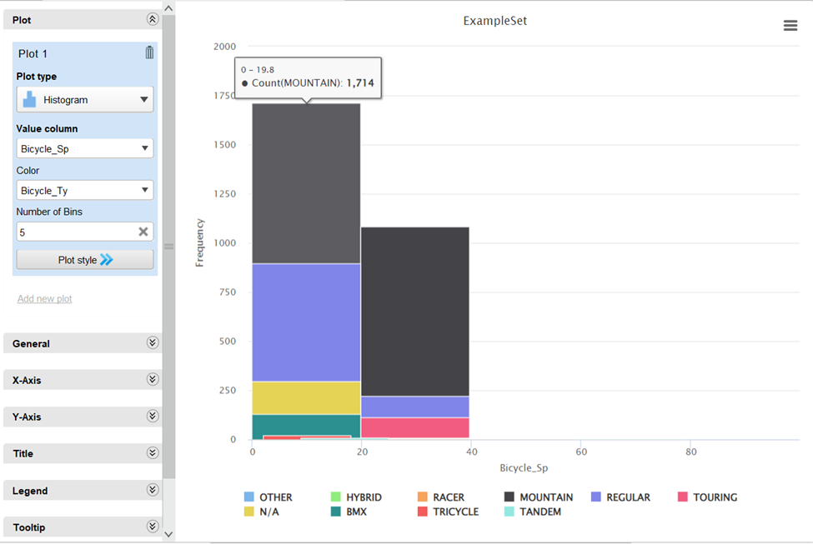
Histogram Plot: The histogram visualizes the frequency distribution of different types of bicycles based on their speed. The X-axis represents the speed of the bicycle, with each point corresponding to a specific speed interval. The Y-axis indicates the frequency or count of bicycle occurrences. Each bar's height reflects how many times a particular type of bicycle appears in the dataset.
DATA UNDERSTANDING

Slide 10
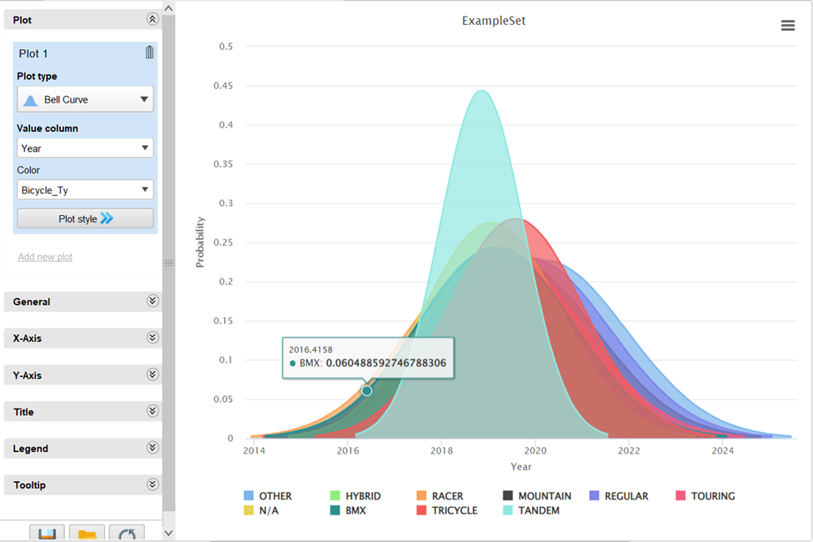
Probability Distribution Over Time: This plot illustrates the probability distribution of specific bicycle types over the years from 2014 to 2024. The X-axis denotes the years, while the Y-axis represents the probability of a particular bicycle type occurrence. The colorful bell-shaped curve showcases how the probability of different bicycle types changes over time.
DATA UNDERSTANDING

Slide 11
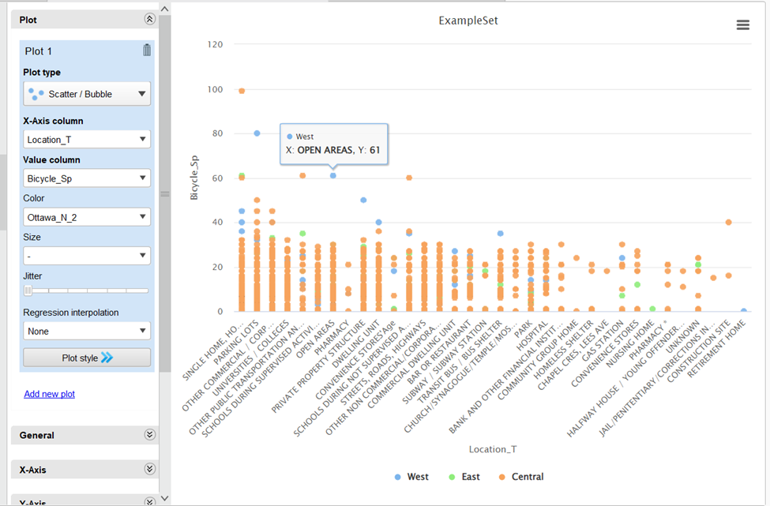
Scatter Plot: Data points are categorized by the "Location_T" attribute on the X-axis and "Bicycle_Sp" attribute on the Y-axis. Each data point is represented by a dot, with different colors indicating various categories or groups of data points. The X-axis categories include "West," "East," and "Central," while the Y-axis represents the speed of the bicycles, ranging from 0 to 120.
DATA UNDERSTANDING

Slide 12
Data Type Matching: We ensured the data type of each attribute matched its respective type, maintaining consistency and accuracy in our analysis.
Handling Missing Values: The dataset underwent a thorough check for missing values, and we utilized the replace missing value operator to address any gaps in the data effectively.
Duplicate Removal: To maintain data integrity, we identified and removed duplicates from the dataset using the remove duplicates operator, ensuring that each observation is unique and reliable for analysis.
DATA UNDERSTANDING

Slide 13
DATA PREPARATION
Selection of Relevant Attributes: We carefully selected attributes deemed crucial for our analysis, focusing on those that provide meaningful insights into bike theft patterns. These attributes were chosen based on their relevance to the project question and business goals.
Data Cleaning Process: Our data cleaning process involved handling missing values and duplicates to ensure the integrity and accuracy of our dataset. We utilized appropriate operators to address missing values, replacing them with suitable alternatives, and removed duplicates to eliminate redundancy and streamline our analysis.

Slide 14
DATA PREPARATION
Construction of New Attributes: To enhance our analysis and gain deeper insights, we constructed new attributes tailored to our specific objectives. These new attributes were designed to capture additional dimensions of bike theft incidents, facilitating a more comprehensive understanding of the underlying patterns. Through this process, we aimed to enrich our dataset and enable more robust analysis for informed decision-making.

Slide 15
DATA PREPARATION
FORMAT DATA:
We used an operator called "nominal to numerical" operator,in which the format of the data has been transformed from a categorical or nominal format to a numerical format. This means that the previously categorical variables, have been encoded into numerical values.
We renamed the attributes so they are better understandable according to our question based on bike thefts and is focused on organizing and clarifying the structure of your data, rather than integrating new data sources. Also changed the data types of some of the attributes like the X and Y coordinates from real to polynominal.

Slide 16
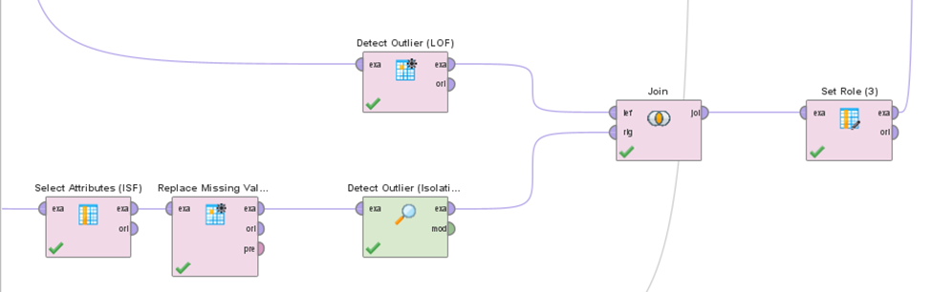
MODELLING
Outlier Detection

Slide 17
MODELLING
Outlier Detection
Techniques Used: Local Outlier Factor (LOF) and Isolation Forest (ISF).
LOF: Density-based algorithm measuring local deviation, identifying less dense outliers.
ISF: Algorithm isolating outliers by partitioning data, effective for high-dimensional data
Implementation: LOF applied with "Detect Outlier (LOF)" operator, results combined with ISF using "Join" operator
ISF applied after excluding certain attributes, missing value replacement, and outer join
Purpose: Identifying anomalies in bike theft data to understand unusual patterns or occurrences

Slide 18
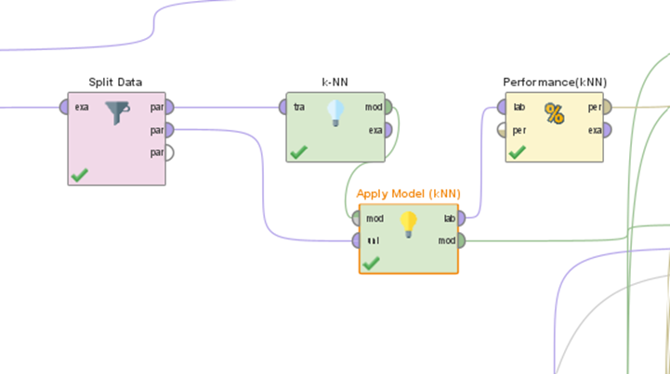
MODELLING
Classification

Slide 19
MODELLING
Classification
Algorithms Used: k-Nearest Neighbors (kNN), Decision Trees (DT), Random Forests (RF)
kNN Modeling:
Split data into training and testing sets
Build a model with varying k values, select optimal k=25
Test model performance and evaluate accuracy using the "Performance" operator
DT Modeling:
Select relevant features, split data, and build decision tree model
Predict on test data, evaluate performance metrics, visualize tree structure
RF Modeling:
Split data, train RF model, set parameters
Predict on test data, evaluate performance, visualize feature importance

Slide 20
Description of Results
Confusion Matrix Analysis:
Provides insights into the strength, reliability, and predictive power of association rules.
Each metric contributes to understanding the performance of rules in capturing patterns and relationships.

Slide 21
Description of Results
Performance Vector in kNN
kNN Algorithm Performance:
Precision and recall metrics analyzed for different classes.
Precision highest for "SINGLE HOME, HOUSE" class but lower for other categories.
Variability in performance across classes suggests influence of data distribution.
Further analysis and fine-tuning may be required for improved performance.

Slide 22
Description of Results
Performance Vector in Decision Trees
Decision Tree Model Performance:
Achieved high precision for some classes but lower recall.
Variability in precision and recall across classes.
Some classes show struggles in accurate prediction.
Further analysis needed to enhance model performance, especially for challenging classes.

Slide 23

Evaluation
Cross-Validation Process: Implementation of k-fold cross-validation for assessing model performance.
Dataset divided into 10 folds, model trained and tested iteratively.
Performance metrics averaged across folds for robust estimation.
Cross-Validation Results: Robust estimation of model performance provided by evaluating on multiple subsets.
Cross-validation performed for kNN, Decision Trees, and Random Forest models.
Back to Agenda Page

Slide 24
Evaluation of Association
Evaluation
Association Analysis Process:
Association algorithm applied to discover frequent item sets and rules.
Patterns and correlations between attributes of bike theft incidents identified.
Association Analysis Results:
Interesting patterns and correlations revealed between different attributes.
High-confidence association rules provide actionable insights.
Back to Agenda Page

Slide 25
Objective and Approach:
Aimed to address bike theft in Ottawa using data science techniques.
Leveraged CRISP-DM methodology for comprehensive analysis.
Conclusion
Impact and Recommendations:
Provided valuable insights and recommendations for improving bike security.
Collaborative efforts aimed at reducing theft incidents in Ottawa.
Back to Agenda Page

Slide 26
Future Directions:
Aimed Further refinement and optimization of models for enhanced performance.
Continued monitoring and analysis of bike theft patterns for proactive measures.
Continued collaboration with stakeholders for effective implementation of recommendations.
Conclusion
Back to Agenda Page

Slide 27
