Slide 1
PROJECTS:
Data Visualization Projects:
UK Bank Customer Analysis
Super Bowl Analytics
Predictive analytics IOWA Ames Data Set
Tools and Technologies
R, Tableau ,Python, D3
On Going Projects :
Cluster Analysis on Head Start
Capstone Project : Utah Sports Athletics Portal
Mining Unstructured Health Data
Tools and Technologies
Vue.js , R, Python

Slide 2
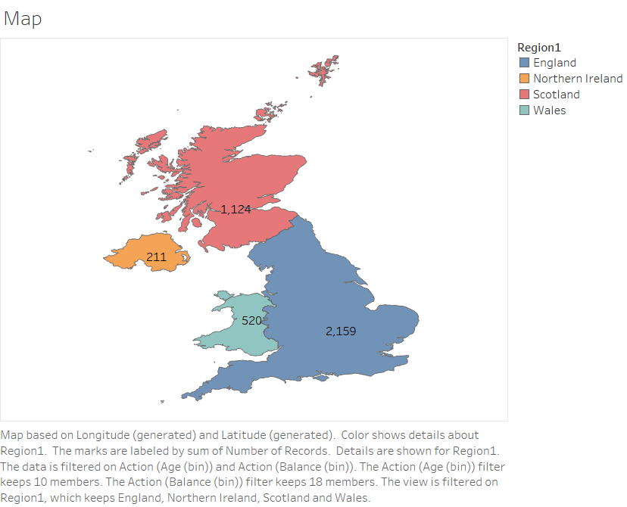
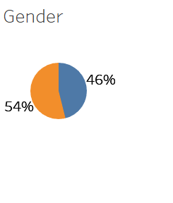
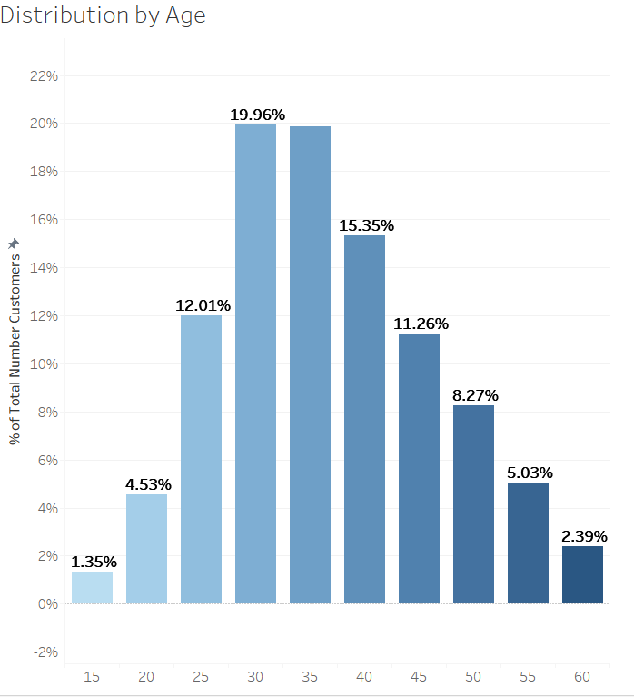
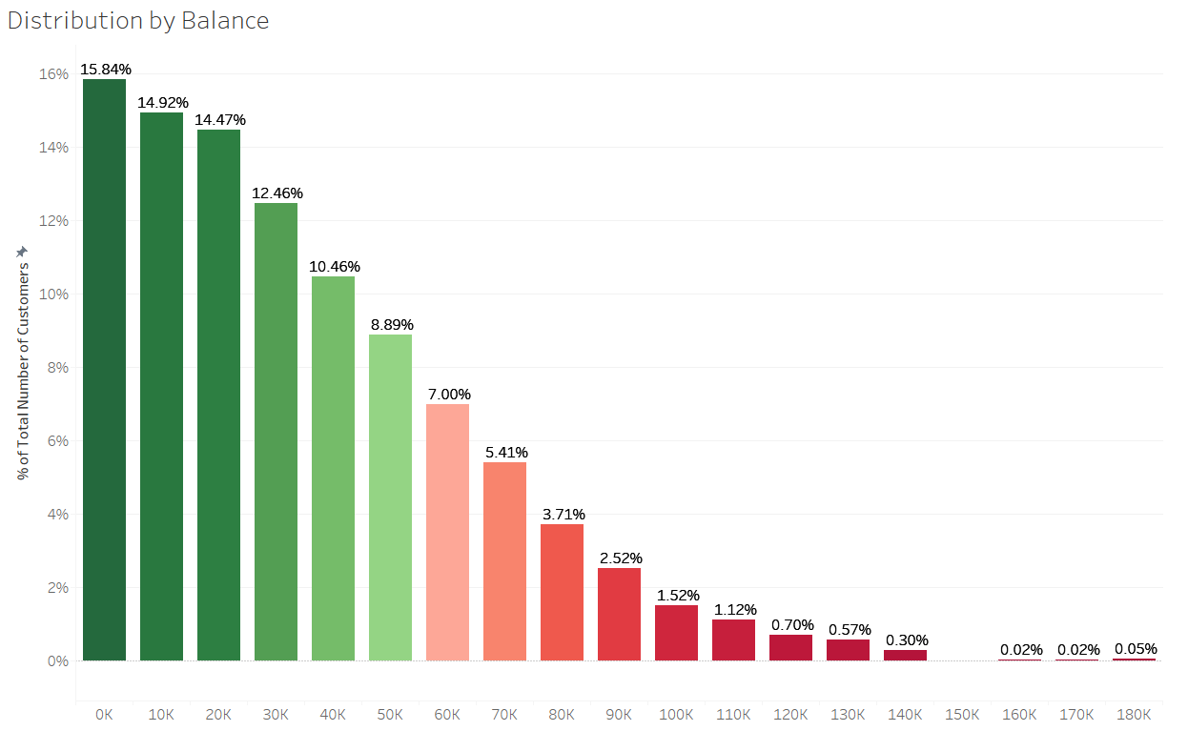
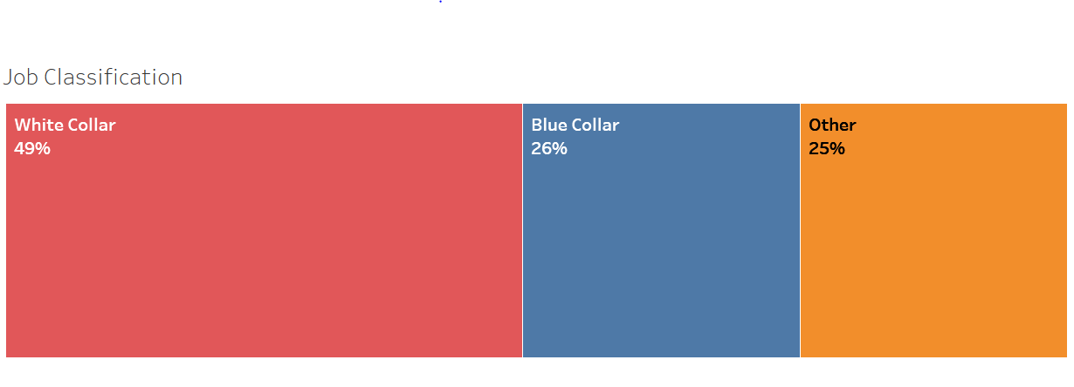

SAKSHI VIG
Analyze the data set UK BANK CUSTOMERS data set in order to signify the relation about region and Job Classification .
Create Data Visualization Story to extract meaningful and rational information
INFORMATION
SQUIRRELS
This visual uses the dataset UK Bank Customers and depicts the number of customer records in different region of UK
PREFER
PEANUT BUTTER
OVER
PEOPLE
GENDER DISTRIBUTION
9 OUT OF 10
MARKETERS
This shows the gender distribution across UK
Female – 46%
Male – 54%
WILL SHARE THIS
AGE DISTRIBUTION
STATEMENTS
INBOUND MARKETERS
ARE RESPONSIBLE FOR FINDING LIFE ON MARS
2012
2013
2015
GRAPHS
RANDOM THOUGHTS
ATTENTION SPAN OF PEOPLE
Representation shows that customers are majorly in the age group of 30 and 35.
INCOME DISTRIBUTION
Representation depicts that maximum people lie in the range of 0K to 10K
JOB CLASSIFICATION

Slide 3

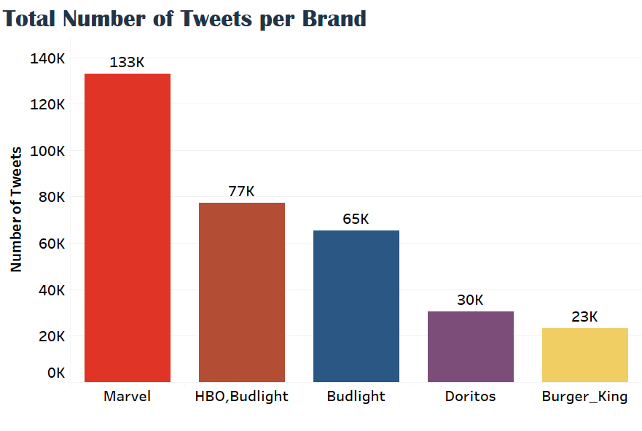
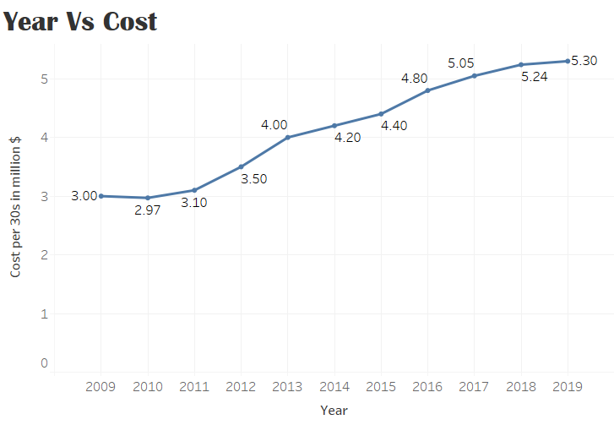
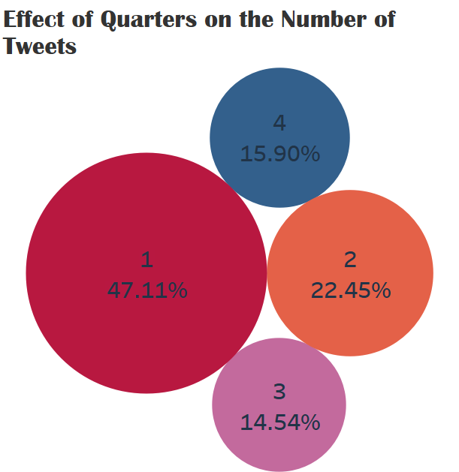
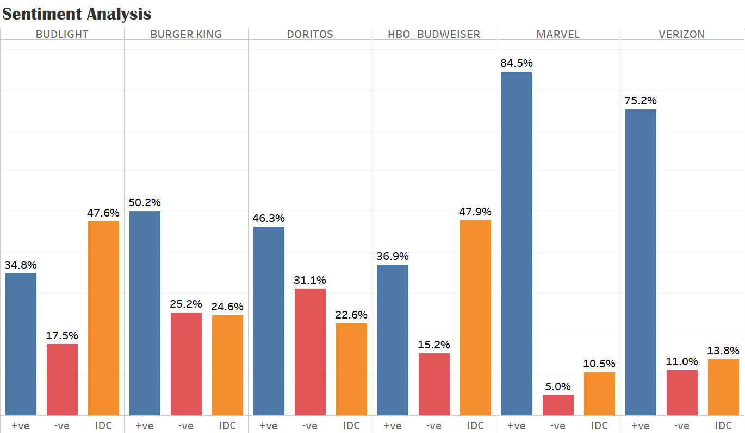
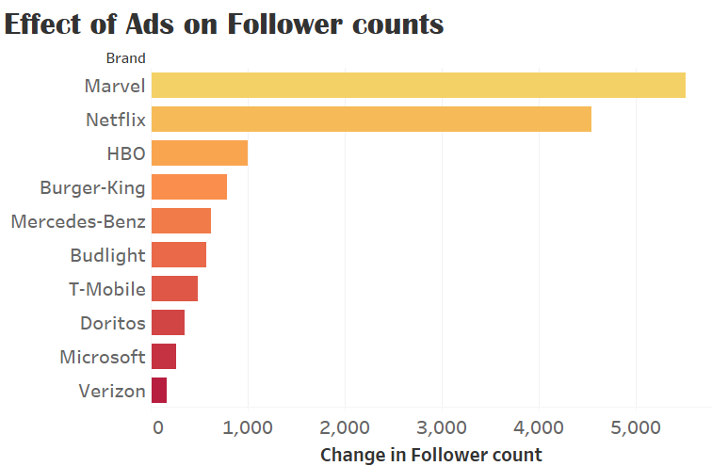
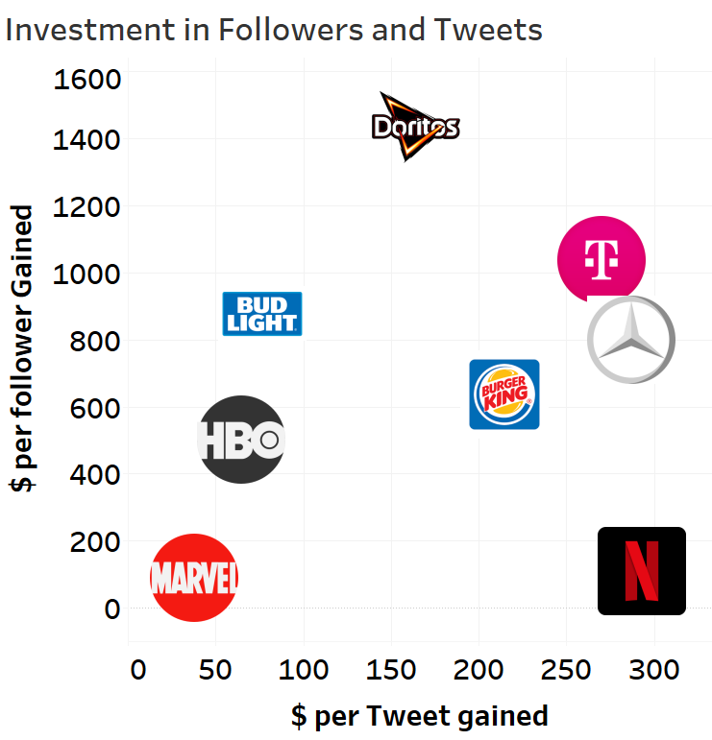
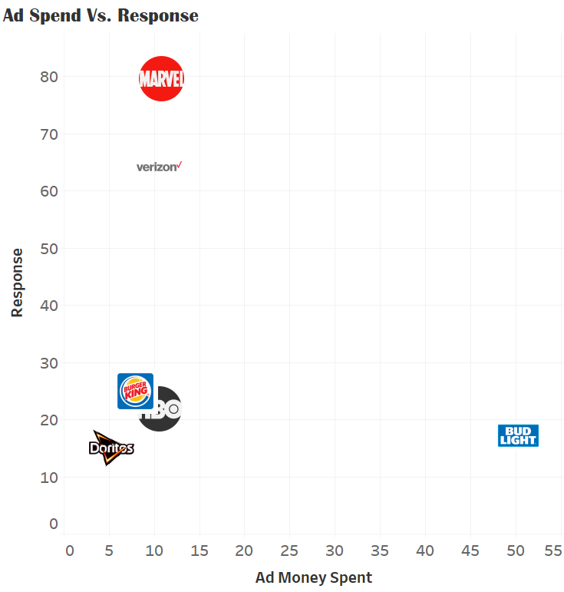



$5.3m
Spent on Average to Air SUPERBOWL Commercials for 30s.
There were 59 commercials aired by 48 brands
The First Responders ad by Verizon made it one of the Top Performer this year.
2019 Game Day Ad Analytics Blitz

Slide 4
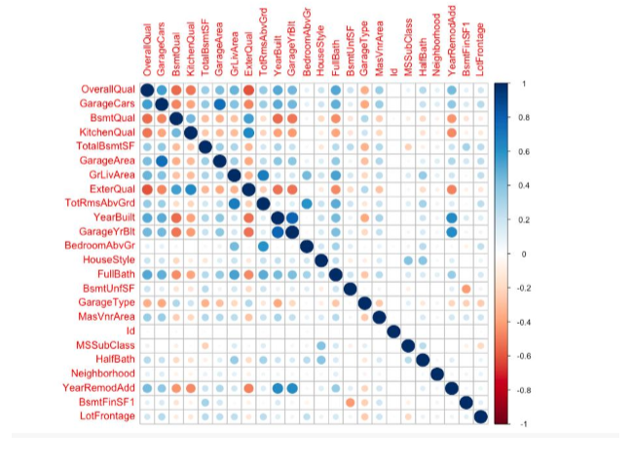
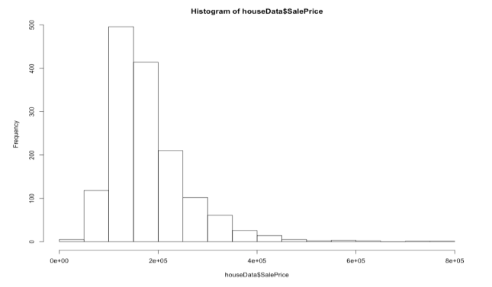
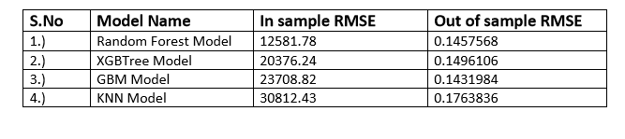
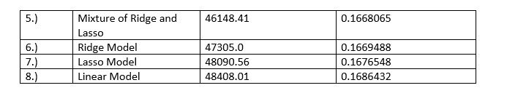
Predictive Analytics on Ames House Price Prediction Data Set
INTRODUCTION
The dataset taken into consideration from Kaggle focusses on predicting the Sales price of individual residential property in Ames, Iowa. The dataset in total consists of 2919 observations with 80 different variables that are 23 nominal, 23 ordinal, 14 discrete and 20 continuous which focus on quality and quantity of many physical attributes of the property.
The complete data has been split into two datasets given in csv format –
The train dataset consists of 1460 observations with 80 predictor variables and SalePrice as the outcome variable.
The test dataset consists of 1459 observations with 80 predictor values and no SalePrice value given. The train dataset is used for building a robust and efficient model to predict the SalePrice value and the test dataset will be used to predict the SalePrice in order to see the fit and performance of the built model.
OBJECTIVE
The objective of the project is:
Step I: Analyzing the given data
Step II: Applying methods to clean the data
Step III: Determining the Effect Size of Predictor Variables: Using different models on ALL predictor variables to determine the effect size of the predictor variables.(Variable selection is automatic ;no preselection)
Step IV: Choosing 15 strong predictors after comparing 8 different models
Step V: Building different models using Step IV predictor variables to determine best model that predicts the Sale Price of the houses
Correlation between Predictors
Checking the normality of Target Variable
Statistical Significance
Model Performance
RMSE and R^2 on train dataset: 12581.78, 0.87
RMSE and R^2 on test dataset: 12581.78, 0.87
Kaggle Rank - 2947
Kaggle Score - 0.15
Result
The final model reveals that the housing prices in Ames, Iowa can be strongly determined by the factors above ground living area square feet, general zones of the house, lot size, types of utilities available, neighborhood of the houses, overall qualitiy of the house, overall condition of the house, the year the house was built in , the year the house was remodelled, external quality of the house, external condition of the house, basement quality, total basement area, size of garage in car capacity and size of the garage.

