Slide 1

Customer Shopping Behavior Analysis
Uncovering insights from 3,900 transactions across product categories to guide strategic business decisions.

Slide 2

Dataset at a Glance
3,900
18
Transactions
Columns
37
4
Missing Ratings
Categories
Key Features
Demographics: Age, Gender, Location
Purchase details: Item, Category, Amount
Behavior: Discount, Promo, Frequency, Rating

Slide 3

Data Preparation in Python
Load & Explore
Handle Missing Values
Feature Engineering
Load to PostgreSQL
Columns standardized to snake_case; redundant promo_code_used dropped; cleaned DataFrame loaded into PostgreSQL for SQL analysis.

Slide 4
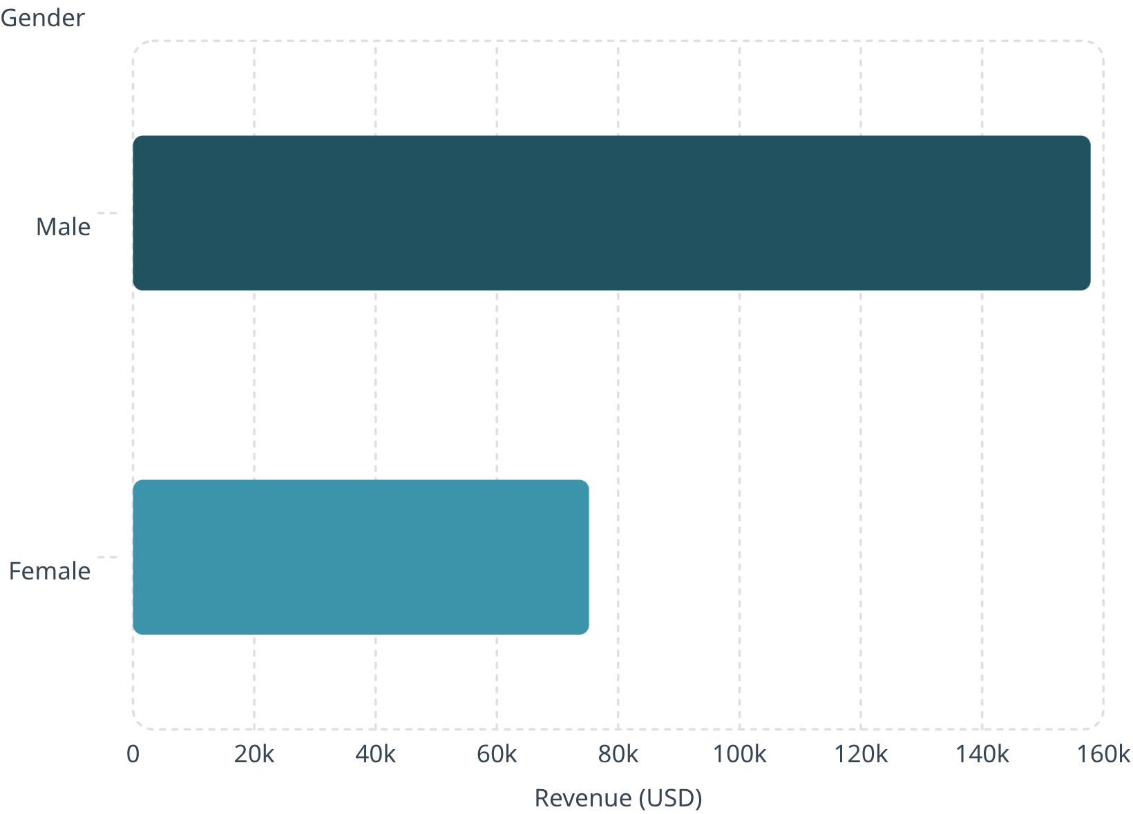

Revenue by Gender
Key Finding
Male customers generated 2.1× more revenue than female customers — a key segment for targeted campaigns.
Male: $157,890 · Female: $75,191

Slide 5
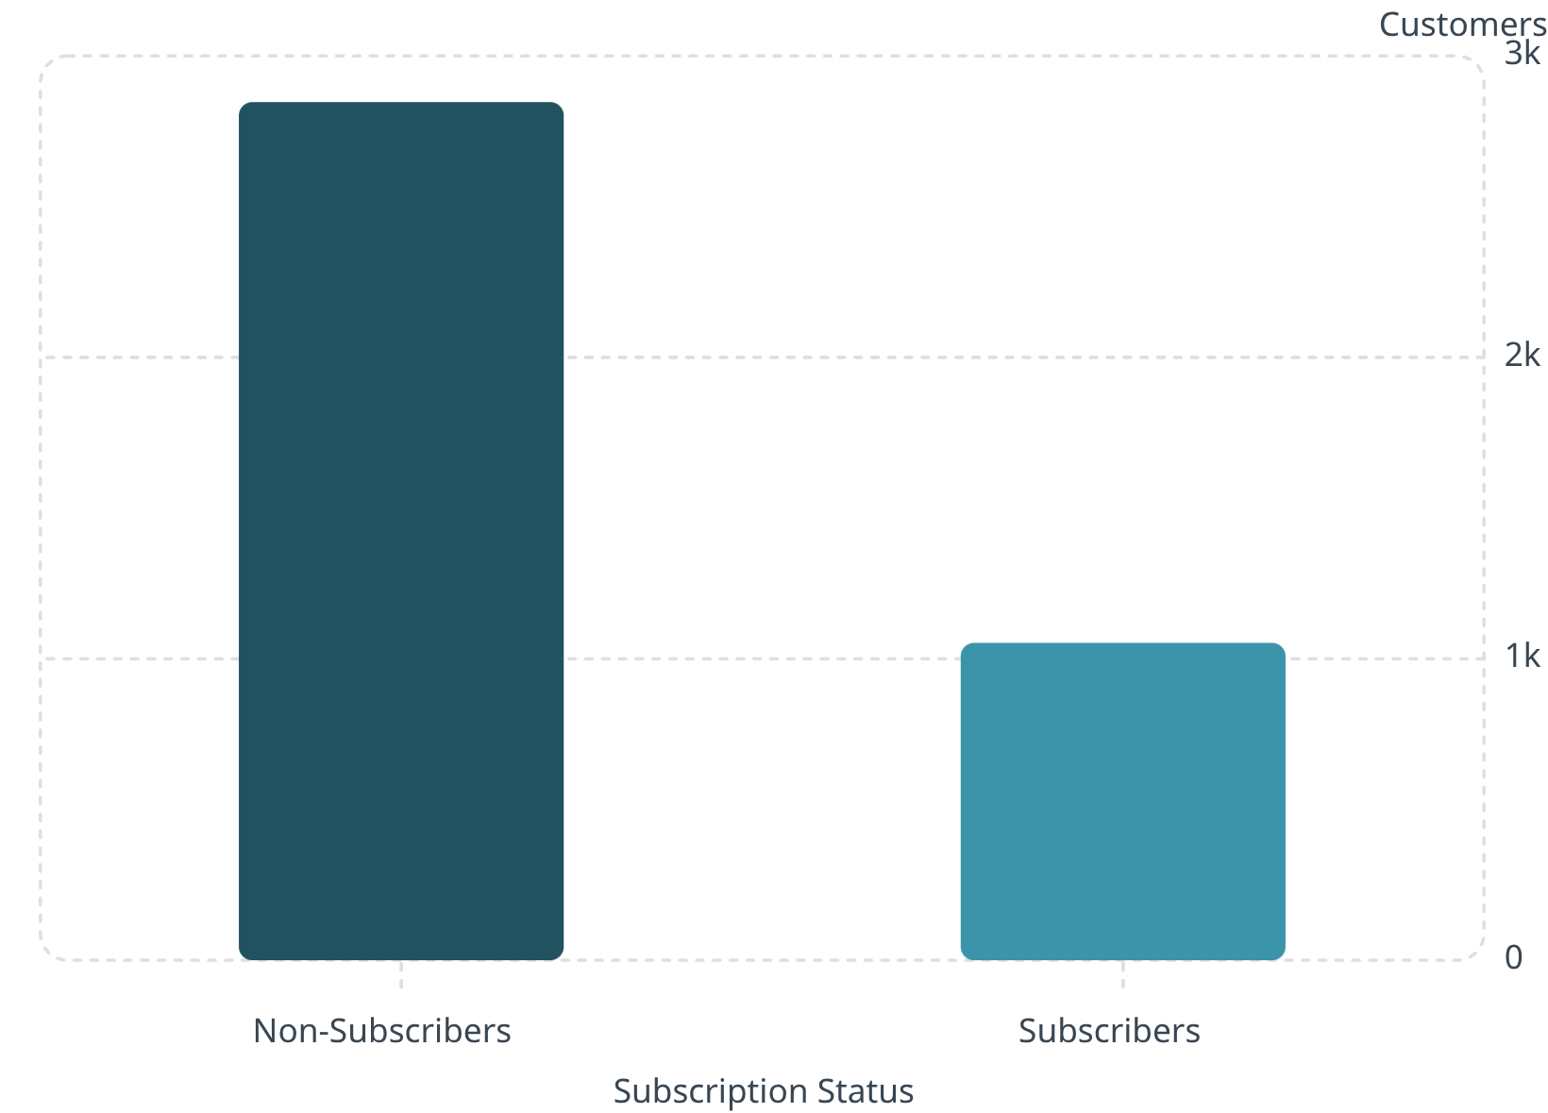
Subscribers vs. Non-Subscribers
Revenue Breakdown
Non-Subscribers: 2,847 customers · $170,436 total
Subscribers: 1,053 customers · $62,645 total
Average spend nearly identical: $59.87 vs. $59.49

Slide 6
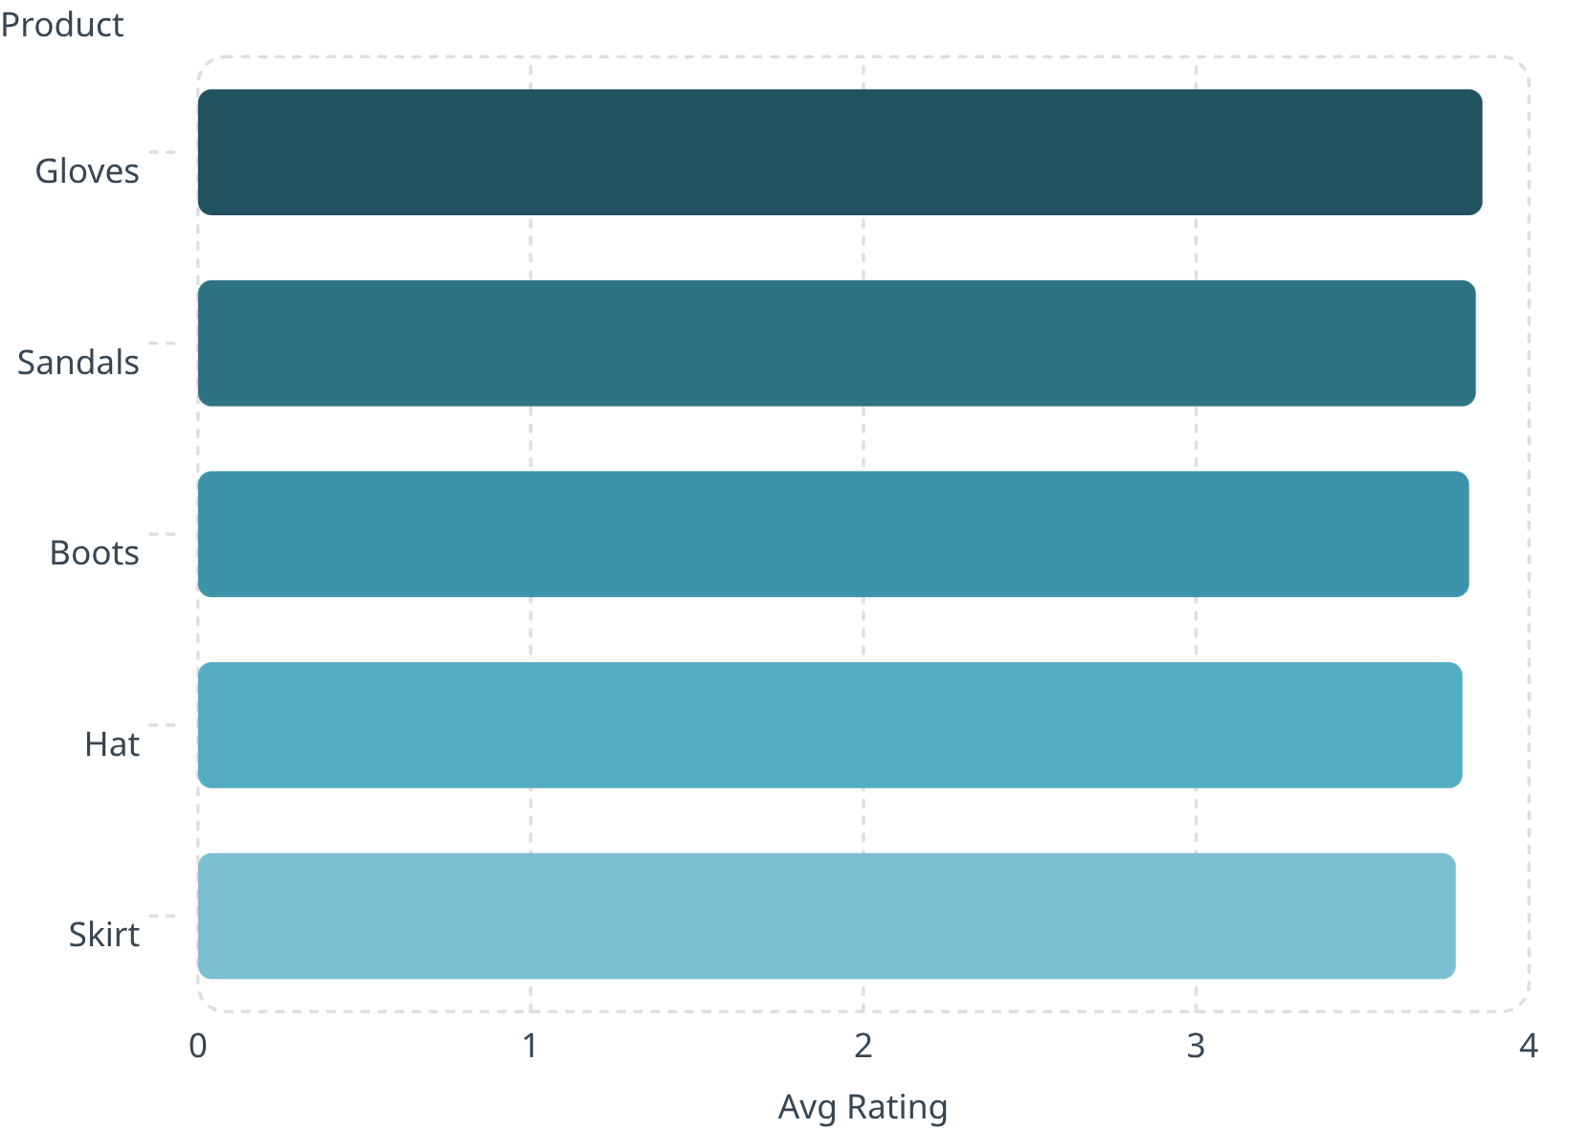
Top Products & Discount Patterns
Top 5 Products by Rating
Most Discount-Dependent Products
Hat — 50% discounted purchases
Sneakers — 49.66%
Coat — 49.07%
Sweater — 48.17%
Pants — 47.37%

Slide 7

Customer Segmentation
Loyal
Returning
3,116 customers
701 customers
New
83 customers
Repeat buyers (>5 purchases): 958 subscribers vs. 2,518 non-subscribers

Slide 8
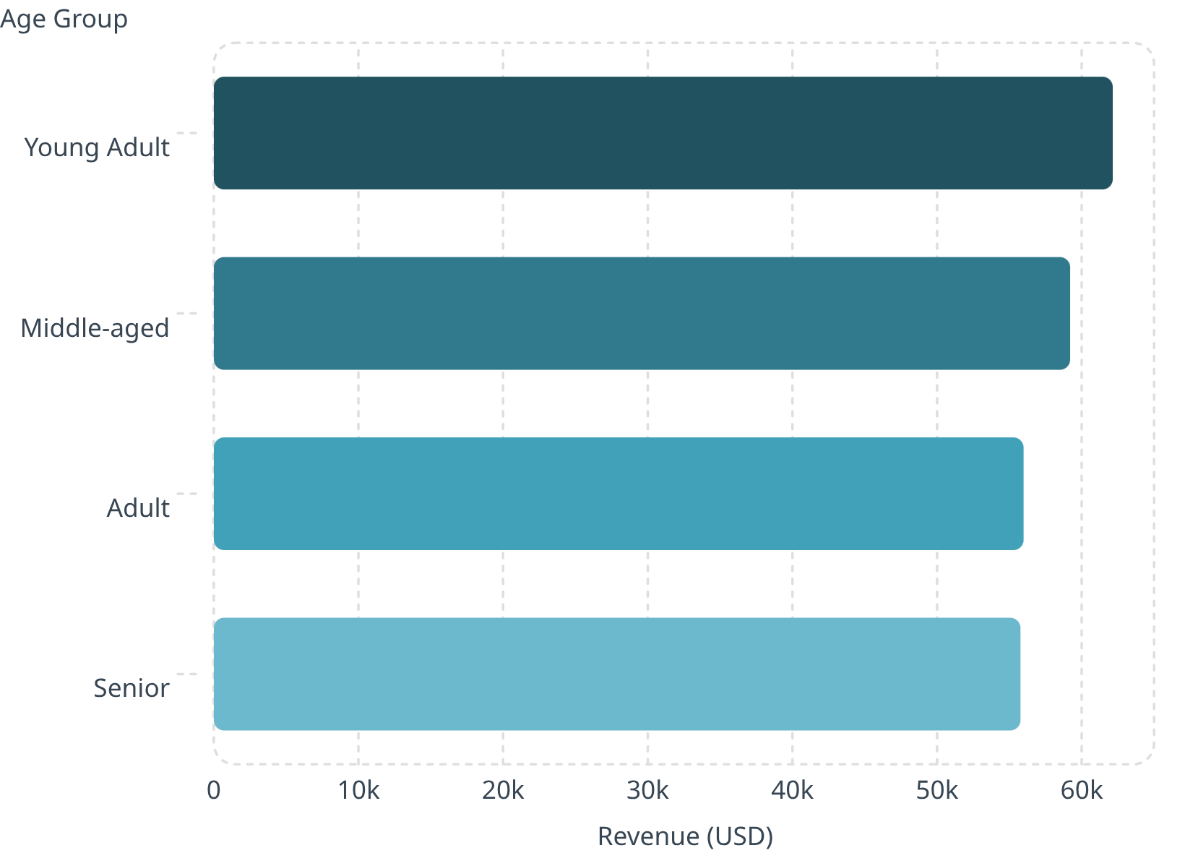
Revenue by Age Group
Shipping Comparison
Average spend by shipping type:
Express: $60.48
Standard: $58.46
Young Adults lead revenue — focus marketing on this segment and express-shipping users.

Slide 9
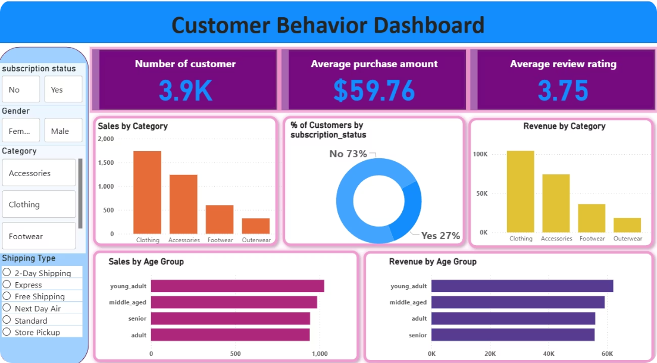
Power BI Dashboard
Dashboard Highlights
3.9K customers · Avg. purchase $59.76 · Avg. rating 3.75
Subscription split: 27% Yes / 73% No
Revenue & sales by category and age group
Filters: Gender, Category, Shipping Type

Slide 10





Business Recommendations
Boost Subscriptions
Promote exclusive subscriber benefits.
Loyalty Programs
Reward repeat buyers toward "Loyal" segment.
Review Discount Policy
Balance sales lift with margin control.
Targeted Marketing
Focus on high-revenue age groups & express-shipping users.

