Slide 1

Skin Disease Classification
Phase 2 Presentation
Ms. Shruti Sakpal, Ms. Sakshi Ajit Zagade
Under the supervision of
Prof. Merrin Solomon
Usha Mittal Institute of Technology
Department of Data Science
March 21, 2023

Slide 2
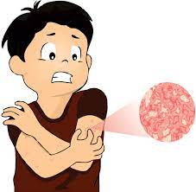
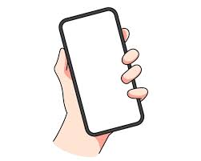
Problem Statement:
An automated system for skin disease identification and classification through images is needed to improve the diagnostic accuracy as well as to handle the scarcity of human experts.

Slide 3

Project Overview:
Mobile Application
Convolutional Neural Network, Deep Learning, Image Classification, and ML Ops

Slide 4
Literature Survey:
Name | Observation
A Smartphone-Based Skin Disease Classification Using MobileNet CNN (October 2019) | Oversampling and data augmentation generate the most accurate result.
Potato Plant Disease Classification using CNN and Transfer Learning (July 2022) | Transfer Learning models are simple to use and have a high degree of accuracy.
Skin Disease Detection using Machine Learning | Validation Data makes the system more accurate.
Detection and classification of skin diseases with ensembles of deep learning networks in medical imaging | A multi-model ensemble approach to combine these two data mining techniques to get the greatest accuracy of 96.1 percent.
Classification of Apple Tree Leaves Diseases using Deep Learning Methods | The Adam optimizer is effective in the transfer learning of the ResNetV2 model. Increasing the number of instances may further improve classification accuracy.

Slide 5
Phases Distribution:
Phase 1
Phase 2
SRS Documentation
Data Preprocessing
Model Building
Fast API
Quantization, TF Lite
App Development

Slide 6
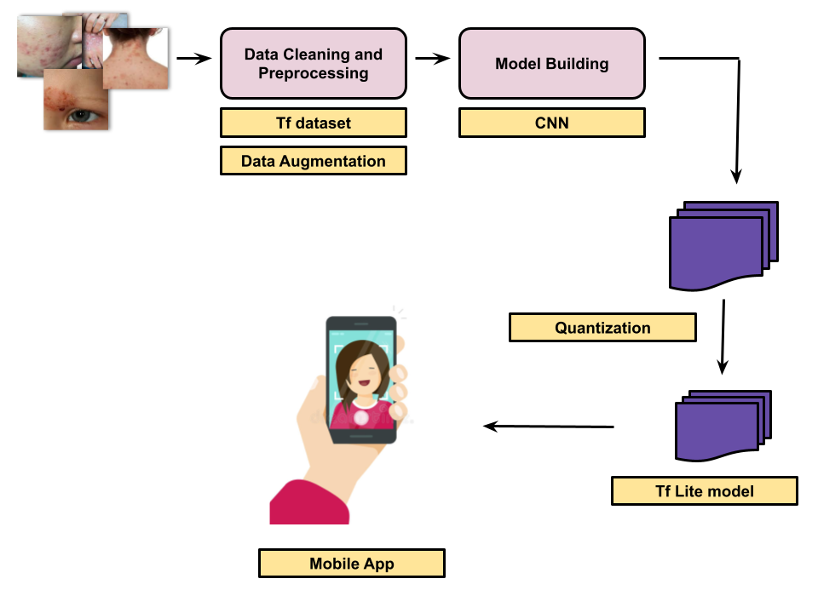
Methodology:

Slide 7
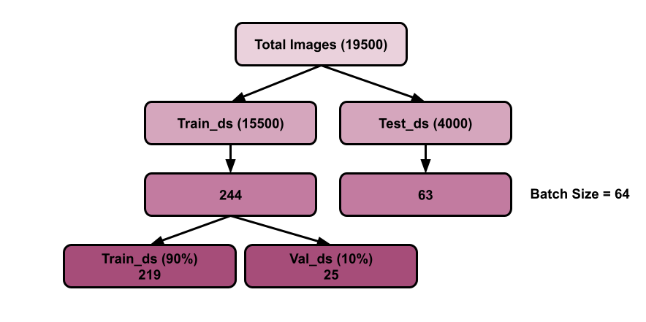
Data Preprocessing:
23 Classes

Slide 8
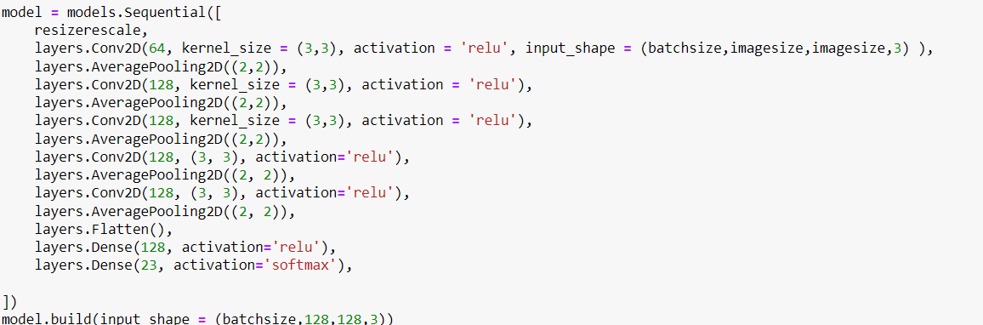
Model Building:
Train_ds
accuracy | 0.6951
loss | 0.9528
Val_ds
accuracy | 0.6810
loss | 1.1130
Test_ds
accuracy | 0.32
loss | 3.58

Slide 9
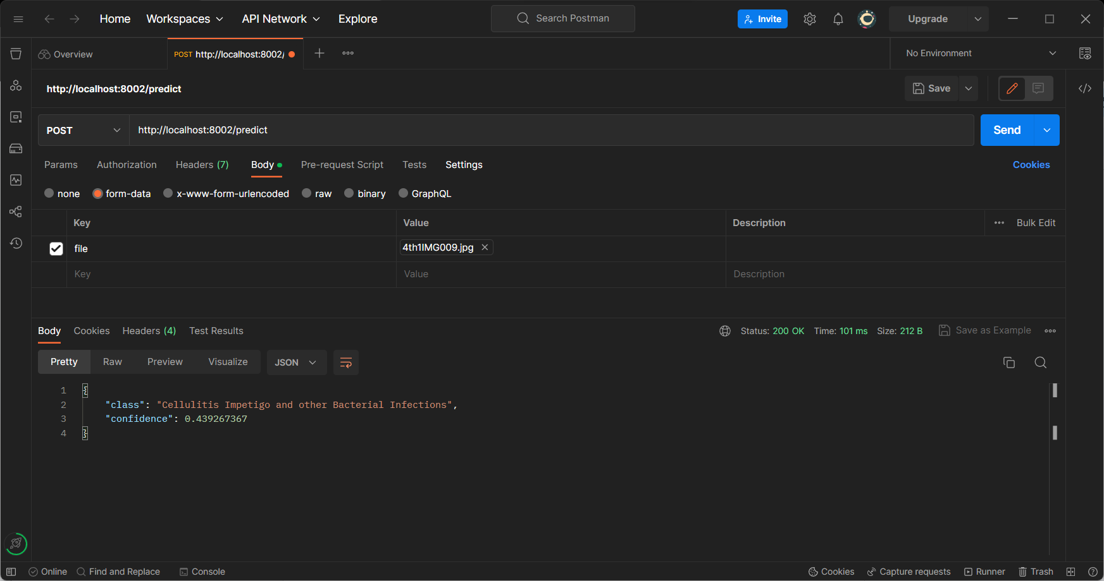
TF Lite:

Slide 10
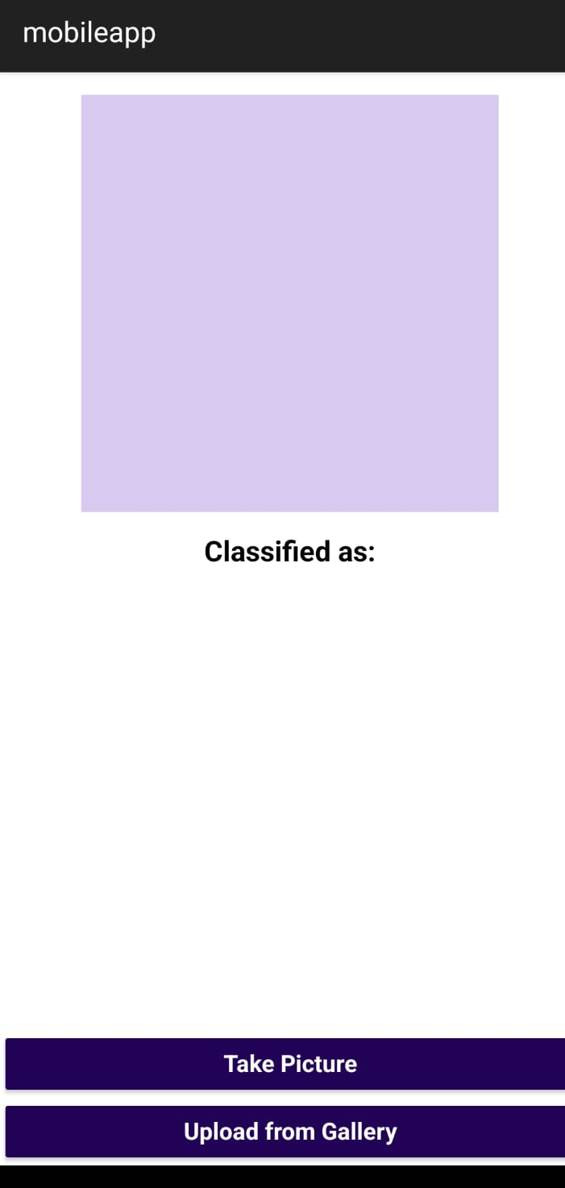
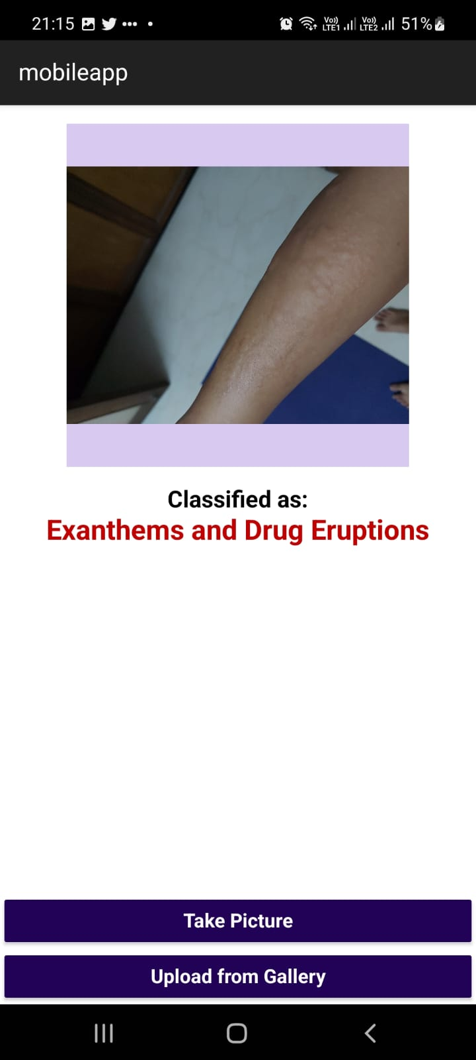
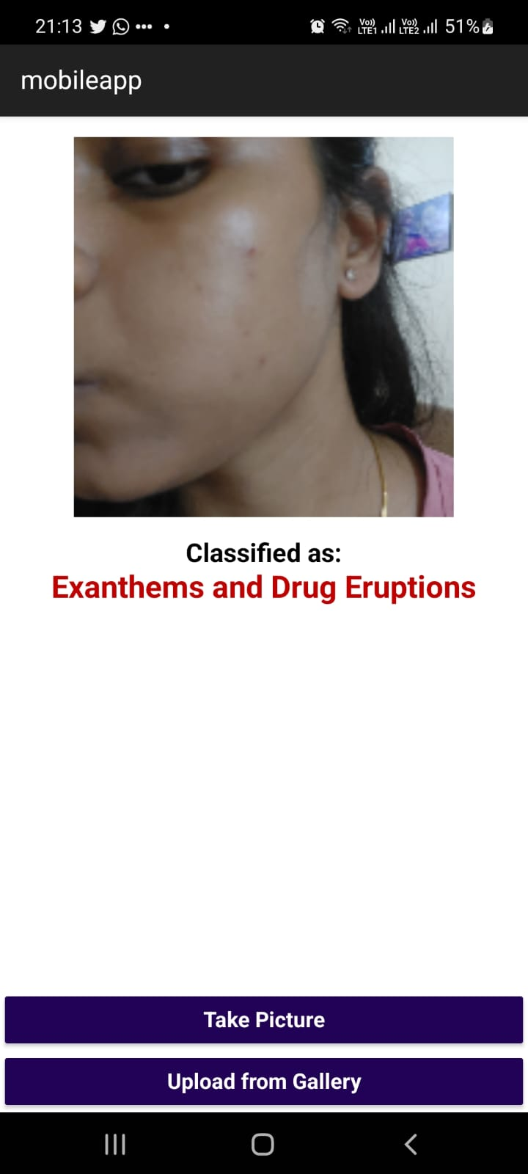

Slide 11
References:
[1] https://codebasics.io/blogs/programming
[2] https://codebasics.io/blog/what-is-a-neural-network
[3]https://youtube.com/playlist?list=PLeo1K3hjS3uu7CxAacxVndI4bE_o3BDtO
[4] Geron Aurelien, Hands-On Machine Learning with Scikit-Learn and TensorFlow: Concepts, Tools, and Techniques to Build Intelligent Systems, 2017.
[5] Adam Gibson, Josh Patterson, Deep Learning, A Practitioner’s Approach, Shroff Publisher /O’Reilly Publisher Media
[6] https://youtube.com/playlist?list=PLeo1K3hjS3uv5U-Lmlnucd7gqF-3ehIh0
[7] Dan Ward, React Native Cookbook - Second Edition, 2019
[8] Artemij Fedosejev, React.js Essentials: A fast-paced journey, 2015
[9] Amit R S, Sheetal Mittal, Heena Kouser,Akshitha Katkeri Published Journal titled “Potato Plant’s disease classification using CNN and Transfer Learning” in International Research Journal of Modernization in Engineering Technology and Science-ISSN:2582-5208- July 2022
[10] Kritika Sujay Rao, Pooja Suresh Yelkar, Omkar Narayan Pise, Dr. Swapna Borde, 2021, Skin Disease Detection using Machine Learning, INTERNATIONAL JOURNAL OF ENGINEERING RESEARCH & TECHNOLOGY (IJERT) NTASU – 2020 (Volume 09 – Issue 03)
[11] A., Kalaivani & Karpagavalli, S. (2022). Detection and classification of skin diseases with ensembles of deep learning networks in medical imaging. International journal of health sciences. 10.53730/ijhs.v6nS1.8402. (2022)
[12] Alsayed, A., Alsabei, A., & Arif, M. (2021). Classification of Apple Tree Leaves Diseases usingDeep Learning Methods. International Journal of Computer Science and Network Security, 21(7), 324–330. https://doi.org/10.22937/IJCSNS.2021.21.7.37.

Slide 12
Thank You!

