Slide 1
Independent Study on MoveIt, Crazyflie and Computer Vision
Submitted By:
Sakshi Shrivastava
Department of Computer Science
College of Computing and Informatics

Slide 2
Contents
Objective
Goals Proposed
Basics of MoveIt
Basics of Fetch
Optitrack System
Basics of Bitcraze Crazyflie
Topics covered in Computer Vision
Goals Achieved
Bottlenecks
Future Scope

Slide 3
Objective
The main objective of this independent study was to learn the MoveIt framework and use it to operate Fetch robot.
Along with MoveIt, I wanted to learn about Crazyflies and OptiTrack system.
Lastly, I wanted to learn the basics of Computer Vision.

Slide 4
Goals Proposed
At the starting of the independent study I listed out the following goal that I plan to achieve during the course of the semester:
Fetch Robot:
Learn MoveIt and prepare prototype for Fetch robot
Make the Fetch pick-up an object from one place and place it at another place
Crazyflie and OptiTrack:
Help setup the OptiTrack system and document all the details.
Learn about Crazyflie and how they operate
Computer Vision:
Complete an online course on computer vision.

Slide 5
Basics of MoveIt
MoveIt is state of the art software for mobile manipulation, incorporating the latest advances in motion planning, manipulation, 3D perception, kinematics, control and navigation.
MoveIt is one of the most widely used software for manipulation and has been used over multiple types of robots.
The most important class of MoveIt is the move_group class which serves as an integrator pulling all the individual components together to provide a set of ROS actions and services for users to use.

Slide 6
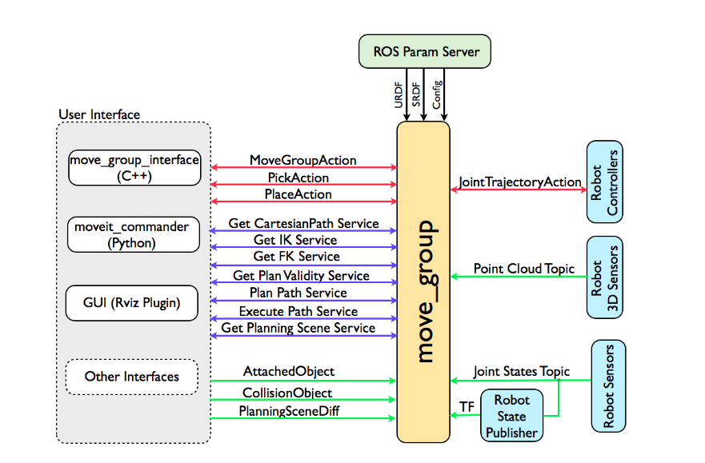
Architecture of MoveIt

Slide 7
Basics of Fetch
Fetch is a mobile manipulator with a 7 DOF arm which is capable of lifting upto 6 Kg of weight.
Between the arm and the telescoping spine, Fetch has a grasping range all the way from the floor up to just under two meters, which can cover approximately the same manipulation range as a human.
Fetch has a PrimeSense 3D sensor in its head, which can pan and tilt. There are a bunch of mounting points available for additional sensors. Fetch’s base includes a charging dock, a 25-meter range navigation and obstacle avoidance laser from SICK, and differential drive.

Slide 8
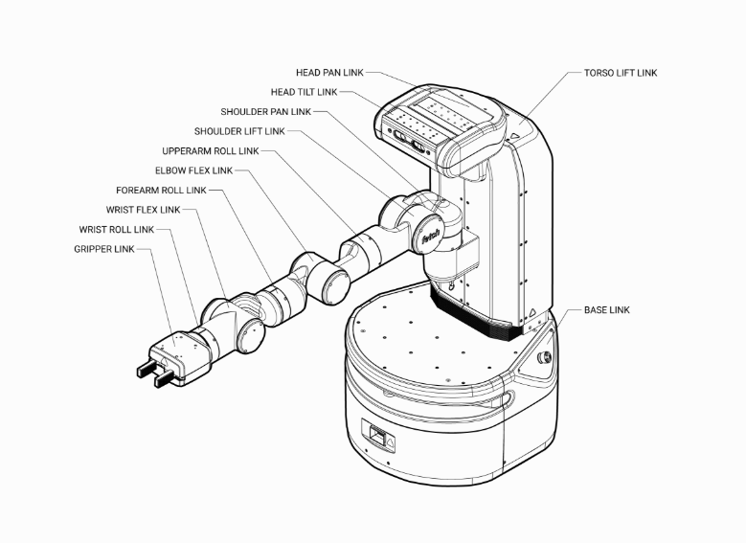
Naming Convention
for Fetch Links

Slide 9
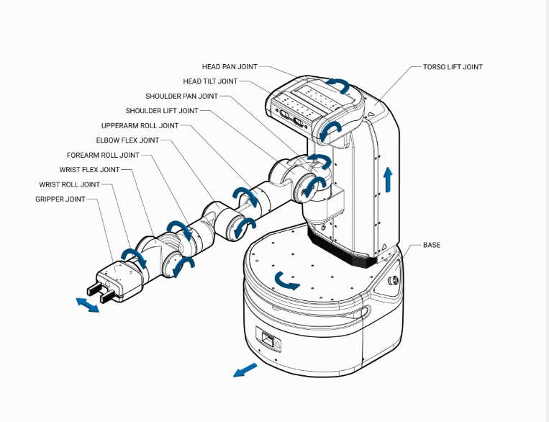
Naming Convention
for Fetch Joints

Slide 10
OptiTrack System
OptiTrack is a motion capture system that has its applications in the field of virtual reality, robotics, movement sciences, animation, and many other field.
Motive is a software platform designed to control motion capture systems for various tracking applications. Motive not only allows the user to calibrate and configure the system, but it also provides interfaces for both capturing and processing of 3D data.
The OptiTrack system present in the lab consist of 24 cameras. We tried to setup and work with 12 of them. The Motive version we used is Motive 2.0.

Slide 11
Basics of Bitcraze Crazyflie
Bitcraze Crazyflie 2.0 is an open-source open-hardware nano quadcopter.
The Crazyflie 2.0 is a palm sized (92mm diagonal) quadcopter weighing 29 grams supporting wireless control over radio and BlueTooth low energy. It has a flight time of 7 minutes and a charge time of 40 minutes.
Crazyflie is considered to be best suited for indoor swarming applications. To implement any single or multiple UAV application we need to use a combination of OptiTrack (or any other motion capture system) and Crazyflie as Crazyflie are not able to localize themselves.

Slide 12
Topics Covered in Computer Vision
Images as functions
Filtering
Linearity and convolution
Filters as templates
Edge Detection
Hough Transform
Aliasing
Perceptive Imaging
Stereo Geometry

Slide 13
Goals Achieved
Following are the goals achieved out of the proposed goals:
Fetch Robot:
Learn MoveIt and prepare prototype for Fetch robot (Learned MoveIt, completed the online tutorial, prepared prototype for PR2 and Fetch robot)
Make the Fetch pick-up an object from one place and place it at another place (Since there were come difficulties with fetch working on ROS kinetic I was able to use manipulator arms but had difficulty using gripper)
Crazyflie and OptiTrack:
Help setup the OptiTrack system and document all the details.
Learn about Crazyflie and how they operate (Both the points mentioned here are completed and documentation uploaded on Github)
Computer Vision:
Complete an online course on computer vision. (Covered majority of the topics taught in the course. I can say covered 80% of the course)

Slide 14
Bottlenecks
The major problem I faced during the independent study is with Fetch. There is no proper documentation of using fetch with MoveIt. Major complications come with the difference in versions of ROS of which Fetch and MoveIt works. Fetch works only on ROS indigo and there are a lot of libraries in MoveIt which they have updated to ROS kinetic and are no longer supported on Indigo. This makes in very difficult for working on Fetch with MoveIt.
Second major problen was over estimation. I believe I took too many things for the scope of one semester. The computer vision course itself is designed for 4 months and working on it along with the other two goal became very difficult.

Slide 15
Future Scope
For future there is certainly a lot of scope in MoveIt. I would definitely like to continue my work on Fetch and MoveIt during the summer so that I came figure out a way to use both of them on same version o ROS.

