Slide 1
BIRDS
What are the world’s most distinctive birds? That question could be answered in several ways, but a new paper released this month — Global Distribution and Conservation of Evolutionary Distinctness in Birds (Jetz et al. 2014) — attempts to answer it by ranking species according to their “evolutionary distinctiveness,” or how distantly related they are to all other living birds. The ranking was done for the purpose of conservation triage, and it’s gotten quite a bit of media attention, for example, Brandon Keim’s Wired story.

Slide 2
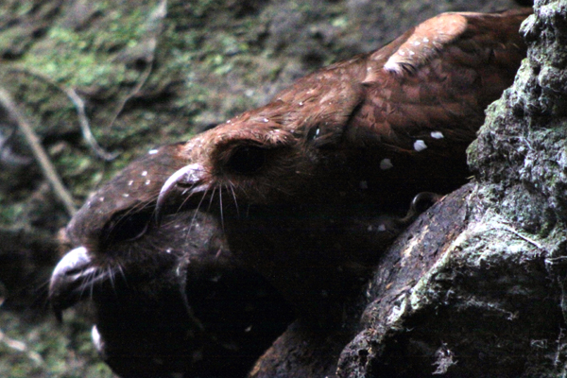
1.OILBIRD (STETORNIS CARAPENSIS)
The Oilbird‘s ancestors appear to have diverged from all other birds before the cataclysm that wiped out the non-avian dinosaurs, the pterosaurs, and countless other forms of life. It’s a bat-like cave-dwelling, echolocating, fruit-eating nocturnal species capable of hovering on three-foot wings. The Oilbird today lives only in South America, but fossils of similar species are known from Wyoming Based on current genetic and morphological evidence, it seems that Oilbird is an early offshoot of the branch that eventually gave rise to potoos, frogmouths, nightjars, owlet-nightjars, swifts, and hummingbirds. In addition to Corey’s photo below from his trip to an Oilbird cave in Ecuador, check out these additional remarkable Oilbird eyecandy images.

Slide 3
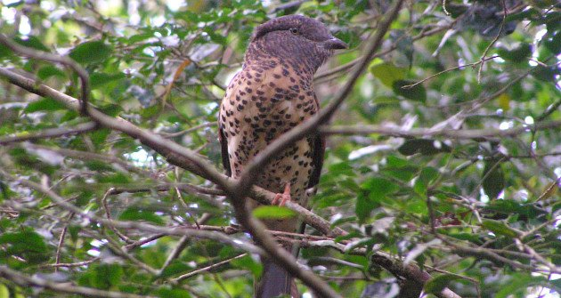
2. Cuckoo Roller (Leptosomus discolor)
The Cuckoo Roller — today found only in Madagascar and Comoros — is an oddball bird with a puffy head and a chameleon-eating habit. The sexes are dimorphic (here’s a fetching male), and nobody seems quite sure what this bird’s closest relatives are. It’s not a cuckoo or a roller, and as Darren Naish summarizes, it is the only survivor of an ancient neoavian lineage — hence its position at number two on this list.

Slide 4
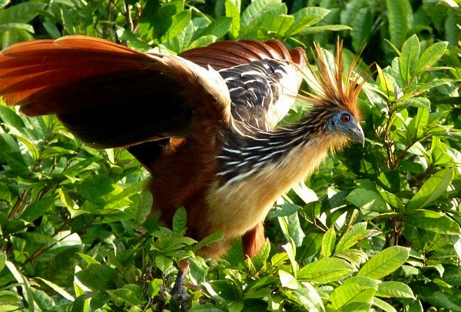
3. Hoatzin (Opisthocomus hoazin)
Ah, the Hoatzin, which seems as likely to have been dreamt up by Lewis Carroll as anything, given its truly mind-bending looks and habits and the fact that we still have no idea what its relationship is to the other neoavian birds. I wrote about the Hoatzin here a couple of years ago when Gerald Mayr published a paper hypothesizing that Hoatzins invaded South America from Africa by raft. The story just keeps getting better.

Slide 5
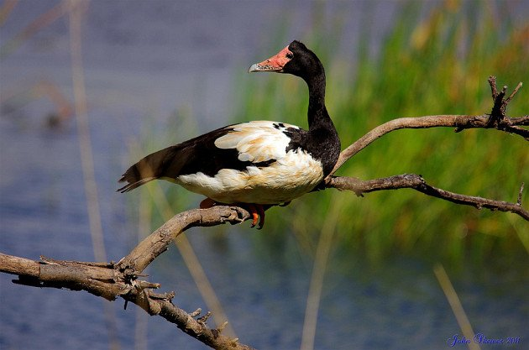
4. Magpie Goose (Anseranas semipalmata)
The large, pied, knob-headed Magpie Goose of Australia and New Guinea is the sole living member of an early anseriform waterfowl lineage. Note that while the magnificently bizarre screamers represent an even older anseriform offshoot, they didn’t make the top spots on the list because the extant screamer species are relatively more closely related to each other than the Magpie Goose is to anything else alive today. The Magpie Goose has only partially webbed toes, as hinted in the image below.

