Slide 1



FASHION GENERAL
COMING SOON PAGE WITH
COUNTDOWN TIMER

Slide 2


CONTENT
Features of the website and design choices.
01
Challenges faced and how they were addressed.
02
Future improvements or additional features that could be add
03
Github / Deployed Link
04

Slide 3

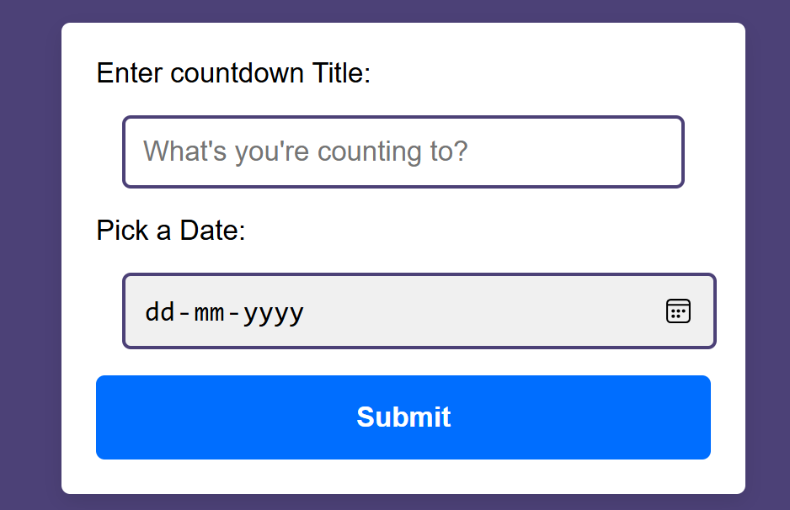
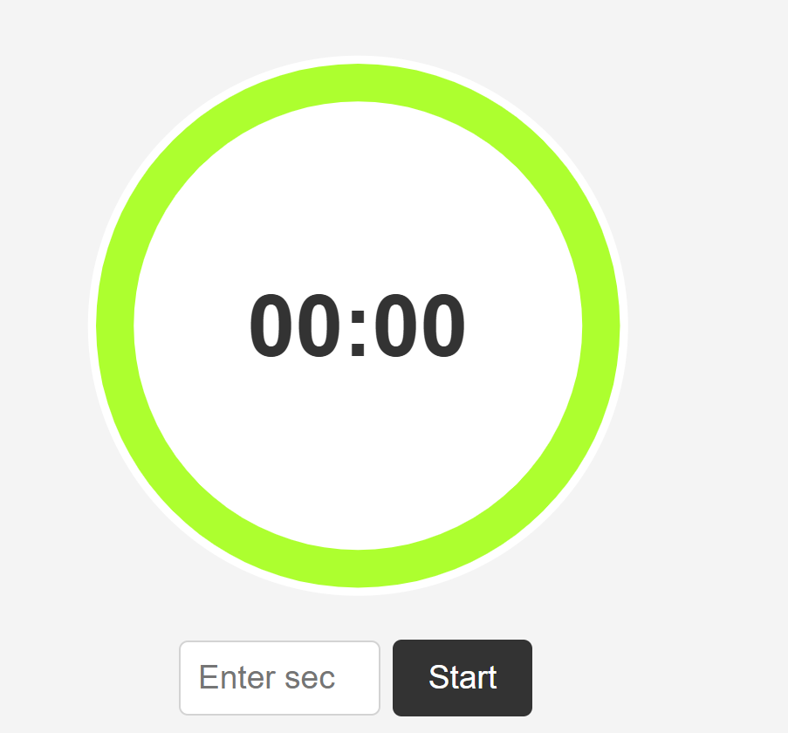

Features of the website and design choices.
Page Layout

Slide 4
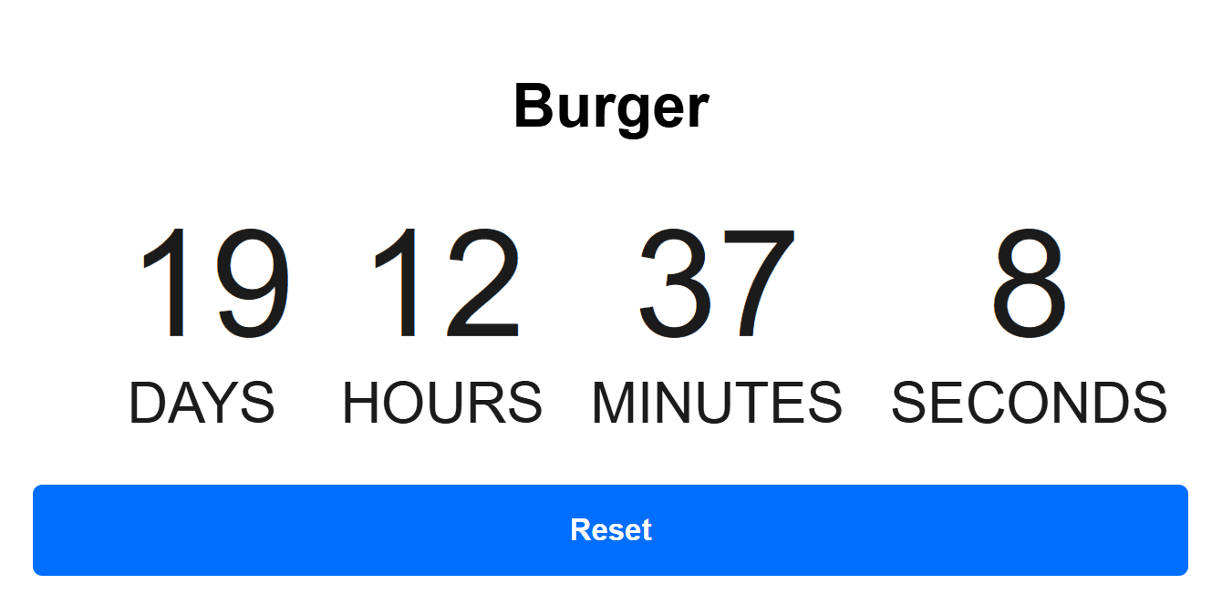
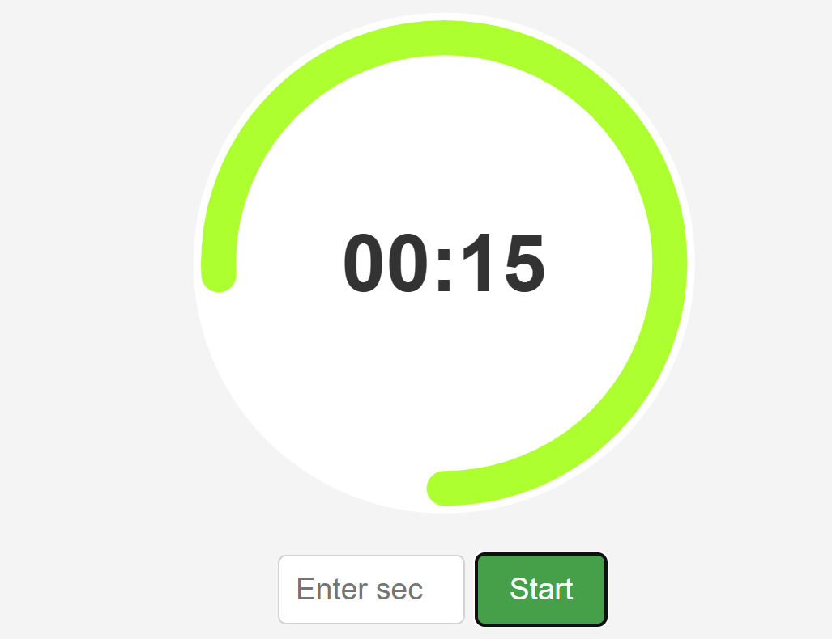
Features of the website and design choices.
CountDown Timer

Slide 5
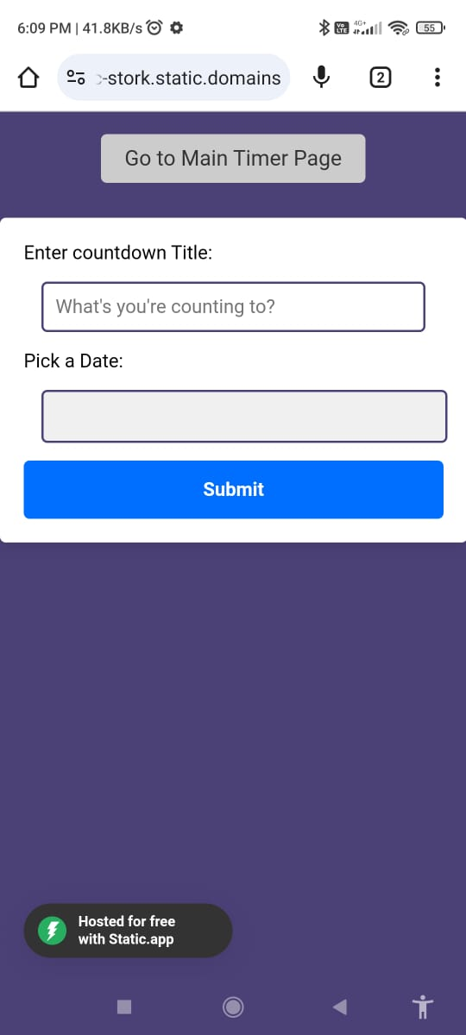
Features of the website and design choices.
Responsive Design

Slide 6

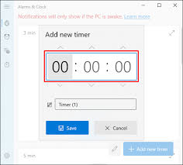

Features of the website and design choices.
Optional Features
1) Sound Notifications
2) Desktop Notifications
3) Pop-up alert

Slide 7
Challenges faced and how they were addressed.
oChallenges faced and how they were addressed.
o
Challenges faced and how they were addressed.
30%
25%
20%
15%
Mobile Responsiveness
Dynamic Filtering and Search
Clock functioning
Loading Speed
Challenge:- Ensuring the website looks good on all devices.
Solution: Used CSS media queries and flexible layouts (Flexbox/Grid).
Challenge: Implementing real-time filtering of timing.
Solution: Used JavaScript to update results dynamically as users applied filters or typed search queries.
Challenge: Ensuring clock functioned system
Solution: Implemented real-time validation using JavaScript with feedback for missing or incorrect fields.
Challenge: High-quality images slowing down the site.
Solution: Optimized image sizes and used lazy loading techniques.

Slide 8
Future improvements or additional features that could be added.
1.
Multiple Timers
2.
Sounding
Timer
3.
For entering Login Page

Slide 9
CONCLUSION
FASHION GENERAL
The countdowm timer website has been designed with features to simplify the timing process which provide an engaging user experience, and encourage responsible pet ownership.

Slide 10
FASHION GENERAL
THANKYOU!!!

