Slide 1
Mini Project Title Presentation
on
PageRank Algorithm for Web Search
Group Members
Urmila Junawa
Samruddhi Patil
Sakshi Shah
Sakshi Rathi
Project Guide
Mrs. Pallavi. D. Patil

Slide 2
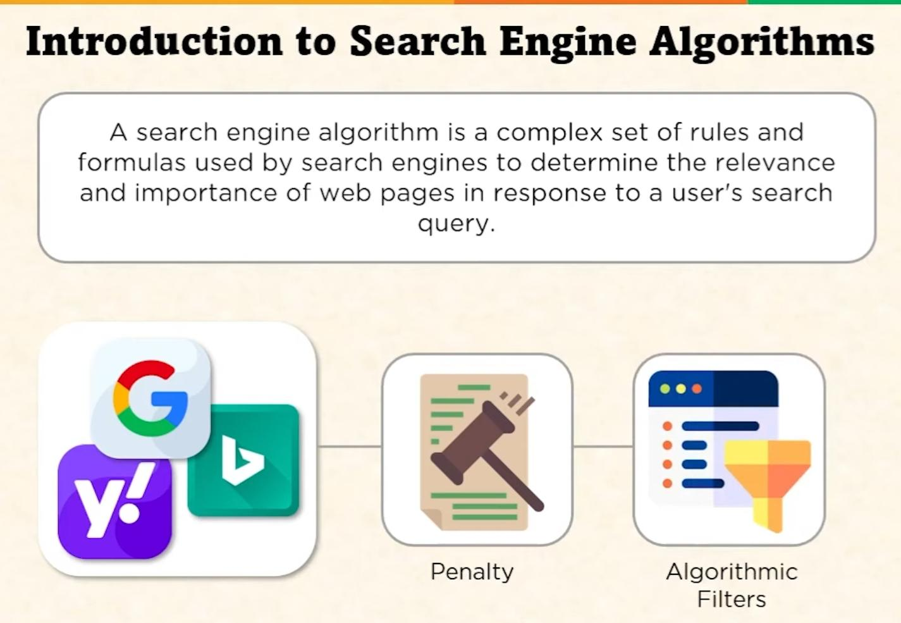

Slide 3
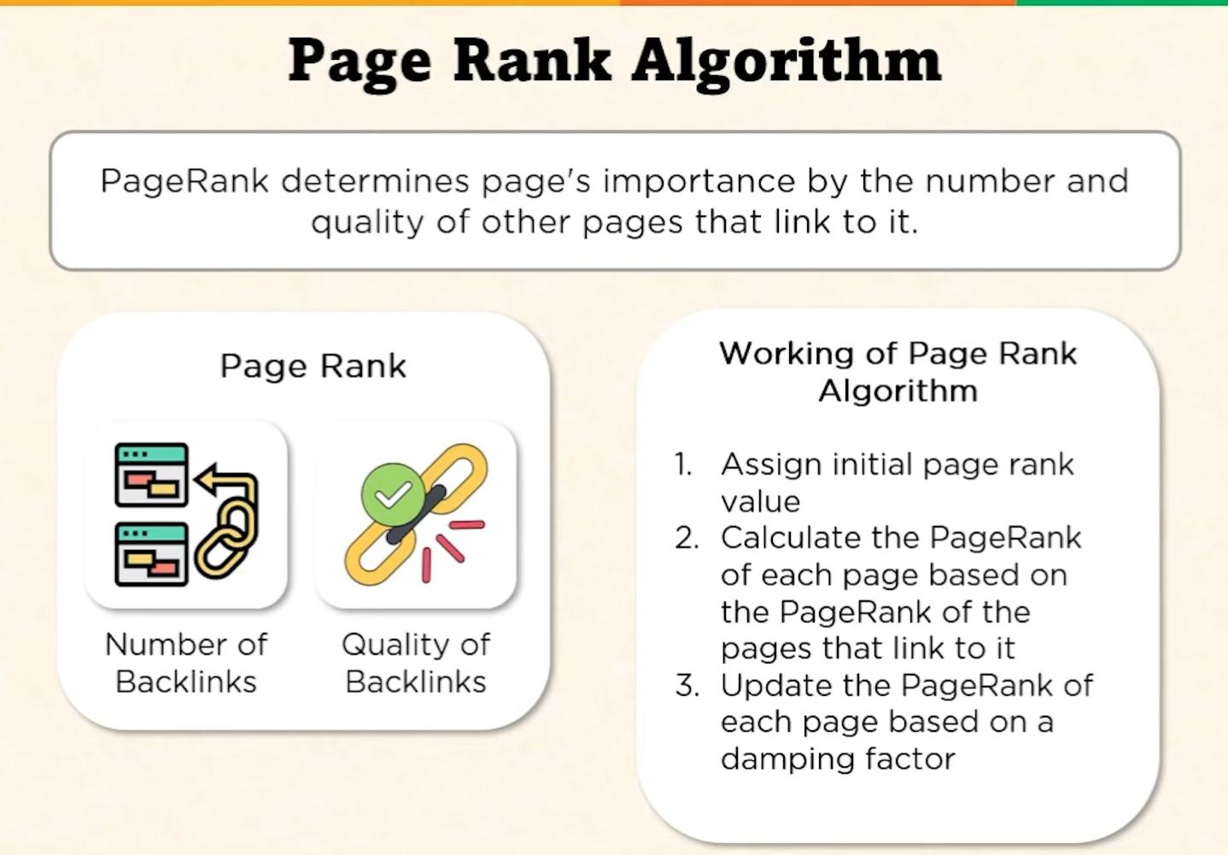

Slide 4
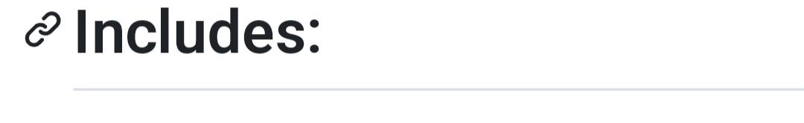
• Data Science • Graph Algorithms • Linear Algebra • Probability and Random Processes • Result Interpretation and Visualization
📈
📊

Slide 5
